Slide 1








[
]
Resilient BCA Regional
Stakeholder Webinar
presented by
Funded By
Project Team

Slide 2
WELCOME
TCRPC Staff - Terry Ann Paulo, Regional Planner
SFRPC Staff – Marion Knowles, Regional Planner

Slide 3
Regional Resilience Projects –
Treasure Coast

Slide 4
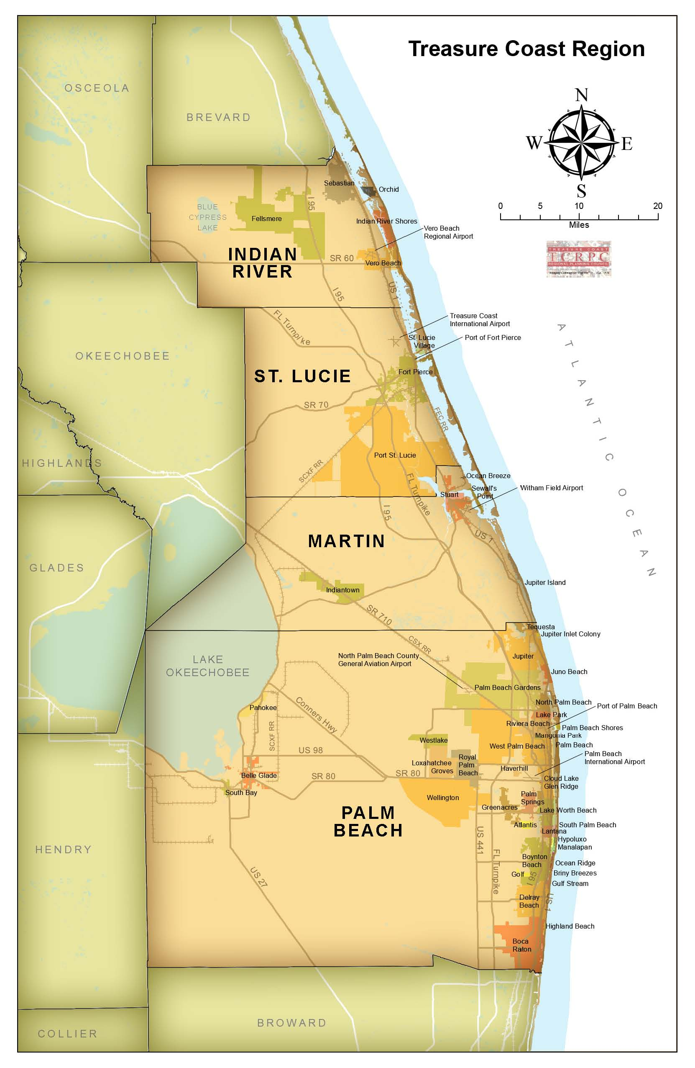

TCRPC Overview
The Treasure Coast Regional Planning Council (TCRPC) was established in 1976 and is the Treasure Coast’s only regional forum where elected and appointed leaders regularly come together to discuss complex regional issues; develop strategic regional responses for resolving them; and build consensus for setting and accomplishing regional goals. Elected officials serve annual terms, and gubernatorial appointees serve three-year terms. TCRPC is made up of nineteen local elected officials and nine gubernatorial appointees. TCRPC is 1 out of 10 regional planning councils in the state.
TCRPC Programs & Services:
Urban Design & Town Planning
Economic Development
Transportation & Land Use Planning
Emergency Preparedness
Brownfields Revolving Loan Fund Program
Natural Resources

Slide 5
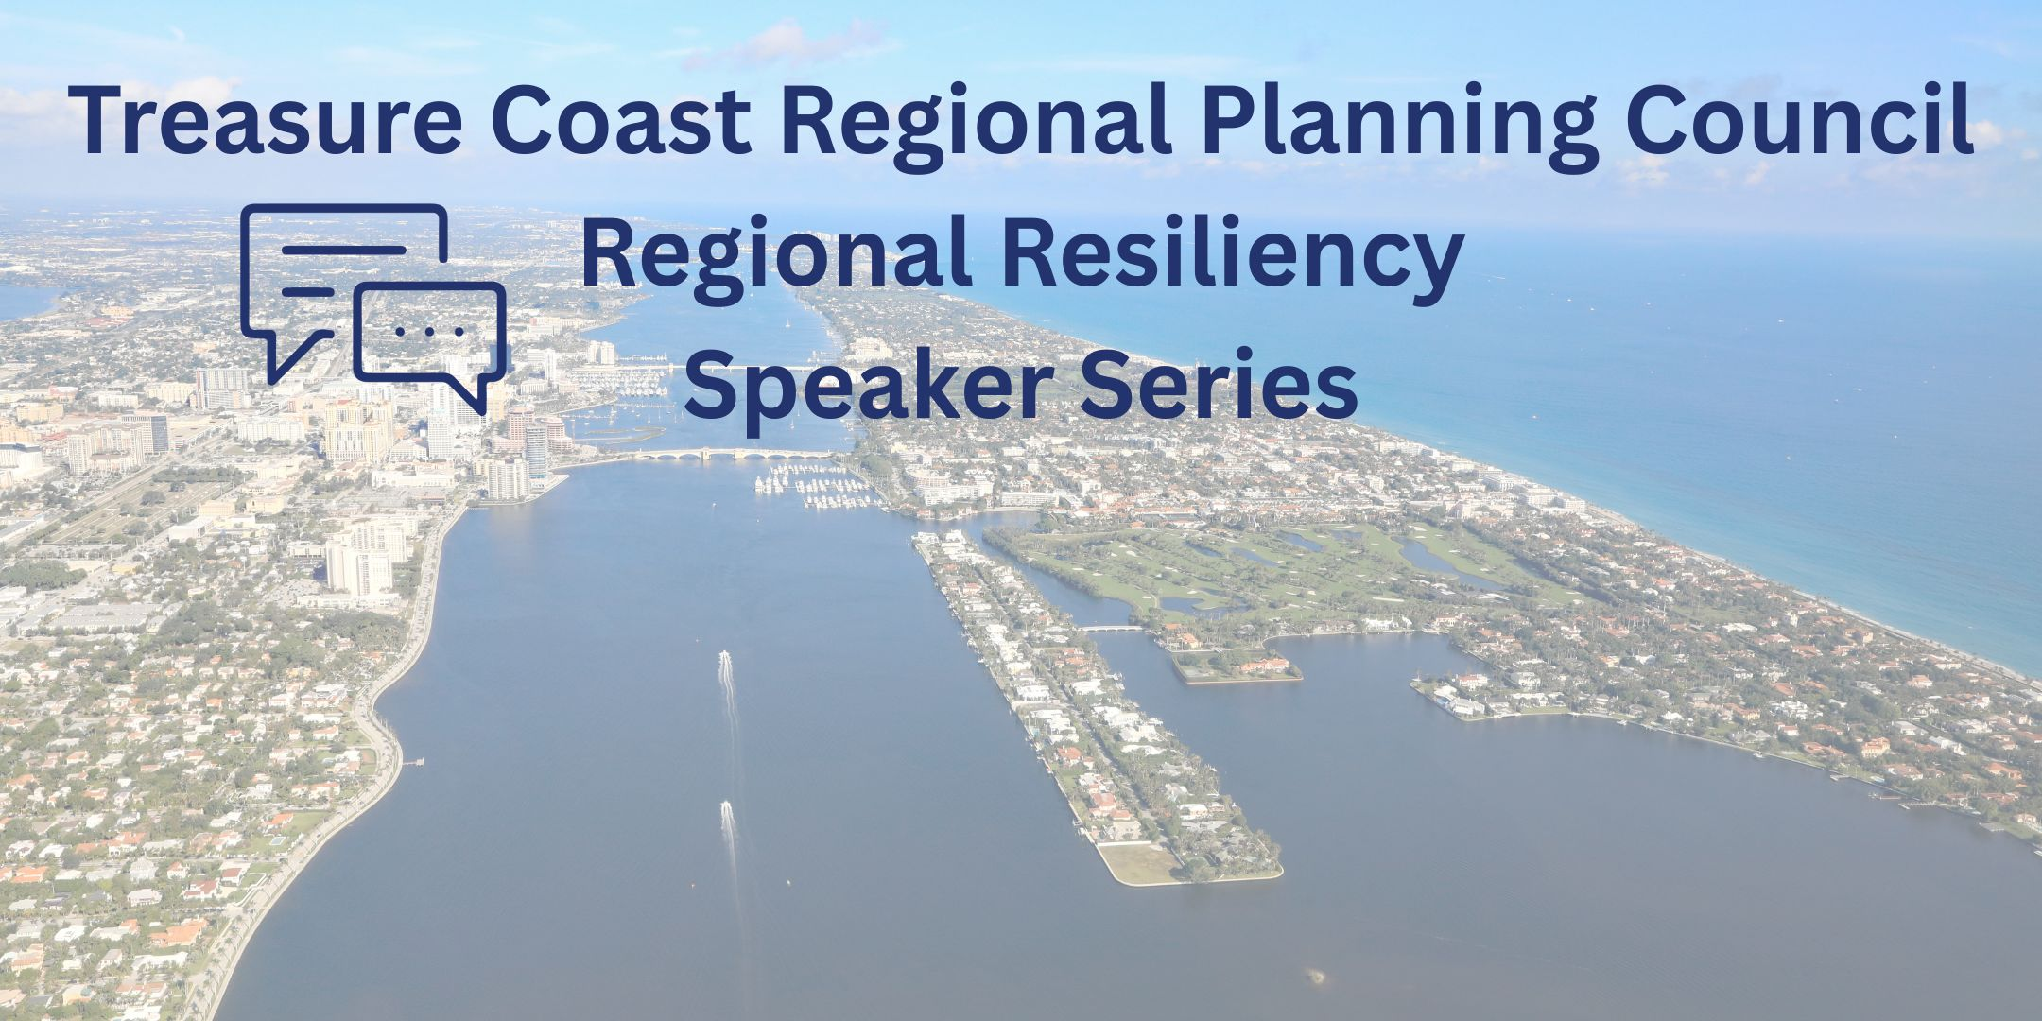
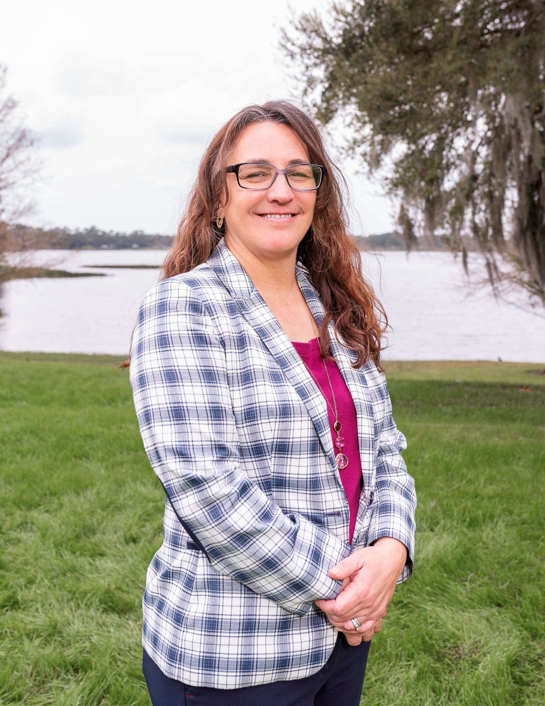
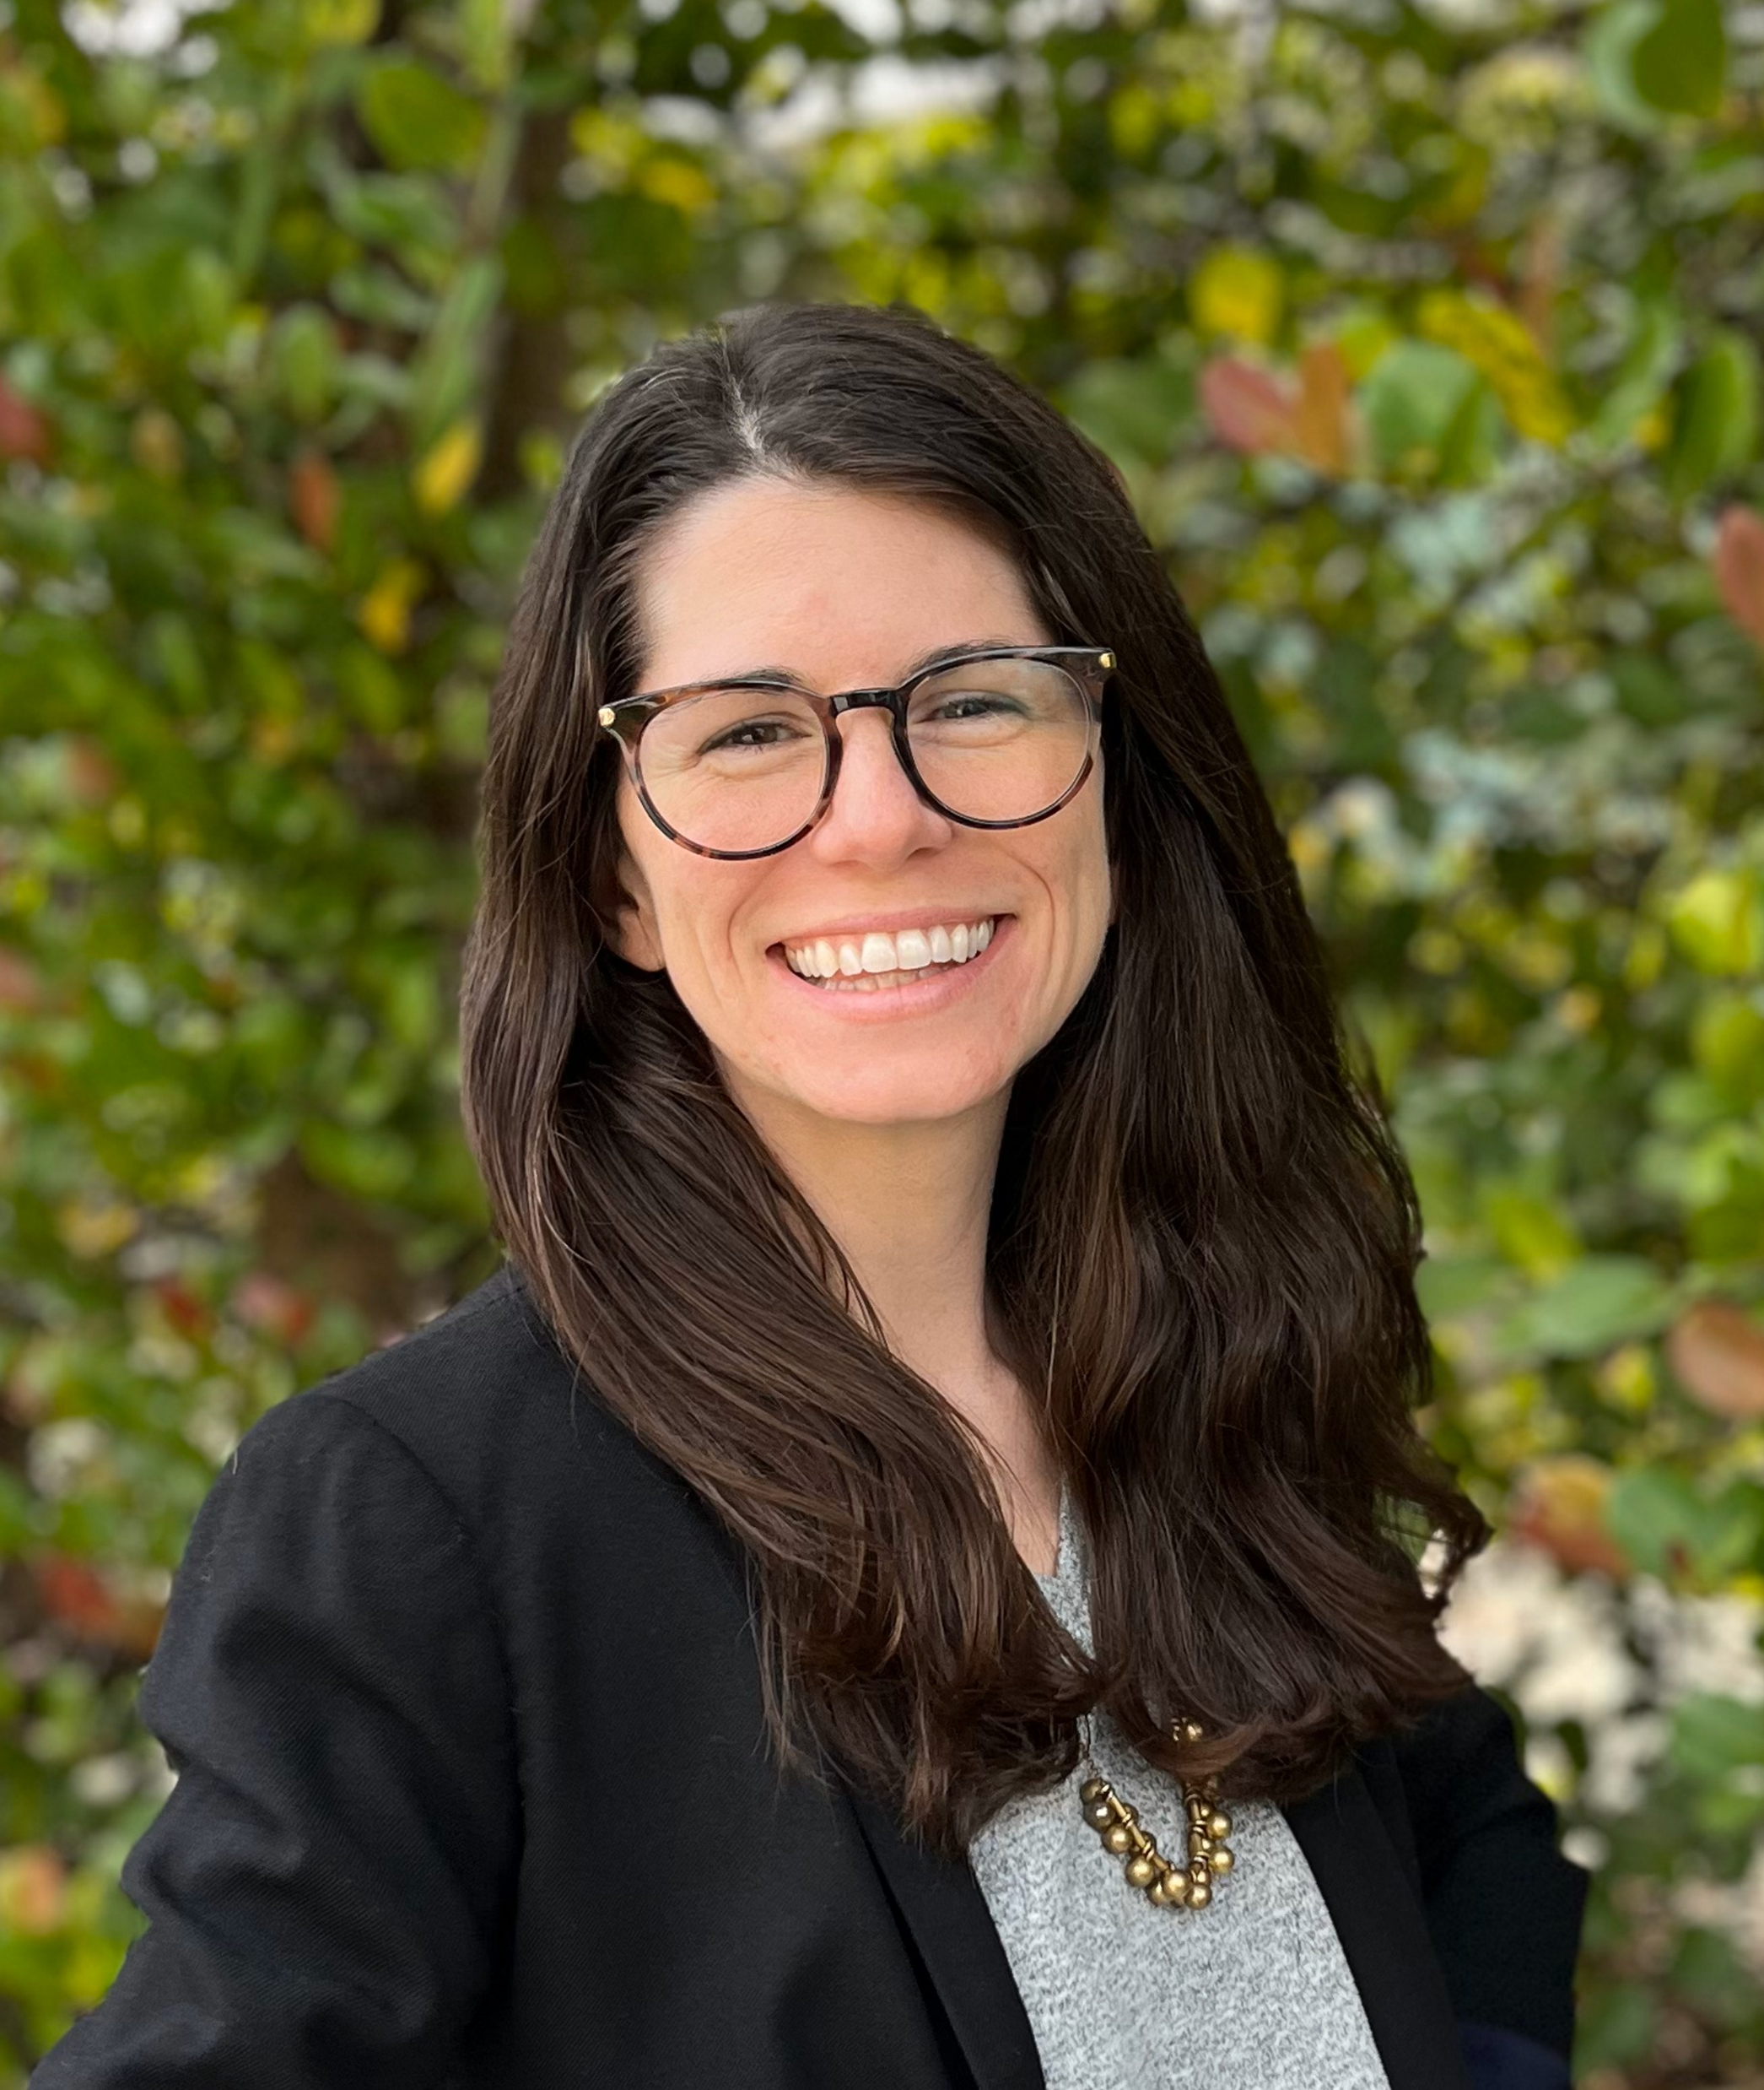
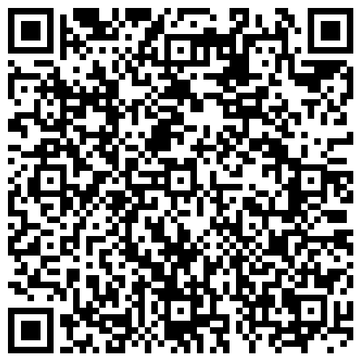
Save the Date
March 26, 2026 @ 2PM
Advancing Mitigation Assessment and Planning Through Resilience Collaboration – Program Overview and Small Area Plans
Tara McCue, East Central Florida Regional Planning Council Executive Director
Jessica Seymour, Treasure Coast Regional Planning Council Principal Planner
Notes:
Tara McCue, East Central Florida Regional Planning Council Tara McCue, AICP, is the Director of Planning and Community Development at the East Central Florida Regional Planning Council where she has been working for the past 17 years on a variety of regional and local projects across sectors aimed at creating healthy, resilient and sustainable communities. She has extensive experience working with regional, state and federal agencies, universities and jurisdictions to further resiliency and sustainability in East Central Florida. Tara has co-authored two white papers examining land use impacts to rising sea level. Tara has a B.S. in Marine Biology from UNCW and a Master’s in Environmental Resource Management from Florida Institute of Technology.

Slide 6
Regional Resilience Projects –
South Florida

Slide 7
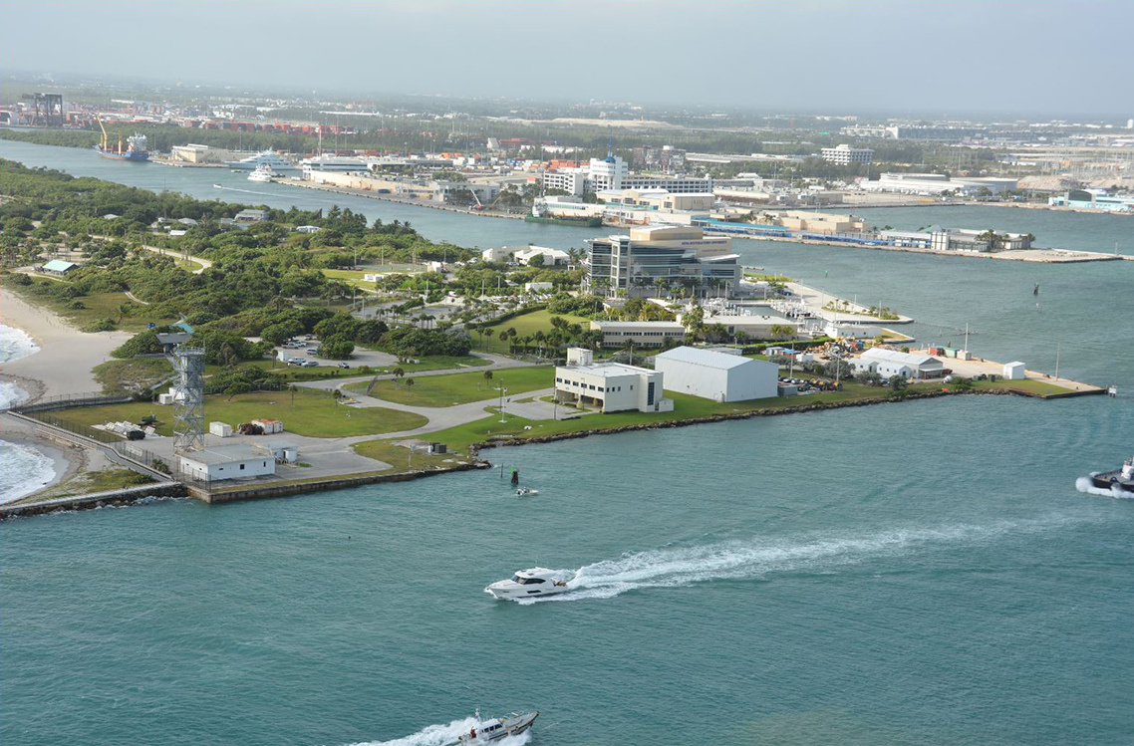


South Florida Regional Planning Council
Resilient Infrastructure Benefit Cost Analysis Tool March 10, 2026

Slide 8
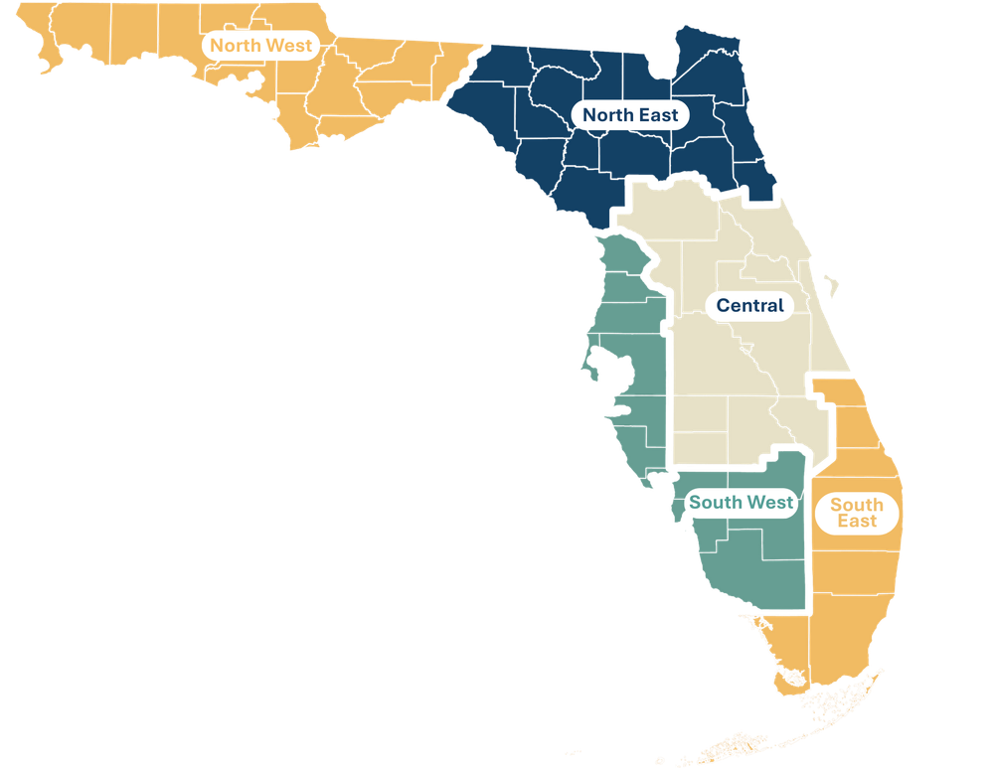





Background
The South Florida Regional Planning Council (SFRPC) provides planning technical support to Broward, Miami-Dade, and Monroe Counties.
Resiliency Initiatives
Military Installation Resilience Review
Identified vulnerabilities resulting from natural hazards that may interfere with four SF military installations’ missions.
Florida Office of the Ocean Economy
Research initiative by Florida Atlantic University to understand the ocean’s impact on Florida’s economy.

Slide 9


PROJECT Team Introductions
Alec Bogdanoff, Ph.D.
Project Principal
Sharai Lewis-Gruss
Project Manager
Grace Filmont
Assistant Project Manager
Annie deBoer
Technical Lead
Olivia d'Almeida
Economic Analyst
Anne Watkins
Tool Development Lead
Randy Deshazo
Economic Lead; Deputy Director
Marion Knowles
Project Coordinator; Regional Planner

Slide 10
Today's Objectives
What We Want to Discuss with You:
Background on the tool and how engagement has shaped its development.
The current version of the BCA tool.
Feedback we would like to hear from you.
Discussion of next steps, office hours, and request for super users.

Slide 11
Project timeline
*
Q1 2026
Q2 2026
3/9/2026
3/16 - 4/3/2026
4/3/2026
Host office hours for test users
Collect individual stakeholder feedback
Regional Stakeholder Workshop
4/17/2026
5/8/2026
5/15/2026
6/22/2026
Deliver final updated Resilient BCA Tool – Statewide version
Host two virtual training sessions, including case study review
Final Engagement Complete
All deliverables due to DEP

Slide 12
Overview of the Resilience Cost-Benefit Tool
The Resilient Infrastructure Benefit-Cost Analysis (BCA) Tool is designed to help communities evaluate, compare, and prioritize resilient infrastructure projects (green, gray, or hybrid,) using a consistent, transparent, and repeatable method.
A BCA demonstrates the cost-effectiveness of a project by comparing the anticipated costs and expected benefits that may accrue from a project over a specified period.
The primary goals of the Tool are to:
Standardize benefit-cost evaluation across regions and projects Support early-stage planning Allow customization and flexibility through an excel-based tool | Provide defensible, data-driven outputs that support funding proposals and decision making Incorporate community, environmental, and economic benefits

Slide 13
Background of the tool
  The Resilient Infrastructure BCA Tool is a project of the South Florida Regional Planning Council, in collaboration with seven other regional planning councils around Florida.
  In Phase1of the project (2025), the Tool was designed for use in South Florida only.
  The project is now in Phase 2, where the Tool is being expanded for statewide use.
  Stakeholders have been heavily involved throughout both phases of Tool development.

Slide 14
How engagement has shaped the tool
Stakeholder engagement has informed development of the Tool throughout Phase 1 and Phase 2.
Prior feedback improved:
User experience and interface clarity: modifying the user interface and simplifying navigation.
Cost and benefit tool capabilities: refining cost inputs and expanding benefits.
Output and automation features: improving the formatting and visibility of key outputs.
DEP and Statewide integration: aligning outputs with state templates.

Slide 15
Examples of prior feedback implemented
Feedback received | Implementation
The tool should evaluate complex and hybrid designs | More infrastructure solutions (green, gray and hybrid) were added to the cost database. Cost estimates may be updated following stakeholder engagement.
Analysis must vary based on local geography and conditions | Building value assumptions have been regionalized.
The analysis should evaluate a wider range of structure types | Three additional structure prototypes have been added (government office, police, school). More may be added following stakeholder engagement.
The tool should incorporate additional benefits | Avoided debris cleanup cost has been added. Other benefit categories may be added following stakeholder engagement.
The tool should support grant funding securement | Output formats have been aligned with Resilient Florida grant templates for seamless integration, the "Community Score Card" has been replaced by the "Resilient Score Card".

Slide 16
Importance of continuing conversations and feedback
Prior stakeholder feedback has informed valuable updates to the Tool; however, we are seeking clarification and additional feedback before finalizing the Tool. Continuing conversations and feedback will help to support a tool that can:
Align with organizational goals, priorities and funding requirements and the outputs remain relevant and actionable.
Have customizability while maintaining consistency.
Be easy to use, avoid confusing concepts or jargon, and ideally minimize rework.

Slide 17
Your role in feedback
Regular Test User:
Run one project (real or hypothetical).
Provide feedback on usability, clarity, and applicability to your region.
Super Test User:
Spend more time going through tool, run multiple project scenarios.
Override defaults and compare outcomes.
Especially encouraged to participate in office hours.

Slide 18
Tool Walk-through

Slide 19
Questions and feedback

Slide 20
questions
Navigation and interface
  Did the supporting materials (User Guide, video demonstration) clearly explain how to use the Tool? Was anything confusing or lacking detail?
  Should there be more ‘tool tips’ throughout to supplement the guides?
  Generally, was the structure of the tool easy to navigate/follow? Was the workflow intuitive?
  What important features or capabilities are missing that would make this tool more valuable for you?

Slide 21
questions
Cost and benefit data
  Are the default values in the Tool representative/accurate for your region?
  Are there additional structure prototypes that should be incorporated?
  Are there additional infrastructure solutions (green, gray, hybrid) that should be included in the cost database?
Outputs
  Is the presentation of outputs clear? Are the metrics and outputs useful for supporting decisions in your organizations or projects?
  Are there any other economic metrics you would like to see incorporated into the tool?
  What visualizations/graphs would be useful to include in a dashboard?

Slide 22
Discussion and Q&A

Slide 23
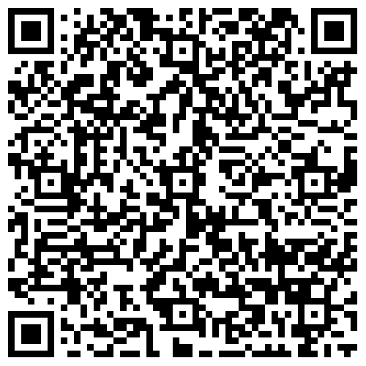
Link to tool, video demonstration
Link to Dropbox
Notes:
Link for webinar: https://www.dropbox.com/scl/fo/wmyqwmhfqeph87j8o8dbm/ADV0WeCZXeiRqW5t0YJl5fA?rlkey=8z4be4o23d5m0p05t6b2qh8nz&e=1&st=pr3edteu&dl=0

Slide 24
Next Steps
Test users to explore tool and provide feedback by Friday, April 3, 2026
Attend office hours: 3/19 @ 10am | 3/26 @ 2pm | 3/30 @ 9am
Notes:
Link to register: https://us02web.zoom.us/meeting/register/ddQyjcL_TF6FrMZXN37iyQ

Slide 25
Contact us – Project Team
Annie deBoer, Technical Lead: anne.deboer@aecom.com
Alec Bogdanoff, Project Principal: alec@brizaga.com
Randy Deshazo, Economic Lead; Deputy Director: rdeshazo@sfrpc.com
Notes:
Annie deBoer, Technical Lead anne.deboer@aecom.com
Alec Bogdanoff, Principal and Project Manager alec@brizaga.com
Randy Deshazo, Deputy Director rdeshazo@sfrpc.com

Slide 26
Contact us – RPCs
TCRPC
Terry Ann Paulo, Regional Planner: tpaulo@tcrpc.org
SFRPC
Marion Knowles, Regional Planner: mknowles@sfrpc.com
Notes:
TCRPC
Terry Ann Paulo, Regional Planner: tpaulo@tcrpc.org
SFRPC
Marion Knowles, Regional Planner: mknowles@sfrpc.com

Slide 27
Closing & Thank you

Slide 28
FINAL Discussion

