Slide 1









[
]
Resilient BCA Regional
Stakeholder Webinar
presented by
RPC Logo 1
Funded By
Project Team

Slide 2
WELCOME
TBRPC Staff - Alison Prater, Disaster Recovery Grants Coordinator
SWFRPC Staff - Rebekah Harp, Executive Director & Asmaa Odeh, Deputy Director / Portfolio Manager

Slide 3
Regional Resilience Projects –
Tampa Bay

Slide 4
Tampa Bay Regional Planning Council
Statewide Resilient BCA Tool
Alison Prater, Disaster Recovery Grants Coordinator March 12, 2026
Notes:
Good morning. My name is Alison Prater, and I am the Disaster Recovery Grants Coordinator at the TBRPC.
I'm happy to join today to share a little bit about the Tampa Bay Regional Planning Council and some of our regional work in the disaster recovery and resiliency space.

Slide 5
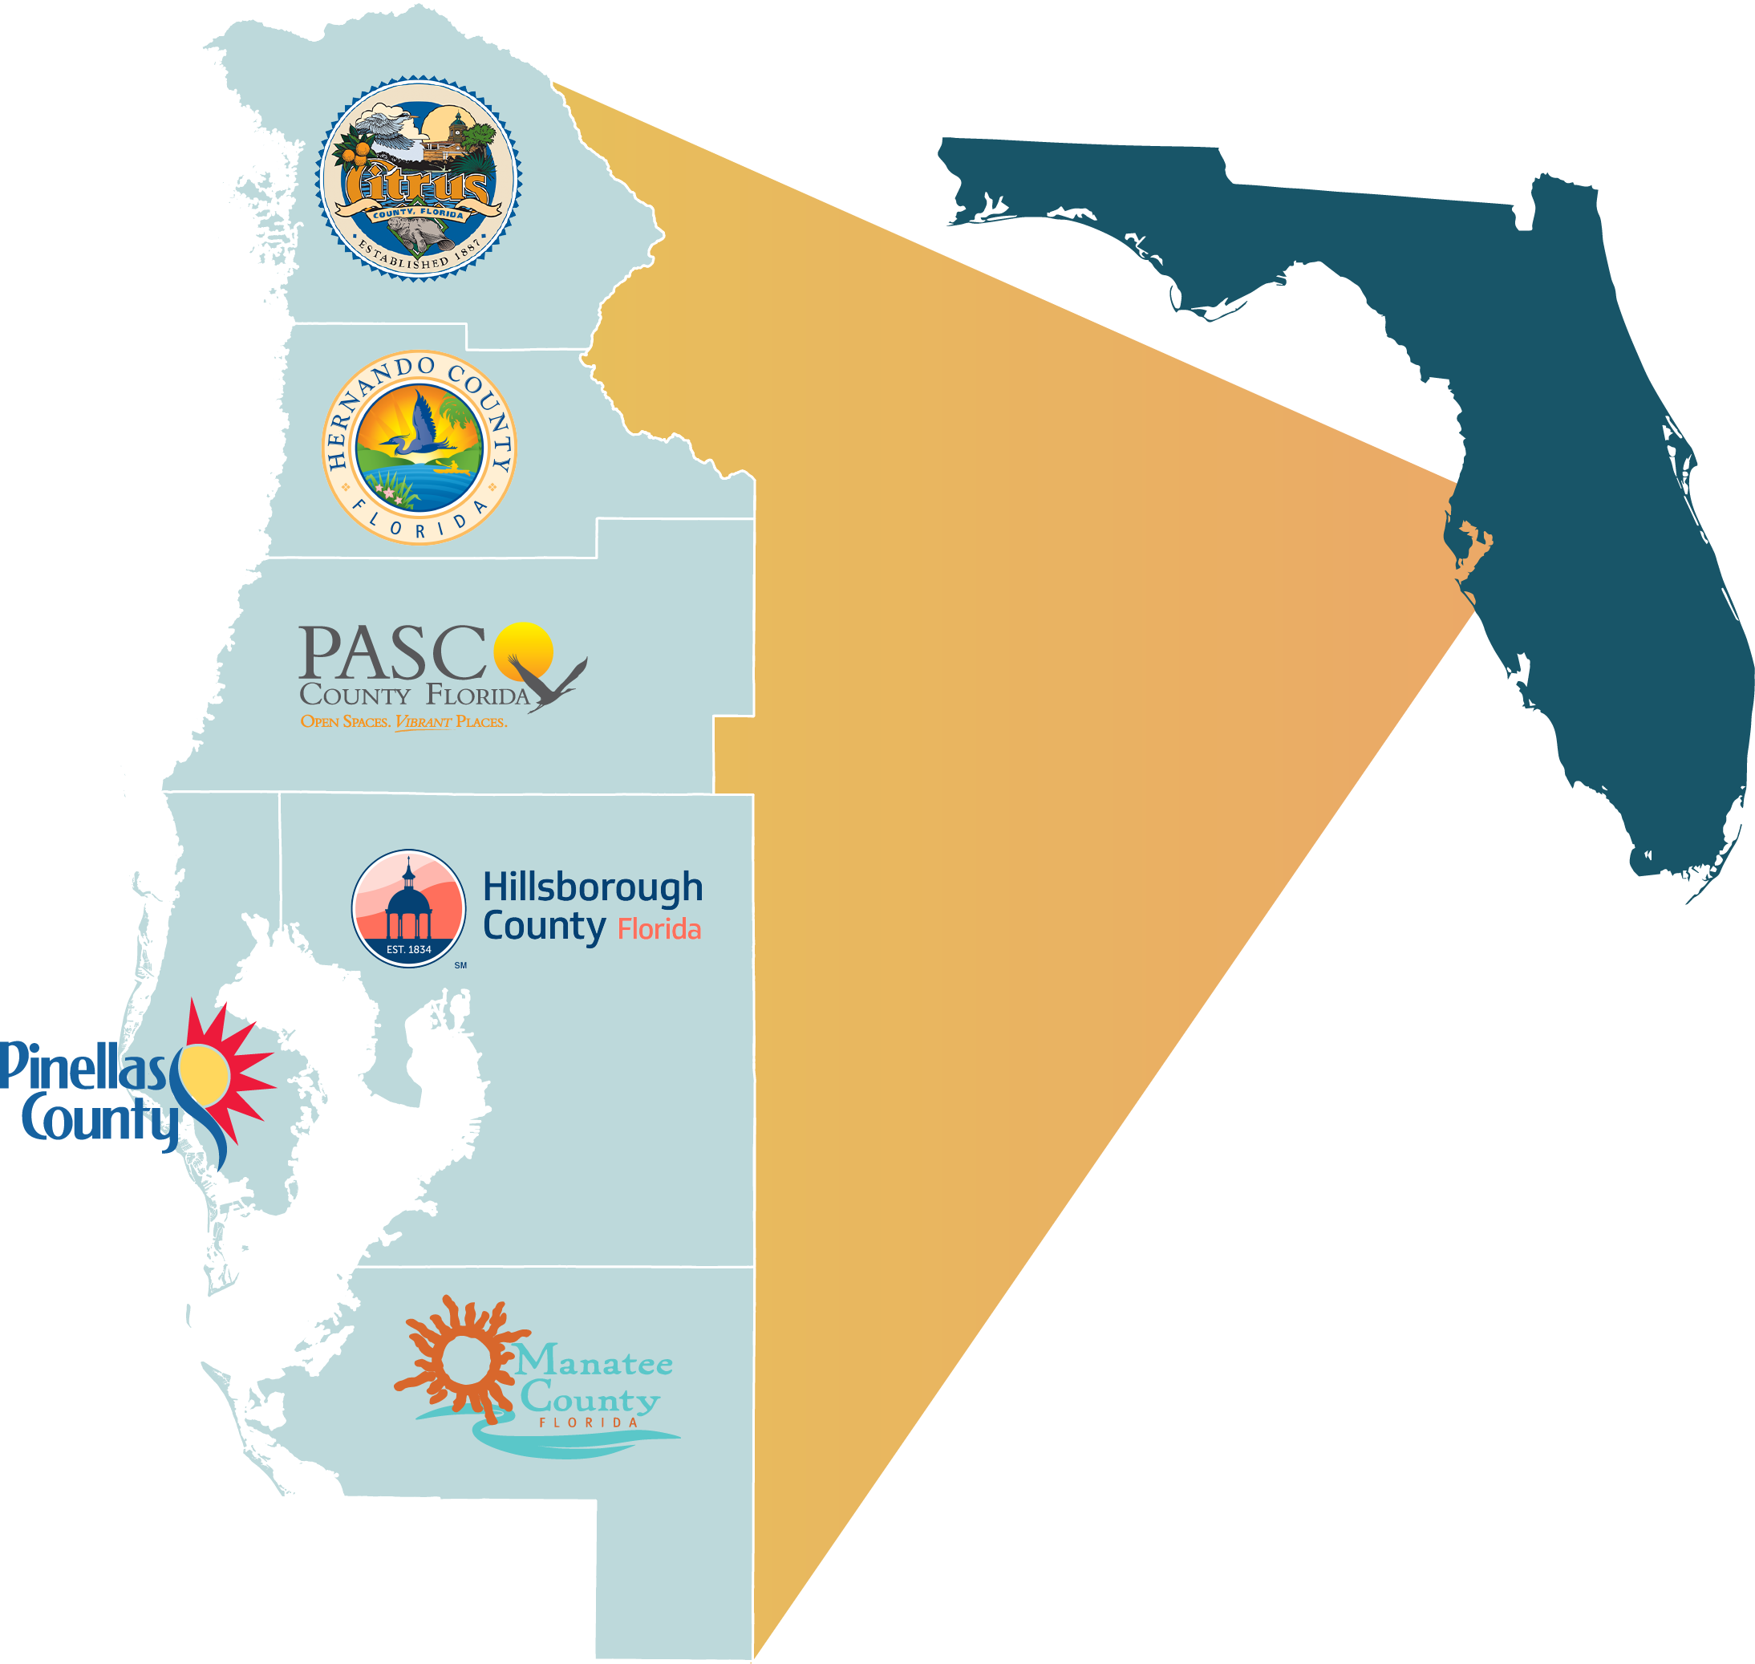


Convening the Region
Since 1962!
6 Counties
23 Municipalities
13 Gubernatorial Appointees
3 Ex-Officios
Notes:
The TBRPC's mission is to serve our citizens and member governments by providing a forum to foster communication, coordination, and collaboration in identifying and addressing needs regionally.
We serve six counties from Citrus County in the north to Manatee County in the south. Our membership also includes 23 Municipalities.
In addition to representatives from our 28 member governments, the council includes 13 gubernatorial appointees and 3 ex-officio members from FDOT, FDEP and SWFWMD (swifmud)

Slide 6



Resilience Activities on the Horizon
6

Slide 7
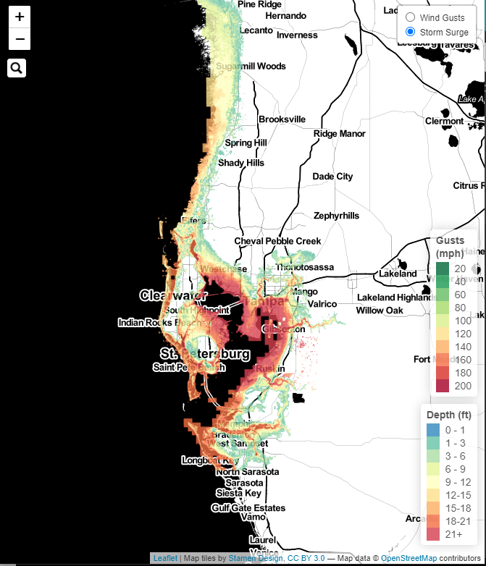
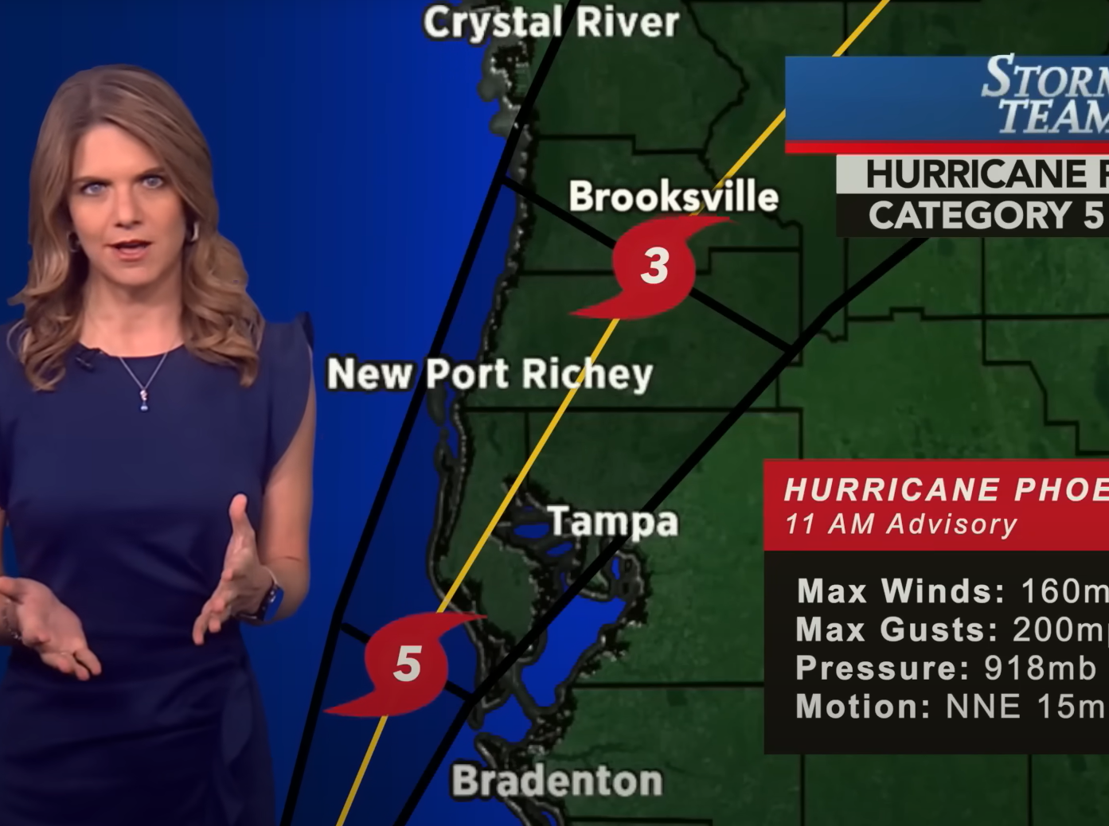
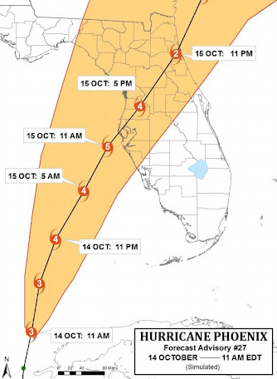
April 2026 –
Tabletop exercises throughout the region to prepare emergency managers and businesses for the next big hurricane.
tbrpc.org/phoenix

Slide 8
Building resilience through collaboration
PLAN’S AIM
This plan will illustrate flood risks for the region’s vulnerable communities and habitats, proposing a coordinated suite of restoration and (non)structural flood reduction projects to support adaptation.
THE TBCMP WILL PROVIDE A ROADMAP FOR FLOOD RISK PROJECT FUNDING AND IMPLEMENTATION, BUILDING UPON ONGOING WORK BY THE TAMPA BAY REGIONAL PLANNING COUNCIL (TBRPC) AND PARTNERS
CoastalTampaBay.org

Slide 9
Thank you!
tbrpc.org
Alison Prater, Alison@TBRPC.org March 12, 2026
Notes:
Thank you all again for joining us today. This tool is still in development, and your feedback will be critical to making sure it works for communities across Florida. We encourage you to take some time to explore the tool and think about how it might apply to your projects. If questions come up, please feel free to reach out to the project team.

Slide 10
Regional Resilience Projects –
Southwest Florida

Slide 11

strengthening southwest Florida
From Coastlines to the Heartland
SOUTHWEST FLORIDA REGIONAL PLANNING COUNCIL
Est. 1973
Serving Charlotte, Collier, Glades, Hendry, Lee and Sarasota Counties

Slide 12
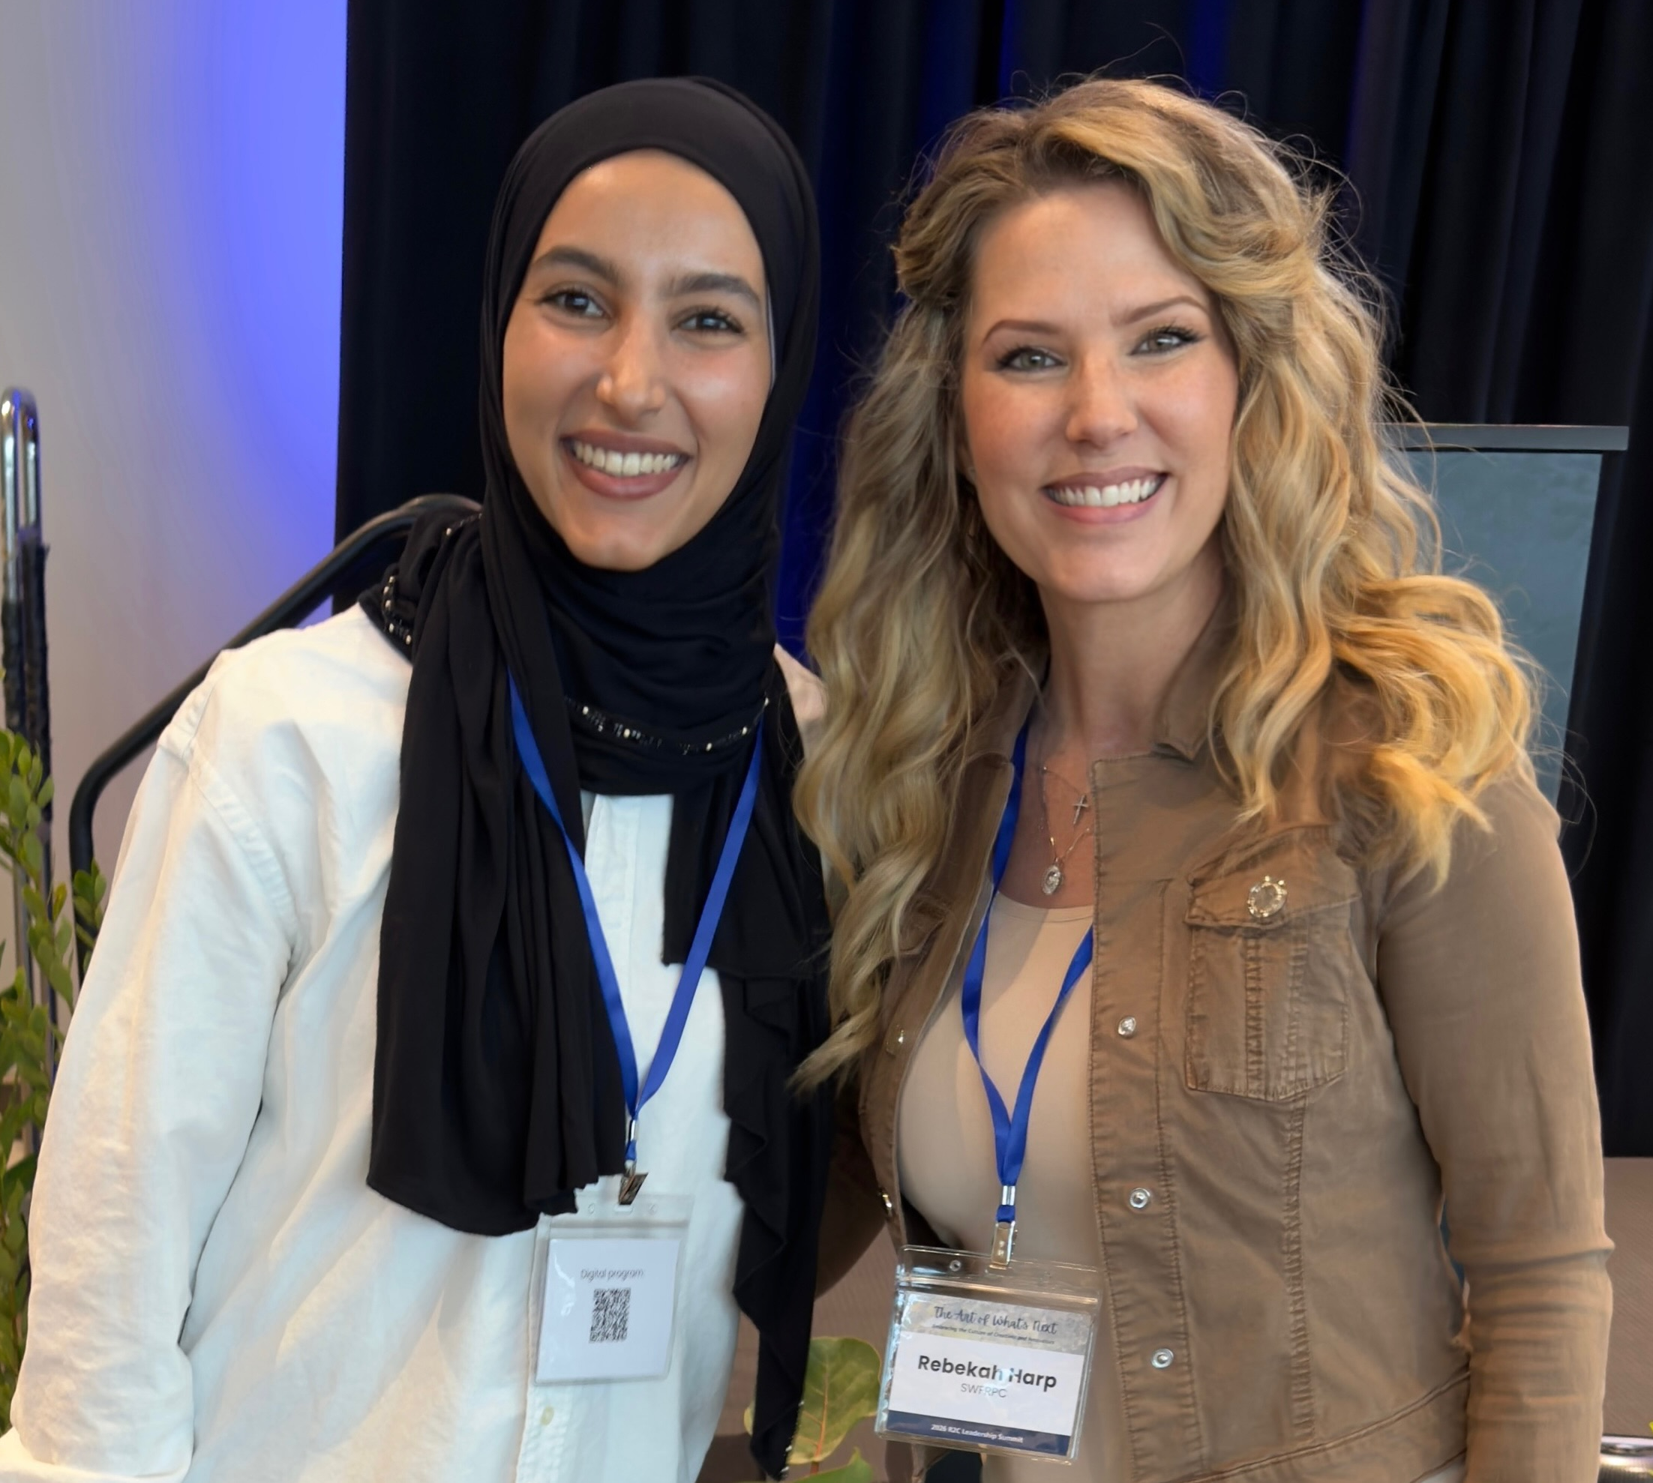


SOUTHWEST FLORIDA
REGIONAL PLANNING COUNCIL
Our Team…
Rebekah Harp
Executive Director
Asmaa Odeh
Deputy Director Portfolio Manager
LEPC Coordinator
strengthening southwest Florida
From Coastlines to the Heartland
Serving Charlotte, Collier, Glades, Hendry, Lee and Sarasota Counties

Slide 13
Southwest Florida Resilience Collaborative
Purpose: Formed to strengthen regional coordination among
counties, cities, and state agencies across Southwest Florida.
Phase I Highlights:
Align resilience planning efforts across jurisdictions.
Monthly stakeholder meetings & engagement with local governments.
Collaboration with partners: UF/IFAS, Dutch Consulate, and other partners.
Phase II:
Regional Resiliency Forum
Regional Resilience Hub Website
Webinar Series on Resilience Strategies
Key Resilience Priorities:
Gap and overlap analysis of local vulnerability and adaptation plans
Regional Resilience Hub Website
Barriers identified: funding and coordination challenges
Consensus achieved on shared learning and regional alignment
Assist Local Communities with Vulnerability Assessments
Serving Charlotte, Collier, Glades, Hendry, Lee and Sarasota Counties

Slide 14
Thank you!!!
SOUTHWEST FLORIDA REGIONAL PLANNING COUNCIL
Est. 1973
Serving Charlotte, Collier, Glades, Hendry, Lee and Sarasota Counties
Notes:
Thank you all again for joining us today. This tool is still in development, and your feedback will be critical to making sure it works for communities across Florida. We encourage you to take some time to explore the tool and think about how it might apply to your projects. If questions come up, please feel free to reach out to the project team.

Slide 15


PROJECT Team Introductions
Alec Bogdanoff, Ph.D.
Project Principal
Sharai Lewis-Gruss
Project Manager
Grace Filmont
Assistant Project Manager
Annie deBoer
Technical Lead
Olivia d'Almeida
Economic Analyst
Anne Watkins
Tool Development Lead
Randy Deshazo
Economic Lead; Deputy Director
Marion Knowles
Project Coordinator; Regional Planner

Slide 16
Today's Objectives
What We Want to Discuss with You:
Background on the tool and how engagement has shaped its development.
The current version of the BCA tool.
Feedback we would like to hear from you.
Discussion of next steps, office hours, and request for super users.

Slide 17
Project timeline
*
Q1 2026
Q2 2026
3/9/2026
3/16 - 4/3/2026
4/3/2026
Host office hours for test users
Collect individual stakeholder feedback
Regional Stakeholder Workshop
4/17/2026
5/8/2026
5/15/2026
6/22/2026
Deliver final updated Resilient BCA Tool – Statewide version
Host two virtual training sessions, including case study review
Final Engagement Complete
All deliverables due to DEP

Slide 18
Overview of the Resilience Cost-Benefit Tool
The Resilient Infrastructure Benefit-Cost Analysis (BCA) Tool is designed to help communities evaluate, compare, and prioritize resilient infrastructure projects (green, gray, or hybrid,) using a consistent, transparent, and repeatable method.
A BCA demonstrates the cost-effectiveness of a project by comparing the anticipated costs and expected benefits that may accrue from a project over a specified period.
The primary goals of the Tool are to:
Standardize benefit-cost evaluation across regions and projects Support early-stage planning Allow customization and flexibility through an excel-based tool | Provide defensible, data-driven outputs that support funding proposals and decision making Incorporate community, environmental, and economic benefits

Slide 19
Background of the tool
  The Resilient Infrastructure BCA Tool is a project of the South Florida Regional Planning Council, in collaboration with seven other regional planning councils around Florida.
  In Phase1of the project (2025), the Tool was designed for use in South Florida only.
  The project is now in Phase 2, where the Tool is being expanded for statewide use.
  Stakeholders have been heavily involved throughout both phases of Tool development.

Slide 20
How engagement has shaped the tool
Stakeholder engagement has informed development of the Tool throughout Phase 1 and Phase 2.
Prior feedback improved:
User experience and interface clarity: modifying the user interface and simplifying navigation.
Cost and benefit tool capabilities: refining cost inputs and expanding benefits.
Output and automation features: improving the formatting and visibility of key outputs.
DEP and Statewide integration: aligning outputs with state templates.

Slide 21
Examples of prior feedback implemented
Feedback received | Implementation
The tool should evaluate complex and hybrid designs | More infrastructure solutions (green, gray and hybrid) were added to the cost database. Cost estimates may be updated following stakeholder engagement.
Analysis must vary based on local geography and conditions | Building value assumptions have been regionalized.
The analysis should evaluate a wider range of structure types | Three additional structure prototypes have been added (government office, police, school). More may be added following stakeholder engagement.
The tool should incorporate additional benefits | Avoided debris cleanup cost has been added. Other benefit categories may be added following stakeholder engagement.
The tool should support grant funding securement | Output formats have been aligned with Resilient Florida grant templates for seamless integration, the "Community Score Card" has been replaced by the "Resilient Score Card".

Slide 22
Importance of continuing conversations and feedback
Prior stakeholder feedback has informed valuable updates to the Tool; however, we are seeking clarification and additional feedback before finalizing the Tool. Continuing conversations and feedback will help to support a tool that can:
Align with organizational goals, priorities and funding requirements and the outputs remain relevant and actionable.
Have customizability while maintaining consistency.
Be easy to use, avoid confusing concepts or jargon, and ideally minimize rework.

Slide 23
Your role in feedback
Regular Test User:
Run one project (real or hypothetical).
Provide feedback on usability, clarity, and applicability to your region.
Super Test User:
Spend more time going through tool, run multiple project scenarios.
Override defaults and compare outcomes.
Especially encouraged to participate in office hours.

Slide 24
Tool Walk-through

Slide 25
Questions and feedback

Slide 26
questions
Navigation and interface
  Did the supporting materials (User Guide, video demonstration) clearly explain how to use the Tool? Was anything confusing or lacking detail?
  Should there be more ‘tool tips’ throughout to supplement the guides?
  Generally, was the structure of the tool easy to navigate/follow? Was the workflow intuitive?
  What important features or capabilities are missing that would make this tool more valuable for you?

Slide 27
questions
Cost and benefit data
  Are the default values in the Tool representative/accurate for your region?
  Are there additional structure prototypes that should be incorporated?
  Are there additional infrastructure solutions (green, gray, hybrid) that should be included in the cost database?
Outputs
  Is the presentation of outputs clear? Are the metrics and outputs useful for supporting decisions in your organizations or projects?
  Are there any other economic metrics you would like to see incorporated into the tool?
  What visualizations/graphs would be useful to include in a dashboard?

Slide 28
Discussion and Q&A

Slide 29
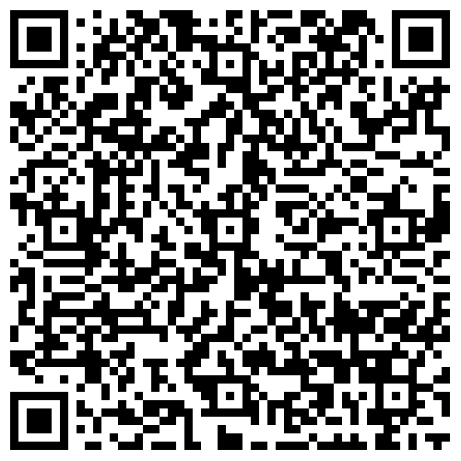
Link to tool, video demonstration
Link to Dropbox
Notes:
Link for dropbox: https://www.dropbox.com/scl/fo/wmyqwmhfqeph87j8o8dbm/ADV0WeCZXeiRqW5t0YJl5fA?rlkey=8z4be4o23d5m0p05t6b2qh8nz&e=1&st=pr3edteu&dl=0

Slide 30
Next Steps
Test users to explore tool and provide feedback by Friday, April 3, 2026
Attend virtual office hours: 3/19 @ 10am | 3/26 @ 2pm | 3/30 @ 9am
Notes:
Link to register: https://us02web.zoom.us/meeting/register/ddQyjcL_TF6FrMZXN37iyQ

Slide 31
Contact us – Project Team
Annie deBoer, Technical Lead: anne.deboer@aecom.com
Alec Bogdanoff, Project Principal: alec@brizaga.com
Randy Deshazo, Economic Lead; Deputy Director: rdeshazo@sfrpc.com
Notes:
Annie deBoer, Technical Lead anne.deboer@aecom.com
Alec Bogdanoff, Principal and Project Manager alec@brizaga.com
Randy Deshazo, Deputy Director rdeshazo@sfrpc.com

Slide 32
Contact us – RPCs
TBRPC
Alison Prater, Disaster Recovery Grants Coordinator alison@tbrpc.org
SWFRPC
Rebekah Harp, Executive Director rharp@swfrpc.org
Asmaa Odeh, Deputy Director / Portfolio Manager aodeh@swfrpc.org
Notes:
TBRPC
Alison Prater, Disaster Recovery Grants Coordinator alison@tbrpc.org
SWFRPC
Rebekah Harp, Executive Director rharp@swfrpc.org
Asmaa Odeh, Deputy Director / Portfolio Manager aodeh@swfrpc.org

Slide 33
Questions and feedback

Slide 34
Closing & Thank you

