Slide 1









[
]
Resilient BCA Regional
Stakeholder Webinar
presented by
RPC Logo 1
Funded By
Project Team

Slide 2
WELCOME
ECFRPC Staff - Michelle Morrison, Director of Planning
CFRPC Staff - Sheila McNamara, Regional Resiliency Manager & Mike Daniels, Senior Transportation Planner

Slide 3
Regional Resilience Projects –
East central Florida

Slide 4
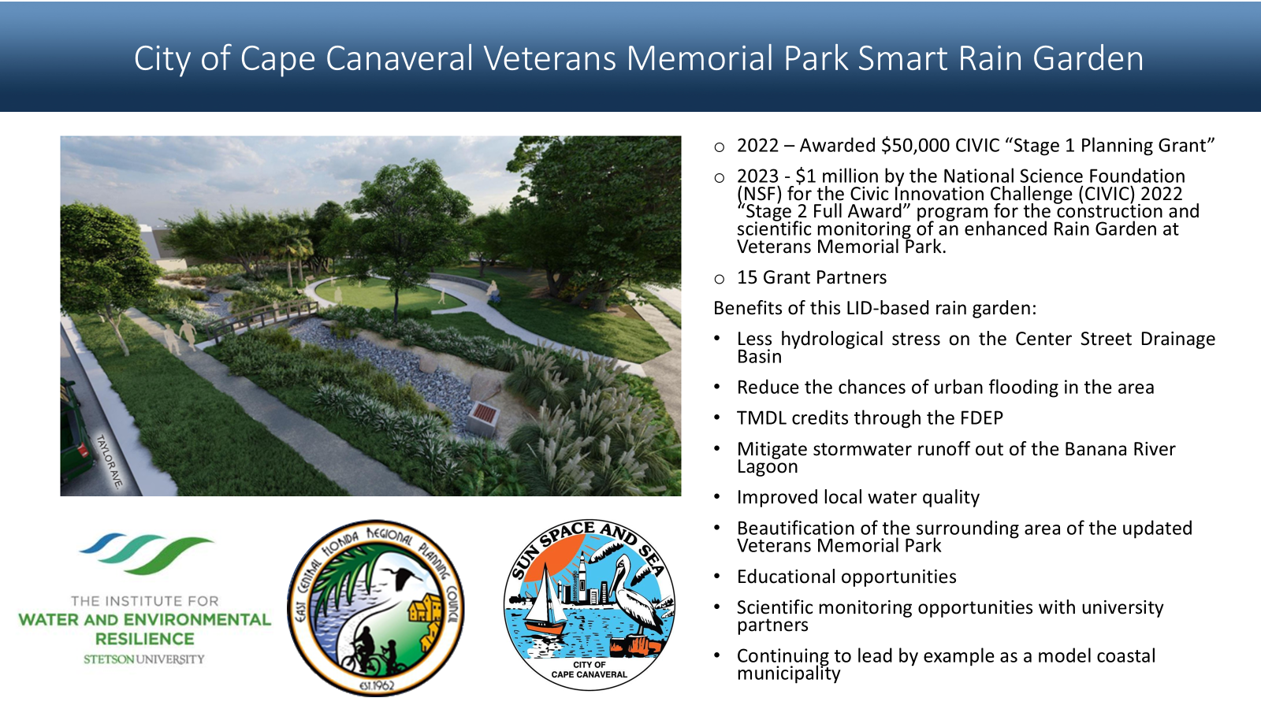
Notes:
This is the culmination of a long-term and growing partnership with the city that began in 2018 when the ECFRPC conducted the City’s first Vulnerability Assessment. RPC with our partnership with Stetson then brought in Cape Canaveral, a progressively resilient City, to be the Florida pilot community on a 4 state Sea Grant project as the city not only experiences tremendous flooding in its 98% built out city, the infrastructure is aging, sea level rise is working against drainage and they are working to improve the water quality of the Indian river lagoon. The Sea grant project set the stage for identifying areas to implement LID stormwater projects, Veteran’s park being one of these areas, which was identified to help alleviate flooding in a residential area of the city.
In 2022, the City and Stetson University received a $50,000 CIVIC “Stage 1 Planning Grant” from the NSF for public outreach on “low impact development” (LID) for flood mitigation and water quality improvements, and community engagement on potential project decisions and implementation.
Between November 2022 and February 2023, community members attended three (3) public workshops to learn about basic stormwater principles, define unique challenges, and provide ideas and comments for practical LID solutions in their neighborhood. These workshops directly informed the City’s “Stage 2” CIVIC Application, the Veterans Memorial Park Enhanced Bioswale, submitted in March 2023.
City of Cape Canaveral and Stetson University were awarded $1 million by the National Science Foundation (NSF) for the Civic Innovation Challenge (CIVIC) 2022 “Stage 2 Full Award” program for the construction and scientific monitoring of an enhanced bioswale at Veterans Memorial Park. . The NSF CIVIC Program is a research and action competition driven by community priorities, supporting planning and implementation of community-university partnerships with potential for significant near-term community impact. Staff submitted the City’s “Stage 2” application in March 2023 along with 56 other communities across the nation, with 19 ultimately being awarded.
Hope to replicate across the city in smaller scales projects.

Slide 5
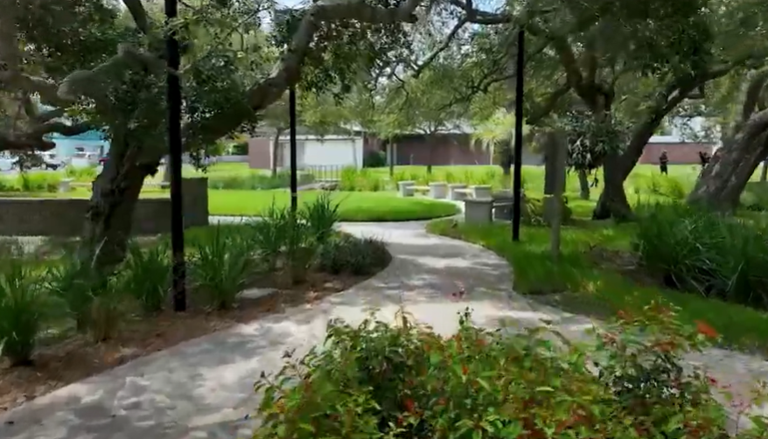
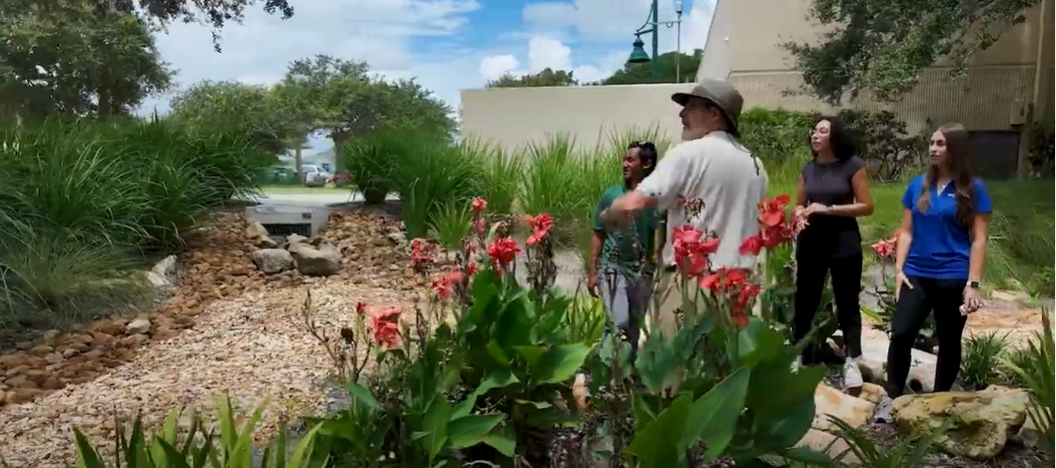
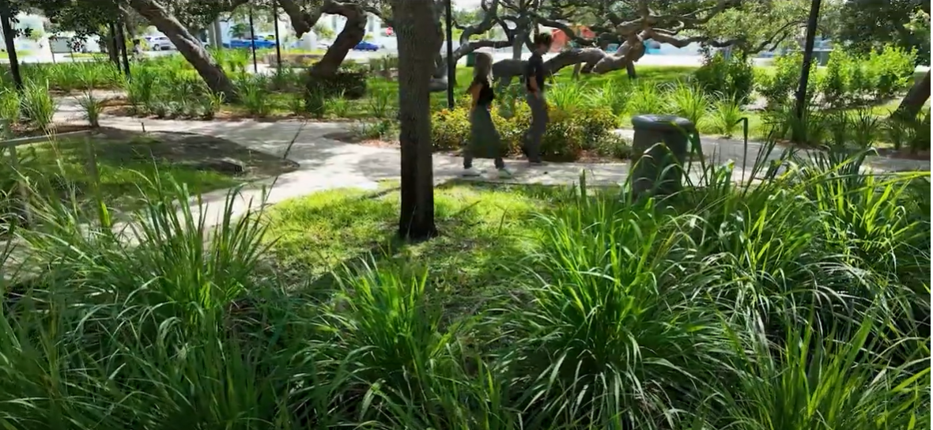
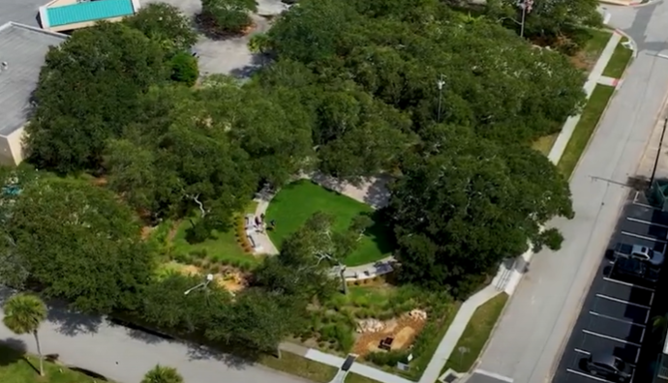

Slide 6
Regional Resilience Projects –
Central Florida

Slide 7
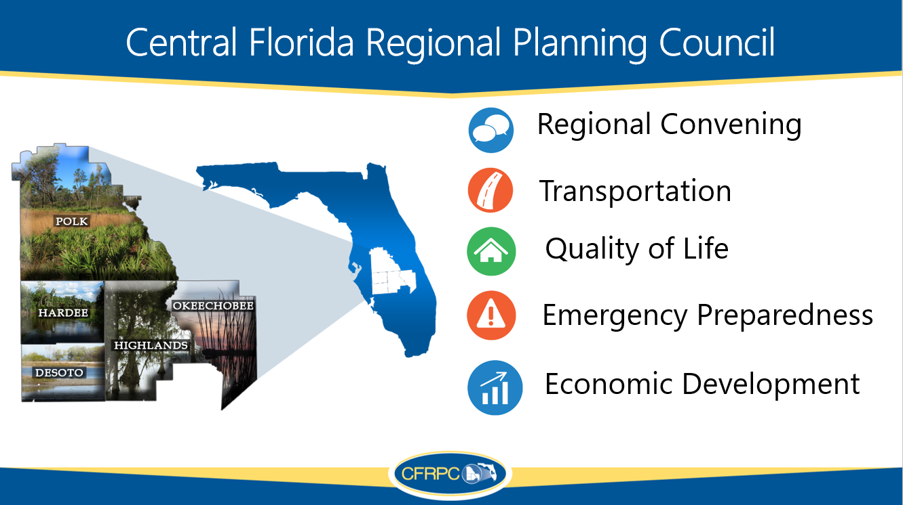

Slide 8
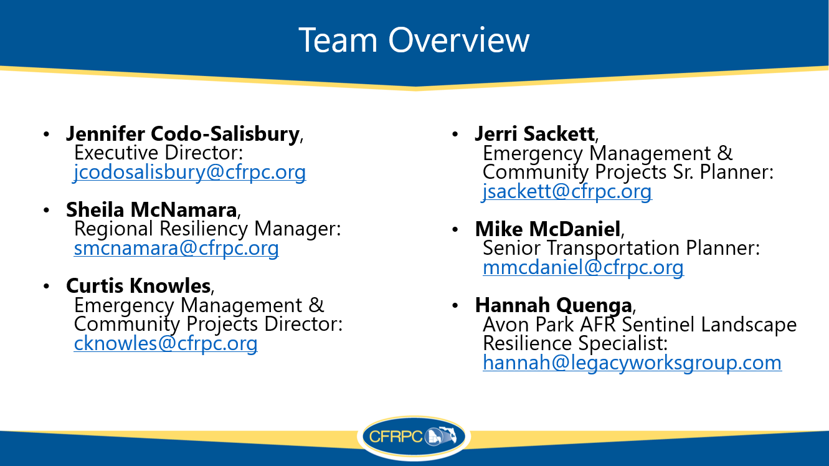

Slide 9
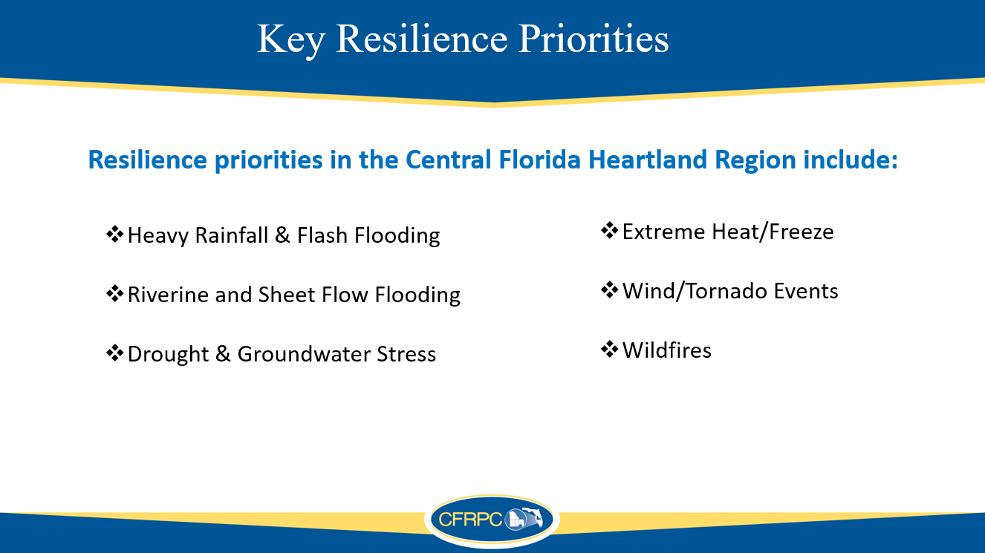

Slide 10
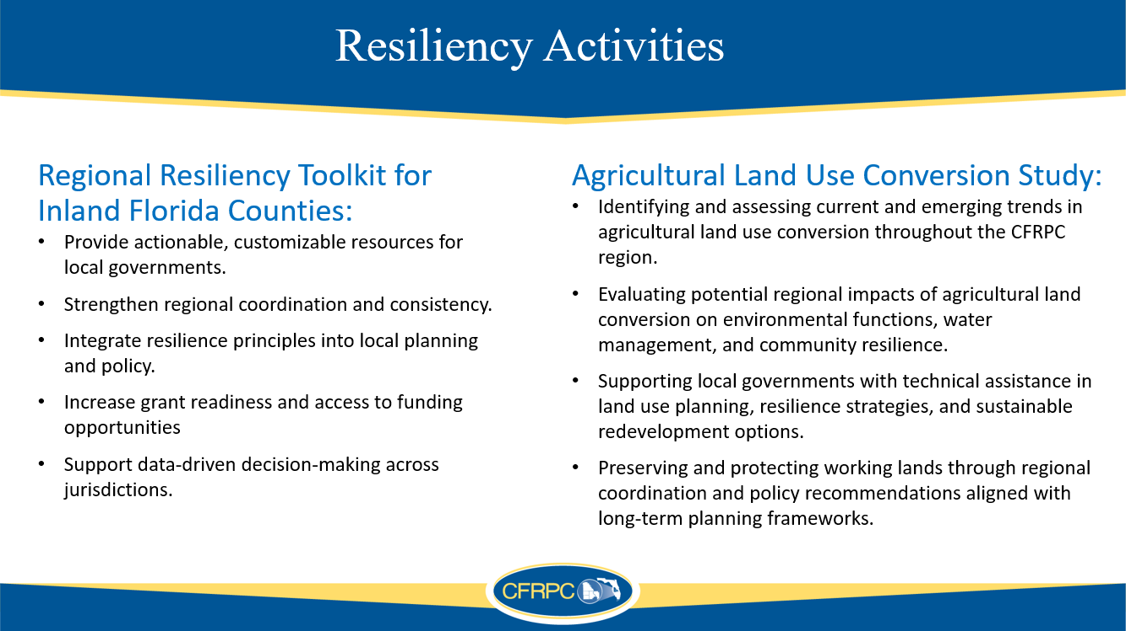

Slide 11
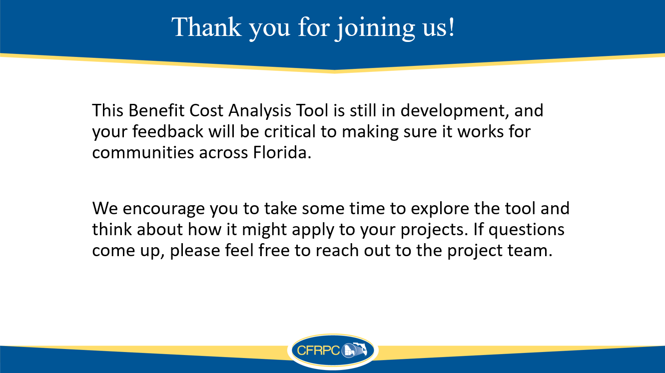

Slide 12


PROJECT Team Introductions
Alec Bogdanoff, Ph.D.
Project Principal
Sharai Lewis-Gruss
Project Manager
Grace Filmont
Assistant Project Manager
Annie deBoer
Technical Lead
Olivia d'Almeida
Economic Analyst
Anne Watkins
Tool Development Lead
Randy Deshazo
Economic Lead; Deputy Director
Marion Knowles
Project Coordinator; Regional Planner

Slide 13
Today's Objectives
What We Want to Discuss with You:
Background on the tool and how engagement has shaped its development.
The current version of the BCA tool.
Feedback we would like to hear from you.
Discussion of next steps, office hours, and request for super users.

Slide 14
Project timeline
*
Q1 2026
Q2 2026
3/9/2026
3/16 - 4/3/2026
4/3/2026
Host office hours for test users
Collect individual stakeholder feedback
Regional Stakeholder Workshop
4/17/2026
5/8/2026
5/15/2026
6/22/2026
Deliver final updated Resilient BCA Tool – Statewide version
Host two virtual training sessions, including case study review
Final Engagement Complete
All deliverables due to DEP

Slide 15
Overview of the Resilience Cost-Benefit Tool
The Resilient Infrastructure Benefit-Cost Analysis (BCA) Tool is designed to help communities evaluate, compare, and prioritize resilient infrastructure projects (green, gray, or hybrid,) using a consistent, transparent, and repeatable method.
A BCA demonstrates the cost-effectiveness of a project by comparing the anticipated costs and expected benefits that may accrue from a project over a specified period.
The primary goals of the Tool are to:
Standardize benefit-cost evaluation across regions and projects Support early-stage planning Allow customization and flexibility through an excel-based tool | Provide defensible, data-driven outputs that support funding proposals and decision making Incorporate community, environmental, and economic benefits

Slide 16
Background of the tool
  The Resilient Infrastructure BCA Tool is a project of the South Florida Regional Planning Council, in collaboration with seven other regional planning councils around Florida.
  In Phase1of the project (2025), the Tool was designed for use in South Florida only.
  The project is now in Phase 2, where the Tool is being expanded for statewide use.
  Stakeholders have been heavily involved throughout both phases of Tool development.

Slide 17
How engagement has shaped the tool
Stakeholder engagement has informed development of the Tool throughout Phase 1 and Phase 2.
Prior feedback improved:
User experience and interface clarity: modifying the user interface and simplifying navigation.
Cost and benefit tool capabilities: refining cost inputs and expanding benefits.
Output and automation features: improving the formatting and visibility of key outputs.
DEP and Statewide integration: aligning outputs with state templates.

Slide 18
Examples of prior feedback implemented
Feedback received | Implementation
The tool should evaluate complex and hybrid designs | More infrastructure solutions (green, gray and hybrid) were added to the cost database. Cost estimates may be updated following stakeholder engagement.
Analysis must vary based on local geography and conditions | Building value assumptions have been regionalized.
The analysis should evaluate a wider range of structure types | Three additional structure prototypes have been added (government office, police, school). More may be added following stakeholder engagement.
The tool should incorporate additional benefits | Avoided debris cleanup cost has been added. Other benefit categories may be added following stakeholder engagement.
The tool should support grant funding securement | Output formats have been aligned with Resilient Florida grant templates for seamless integration, the "Community Score Card" has been replaced by the "Resilient Score Card".

Slide 19
Importance of continuing conversations and feedback
Prior stakeholder feedback has informed valuable updates to the Tool; however, we are seeking clarification and additional feedback before finalizing the Tool. Continuing conversations and feedback will help to support a tool that can:
Align with organizational goals, priorities and funding requirements and the outputs remain relevant and actionable.
Have customizability while maintaining consistency.
Be easy to use, avoid confusing concepts or jargon, and ideally minimize rework.

Slide 20
Your role in feedback
Regular Test User:
Run one project (real or hypothetical).
Provide feedback on usability, clarity, and applicability to your region.
Super Test User:
Spend more time going through tool, run multiple project scenarios.
Override defaults and compare outcomes.
Especially encouraged to participate in office hours.

Slide 21
Tool Walk-through

Slide 22
Questions and feedback

Slide 23
questions
Navigation and interface
  Did the supporting materials (User Guide, video demonstration) clearly explain how to use the Tool? Was anything confusing or lacking detail?
  Should there be more ‘tool tips’ throughout to supplement the guides?
  Generally, was the structure of the tool easy to navigate/follow? Was the workflow intuitive?
  What important features or capabilities are missing that would make this tool more valuable for you?

Slide 24
questions
Cost and benefit data
  Are the default values in the Tool representative/accurate for your region?
  Are there additional structure prototypes that should be incorporated?
  Are there additional infrastructure solutions (green, gray, hybrid) that should be included in the cost database?
Outputs
  Is the presentation of outputs clear? Are the metrics and outputs useful for supporting decisions in your organizations or projects?
  Are there any other economic metrics you would like to see incorporated into the tool?
  What visualizations/graphs would be useful to include in a dashboard?

Slide 25
Discussion and Q&A

Slide 26
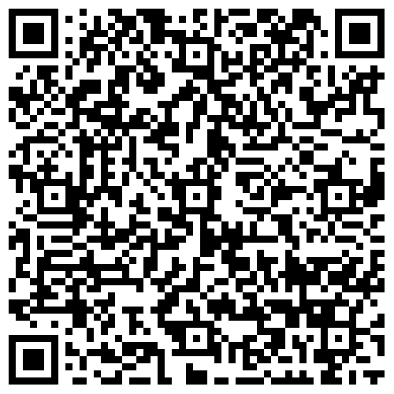
Link to tool, video demonstration
Link to Dropbox
Notes:
Link for webinar: https://www.dropbox.com/scl/fo/wmyqwmhfqeph87j8o8dbm/ADV0WeCZXeiRqW5t0YJl5fA?rlkey=8z4be4o23d5m0p05t6b2qh8nz&e=1&st=pr3edteu&dl=0

Slide 27
Next Steps
Test users to explore tool and provide feedback by Friday, April 3, 2026
Attend office hours: 3/19 @ 10am | 3/26 @ 2pm | 3/30 @ 9am
Notes:
Link to register: https://us02web.zoom.us/meeting/register/ddQyjcL_TF6FrMZXN37iyQ

Slide 28
Contact us – Project Team
Annie deBoer, Technical Lead: anne.deboer@aecom.com
Alec Bogdanoff, Project Principal: alec@brizaga.com
Randy Deshazo, Economic Lead; Deputy Director: rdeshazo@sfrpc.com
Notes:
Annie deBoer, Technical Lead anne.deboer@aecom.com
Alec Bogdanoff, Principal and Project Manager alec@brizaga.com
Randy Deshazo, Deputy Director rdeshazo@sfrpc.com

Slide 29
Contact us – RPCs
ECFRPC
Michelle Morrison, Director of Planning MMorrison@ECFRPC.org
CFRPC
Sheila McNamara, Regional Resiliency Manager smcnamara@cfrpc.org
Mike McDaniel, Senior Transportation Planner mmcdaniel@cfrpc.org
Notes:
ECFRPC
Michelle Morrison, Director of Planning MMorrison@ECFRPC.org
CFRPC
Sheila McNamara, Regional Resiliency Manager smcnamara@cfrpc.org
Mike McDaniel, Senior Transportation Planner mmcdaniel@cfrpc.org

Slide 30
Closing & Thank you

