Slide 1









[
]
Resilient BCA Regional
Stakeholder Webinar
presented by
Funded By
Project Team

Slide 2
WELCOME
ARPC Staff - Divina Lade, Geospatial Environmental & Resilience Planning Director
NERPC Staff - Fara Ilami, Resiliency Manager

Slide 3
Regional Resilience Projects – Apalachee

Slide 4


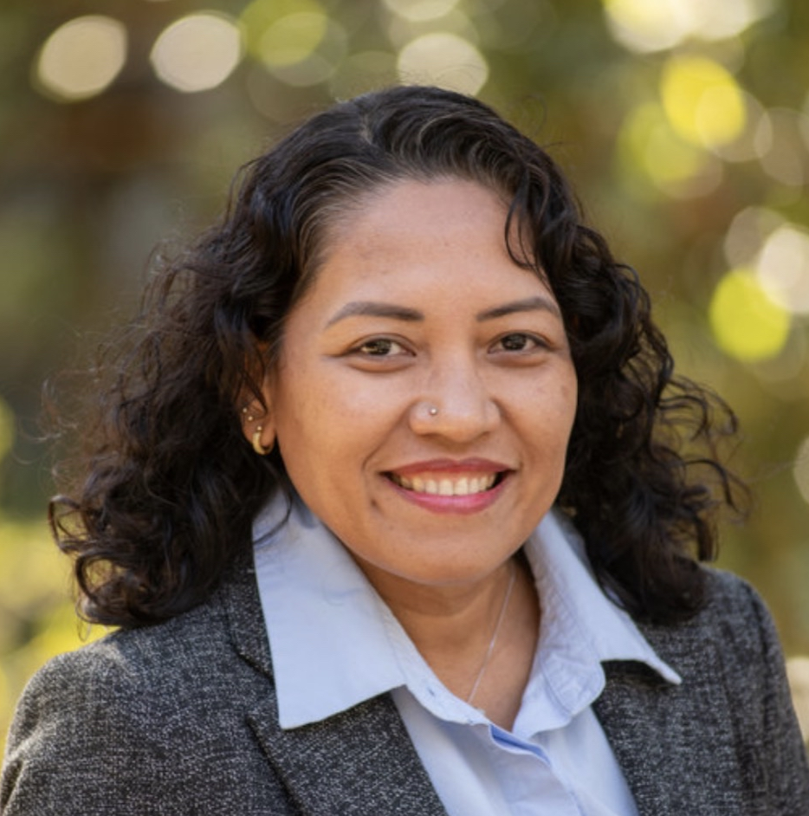
DIVINA LADE
Geospatial Environmental & Resilience Planning Director
dlade@arpc.org | 850-312-3690

Slide 5
Current Projects
Development of Phase 1 of the Apalachee Regional Adaptation Action Plan
Rendering of extreme rainfall-induced flood projections
Living Shoreline in Franklin 98
Notes:
CUMULATIVE AMOUNT OF FUNDING RECEIVED SINCE 2020 ( 7 Projects): Approx $1,379,484.00

Slide 6
Phase 1 Regional Adaptation Action Plan
Draft Vision: A coordinated Apalachee Region where communities collaborate to strengthen infrastructure, protect natural systems, and reduce risks from climate hazards and disasters while supporting sustainable economic and community development.
Notes:
CUMULATIVE AMOUNT OF FUNDING RECEIVED SINCE 2020 ( 7 Projects): Approx $1,379,484.00

Slide 7
Phase 1 Regional Adaptation Action Plan
GOAL AREAS
Regional Collaboration and Governance
Resilient Infrastructure and Utilities
Nature-based solutions
Data, Science, and Decision Support
Funding and Implementation Partnerships
Notes:
CUMULATIVE AMOUNT OF FUNDING RECEIVED SINCE 2020 ( 7 Projects): Approx $1,379,484.00

Slide 8
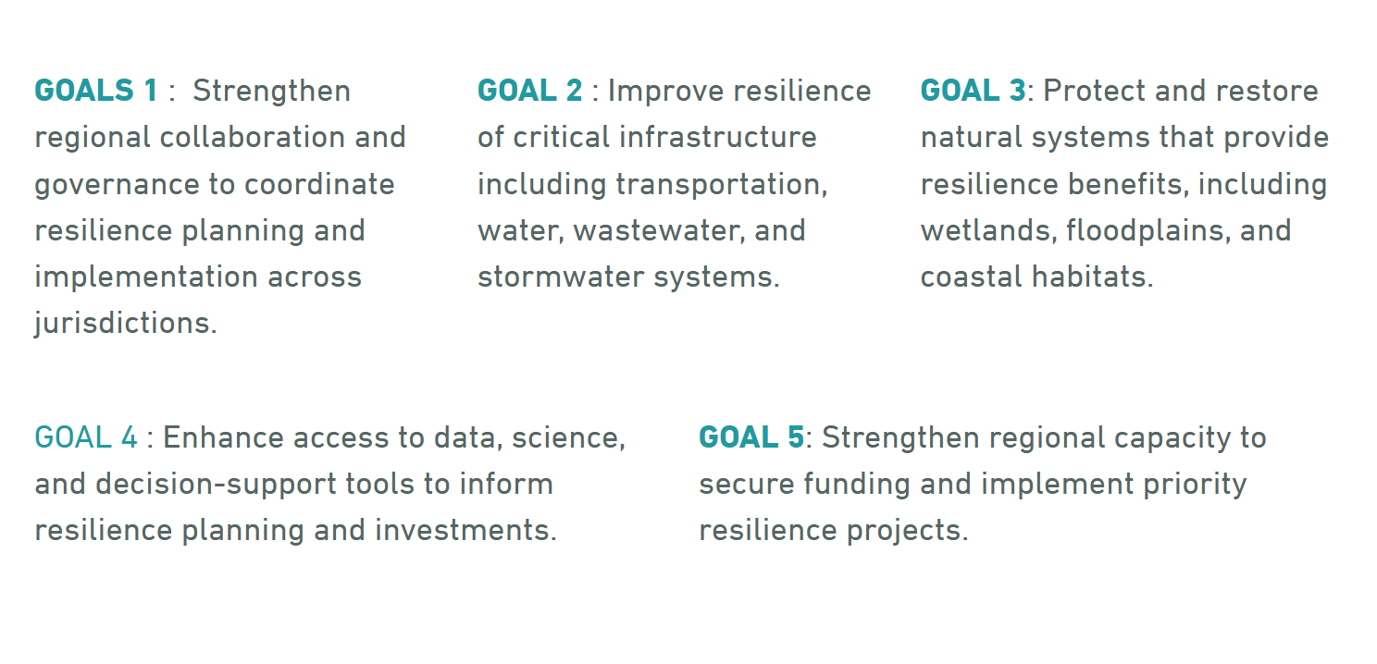
Phase 1 Regional Adaptation Action Plan
Notes:
CUMULATIVE AMOUNT OF FUNDING RECEIVED SINCE 2020 ( 7 Projects): Approx $1,379,484.00

Slide 9
Regional Resilience Projects – Northeast Florida

Slide 10
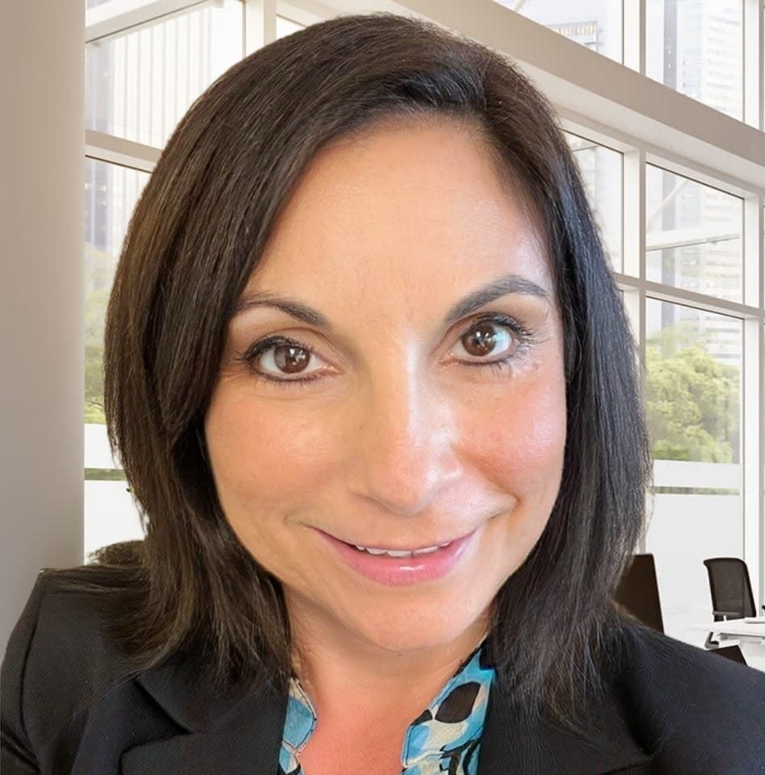
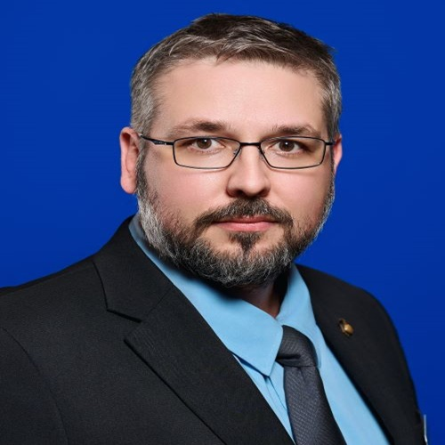
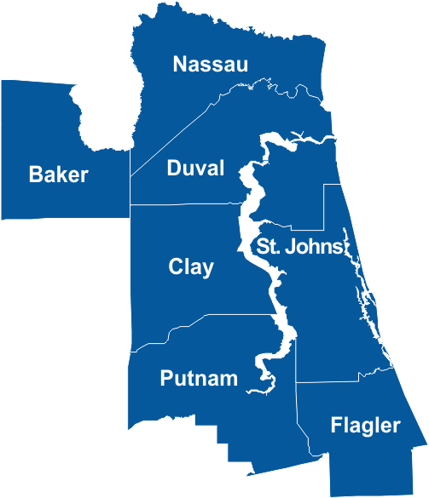

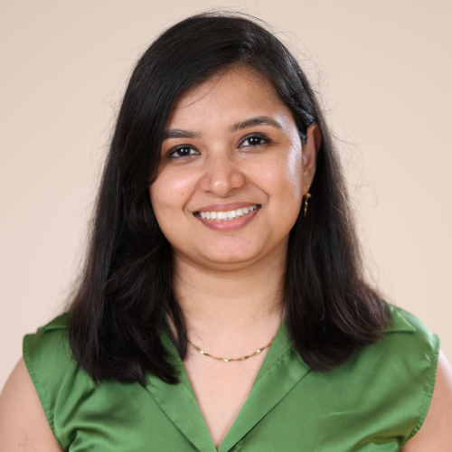
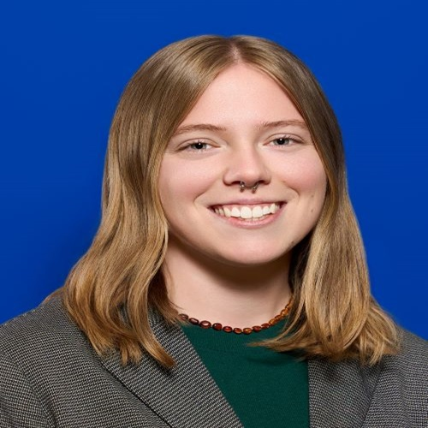

NEFRC Resiliency Program: Welcome!
Mission
To build resilience to climate-related hazards for the communities of Northeast Florida.
Assessing Vulnerabilities
Military and Community Involvement
Mitigation and Adaptation
Fara Ilami
Resiliency Manager
Andrew Prokopiak
Sr. Resiliency Planner
Apurva Jhamb
Sr. Resiliency Planner
Cassidy Taylor
Sr. Regional Planner

Slide 11
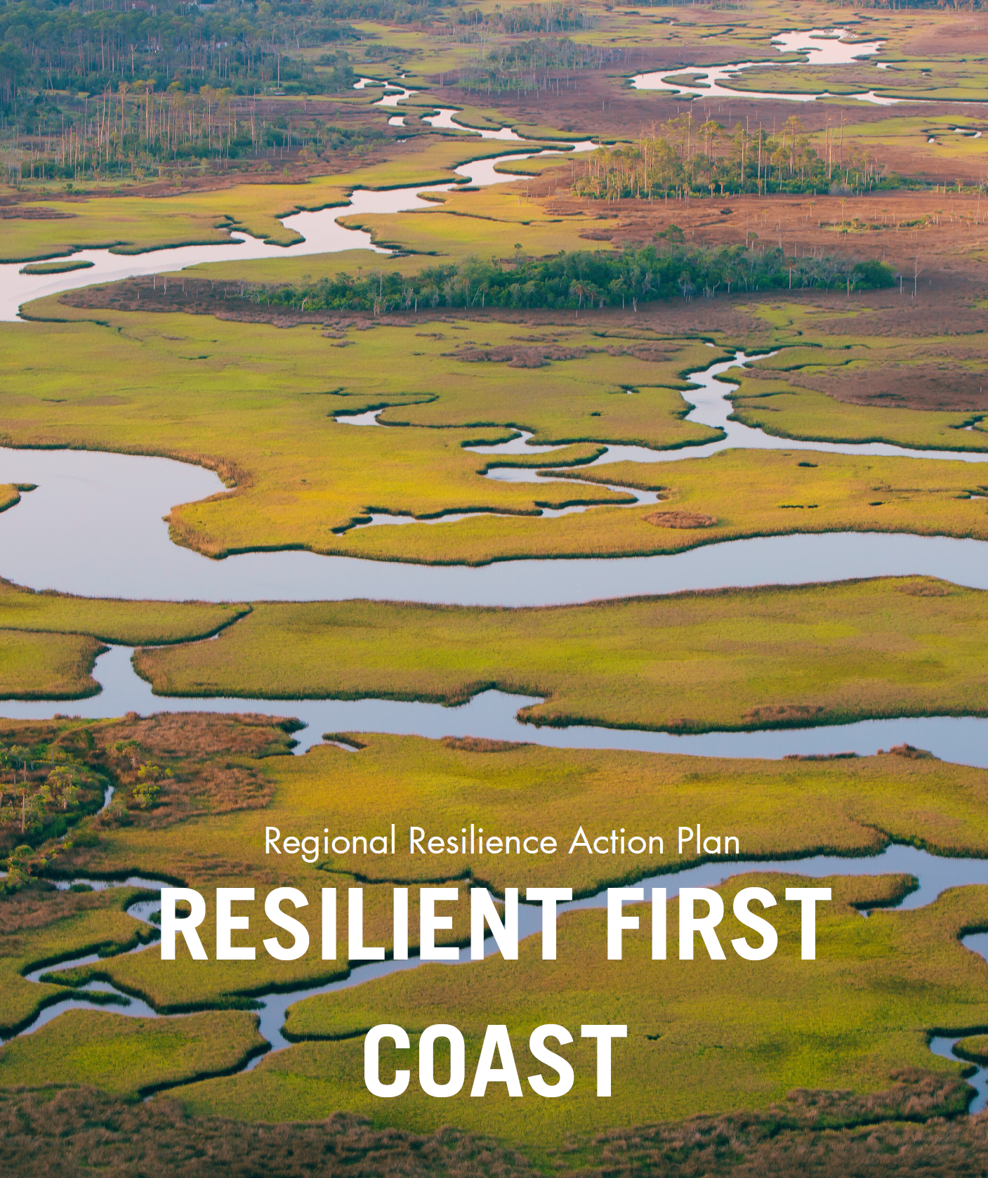

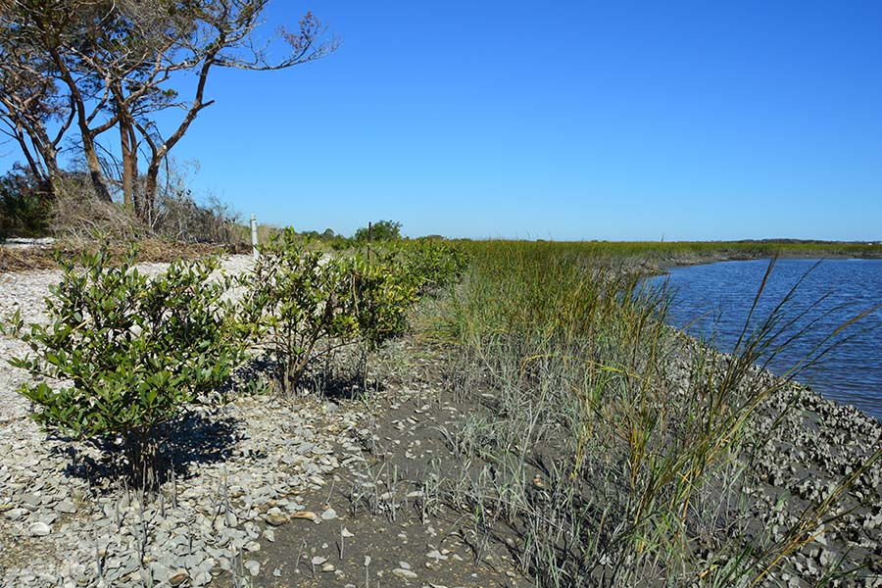
NEFRC Resiliency Program: Project Highlights
Regional Resilience Action Plan
Nature-Based Solutions in Vulnerable Communities
Phase I (2024)
Background, goals, & objectives determined by Resilient First Coast Collaborative
Phase II (2025)
34 Implementable Actions and 83 Sub-actions
80 Committed Partnerships to be leveraged
Phase III (2026)
Metrics, Outcomes, Funding, and additional Partnerships for Actions
Moving into Implementation on 9-10 Actions or Sub-Actions
South Atlantic Salt Marsh Initiative Partnership
Network of over 300 partners across NC, SC, GA, and FL with a goal to enhance the long-term abundance, health, and resilience of 1 million acres of salt marsh
National Fish and Wildlife Foundation Project
NEFRC lead in FL in partnership with North Florida Land Trust to identify sites for nature-based solutions to mitigate flooding
Includes community engagement and science-based analysis
Recently Funded by NFWF for 2026: Aquatic Connectivity Project!

Slide 12

NEFRC Resiliency Program: Closing
Thank you all again for joining us today. This tool is still in development, and your feedback will be critical to making sure it works for communities across Florida. We encourage you to take some time to explore the tool and think about how it might apply to your projects. If questions come up, please feel free to reach out to the project team, and/or check our websites for updates.
Fara Ilami
filami@nefrc.org
Andrew Prokopiak
aprokopiak@nefrc.org
https://www.nefrc.org/
https://resilientfirstcoast.com/
Apurva Jhamb
ajhamb@nefrc.org
Cassidy Taylor
ctaylor@nefrc.org

Slide 13


PROJECT Team Introductions
Alec Bogdanoff, Ph.D.
Project Principal
Sharai Lewis-Gruss
Project Manager
Grace Filmont
Assistant Project Manager
Annie deBoer
Technical Lead
Olivia d'Almeida
Economic Analyst
Anne Watkins
Tool Development Lead
Randy Deshazo
Economic Lead; Deputy Director
Marion Knowles
Project Coordinator; Regional Planner

Slide 14
Today's Objectives
What We Want to Discuss with You:
Background on the tool and how engagement has shaped its development.
The current version of the BCA tool.
Feedback we would like to hear from you.
Discussion of next steps, office hours, and request for super users.

Slide 15
Project timeline
*
Q1 2026
Q2 2026
3/9/2026
3/16 - 4/3/2026
4/3/2026
Host office hours for test users
Collect individual stakeholder feedback
Regional Stakeholder Workshop
4/17/2026
5/8/2026
5/15/2026
6/22/2026
Deliver final updated Resilient BCA Tool – Statewide version
Host two virtual training sessions, including case study review
Final Engagement Complete
All deliverables due to DEP

Slide 16
Overview of the Resilience Cost-Benefit Tool
The Resilient Infrastructure Benefit-Cost Analysis (BCA) Tool is designed to help communities evaluate, compare, and prioritize resilient infrastructure projects (green, gray, or hybrid,) using a consistent, transparent, and repeatable method.
A BCA demonstrates the cost-effectiveness of a project by comparing the anticipated costs and expected benefits that may accrue from a project over a specified period.
The primary goals of the Tool are to:
Standardize benefit-cost evaluation across regions and projects Support early-stage planning Allow customization and flexibility through an excel-based tool | Provide defensible, data-driven outputs that support funding proposals and decision making Incorporate community, environmental, and economic benefits

Slide 17
Background of the tool
The Resilient Infrastructure BCA Tool is a project of the South Florida Regional Planning Council, in collaboration with seven other regional planning councils around Florida.
In Phase1of the project (2025), the Tool was designed for use in South Florida only.
The project is now in Phase 2, where the Tool is being expanded for statewide use.
Stakeholders have been heavily involved throughout both phases of Tool development.

Slide 18
How engagement has shaped the tool
Stakeholder engagement has informed development of the Tool throughout Phase 1 and Phase 2.
Prior feedback improved:
User experience and interface clarity: modifying the user interface and simplifying navigation.
Cost and benefit tool capabilities: refining cost inputs and expanding benefits.
Output and automation features: improving the formatting and visibility of key outputs.
DEP and Statewide integration: aligning outputs with state templates.

Slide 19
Examples of prior feedback implemented
Feedback received | Implementation
The tool should evaluate complex and hybrid designs | More infrastructure solutions (green, gray and hybrid) were added to the cost database. Cost estimates may be updated following stakeholder engagement.
Analysis must vary based on local geography and conditions | Building value assumptions have been regionalized.
The analysis should evaluate a wider range of structure types | Three additional structure prototypes have been added (government office, police, school). More may be added following stakeholder engagement.
The tool should incorporate additional benefits | Avoided debris cleanup cost has been added. Other benefit categories may be added following stakeholder engagement.
The tool should support grant funding securement | Output formats have been aligned with Resilient Florida grant templates for seamless integration, the "Community Score Card" has been replaced by the "Resilient Score Card".

Slide 20
Importance of continuing conversations and feedback
Prior stakeholder feedback has informed valuable updates to the Tool; however, we are seeking clarification and additional feedback before finalizing the Tool. Continuing conversations and feedback will help to support a tool that can:
Align with organizational goals, priorities and funding requirements and the outputs remain relevant and actionable.
Have customizability while maintaining consistency.
Be easy to use, avoid confusing concepts or jargon, and ideally minimize rework.

Slide 21
Your role in feedback
Regular Test User:
Run one project (real or hypothetical).
Provide feedback on usability, clarity, and applicability to your region.
Super Test User:
Spend more time going through tool, run multiple project scenarios.
Override defaults and compare outcomes.
Especially encouraged to participate in office hours.

Slide 22
Tool Walk-through

Slide 23
Questions and feedback

Slide 24
questions
Navigation and interface
Did the supporting materials (User Guide, video demonstration) clearly explain how to use the Tool? Was anything confusing or lacking detail?
Should there be more ‘tool tips’ throughout to supplement the guides?
Generally, was the structure of the tool easy to navigate/follow? Was the workflow intuitive?
What important features or capabilities are missing that would make this tool more valuable for you?

Slide 25
questions
Cost and benefit data
Are the default values in the Tool representative/accurate for your region?
Are there additional structure prototypes that should be incorporated?
Are there additional infrastructure solutions (green, gray, hybrid) that should be included in the cost database?
Outputs
Is the presentation of outputs clear? Are the metrics and outputs useful for supporting decisions in your organizations or projects?
Are there any other economic metrics you would like to see incorporated into the tool?
What visualizations/graphs would be useful to include in a dashboard?

Slide 26
Discussion and Q&A

Slide 27
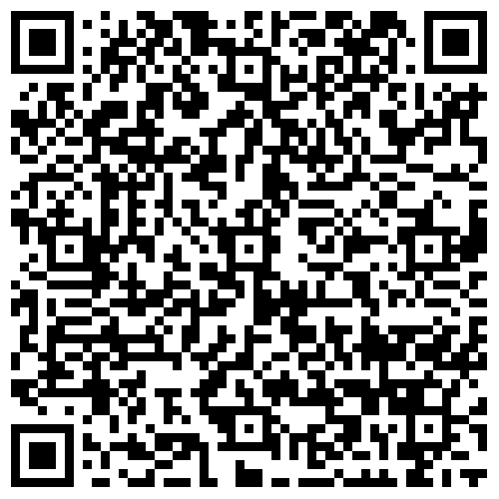
Link to tool, video demonstration
Link to Dropbox
Notes:
Link for dropbox: https://www.dropbox.com/scl/fo/wmyqwmhfqeph87j8o8dbm/ADV0WeCZXeiRqW5t0YJl5fA?rlkey=8z4be4o23d5m0p05t6b2qh8nz&e=1&st=pr3edteu&dl=0

Slide 28
Next Steps
Test users to explore tool and provide feedback by Friday, April 3, 2026
Attend office hours: 3/19 @ 10am | 3/26 @ 2pm | 3/30 @ 9am
Notes:
Link to register: https://us02web.zoom.us/meeting/register/ddQyjcL_TF6FrMZXN37iyQ

Slide 29
Contact us – Project Team
Annie deBoer, Technical Lead: anne.deboer@aecom.com
Alec Bogdanoff, Project Principal: alec@brizaga.com
Randy Deshazo, Economic Lead; Deputy Director: rdeshazo@sfrpc.com
Notes:
Annie deBoer, Technical Lead anne.deboer@aecom.com
Alec Bogdanoff, Principal and Project Manager alec@brizaga.com
Randy Deshazo, Deputy Director rdeshazo@sfrpc.com

Slide 30
Contact us – RPCs
ARPC Divina Lade, Geospatial Environmental & Resilience Planning Director:
dlade@arpc.org
NEFRPC
Fara Ilami, Resiliency Manager: FIlami@nefrc.org
Notes:
ARPC Divina Lade, Geospatial Environmental & Resilience Planning Director:
dlade@arpc.org
NEFRPC
Fara Ilami, Resiliency Manager: FIlami@nefrc.org

Slide 31
Closing & Thank you

