Slide 1
Addressing the Health and Economic Impacts of Extreme Heat
Jane Gilbert
Chief Heat Officer
May 19, 2025

Slide 2
Extreme Heat
Heat is the leading weather-related killer in the United States.
700 average annual heat caused deaths nationwide (CDC)
But real impacts are much higher:
Annual excess heat related death estimates in U.S. at 12,000 (Shindell)
600 average annual heat-related deaths in Miami-Dade (Uejio, MDC)
Notes:
Extreme heat is the most deadly weather-related killer in the United States. Hot weather is a public health threat that results in severe illness and death. South Florida is no stranger to high levels of temperature and humidity and the region experiences periods where it is hot all the time. This type of hot weather is also known as chronic heat.
Economic Impact: $50 million/year in treatment costs (Economic Impact Analysis, 2020).
Extreme heat is a period with heat index exceeding 90 degrees for at least 2-3 days.

Slide 3
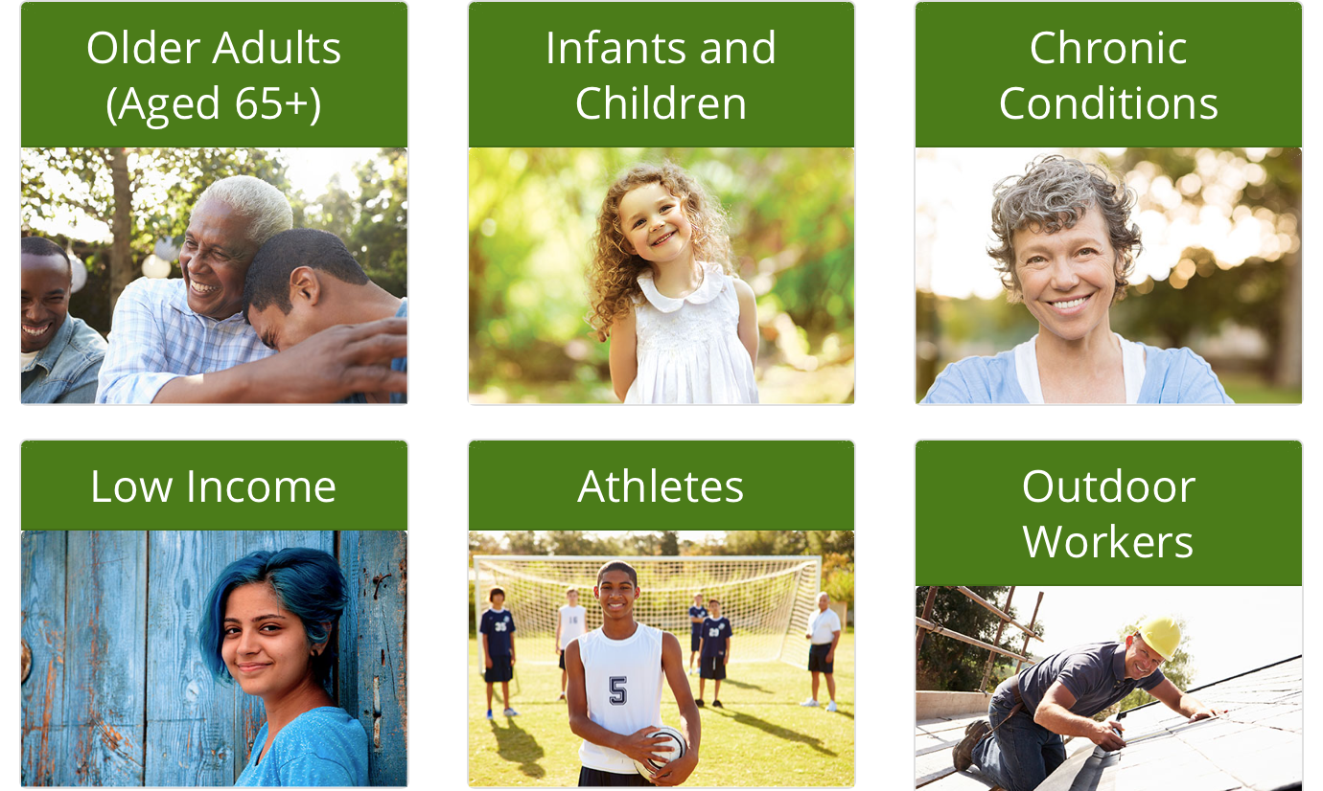
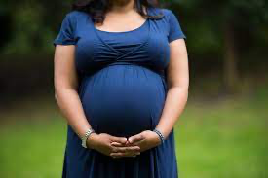
Audience: Vulnerable Populations
Pregnant
Women
One way of educating does NOT fit all
We have leveraged our vulnerability assessment to target the outreach populations
Notes:
For education on extreme heat to be effective, different groups will need to be exposed to information through different outlets and it will need to be presented in unique ways. These groups may also use different tactics to respond to heat, i.e. older adults versus athletes.

Slide 4
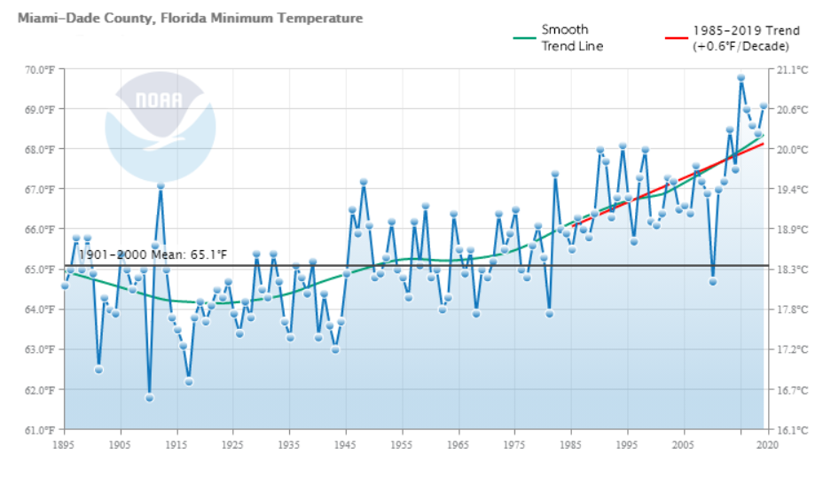
Notes:
While southeast Florida is known for its tropical climate and warmer temperatures, our average minimum temperatures have risen a little over 2 degrees farhenheit since 1985 and projected global warming will raise the state’s average temperature by between 4 and 10 degrees Fahrenheit over the next 80 years (NRDC).

Slide 5
Notes:
And of course in South Florida we have very high average humidity, which makes it more difficult for our bodies to regulate the heat and therefore elevates the heat health related risks. Currently our humidity in the summer averages around 65-70% and so far we're seeing a slight avg increase in humidity over time. So This means that while historically Miami Dade County has experienced an average of 7 days or a week of days with a heat index at or above 105 degrees fahrenheit, by mid century that will likely increase to 88 days or essentially 3 months of days that reach a heat index of 105 or above.

Slide 6
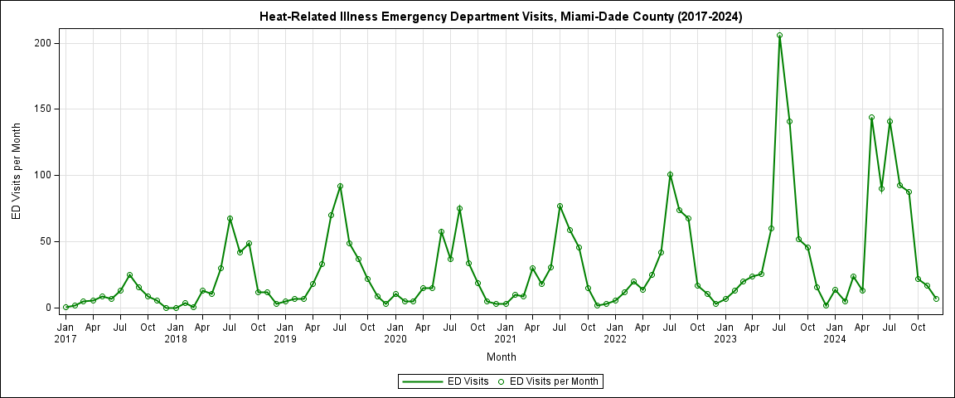
In 2023:
We experienced 42 days with a heat index 105°F or more. Peak in weekly heat-related emergency department visits was 100% higher and double in total counts than past 5 years.
In 2024:
We experienced 60 days with a heat index of 105°F or more. We also had the hottest May on record which led to high ED visit. Total counts slightly higher than 2023.

Slide 7
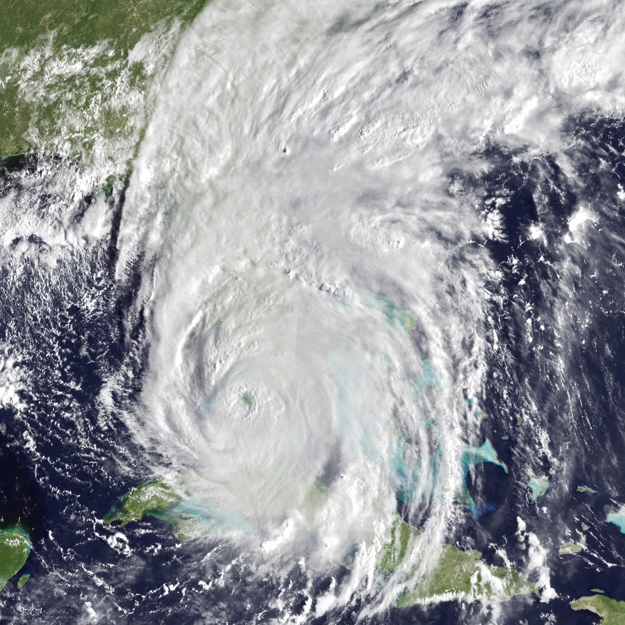
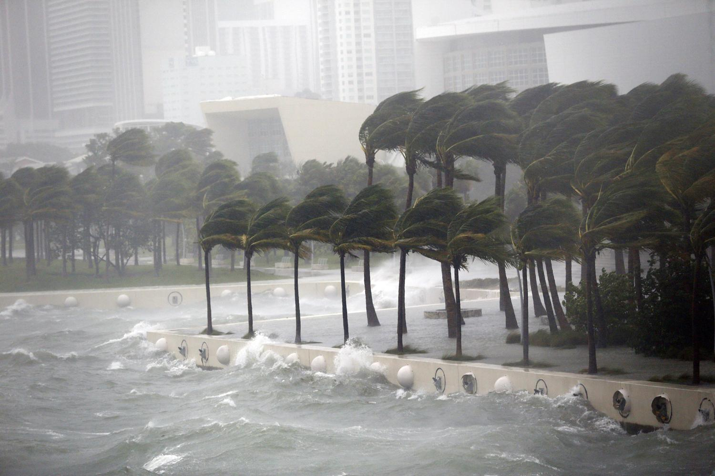
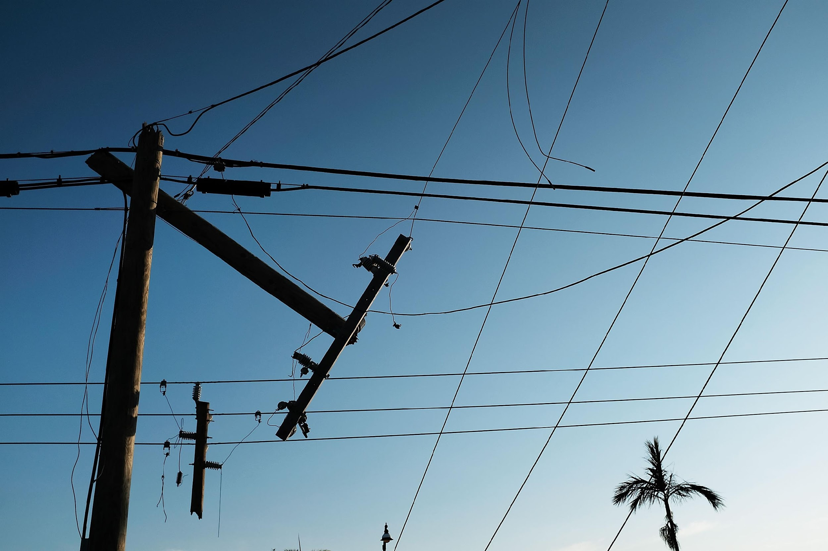
Notes:
Hurricane Irma, 2017.
A significant compounding risk is the event of a widespread and prolonged power outage during a prolonged time of high heat which would most likely occur with a hurricane but could also occur with a different type of disaster such as a terrorist attack. These are images of Hurricane Irma which hit South Florida in 2017. The extended power outages after that storm led to the death of 12 residents in a nursing home just north of us. Since then the State of FLorida now requires all assisted living and nursing homes to have the back up power capacity to keep a common area cool during a power outage. and I'm happy to say our local authorities have been very on top of enforcing that rule. but we still have many more residents at risk of heat exposure during a power outage.

Slide 8
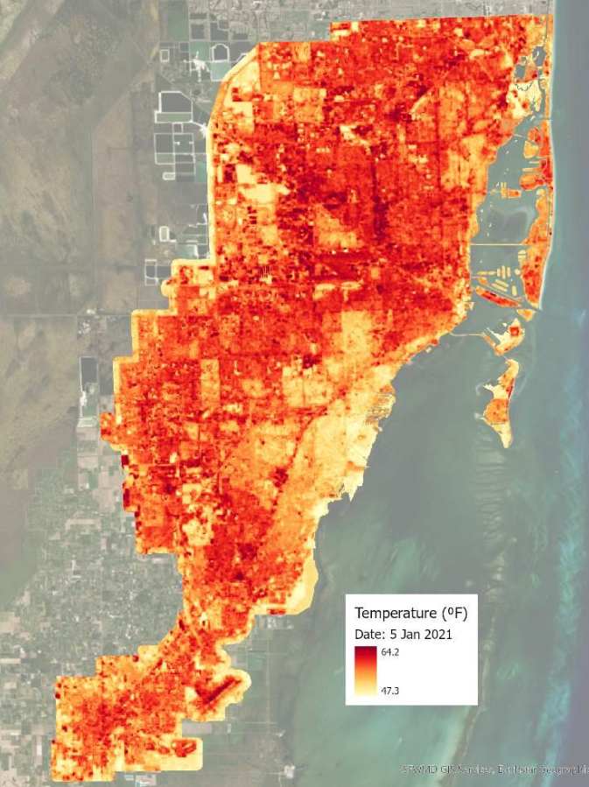
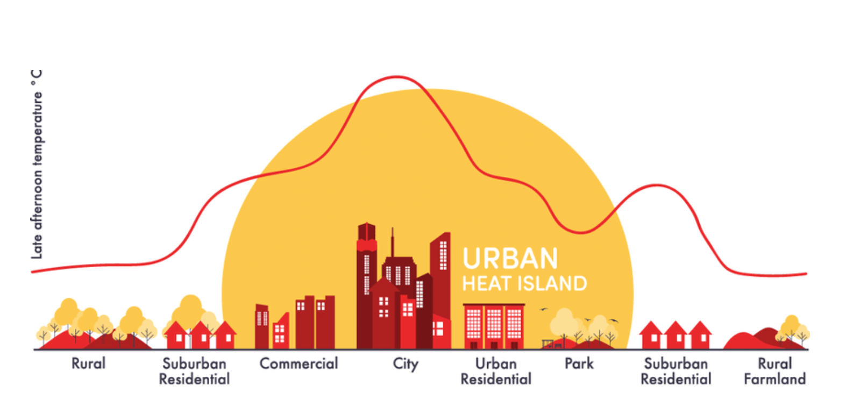
Urban Heat Island Effect
Urban areas can be 5 to 9 degrees Fahrenheit hotter than rural areas during the day.
Some neighborhoods in cities, often in low-income areas, can be as much as 15-20 degrees F hotter during the day.
American Forests 2021
Notes:
Urban development in Miami-Dade is also contributing to higher temperatures throughout the county. The materials that make up the city affect the hydrological cycle because the nonnatural surfaces carry rainfall away from the urban area. Moving rainfall out of the city raises the surface temperature because it minimizes the amount of water that would otherwise be evaporated. Evaporation tends to have a cooling effect at the surface. With that, the city experiences temperatures much higher than its rural surroundings. This phenomenon is known as the Urban Heat Island (UHI) Effect. The UHI effect is also caused by heat waste. Heat waste includes warmth that is pushed out of buildings from air conditioning and vehicle exhaust (Uejio, 2022).

Slide 9
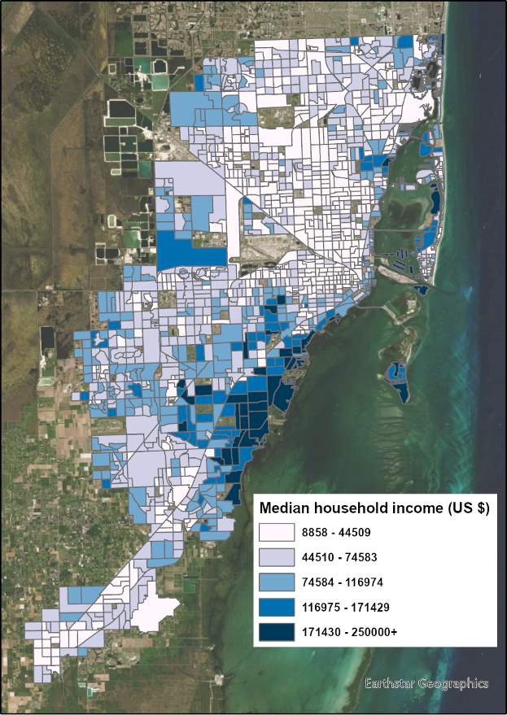
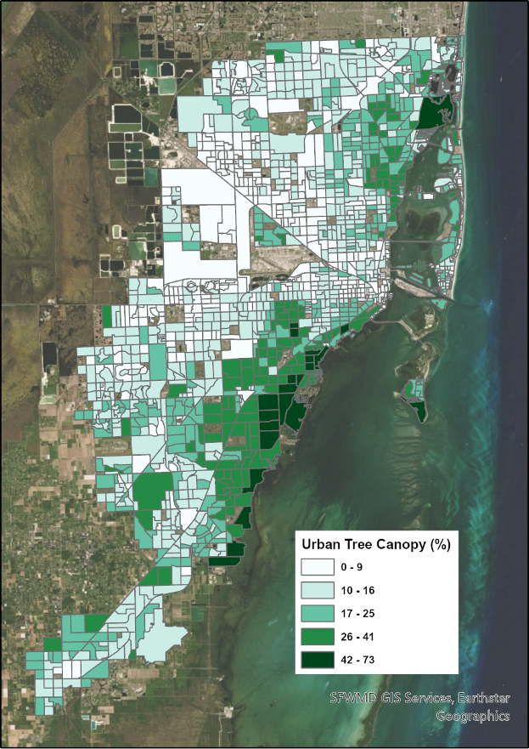
Notes:
The increase in apparent temperatures in our city are not only due to Climate Change but also to our urbanization to development patterns that have led to loss of tree canopy and vegetation and increase of impermeable surfaces.
Median household income and Urban Tree Canopy positive correlation
Equity and tree canopy
Usually urban heat islands are in poorer neighborhoods which have scarce tree canopy. In fact, through a 2016 Urban Tree Canopy Assessment, the County determined that lower-income areas, including predominantly African American and Hispanic neighborhoods, had significantly less tree canopy than their wealthier counterparts.
Benefits of Planting Trees
Reduces air-conditioning costs by providing shade
Improves a home's appearance, which can help to increase a property's real estate value
Provides a natural habitat for wildlife
Lessens flooding by absorbing excess rain water
Removes significant amounts of carbon dioxide from the air, which reduces the impact on climate change

Slide 10
Heat Vulnerability Study: Populations at Risk in Miami-Dade
Category | Description of Data | Provider
Health Outcome | Heat Related Illness Emergency Department | FDOH
 | Heat Related Illness Hospitalizations | FDOH
Exposure | Land Surface Temperature | NASA
 | % Impervious Surface | NLCD (2019)
Sensitivity | % Older Adults (age > 65) | US Census
 | % Living Alone | US Census
 | Children 0-5 | US Census
 | % Living in Poverty | US Census
 | Household Income | US Census
 | % Limited Language Proficiency | US Census
 | % African American | US Census
 | % Hispanic | US Census
 | % Indigenous | US Census
 | % Mobile Homes | US Census
 | % High School Education | US Census
 | % Outdoor Workers (Agr, Forestry, Fish, Mining, Construction) | US Census
 | % Female Head of Housing | US Census
Hospitalizations
% Living in Poverty
% Mobile Homes
Emergency Department Visits
Daytime surface temperature
% Outdoor Workers
% Age less than 18
Miami-Dade Extreme Heat Vulnerability Mapping Report (Uejio and Ahn, 2022)

Slide 11
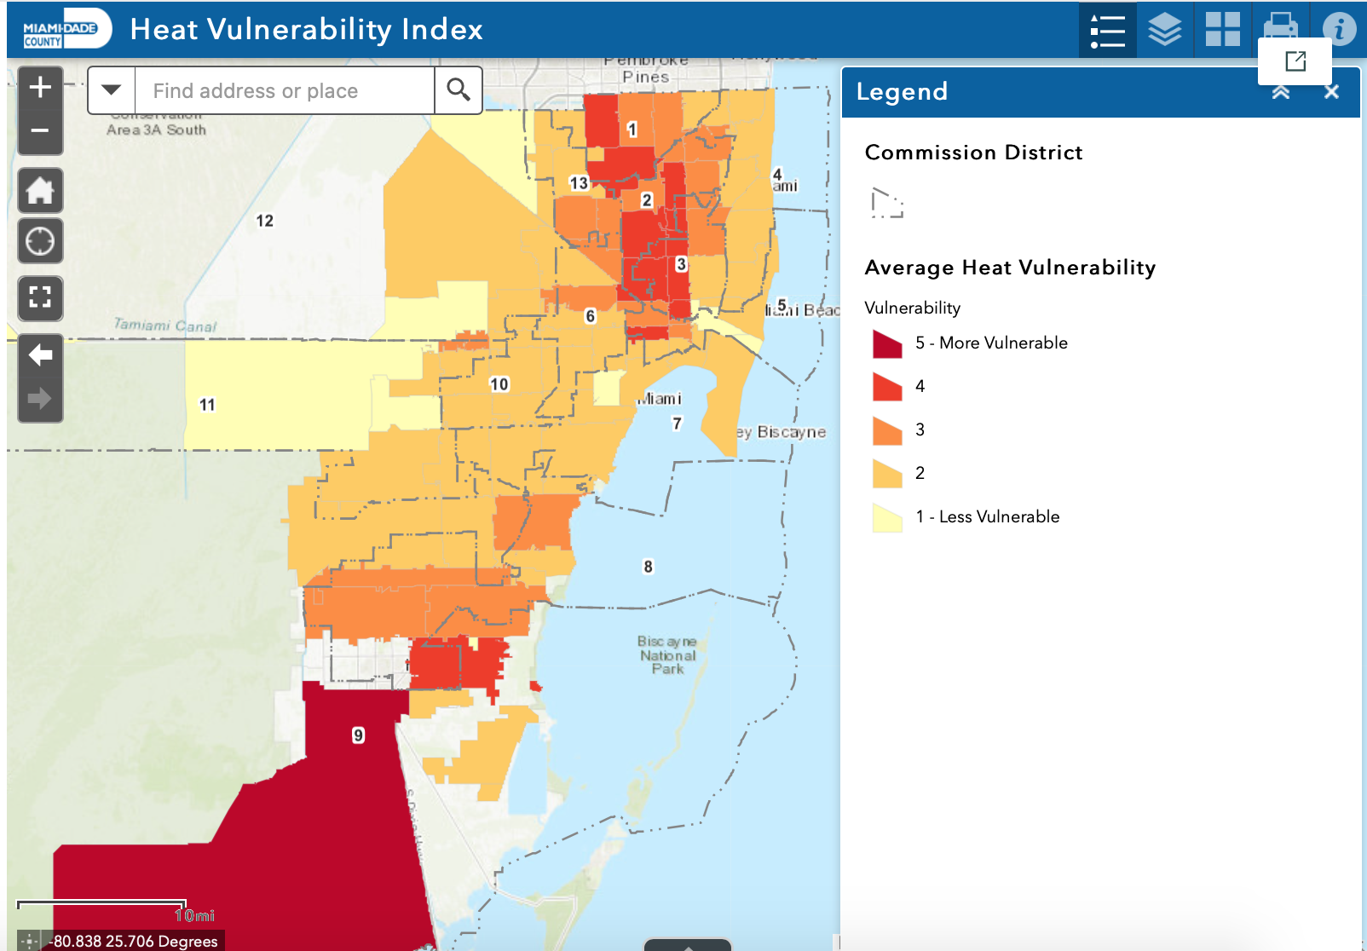
ArcGIS StoryMap: Vulnerability
Interact with the Heat Vulnerability Index web mapping application to identify vulnerable zip codes in Miami-Dade
Homestead, Florida City, Hialeah, Miami, Opa-Locka, and Miami Gardens
** Average of Heat Hospitalization and ER Visit Vulnerability as seen on previous slide

Slide 12
Climate & Heat Health Task Force
Goals:
Prioritize short term actions
Create framework for monitoring progress
Equitable representation
Best available science
The Task Force included 15 appointed members representing local, state and fed govt, scientific experts, community orgs and health care professionals as well as two citizen members who will ensure community voices are heard and lifted up in the formation of the heat plan.
https://miamifoundation.org/extremeheat/

Slide 13
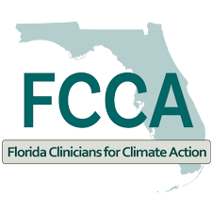
Collaboration is a critical asset
Notes:
Communicating extreme heat impacts across our community can save lives and help us build stronger connections between the County, residents, and a variety of community partners. Deepening engagement with existing partners and expanding our networks helps us collaboratively identify, educate, and advance solutions to protect us from extreme heat.

Slide 14
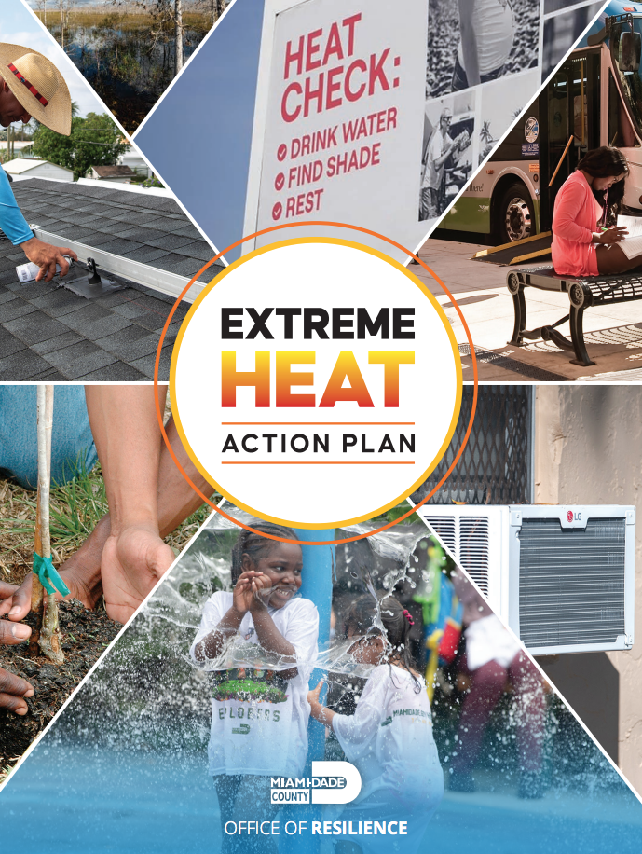
Miami-Dade County Extreme Heat Action Plan
Goal 1: Inform and Prepare People
Goal 2: Cool our Homes & Emergency Facilities
Goal 3: Cool our Neighborhoods

Slide 15
Goal 1: Inform & Prepare People
• Heat Season Campaign – reached 2.8 million annually
• Heat Safety Trainings – 400+ targeted service leaders
• Updated NWS thresholds and response protocols
Expanded cooling site network
• Outdoor Worker Protection – trainings and outreach
• Urban Heat Research Group – monthly updates

Slide 16
Goal 2: Cool our Homes & Emergency Facilities
• 1700 efficient AC units installed in public housing
• Increased funding for weatherization and NOAH rehabs
• Education outreach – Brace for the Heat
• Sustainable Buildings Program
• Cool roof ordinance and Indoor cooling standards
• Resilience hub plan

Slide 17
Goal 3: Cool our Neighborhoods
• Doubled annual tree planting focusing in low canopy areas
• Urban Forestry plan released and underway
• Partnerships with schools and faith-based orgs
• Launched TREE leaders initiative
Updates to landscape and tree protection codes
Parks and transit investments in shade and water access

Slide 18
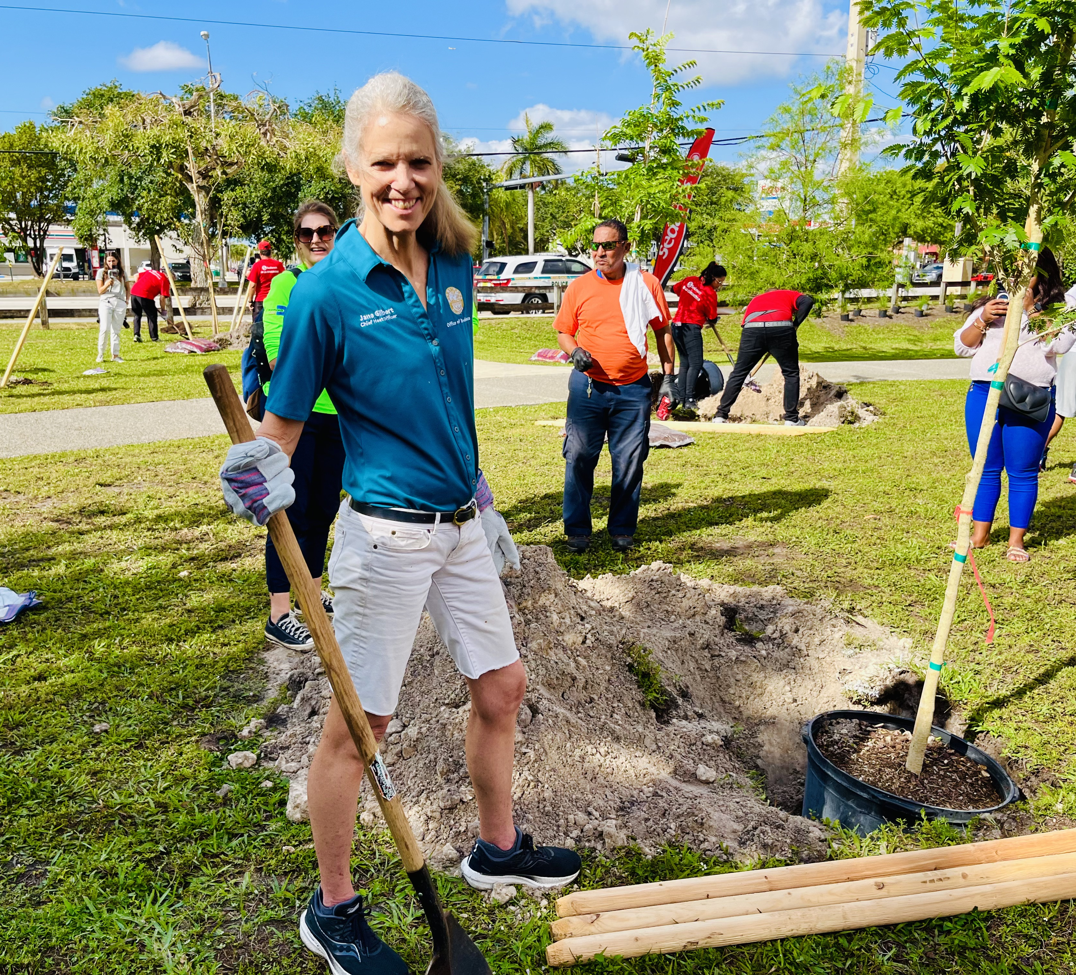
Thank you!
Jane Gilbert
Chief Heat Officer
Miami-Dade County
Jane.Gilbert@miamidade.gov
www.miamidade.gov/heat
Notes:
ST

