Slide 1
Biscayne Bay Reasonable assurance plan: a plan to restore the health and resilience of Biscayne Bay
Pamela Sweeney - Senior Manager
Division of Environmental Resources Management (DERM)
SFRPC | February 28, 2025

Slide 2
agenda
Brief Overview of Biscayne Bay
Natural History
Management
Why a Reasonable Assurance Plan?
What is the state of Biscayne Bay health?
What compliance issues are we facing?
What is a Reasonable Assurance Plan?
What options do we have to address our issues?
How is this effort being coordinated?
What role do stakeholders play in development and implementation of the RAP?
Benefits & Commitments
Q&A
“Cleaner Water, Faster”

Slide 3
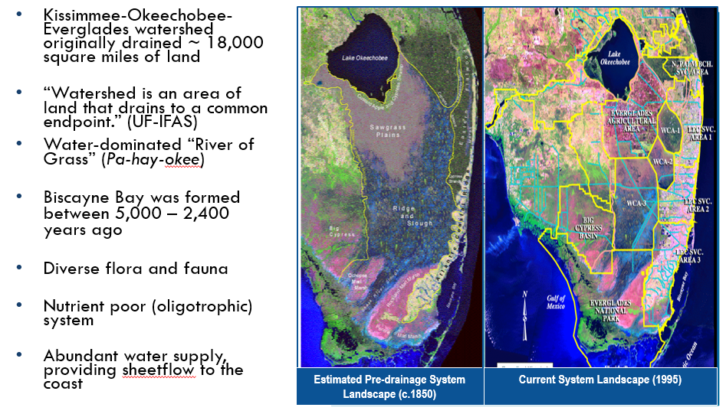
Natural History of Biscayne Bay

Slide 4
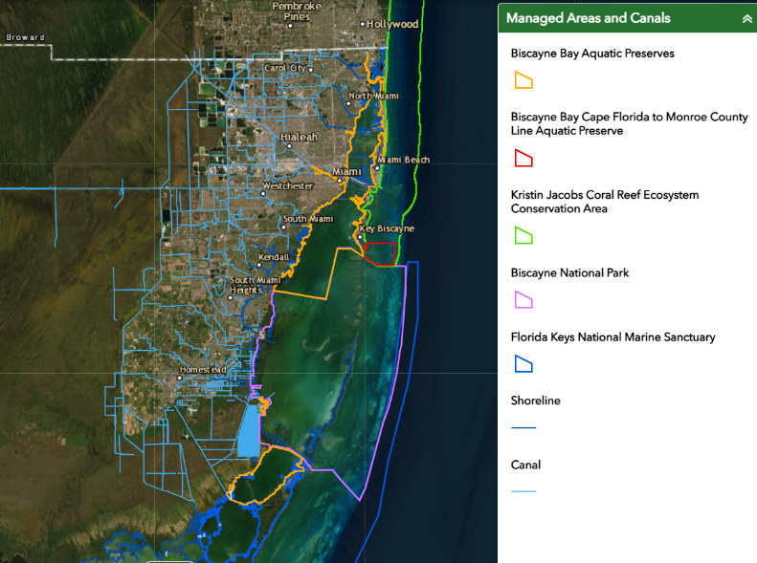
Management of Biscayne Bay
Miami-Dade County DERM long-term ambient monitoring includes:
Surface water and groundwater monitoring
137 surface water sites
Habitat monitoring
Over 450 submerged aquatic vegetation monitoring sites

Slide 5
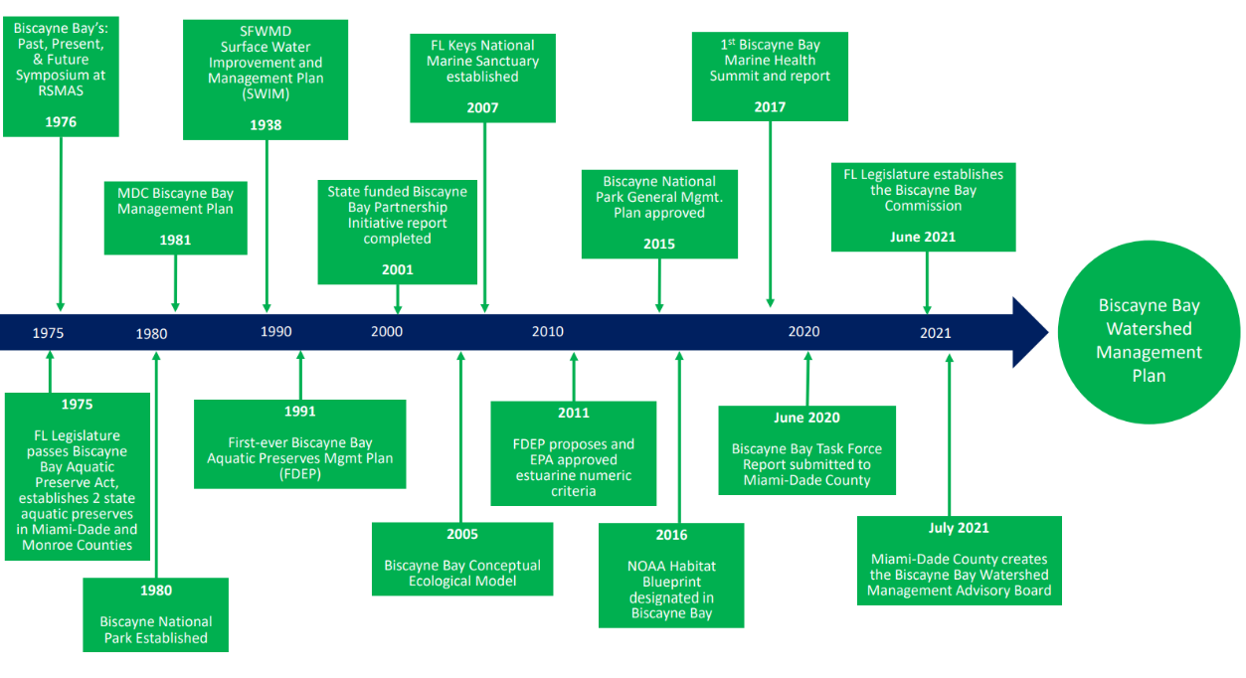
Biscayne Bay Reasonable Assurance Plan
Notes:
- We provide references

Slide 6
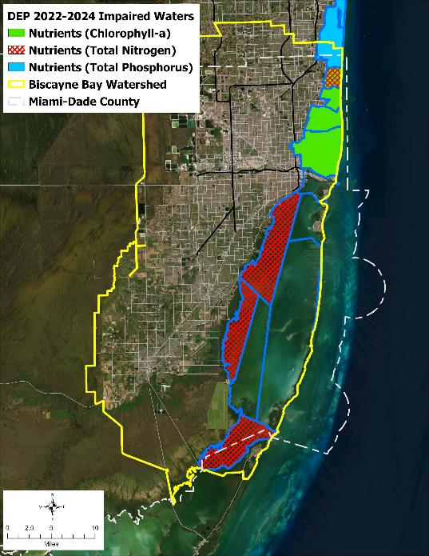
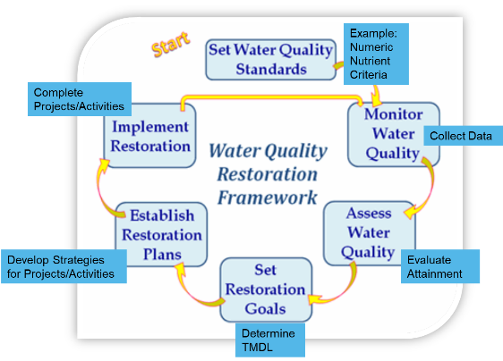
Assessing Waterbodies – Florida DEP Identifying & Addressing impaired waters
State and Federal Legislation
Section 303(d) of the Federal Clean Water Act
Impaired Waters Rule (IWR), Ch. 62-303, F.A.C.
Surface Water Quality Standards, Ch. 62-302, F.A.C.
Florida Watershed Restoration Act, Ch. 403.067, F.S.
Class III Waters: Fish Consumption, Recreation, Propagation and Maintenance of a Healthy, Well-Balanced Population of Fish and Wildlife
Credit: Adapted from DEP

Slide 7
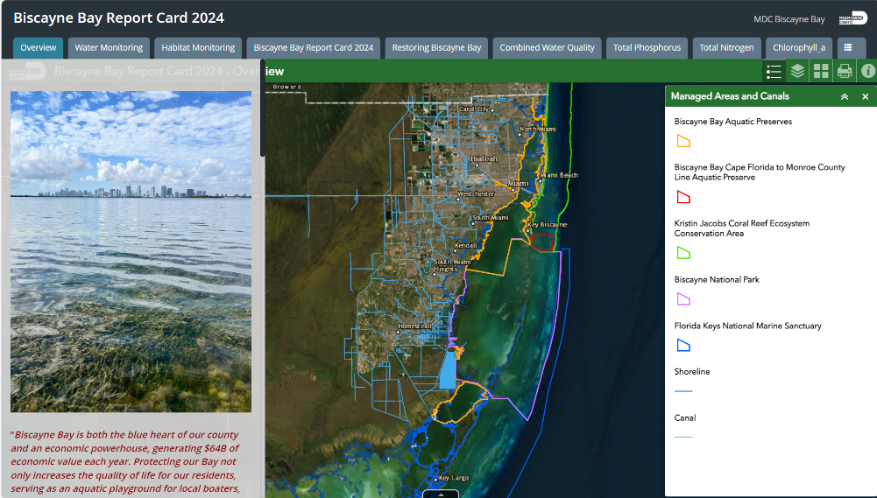
2024 Biscayne Bay Report card
Status of Biscayne Bay Health
www.miamidade.gov/BiscayneBay

Slide 8
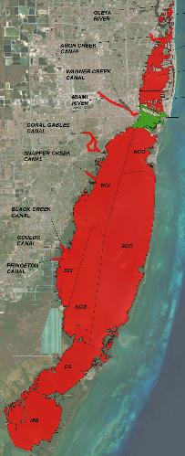
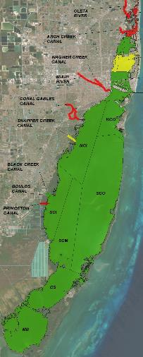
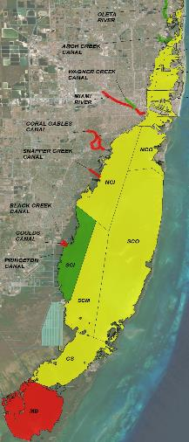
Status of the Health of Biscayne Bay
Biscayne Bay Report Card 2024
Chlorophyll-a
Total Phosphorus
Total Nitrogen
www.miamidade.gov/BiscayneBay

Slide 9
Received by ecosystem
Low Nutrients
Low Chlorophyll
High
Water Clarity
High Seagrass
Cover
High Nutrients
High Chlorophyll
Low
Water Clarity
Low Seagrass
Cover
Healthy
Biscayne Bay
Biscayne Bay
In Peril

Slide 10
Biscayne Bay resilience and the Rap
What we CAN (and must) control
Pollutants via groundwater
Nutrient Loading
What we CANNOT control
Rising water table + Saltwater intrusion
More severe storms
Rising air & water temperatures
Pollutants via stormwater
Sea Level Rise & Sunny day flooding
What we DO Control:
Flooding
Erosion
Notes:
Important to act now because there are forces outside of our control- but we can counter that as best we can with controlling what is within our grasp.
Stormwater and groundwater includes the volumes of water reaching the bay- think about seeming contradictions in policy that we must grapple with, each of us in our respective disciplines and expertise and enterprises, but unified
These impacts on the right column aren’t singular not only do they compound each other but they themselves individually cause cumulative impacts- rising water temperatures as a function of physics reduces the amount of available oxygen in the water column which, when basins have reduced current/flow and also inputs from nutrient-laden canals and groundwater; higher evaporation rates, and you get the idea.
Coastal flooding- we are charged with controlling this and to what end and at what cost? This is where bringing all the tools in the toolbox out for a spin and weighing them together and separately for efficacy and cost. Another shifting paradigm is the “cost” of things-

Slide 11
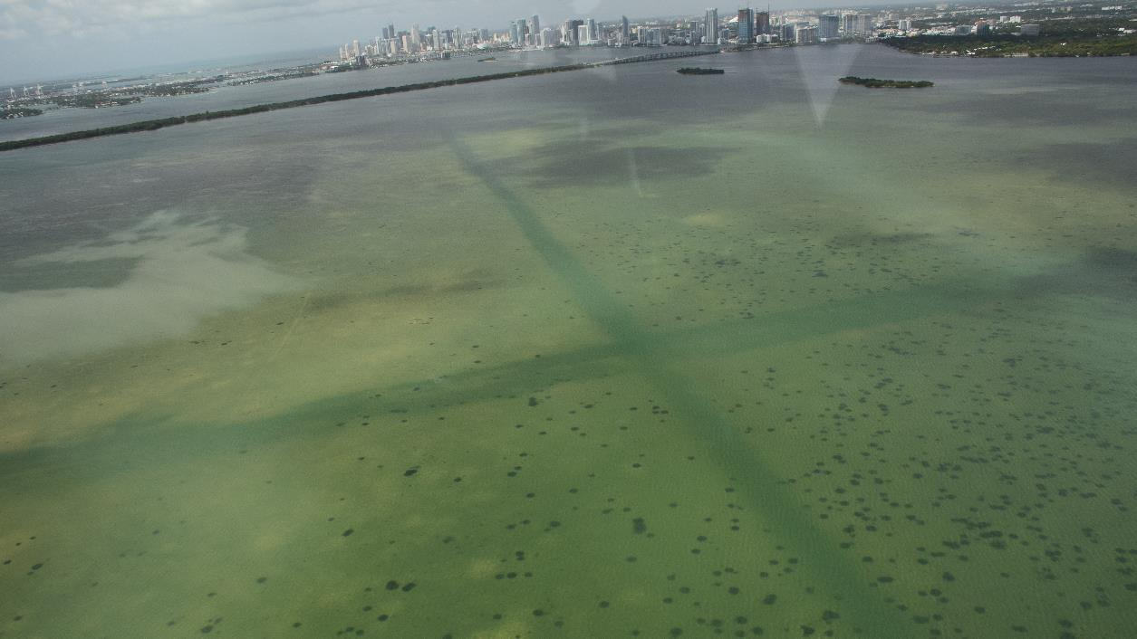
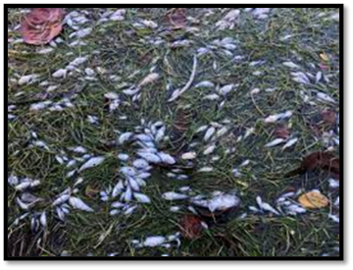
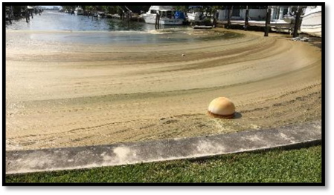
Julia Tuttle Basin, 5/31/2017 – Southwest Direction
2020 Fish Kill – North bay
2020 Algal Bloom – North bay canals

Slide 12
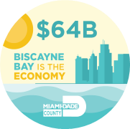

Slide 13
Pathways to Restoration
1-10 years
1-3 years
Every 2 years
+
+
Assess
Prioritization
Total Maximum Daily Load
Basin Management Action Plan
Compliance with water quality Standards
State Drives Process
OR
We
Drive the Process
Assess
Alternative Restoration Plan
Compliance with water quality Standards
Cleaner Water, Faster!!
Both pathways have the same goal:
Water Quality Restoration
Credit: Adapted from DEP
Notes:
Although both paths have the same goal the alternative restoration path has the potential to get stakeholders to their restoration goals faster and more efficiently.

Slide 14
What are the elements of a rap?
Description of the impaired waterbody and water quality and aquatic ecological goals
Determine appropriate water quality target for pollutant reductions
Chlorophyll-a and nutrients – nitrogen & phosphorus
Determine method to assign stakeholder loadings
Estimate load reductions that are needed to attain water quality standards
Identify completed, ongoing, or planned projects to address pollutant sources and develop schedule for implementation
Engage stakeholders and broader public
Provide assurance of funding sources for projects
Develop monitoring plan to measure progress
Provide a commitment to take additional actions if the planned activities do not adequately address the impairment
The process will identify nutrient reductions needed to reduce loading (point source & Non-point sources)

Slide 15
Why is Miami-Dade County Coordinating the RAP Effort?
Commitment from Mayor Levine Cava and Board of County Commissioners’
Taking on expense of technical lift required to fulfill RAP requirements
Rather than trying to share costs for RAP development, stakeholder focus can be placed on project implementation
Outcomes from Biscayne Bay funding for innovative projects
NPDES permit holder with 32 co-permittees
Notes:
- Complex watershed
- Large estuary
- Varied and intensive land uses, most populous County
- Complex interactions between groundwater and surface water, many pathways for pollution
- County funding effort to support stakeholders and prevent time constraints
- Plan of Study concept to gain consensus early on with DEP
- Peer-review work (in-house)
- Accelerated timeline
- Close coordination with DEP; use of Decision Memos
- Tasks running in parallel

Slide 16
Benefits of a RAP
Stakeholder driven
Enhances public relations
Faster Path to Restoration
Funding opportunities
Local entities control the pathway to restoration
Develop a plan prior to state or federal action
Collaborative
Support from elected officials
Support from non-governmental organizations
Greater understanding of the significance of your efforts
Minimizes regulatory process
Reduces time it takes to get to “Cleaner Water, Faster”
* Statutory protections that support restoration (e.g., state rules requiring advanced wastewater treatment)
Several state and federal funding sources prioritize those waterbodies with a BMAP or RAP
Credit: Adapted from DEP

Slide 17
Commitments of a RAP
Project Implementation
Funding Projects
Meeting Nutrient allocations
collaboration
Forecasting and completing projects
Monitoring for improved Bay health
Municipal-level funding
State and Federal funding
Partnerships with the County and fellow municipalities
Agreeing to abate nutrient loading with projects based on quantifiable loads
Prepared to be part of the solution
Remain engaged with the County, fellow municipalities and other stakeholders

Slide 18
Summary
Biscayne Bay segments designated impaired by the State for nutrients (TN, TP) and chlorophyll
This means Biscayne Bay is not attaining standards to protect its designated uses as Class III Waters.
Impairments are addressed through establishing either a TMDL & BMAP (state directed) or an Alternative Restoration Plan, like a RAP (voluntary)
RAPs are adopted by final order of the Secretary of DEP
For RAP approval by DEP and EPA, we must demonstrate that we can meet nutrient reduction goals through projects and policies.
The RAP will only provide reasonable assurance to the extent we work together to provide it.
An approved RAP to review:
Mosquito Lagoon Reasonable Assurance Plan (RAP) | Florida Department of Environmental Protection
Stay tuned:
Biscayne Bay Watershed Management Advisory Board (County)
Biscayne Bay Commission (State)

Slide 19
Thank you! Pamela.sweeney@miamidade.gov
www.miamidade.gov/BiscayneBay
Concerned? Report it: Baywatch@miamidade.gov or 305-372-6955
@miamidadeRER

Slide 20
Biscayne Bay Reasonable Assurance Plan:
Reducing Time to Completion
Expertise
Experience and expertise in RAP development and approval
Technical Services
Procurement for technical services through the County’s EDP process
Coordination & Engagement
Close coordination with DEP & Milestone Decision Memos
Engagement with key stakeholders (those who are party to the RAP – municipalities, agencies, industries)
Leadership
Strong support of Mayor, Board of County Commissioners, Biscayne Bay Watershed Management Advisory Board (county), Biscayne Bay Commission (state), Stakeholders
Financial support
Engagement with interested parties (academia and agencies, non-governmental organizations, the public at large)
Modeling
Nutrient-reducing project identification
Key Tasks and Milestones To Date
Plan of Study (POS)
POS outlines the development of the information needed in the RAP and provides an agreed-upon path forward
POS Final Draft + DEP Decision Memo
Procurement of Technical Services
Meetings with Key Stakeholders
Meetings with Technical Experts

