Slide 1
2025 Florida Legislative Session Preview

Slide 2
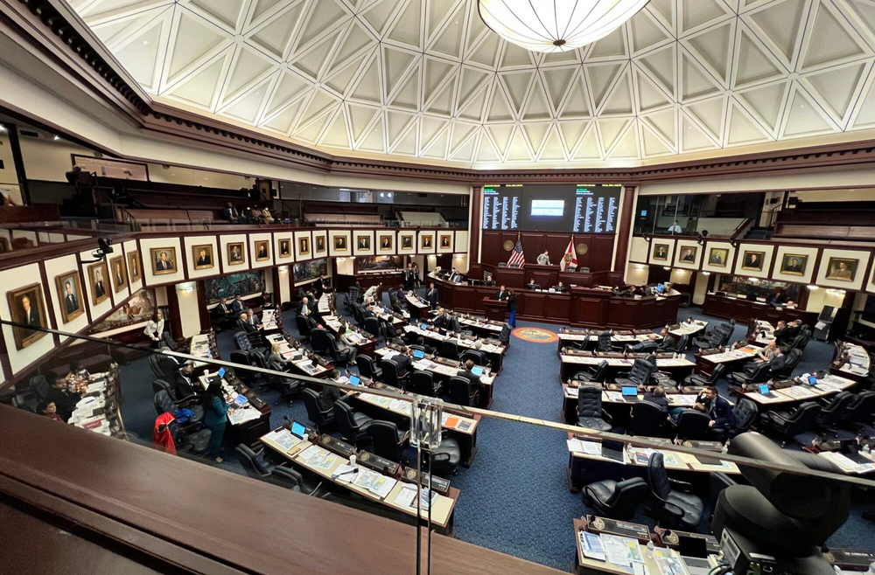
NUMBERS TO KNOW
120
40
Total House Seats
Total Senate Seats
22
7
Freshman Reps
Freshman Senators
86-33-1
28-12
Split
Split
Notes:
Senate seats up this year are the odd-numbered districts.
at a minimum, we will have 7 freshman senators who have never served in the Senate. Some of these will be coming from the house, and others have never served.
Currently, there is a 28-12 split in the Senate, we don't anticipate that changing in this election cycle.
The house is a different story though, we have all 120 house districts up for election and some races throughout the state where we could see some party swaps.
In the House, we will see a minimum of 22 freshman representatives and potentially more if the Democrats are able to win back some seats lost during the red wave in the last election.
Currently, the state is in a republican supermajority and house democrats would need to flip 5 seats to break that. that could be good or bad depending on what side of the aisle you sit on.

Slide 3
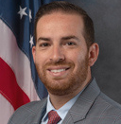
MEET THE LEADERS
Senate President
House Speaker
Senator Ben Albritton
Rep. Daniel Perez
His Senate district consists of Charlotte, DeSoto, and Hardee counties, and parts of Lee, and Polk counties
His House district consists of parts of Miami-Dade County.
Notes:
Here we have the future of the Florida House and Senate between November of this year and 2030.
The incoming Senate President is Senator Ben Albritton out of Wauchula, Florida. Now I can't tell you the exact number of units in Wauchula but I guarantee you it's not high. And because of that, it's why his priority is in rural Florida and the issues they encounter there. He cares about food insecurity and farming. Now, that doesn't mean he doesn't care about multi-family or housing in general. He does. But he cares about making it work in his community and other rural communities the way that former presidents have done for more populated areas.
The incoming House Speaker is Representative Danny Perez out of Miami-Dade County. I simply cannot imagine a larger contrast to our rural county farmer Senator Albritton than Speaker Designate Perez. Danny is no stranger to the multi-family world, living and growing up in South Florida where our unit numbers sit in the tens maybe hundreds of thousands. But I believe that with their differences they will meet in the middle on a lot of issues. Danny's Priorities lie in healthcare and Miami-Dade County. He has expressed his desire to prop up Dade County on multiple occasions and wants to make sure that South Florida is getting back a lot of the dollars that we put into the state.

Slide 4
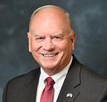
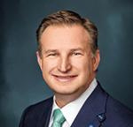
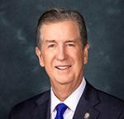
MEET THE SENATE LEADERSHIP TEAM
Appropriations Chair
President Pro Tempore
Majority Leader
Senator Ed Hooper
Senator Jason Brodeur
Senator Jim Boyd
District Covers Parts of Pasco and Pinellas County
District Covers Parts of Hillsborough and Manatee County
District Covers Parts of Orange and Seminole County

Slide 5
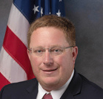
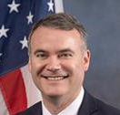
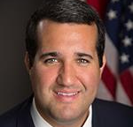
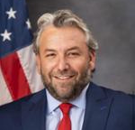
MEET THE HOUSE LEADERSHIP TEAM
Appropriations Chair
Speaker Pro Tempore
Majority Leader
Majority Whip
Rep. Lawrence McClure
Rep. Wyman Duggan
Rep. Tyler I. Sirois
Rep. Adam Botana
District Covers Parts of Duval County
District Covers Parts of Brevard County
District Cover Parts of Collier and Lee County
District Covers Parts of Hillsborough County

Slide 6
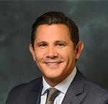
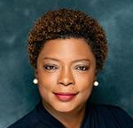
MEET THE SENATE DEMOCRATIC LEADERSHIP TEAM
Senate Minority Leader
Senate Minority Leader Pro Tempore
Senator Jason Pizzo
Senator Tracy Davis
District Covers Parts of Broward and Miami-Dade County
District Cover Parts of Duval County

Slide 7
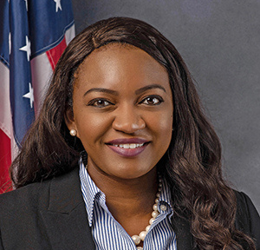
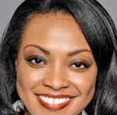
MEET THE HOUSE DEMOCRATIC LEADERSHIP TEAM
House Minority Leader
House Minority Leader Pro Tempore
Rep. Fentirce Driskell
District Covers Parts of Hillsborough County
Rep. Dottie Joseph
District Covers Parts of Miami-Dade County

Slide 8
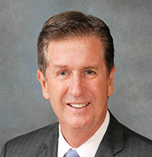
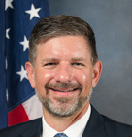
MEET THE FUTURE LEADERS
2028-2030 President
2028-2030 Speaker
Senator Jim Boyd
Rep. Sam Garrison
His Senate district consists of parts of Hillsborough, and Manatee counties.
His House district consists of parts of Clay County.
Notes:
Here we have the future of the Florida House and Senate between November of this year and 2030.
The incoming Senate President is Senator Ben Albritton out of Wauchula, Florida. Now I can't tell you the exact number of units in Wauchula but I guarantee you it's not high. And because of that, it's why his priority is in rural Florida and the issues they encounter there. He cares about food insecurity and farming. Now, that doesn't mean he doesn't care about multi-family or housing in general. He does. But he cares about making it work in his community and other rural communities the way that former presidents have done for more populated areas.
The incoming House Speaker is Representative Danny Perez out of Miami-Dade County. I simply cannot imagine a larger contrast to our rural county farmer Senator Albritton than Speaker Designate Perez. Danny is no stranger to the multi-family world, living and growing up in South Florida where our unit numbers sit in the tens maybe hundreds of thousands. But I believe that with their differences they will meet in the middle on a lot of issues. Danny's Priorities lie in healthcare and Miami-Dade County. He has expressed his desire to prop up Dade County on multiple occasions and wants to make sure that South Florida is getting back a lot of the dollars that we put into the state.

Slide 9
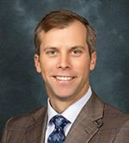
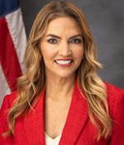
MEET THE FUTURE LEADERS
2030-2032 President
2030-2032 Speaker
Senator Jay Trumbull
Rep. Jennifer Canady
District Covers Parts of Bay, Calhoun, Holmes, Jackson, Okaloosa, Walton, Washington
District Covers Parts of Polk County
Notes:
Here we have the future of the Florida House and Senate between November of this year and 2030.
The incoming Senate President is Senator Ben Albritton out of Wauchula, Florida. Now I can't tell you the exact number of units in Wauchula but I guarantee you it's not high. And because of that, it's why his priority is in rural Florida and the issues they encounter there. He cares about food insecurity and farming. Now, that doesn't mean he doesn't care about multi-family or housing in general. He does. But he cares about making it work in his community and other rural communities the way that former presidents have done for more populated areas.
The incoming House Speaker is Representative Danny Perez out of Miami-Dade County. I simply cannot imagine a larger contrast to our rural county farmer Senator Albritton than Speaker Designate Perez. Danny is no stranger to the multi-family world, living and growing up in South Florida where our unit numbers sit in the tens maybe hundreds of thousands. But I believe that with their differences they will meet in the middle on a lot of issues. Danny's Priorities lie in healthcare and Miami-Dade County. He has expressed his desire to prop up Dade County on multiple occasions and wants to make sure that South Florida is getting back a lot of the dollars that we put into the state.

Slide 10
UPCOMING ISSUES
State Budget Expectations and Preview
Florida State Department of Governmental Efficiency (DOGE) Task Force
DEP Resilient Grants Opportunity
Sovereign Immunity
Condominium Regulation
“Live Local” Part 3
Property Taxes
Notes:
Here we have the future of the Florida House and Senate between November of this year and 2030.
The incoming Senate President is Senator Ben Albritton out of Wauchula, Florida. Now I can't tell you the exact number of units in Wauchula but I guarantee you it's not high. And because of that, it's why his priority is in rural Florida and the issues they encounter there. He cares about food insecurity and farming. Now, that doesn't mean he doesn't care about multi-family or housing in general. He does. But he cares about making it work in his community and other rural communities the way that former presidents have done for more populated areas.
The incoming House Speaker is Representative Danny Perez out of Miami-Dade County. I simply cannot imagine a larger contrast to our rural county farmer Senator Albritton than Speaker Designate Perez. Danny is no stranger to the multi-family world, living and growing up in South Florida where our unit numbers sit in the tens maybe hundreds of thousands. But I believe that with their differences they will meet in the middle on a lot of issues. Danny's Priorities lie in healthcare and Miami-Dade County. He has expressed his desire to prop up Dade County on multiple occasions and wants to make sure that South Florida is getting back a lot of the dollars that we put into the state.

Slide 11
Thank you!

