Slide 1
SFRTA/TRI-RAIL UPDATE
DAVID DECH, EXECUTIVE DIRECTOR
Presented For
South Florida & Treasure Coast Regional Planning Councils

Slide 2
South Florida Regional
Transportation Authority
FDOT purchased the South Florida Rail Corridor from CSX in 1988 and started Tri-Rail service in 1989
THE SOUTH FLORIDA REGIONAL TRANSPORTATION AUTHORITY IS AN AGENCY OF THE STATE OF FLORIDA CREATED IN 2003
SFRTA operates Tri-Rail commuter rail service with funding provided by state, county and federal sources
SFRTA provides track, signal and crossing maintenance on the 73.5-mile SFRC and 8 miles of freight service spur tracks
SFRTA dispatches Tri-Rail, Amtrak and CSX freight trains that operate on the SFRC
SFRTA OPERATIONS CENTER
POMPANO BEACH, FL

Slide 3
Tri-Rail
Commuter rail service since 1989
19 stations
54 Weekday trains and 30 Weekend trains
24 MiamiCentral Weekday shuttle trains
23 MiamiCentral Weekend shuttle trains
20 and 30 minute service during Weekday peak hours
Hourly service on Weekends, Holidays and Weekday off-peak hours
Connections to South Florida’s 3 international airports

Slide 4
MiamiCentral
Hardware + Software Upgrades
Overtown CRA Outreach
Train Testing
Grand Opening Event

Slide 5
South Florida Rail Corridor
83
instances of graffiti removed
247
tons of trash and debris removed
1,100
linear feet of fencing installed
776
linear feet of fencing repaired
20
homeless camps cleared
269,680
linear feet of vegetation cleared

Slide 6
South Florida Rail Corridor
$18,912,466
MOW Investment

Slide 7
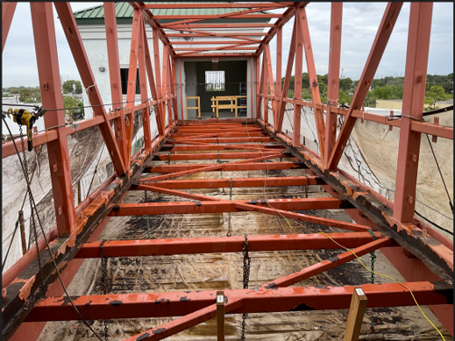
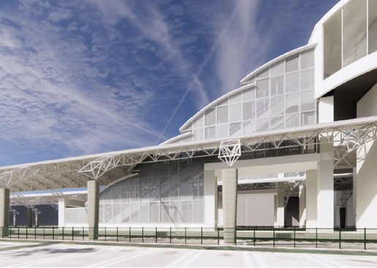
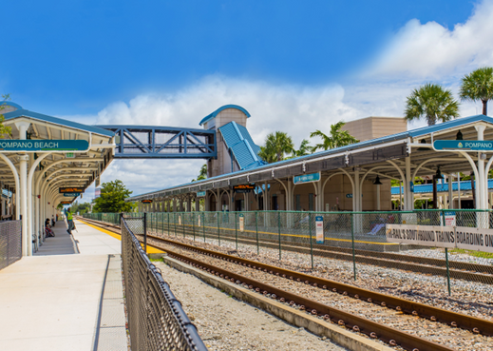
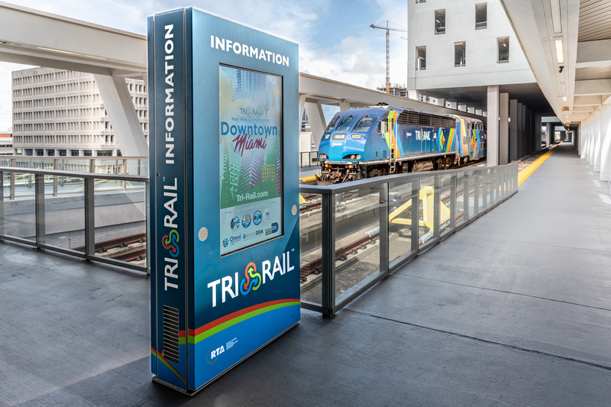
Stations
PEDESTRIAN BRIDGE
REHABILITATION
STATION CONDITION
ASSESMENTS
SECURITY CAMERAS
PASSENGER INFORMATION
SYSTEM

Slide 8
Equipment

Slide 9
Service
12 AM
+53
TRAINS
PER WEEK

Slide 10
Ridership
15,000
Weekday Passengers
First time since 2020
10,129
New Saturday Ridership Record
Rail Fun Day
7,797
New Sunday Ridership Record
Calle Ocho

Slide 11
Safety
System Safety Plan (49 CFR 270)
Passenger Train Emergency Preparedness Plan (49 CFR 239)
Railroad Operating Rules (49 CFR 217)
Fatigue Matigation Plan
Fatigue Risk Management Plan
In the last 6 months
15,656 warnings
1,105 citations
6 fare evasion arrests

Slide 12
Studies + Plans

Slide 13
Transit Oriented Development
The Colony at Boca Raton Station
340 residences (34 affordable/17 workforce)
30,000+ square feet of retail
50% discount on Tri-Rail/Palm Tran fares
SFRTA owned parcel being developed by 13th Floor Investments
Recipient the first residential transit-oriented development loan under the U.S. Department of Transportation’s lending programs (RRIF Loan)
Site Plan received unanimous approval from Boca Raton City Council on January 14th, 2025

Slide 14
Future Plans
Capacity Upgrades & Corridor Improvements
Northern Layover Facility (PB TPA Funded)
New Rolling Stock
Corridor & Signal Upgrades
Service Expansion
Veterans Affairs Medical Center (VA) Extension
Regional Coordination
Partnering with FDOT, Palm Tran, BCT, DTPW, FECR, CSX, Amtrak, and Brightline
Transit Oriented Development (TOD)
Boca Raton & WPB Stations
Northern Layover Facility
FEC Commuter Rail Expansion
Veterans Affairs Extension
Transit Village

Slide 15
SFRTA/TRI-RAIL UPDATE
DAVID DECH, EXECUTIVE DIRECTOR
Presented For
South Florida & Treasure Coast Regional Planning Councils

