Slide 1
Preparing for the Silver Tsunami
Transportation Solutions for Seniors
Notes:
Karen
Welcome and introduce Chris & me

Slide 2
About Senior Resource Association
Located in Indian River County since 1974
501(c)3 non-profit governed by a Board of Directors
Provides Senior Services
Meals on Wheels
Adult Daycare
In-Home Services
Guardianship
Transportation
Notes:
Karen
What allows Chris & I the privilege to speak to this dignified group of decision makers about the Silver Tsunami and mobility?

Slide 3
Senior Resource Association Transportation
Community Transportation Coordinator (CTC) for Indian River County and Martin County:
Providing Transportation since 1976
Operates the fare-free fixed route system in Indian River (GoLine)
Provided 1.35 million trips in FY 23/24
Demand Response Programs for the elderly and disabled
46,000 trips in FY 23/24: Indian River County
28,000 trips in FY 23/24: Martin County
Notes:
Karen
Providing transportation solutions in IRC since 1976
Award winning fixed transit system – in 2023/24 1.35 million trips
Recognizing that IRC has a population of 165,000
When I started this position in 2006 the system was only doing 125,000 trips and CC was doing 65,000
Through strategic rebranding and travel training we are able assist those individuals that can ride the fixed route system
Cost savings because door to door is expensive. Also, provides greater independence for the riders.
Chris will speak to this a little later

Slide 4
Quiz Break #1
Notes:
Karen
Explain how the app works to answer the questions

Slide 5
How did you get here today?
Notes:
Karen
Recognize that most people used their car to get there.
Ask how many carpooled?

Slide 6
Transportation for Seniors
Efficient transportation options are vital as our population grows and ages
Transportation should never be a barrier to someone's quality of life
Notes:
Chris
Everyone here had mobility options this morning, and the physical and cognitive abilities to make their choices. This is something, as we age, that has the potential to decrease. Without a supportive community that fosters aging well, including mobility options, older adults may become socially isolated and vulnerable. At SRA we believe Transportation should never be a barrier to someone's quality of life

Slide 7
What We’ve Learned About Seniors
Isolation is a huge factor in senior health
Researchers conducting studies on social isolation found loneliness in seniors to have as many profound health consequences as smoking 15 cigarettes a day
Notes:
Chris
AND we have a video we want to show that talks about this really fast

Slide 8
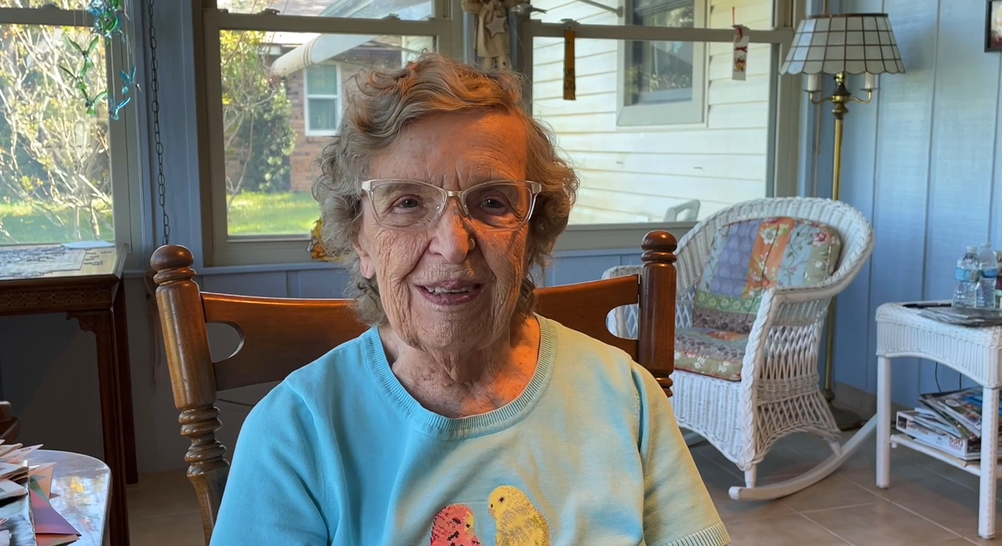
Notes:
How important it is to have transportation available because they gave up their license. Tried using uber/lyft but was expensive, they are thankful to have CC because without it, they would be isolated

Slide 9
Transportation Barriers
Mobility Issues
Limited Accessibility
Affordability
Inadequate Infrastructure-Especially in Rural Areas
High costs of vehicle ownership and public transportation services
Many need to rely on family/friends
Age-related physical and cognitive changes affecting driving abilities
Poor signage, street lighting, crosswalk times, uneven surfaces
Notes:
Karen: must talk about Dori
Up until the age of 78 Dori was able to drive/be independent.........and then life happened.
She is now blind in 1 eye and has a walker.
She’s experienced physical changes that make it hard for her to be mobile.
What does Dori do?
If people don’t have family/friends, they poor, turn to public transportation. But Dori lives in a rural area with limited options, so she has to rely on things like Uber/Lyft
Uber/Lyft doesn’t have ADA vehicles. And is expensive (can be as much as between $12 and $27 per one way trip)
When Dori walks a few blocks to her friends' house, the signage is poor and the crosswalks are not timed well enough to cross the street in a timely manner. The sidewalks are uneven making it difficult to use her walker.
So most of the time she elects to stay inside.
We'll come back to Dori in a little bit

Slide 10
Transit Adaptations: Multi-Modal Systems
Public transit involves multiple modes as well
Pedestrian
Bikes
Buses
Light Rail
Rail
Ferries
Transportation Networking Companies
Notes:
Chris
Lets talk about how Transportation has adapted over time. A big need these days is for communities to be multi-modal. The 4 main modes of transit today are what you would expect Road, Rail, Air and Water. Inside of public transportation, we have multiple modes as well. We have to account for

Slide 11
Safety
GPS location of all transit vehicles
Live audio/visual camera feed from all transit vehicles into transit facility and the Sheriff's Real Time Crime Center
Notes:
Chris
We know some people are apprehensive about riding public transportation. So some of the steps we have enacted to assuage that fear include GPS real time location of all transportation vehicles and live audio/voisual camera feed from transit into our HQ and the IRCSO

Slide 12
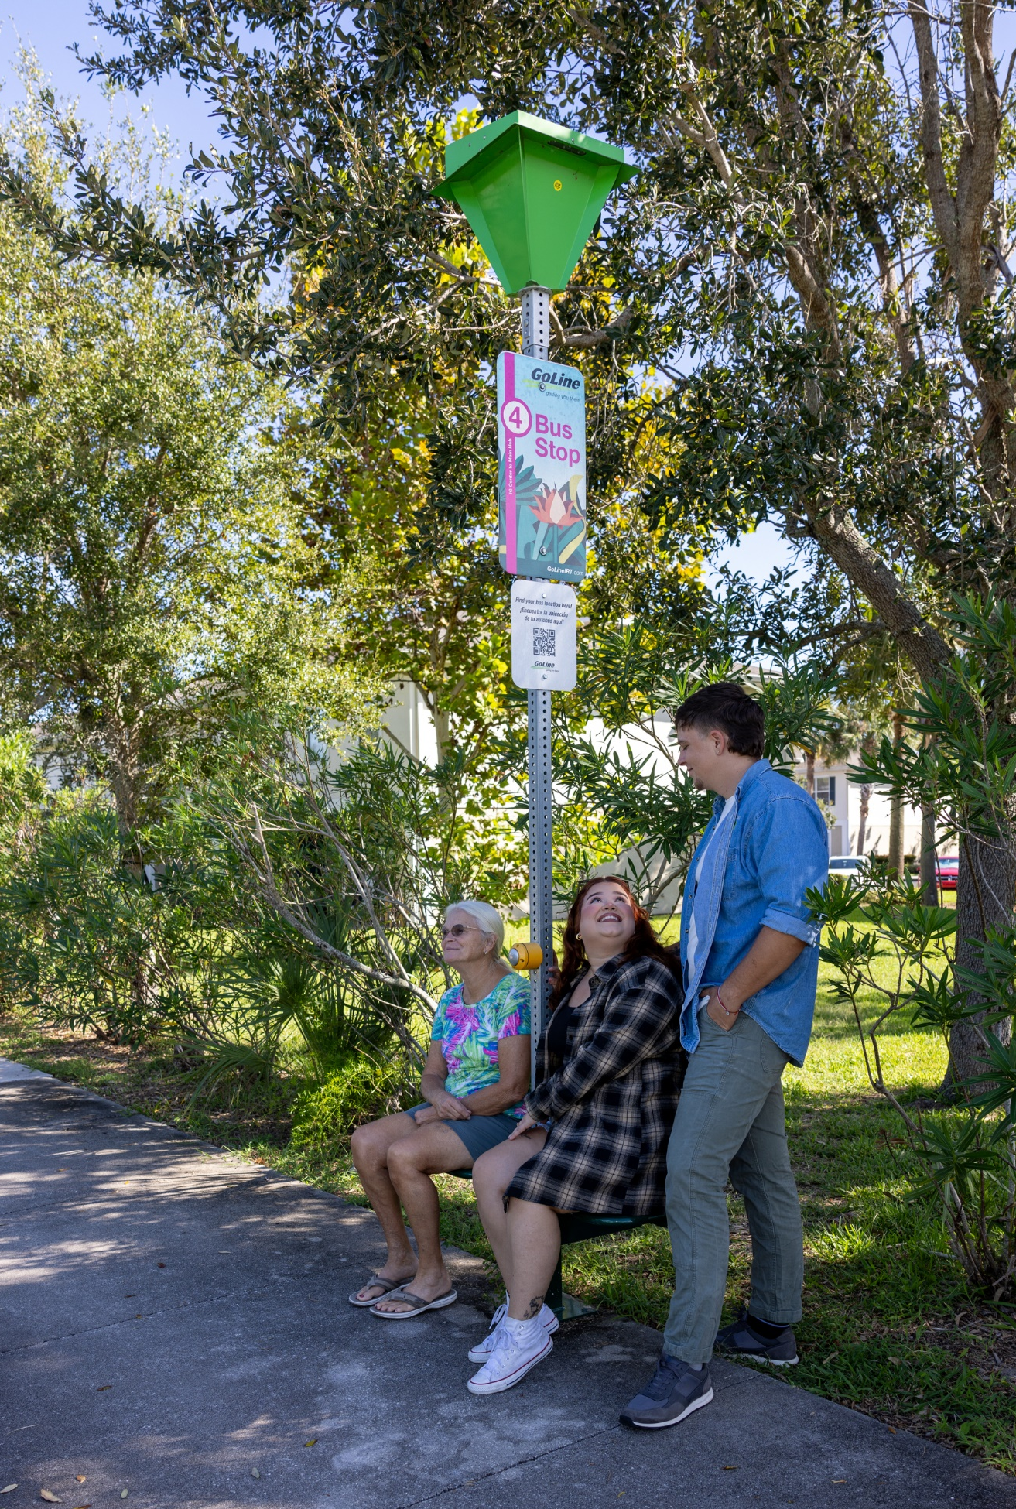
Transit Adaptations: Bus Stop Amenities
Bus shelters/simmee seats
Solar lighting
QR codes at all bus stops provide real time bus tracking
Notes:
Chris

Slide 13
Transit Adaptations: Demand Response
Curb to Curb vs. Door-to-Door vs. Door-through-door
Using TNCs to fill the gaps
First Mile/Last Mile
Microtransit
Used where there are transit deserts and underperforming fixed routes
Notes:
Chris
Demand Response Transportation has adapted as well over the years. Preparing for the silver tsunami, its going to be important that communities continue to be forward thinking in their approach to adding ammenities for passengers, especially older adults

Slide 14
Quiz Break #2
Notes:
Karen

Slide 15
How many licensed drivers does Florida have who are age 80+?
803,252
906,949
598,672
710,405
Notes:
Karen
The answer is B: 906,949

Slide 16
Quiz Break #3
Notes:
Karen

Slide 17
In the state of Florida, all drivers must renew their driver’s licenses every eight years.
True/False

Slide 18
Driver’s License
A Florida driver’s license must be renewed:
Every eight years for drivers 79 years and younger
Every six years for drivers 80 years and older
Drivers who are 80+ and are not eligible to renew their driver’s license online are only required to pass a vision test:
At a driver’s license service center, or by their medical doctor
Notes:
Karen
Of course, go back to Dori.
Dori renewed her license at 78. She did not have to renew for 8 years.
Now she's 86. She's legally blind and uses a walker.
Dori’s family is very concerned for her well being and other on the road. They know she should not be driving. They tale Dori to her doctor who agrees with the family and doesn’t sing the documents..
Dori doesn’t like that – it is changing her whole life. She will no longer be able to go visit friends, grocery shop, go to her medical appointments, or visit the hair salon without asking a family or friend to provide a ride. Of course,, taxi’s, Uber or Lyft are too expensive. And fear of how to navigate the public transportation system is daunting.
So what does Dori do….? She secretly goes to another doctor and that Dr. signs the documents saying her vision is fine for driving......she returns to the DMV and her license is renewed for another six years.
But here's the thing. Dori is a real person. We have a video to talk about that.

Slide 19
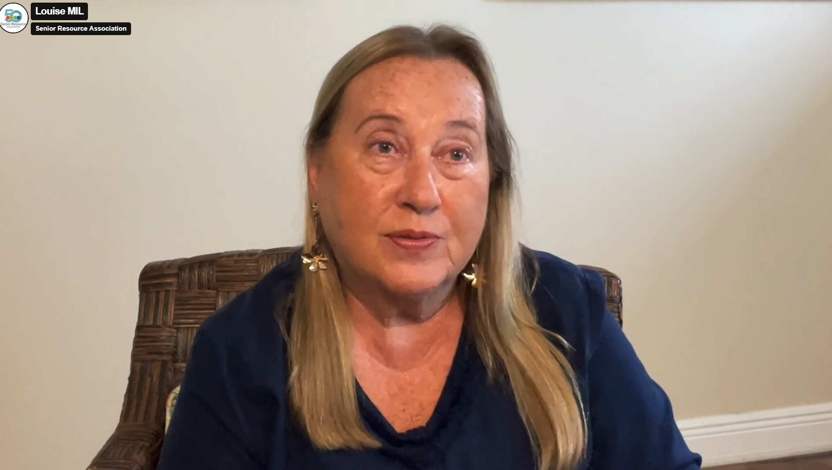
Notes:
Karen
This is a real issue for our communities. As the Silver Tsunami happens…. More people aging up and driving when they should not be, there will be many more accidents – both incidental and fatal happening.

Slide 20
Mobility Resources
Find a Ride Florida
AARP Driver Safety
Safe Mobility for Life Program
FDOT initiative to improve safety and mobility for aging road users
Online refresher courses to improve driving skills
Online listing of transportation service providers
Notes:
Karen
We have many resources available for seniors and their families to access.
Find a ride is an online listing of transpiration services in the state of Florida developed through the FDOT Safe Mobility for Life program
Of course, AARP has several options and refresher courses to improve driving skills
And through the safe mobility for life program we offer
Chris will explain a little more about the Find a Ride online site.

Slide 21
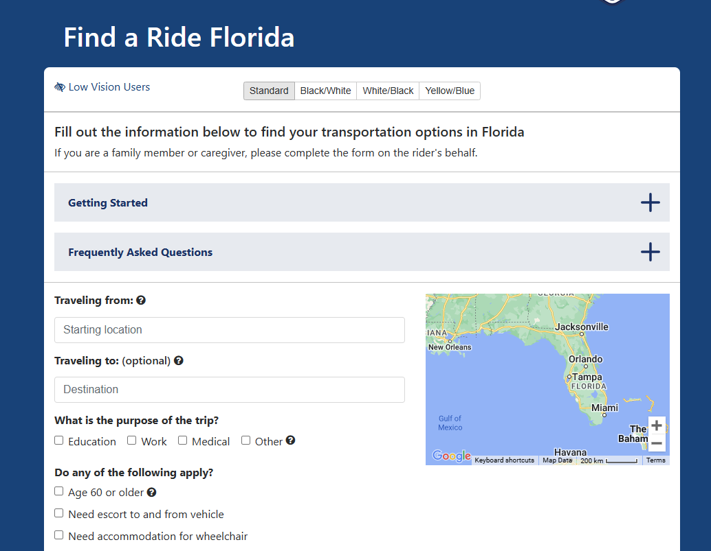
Find a ride screensho
Notes:
Chris can walk through Find a ride Florida

Slide 22
Recommendations for Local Improvements
Enhanced Public Transit
Subsidized Transportation
Infrastructure Improvements
Technology Integration
Notes:
Chris Local recommendations

Slide 23
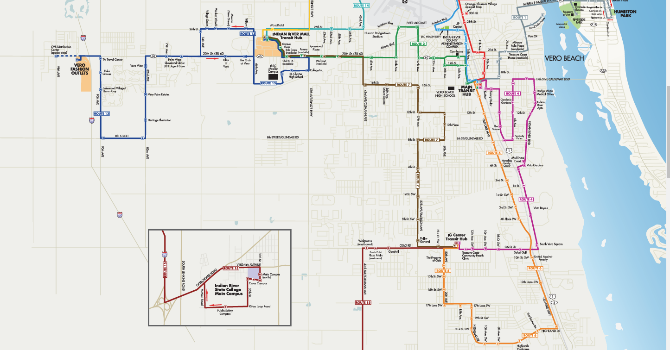
Enhanced Public Transit
Notes:
Chris
Increase the number of routes and frequency of services in senior-dense areas

Slide 24
SRA's Multi-Modal System
Pedestrian-friendly stops and routes
Routes that connect to neighboring counties
All buses are ADA Compliant (wheelchair lifts and ramps, low floors, voice-annunciators at stops)
Bike racks on every bus
Notes:
Chris

Slide 25
Subsidized Transportation
Local Match For Grants
Overmatch Grant Programs
Encourage Collaboration between Government and Private Sector

Slide 26
Infrastructure Improvements
Increased visibility
Larger lettering on signs
Spacing of reflective pavement markers reduced
Pedestrian features at intersections
More Countdown pedestrian signals
Refuge islands
Advance notification
Advance street name signs
Longer walk times
Advance warning signs (stop, yield, etc.)
Notes:
Implement age-friendly design in public spaces
Chris

Slide 27
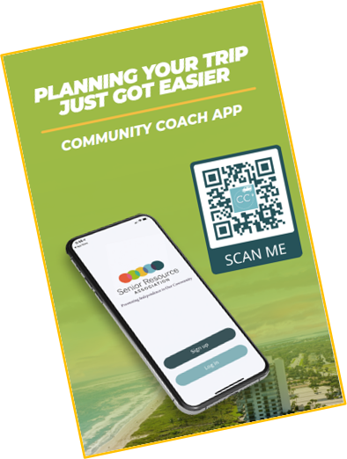
Technology Integration
Real time bus locations
Used for booking demand-response trips
Same day trip requests
To leave comments/contact transportation office
Notes:
Chris
Use apps and online platforms to make scheduling and accessing transportation easier

Slide 28
Recommendations for Improvement
State Funding
Community Engagement
Driving Course for Seniors
Potential pilot programs through Florida Sheriff’s Association
Involve seniors in planning and decision-making processes
Increase state funding for transportation programs
Legislation
Changing the state statute to require more robust testing of seniors 80+ years old
Notes:
^{Karen}
Lastly, what can you do as decision makers to enhance mobility safety in your communities?
Help support the public transportation funding initiatives by advocating for more federal and state funding and support the local match initiatives
Be sure to include seniors when having transportation workshops – ask survey questions that are directed to those over 65
Advocate to change state statute to require more robust testing for individuals over 80
For example, after speaking to our local Sheriff he agreed to support a driving course for persons over the age of 80 through the Florida Sheriff’s Association. It is my understanding that 2 pilot programs – one on the east coast and west coast will be developed. The idea is to ensure drivers are safe on the road and assist family members like Dori’s to make sure their family is safe on the road as well as others.
What our public transit systems can be doing is ensuring we are providing ample information about using our systems including having travel trainers offering guidance to use the system.

Slide 29
Questions?
Notes:
Karen

Slide 30
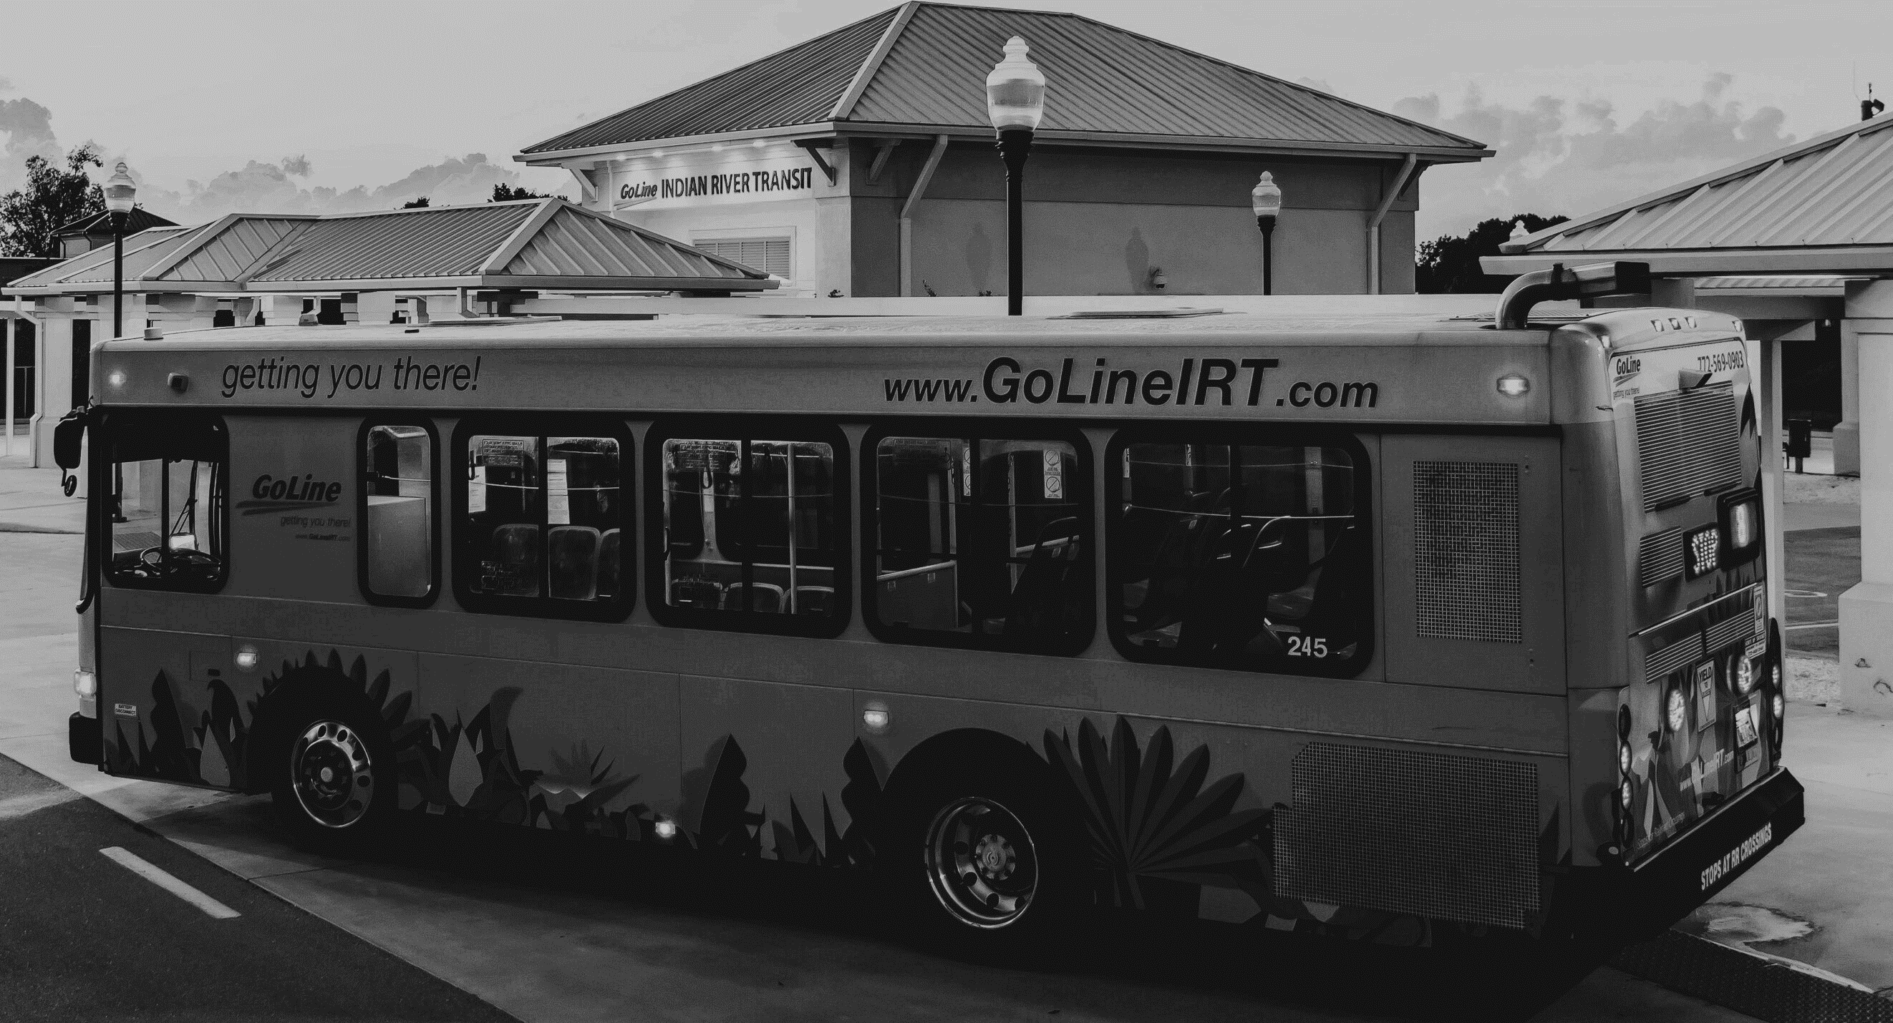
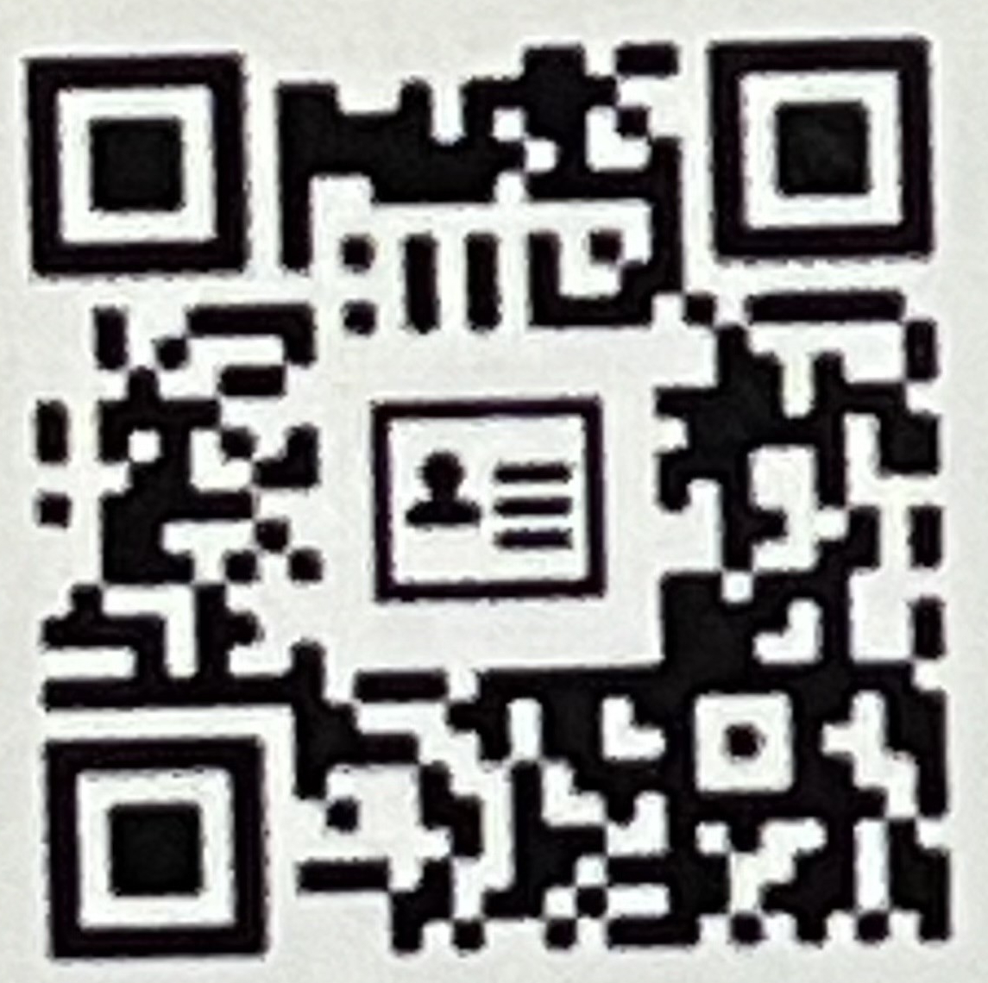
CONTACT US
Senior Resource Association
4385 43rd Avenue
Vero Beach, FL 32967
4385 43rd Avenue
Vero Beach, FL 32967
Karen Deigl
kdeigl@sramail.org
Chris Stephenson
cstephenson@sramail.org
Notes:
QR Code for both
Name
Email
QR Code

