Slide 1
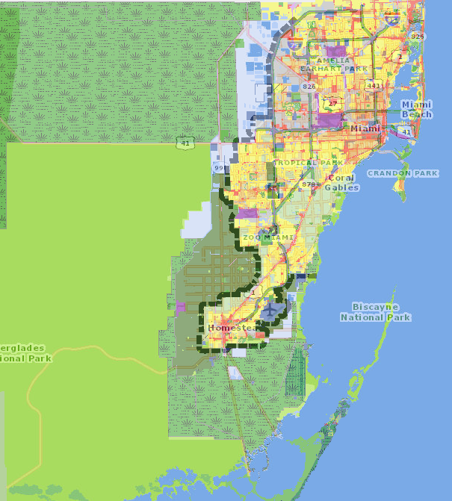
Senior Housing Needs in Miami Dade County
There are 2,701,767 people living in Miami Dade County
17.4% are over the age of 65 or ~470,000 people
An additional ~350,000 are between 55 and 64.
Poverty of seniors is highest out of all age groups at ~20%
Median rent in Miami Dade is $2,100, which requires a salary of $75,600 to be affordable.
Miami Dade Serves many seniors
2,622 Elderly households in Public Housing
~7,200 Seniors in Section 8/ Housing Choice Voucher Program.
~2,500 Senior Project Based Units in portfolio
Average Senior Income: $14,691
Average time on program: 6 years
Miami Dade is redeveloping ~1,800 public housing units to create more density and more opportunities for populations like seniors.
Major Challenges
Limited Space (Ocean and Everglades)
Florida Building Code (hurricane and sea level rise)
Increased competition
Miami Dade Zoning Map

