Slide 1
By 2034
Americans 65-plus will outnumber those 18 and under for the first time
Source: US Census National Population Projections 2017

Slide 2
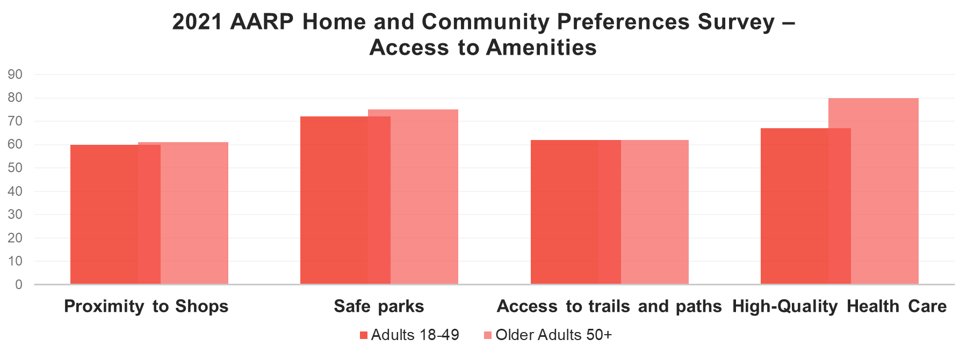
AARP | AARP.ORG © 2024 AARP ALL RIGHTS RESERVED
2

Slide 3
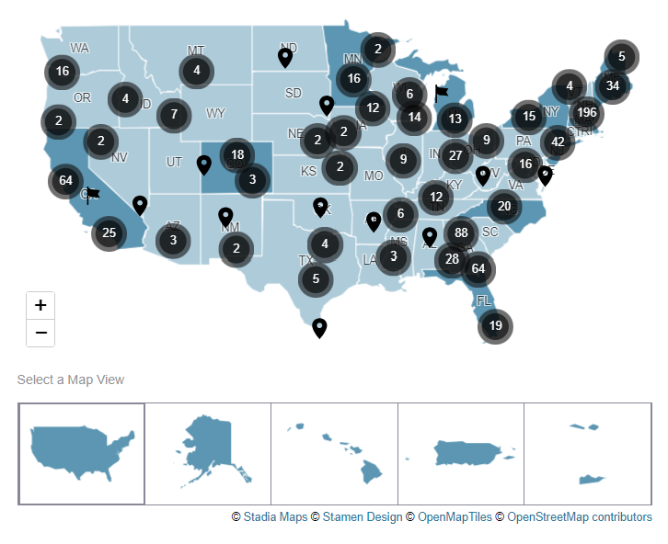
AARP Network of Age-Friendly States and Communities
More than 900 communities have committed to create a more age-friendly future – plus 10 states and 1 US territory.
Nearly 100 million people.
Livable, age-friendly communities provide options that enable you to meet your needs regardless of your age, income, background, or other factors. They are for all people of all ages.
aarp.org/agefriendly

Slide 4
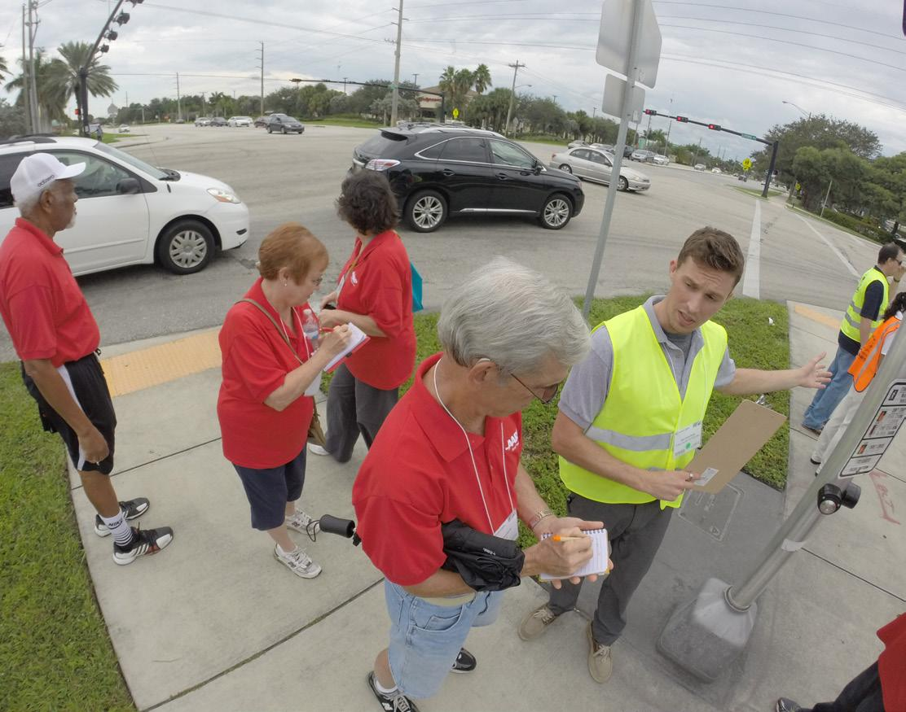
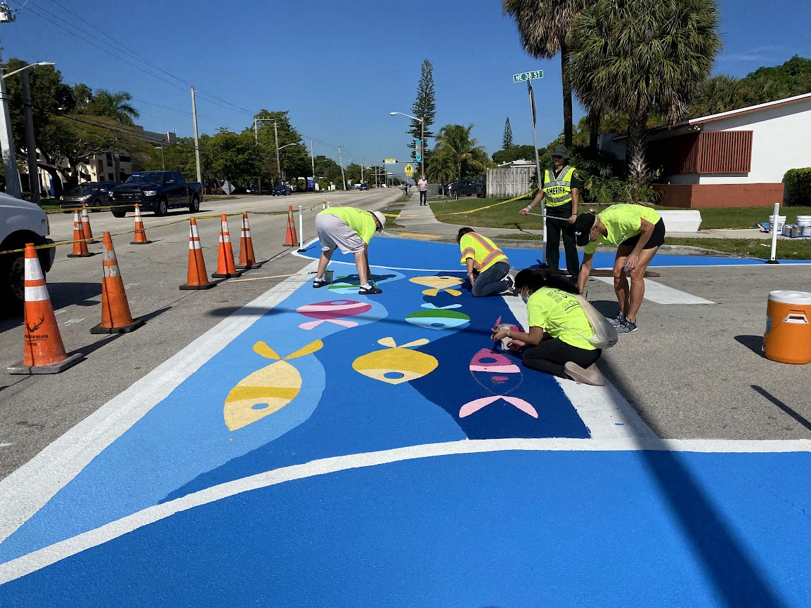
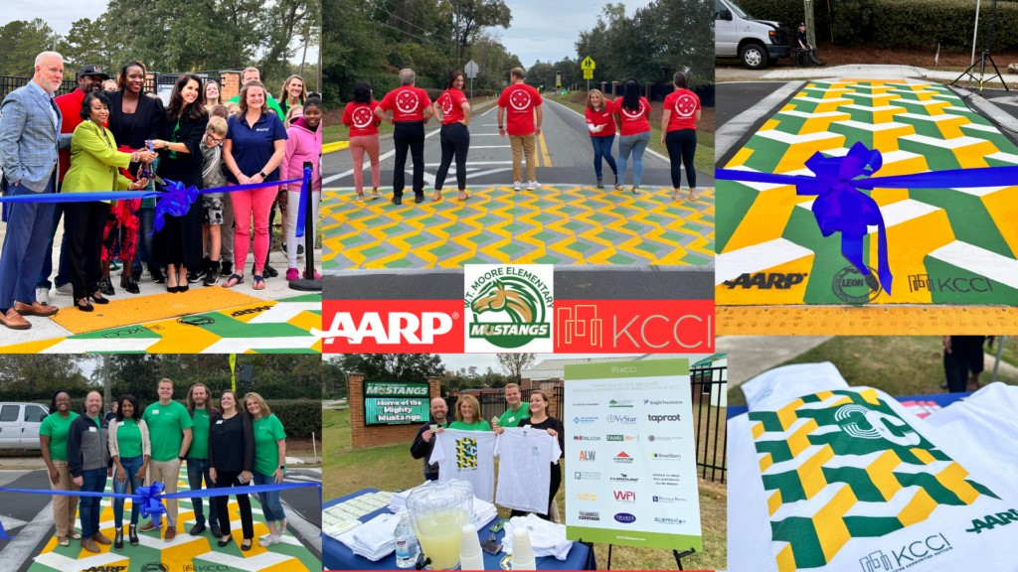
AARP Walk Audits
City of Deerfield Beach and
Broward MPO
City of Tallahassee and Knight
Creative Communities
AARP volunteers have engaged across the state in walk audits to identify any potential improvements to sidewalks or intersections to make them safer for all ages.
A temporary “pop-up” of intersection improvements, informational signage, traffic calming features and highly-visible decorative crosswalks were installed to increase the mobility, accessibility & safety of a roadway in a predominantly residential area.
Two crosswalks were painted near an elementary school and a senior living community. Local artists were paired with students who worked together to make crosswalks more visually appealing.

Slide 5
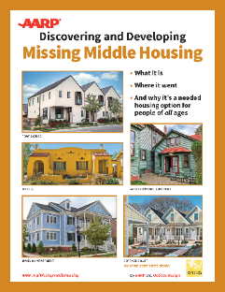
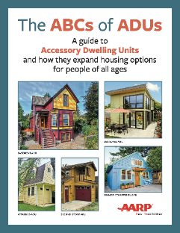
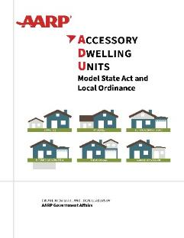
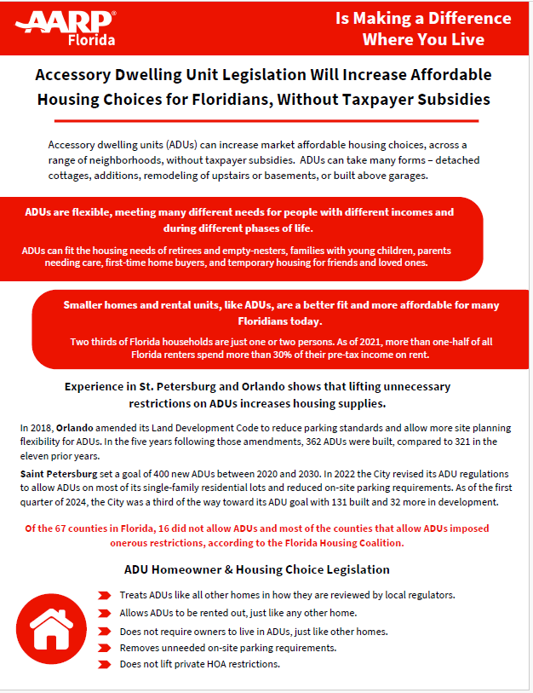
Age-Friendly Housing Policies and Resources
Missing Middle Housing
Accessory Dwelling Units
Creating an age-friendly home
Visit the full livable resources library and download a digital version or ordera printed copy.
aarp.org/livable
AARP | AARP.ORG © 2024 AARP ALL RIGHTS RESERVED
5

Slide 6
Connect with us!
Livable Communities Landing Page: aarp.org/livable
Livable Communities Newsletter: aarp.org/livable-newsletter
Livable Communities Map: livablemap.aarp.org
Livability Index: aarp.org/livabilityindex
20+ Free Publications: aarp.org/livablelibrary
Laura Streed
Sr. Associate State Director
AARP Florida
lstreed@aarp.org www.aarp.org/FL

