Slide 1
cri.georgetown.edu
PREPARING FOR THE SILVER TSUNAMI
A National View of Challenges and Opportunities
TCRPC/SFRPC Regional Conference
Angela Antonelli
Research Professor and Executive Director
November 15, 2024

Slide 2
An Aging Population That’s Living and Working Longer
Between 2020 and 2040, the U.S. will see a 13% growth in its total population and a 44% growth in the 65+ population
10,000+ Americans are turning 65 every day from now until 2030, with 2024 being the PEAK 65 year
By 2029, more than 20% of the U.S. population will be over the age of 65
By 2034, the age 65+ population will outnumber children under 18
Nearly a quarter of today’s 65-year-olds will live past age 90
A baby born in 2007 in the U.S. has a significant chance to live to age 104
If you retire at age 65, you may need to have savings, pensions and other resources from your working life (40+ years) to generate enough income for another 20-30 years once you stop working
Significant increases in the number of those over the age of 65 (38% growth past decade) and over the age of 75 (79% growth over next decade) who will continue to work
Sources: U.S. Census Bureau; DOL BLS; World Economic Forum

Slide 3
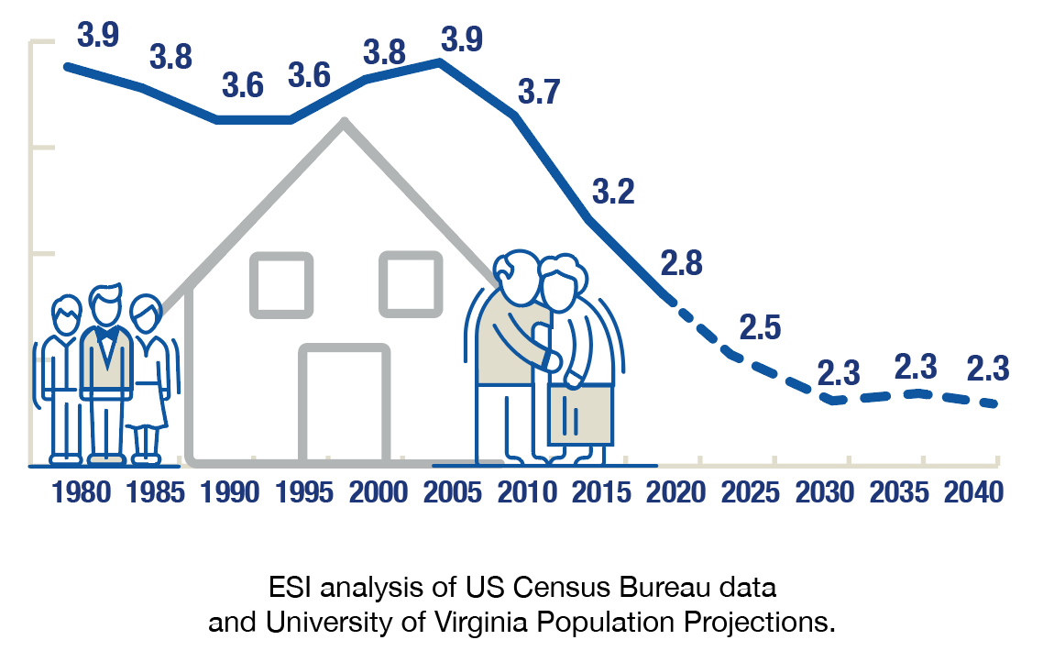
An Aging Population Increases the Urgency
Falling Ratios of Working Age to Elderly Households Creates Fiscal Pressure
Senior households are growing in number and share of the population
Increasing fiscal pressure from a decreasing share of working age households
Generational shifts by 2040: Millennials and Gen Z will be in prime working years (30-60) and need to save for retirement
Ratio of elderly HH (65+) to working age HH (<65)
Source: Antonelli (2020). “What are the Potential Benefits of Universal Access to Retirement Savings?” Georgetown University Center for Retirement Initiatives in conjunction with Econsult Solutions, Inc.
© 2024, Georgetown University

Slide 4
Future Generations Unprepared for Retirement
Near or at retirement | Millennials | Women
Median amount of savings for households age 55+ was $109,000 in 2015 55% of households ages 55-64 had less than $25,000 in retirement savings and 41% had $0 27% have neither DB plan or retirement savings Older Americans are carrying more debt into retirement. Debt held by Americans over 60 is now $4.2 trillion, up from $2.6 trillion a decade ago, and a $800 billion increase in just the past 4 years. Retirees’ major concerns are inflation, lack of savings and lack of support from Social Security Sources: U.S. GAO; Federal Reserve Bank of New York; Consumer Financial Protection Bureau; EBRI | 66% of millennial workers have nothing saved for retirement 55% eligible to participate in an employer-sponsored retirement plan, compared to 77% for Gen X and 80% for Baby Boomers 57% of the $1.58 trillion in outstanding student loan debt is held by those 39 and under (which means those 40 and older carrying 43% of outstanding student loan debt) Those entering the workforce with $30,000 in student loan debt risk ending up with $325,000 less in retirement. The average student debt in 2015 was $33,000 Taking out $3,000 could equal a loss of as much as $40,000 in savings at the time of retirement Sources: NIRS; ValuePenguin; LIMRA | Account for 47% of the workforce, but almost two-thirds of part-time workers, often with fewer benefits Career disruptions due to family caregiving results in lost income and ability to grow retirement savings 41% drop in household income after divorce or separation near retirement, compared to a 23% drop for men Nearly half of elderly unmarried women receiving Social Security relied on it for 90%+ of income, compared to 22% of all seniors Live longer than men (average age 81 vs. 76) but pay more in medical or nursing home costs as a result, creating lower confidence in ability to pay medical expenses Sources: DOL; U.S. GAO; SSA; EBRI

Slide 5
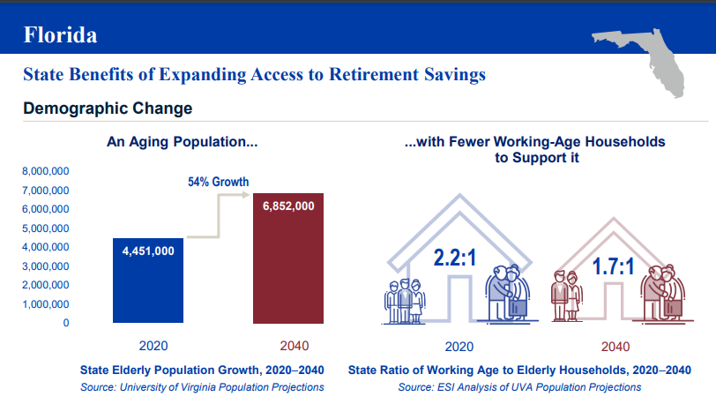
Florida’s Demographics Are Changing, Population is Aging
Source: Georgetown University CRI © 2024, Georgetown University

Slide 6
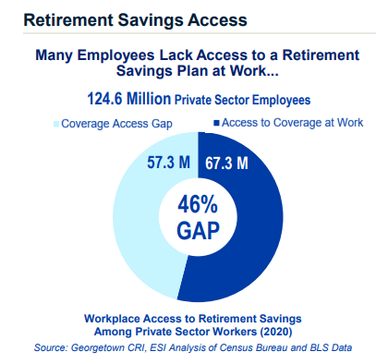
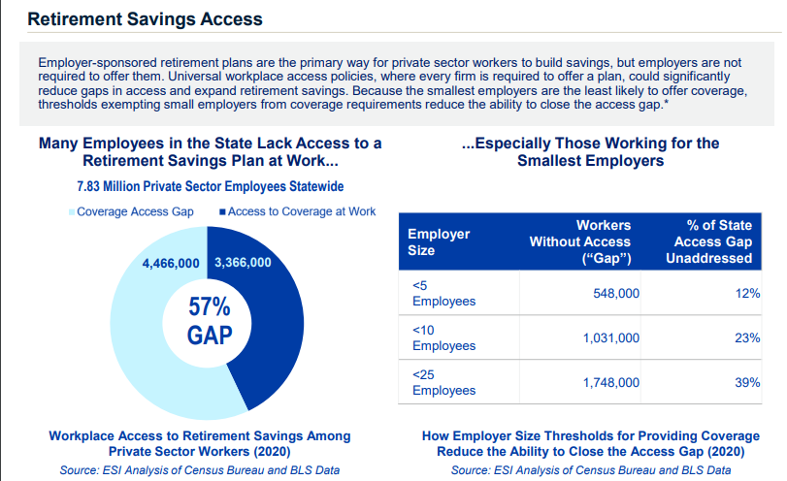
The Retirement Savings Access Gap is Large
United States
Florida
Source: Georgetown University CRI © 2024, Georgetown University

Slide 7
No Progress in 40 Years to Close the Gap
SOURCE: Rhee, Nari & Boivie, Ilana. (2015). The Continuing Retirement Savings Crisis. National Institute on Retirement Security. https://www.nirsonline.org/wp-content/uploads/2017/07/final_rsc_2015.pdf

Slide 8
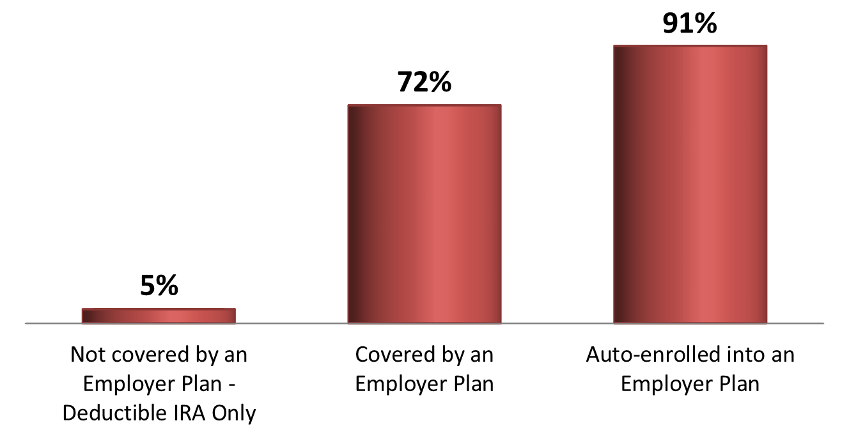
Can’t People Already Save if They Want To?
Participation Rates
SOURCE: AARP. Data compiled by AARP’s Public Policy Institute from unpublished estimates from the Employee Benefit Research Institute of the 2004 Survey of income and Program Participation Wave 7 Topical Module (2006 data). See also Brookings' Retirement Security Project, and WhiteHouse.gov. Automatic enrollment data estimates provided by Vanguard.

Slide 9
Significant Racial Disparities in Savings
Black households have 1/8th and Latino households 1/5th the net worth of white households
Black households are burdened by greater levels of student loan debt & other types of debt
White households have a median retirement account balance of $80,000 compared with $35,000 for black households and $31,000 for Latino households and white households are significant more likely to even have retirement accounts
Source: Aspen Institute, 101 Solutions for Inclusive Wealth Building, May 2022

Slide 10
States Are Driving Change by Designing and Adopting Universal Access Retirement Savings Programs
Provide small employers (those most likely to not offer a retirement plan of their own) an easy way to help their workers save and their reduce burden and cost of offering a retirement account
Auto-enroll workers into simple, low-cost IRA at no cost to employers; workers can always choose to opt-out
Trend is increasingly toward state-level universal access auto-IRAs requiring employers who do not have a retirement savings plan to either get one or to facilitate the ability of their workers to save through the state program (17 auto-IRA states of the 20 enacted state programs)
More than two-thirds of workers who are auto-enrolled save and they are saving on average 5% or more per month
Low- and moderate-income workers can and will choose to save when given the opportunity and access
Preliminary survey data suggests that even a modest amount of saving can help to reduce stress and provide a stronger sense of financial security
© 2024, Georgetown University

Slide 11
States Are Driving Change by Designing and Adopting Universal Access Retirement Savings Programs (20 States)
Individual Retirement Account (Auto-IRA)= 17 states | Voluntary Open Multiple Employer Plan (MEP) | Voluntary Payroll Deduction IRA | Voluntary Marketplace
California Maine Oregon | Massachusetts | New Mexico | New Mexico
Colorado Maryland Rhode Island | Missouri |  | Washington
Connecticut Minnesota Vermont
Delaware Nevada Virginia
Hawai’i New Jersey Washington
Illinois New York
Green = program now open to all eligible workers
© 2024, Georgetown University

Slide 12
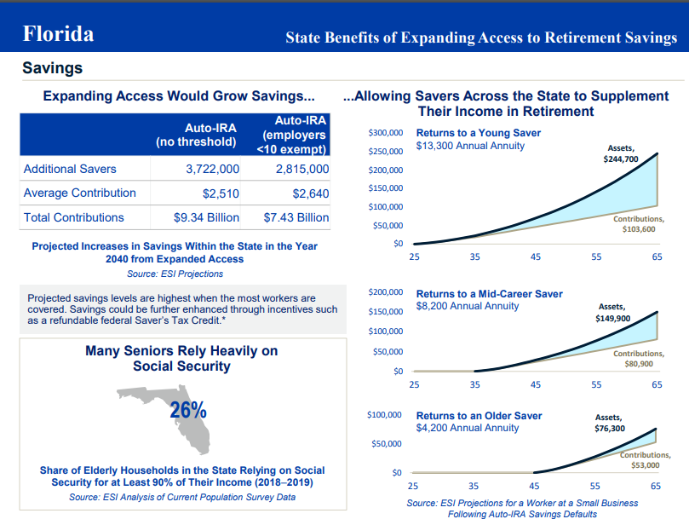
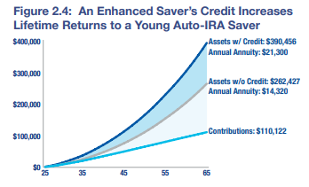
The Increase in Savings and Retirement Income Can Be Great
New Saver’s Match Would Help Boost Savings
Source: Georgetown University CRI © 2024, Georgetown University

Slide 13
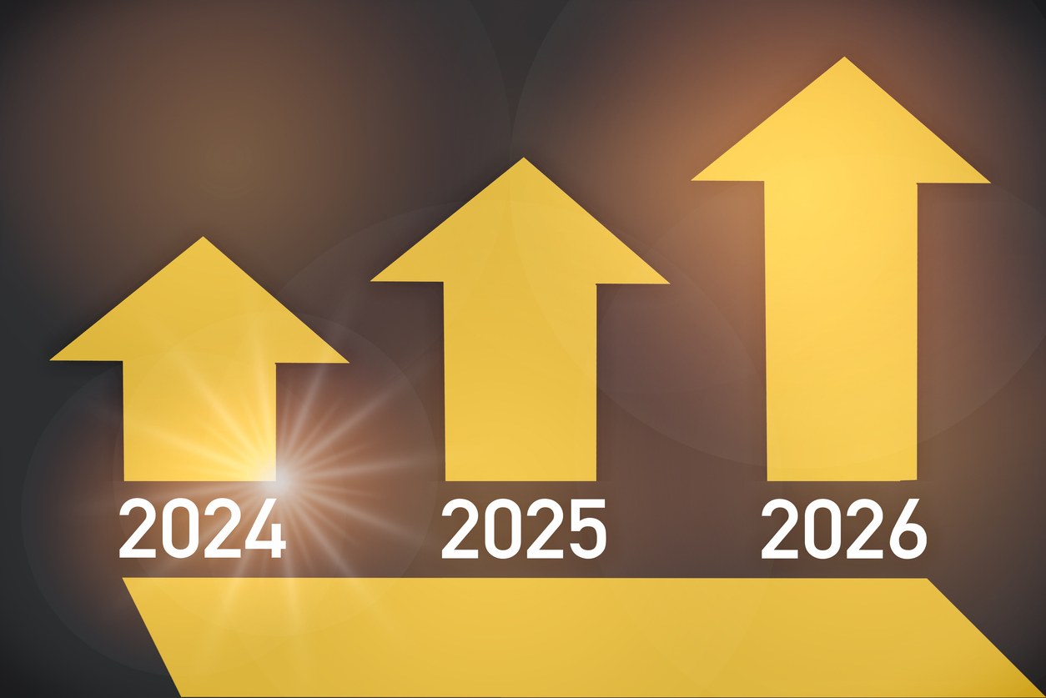
While the Cost of Doing Nothing is Significant Pay Now or Pay Later
Federal Budget Costs = $964 billion/FL share is $63 billion between 2021 and 2040
State Budget Costs = $334 billion/FL share is $17 billion between 2021 and 2040
Source: The Pew Charitable Trusts

Slide 14
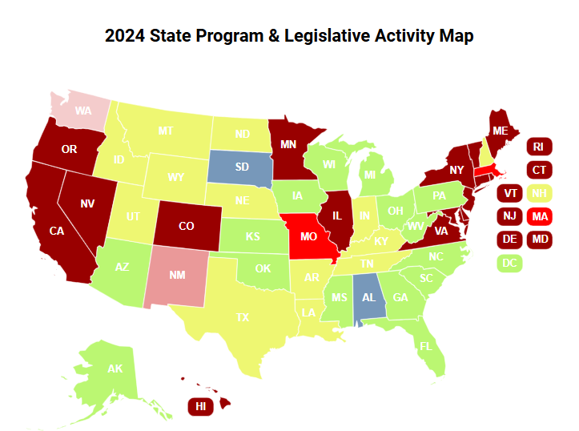
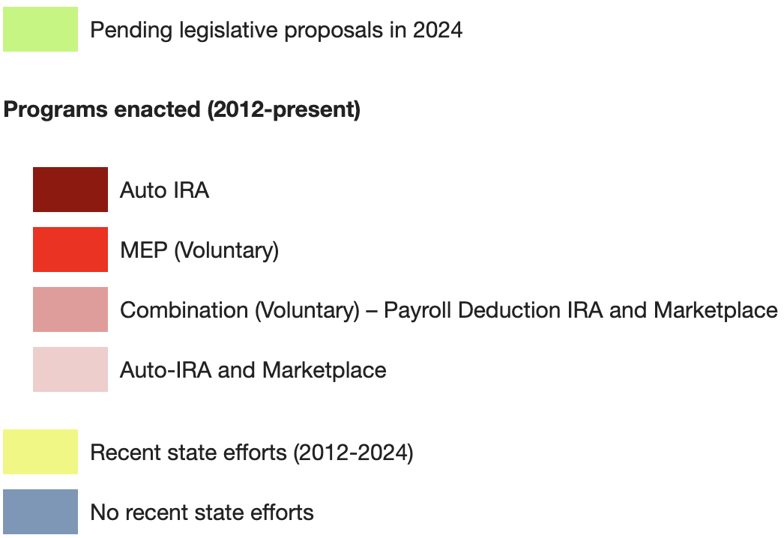
2024 State Programs and Legislative Activity

Slide 15
State Program Performance (Auto-IRA States)
$1.75 Billion in Assets
CA, CO, CT, IL, ME, MD, OR, VA
as of 9/30/2024
223,000+ Registered Employers
CA, CO, CT, IL, ME, MD, OR, VA
as of 9/30/24
941,000+ Funded Accounts
CA, CO, CT, IL, ME, MD, OR, VA
as of 9/30/24
Source: Data compiled by Georgetown CRI from state public and provided data
© 2024, Georgetown University

Slide 16
Strong Public, Employer, and Employee Support
NIRS 2024 survey of views of state-facilitated retirement savings programs:
77 percent agree that state-facilitated retirement programs are a good idea with high support across party and generational lines.
82 percent say they would participate in state-facilitated retirement programs, consistent across party and generational lines.
Many key features of state-facilitated retirement programs viewed favorably, especially higher expected returns than other safe investments (87 percent) and low fees (86 percent).
Pew 2019-2020 survey of 2,500 responding employers in Oregon:
79% of the businesses surveyed responded that they paid no out of pocket costs
80% of employers reported that they heard a little or nothing from their employees about participating in the program (assumption is that employees would express any dissatisfaction to their employer)
73% of employers reported being satisfied or neutral about the program overall

Slide 17
Research Shows State Programs Help Private Plan Growth
Pew Charitable Trust (2023)
Evidence from CA, OR, and IL indicate state programs complement the private sector market for retirement plans
Employers are not enticed by state programs to drop their existing plans
Rate of introduction of new plans as a share of existing plans grew in all three states after program enrollment began (higher than national average): 1.3% in CA; 0.9% in IL; 1.8% in OR
Bloomfield, Lee, Philbrick, Slavov (NBER, 2023) and Bloomfield, Goodman, Rao, Slavov (NBER/CRI, 2024)
Auto-IRA legislation has a positive impact on the likelihood of employers offering retirement plans and employee participation
Firms in states with programs are 1.5-1.7% more likely to offer any employer-sponsored retirement plan relative to firms in states without and workers 3-5% more likely to participate in existing plans
Recent state policies requiring employers to facilitate workplace savings options have induced at least 30,000 firms to establish retirement plans in four of the early adopter states (CA, IL, OR and CT).

Slide 18
Center for Retirement Initiatives McCourt School of Public Policy 125 E Street NW, Suite 530 | Washington, DC 20001 | 202-306-8540
cri.georgetown.edu
Angela M. Antonelli Research Professor Executive Director, Center for Retirement Initiatives ama288@georgetown.edu Follow us on social media for updates:

