Slide 1
Regional Outlook on
AGING IN SOUTH FLORIDA & TREASURE COAST
Randy Deshazo Deputy Director and Director of Economic Development and Research
South Florida Regional Planning Council
Notes:
The United States is experiencing a vast demographic transformation driven by the aging Baby Boomer generation—those Americans born between 1946 and 1964 that is reshaping our economy, our communities, even the future of our family structure and possibly launching a pandemic of loneliness.
With three out of four Baby Boomers already past 65 and half expected to be over 75 by 2030, we face an urgent window to address the declining labor force, economic stability, and as community leaders, you face strategic decisions about land use and the scope of public services and how we fund them. That’s our challenge today.

Slide 2
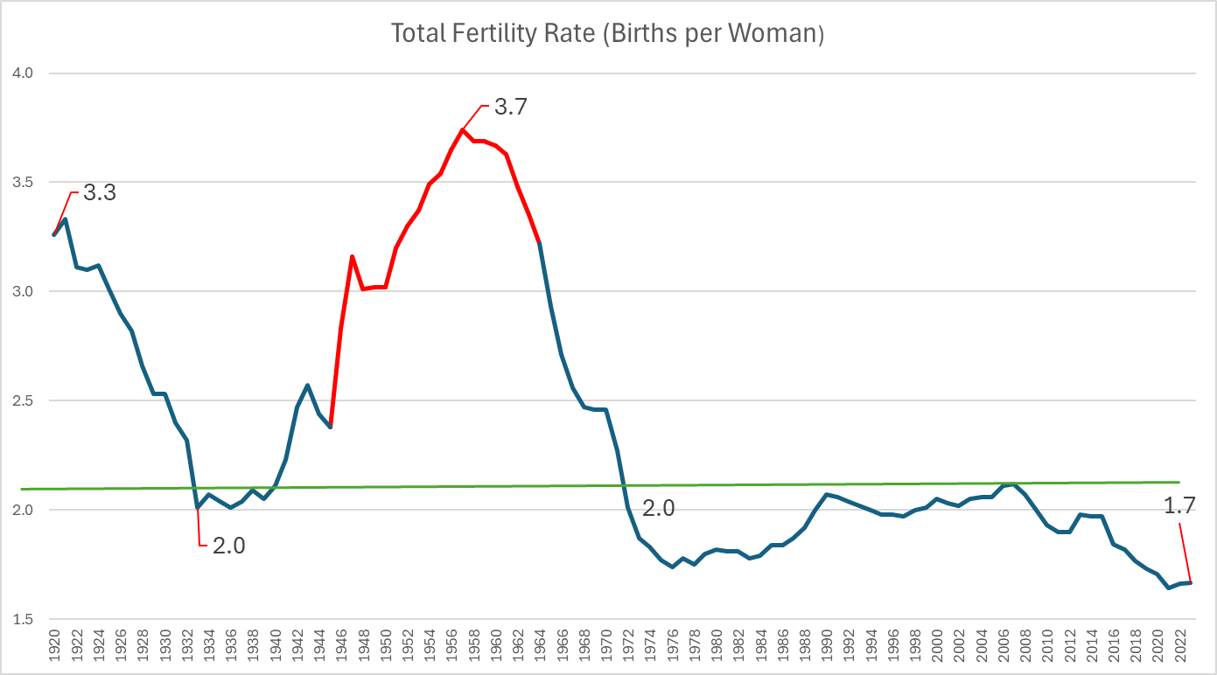
Notes:
This graph traces the number of births per woman from 1910 to the present. Historically, the American birth rate exceeded the replacement level of 2.1 until the Great Depression, surged to a high of 3.8 in 1958, and fell below the replacement rate in the early 70s.
For the parents of the Baby Boomers, large families provided informal elder care, supplementing social support systems. Fast forward to today, and smaller family sizes mean fewer caregivers for this aging population. It also points to an epidemic of loneliness that maybe should be addressed in land use planning for communities.
By 2030, with half of this generation over 75, the strain on our pensions, job creation, new business formation, and labor force will be profound.

Slide 3
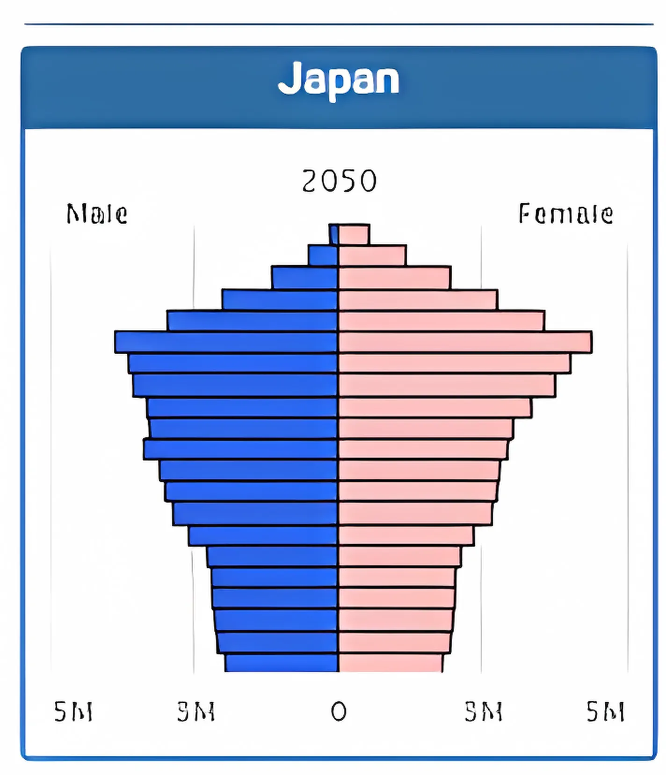
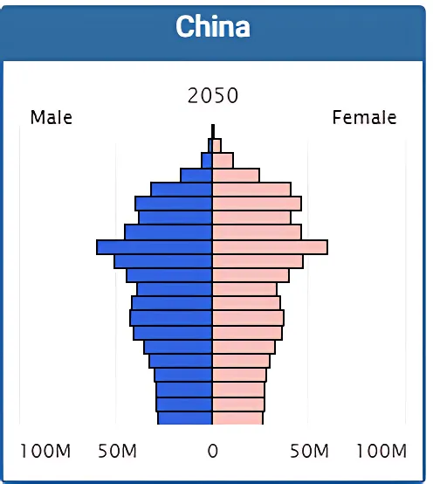
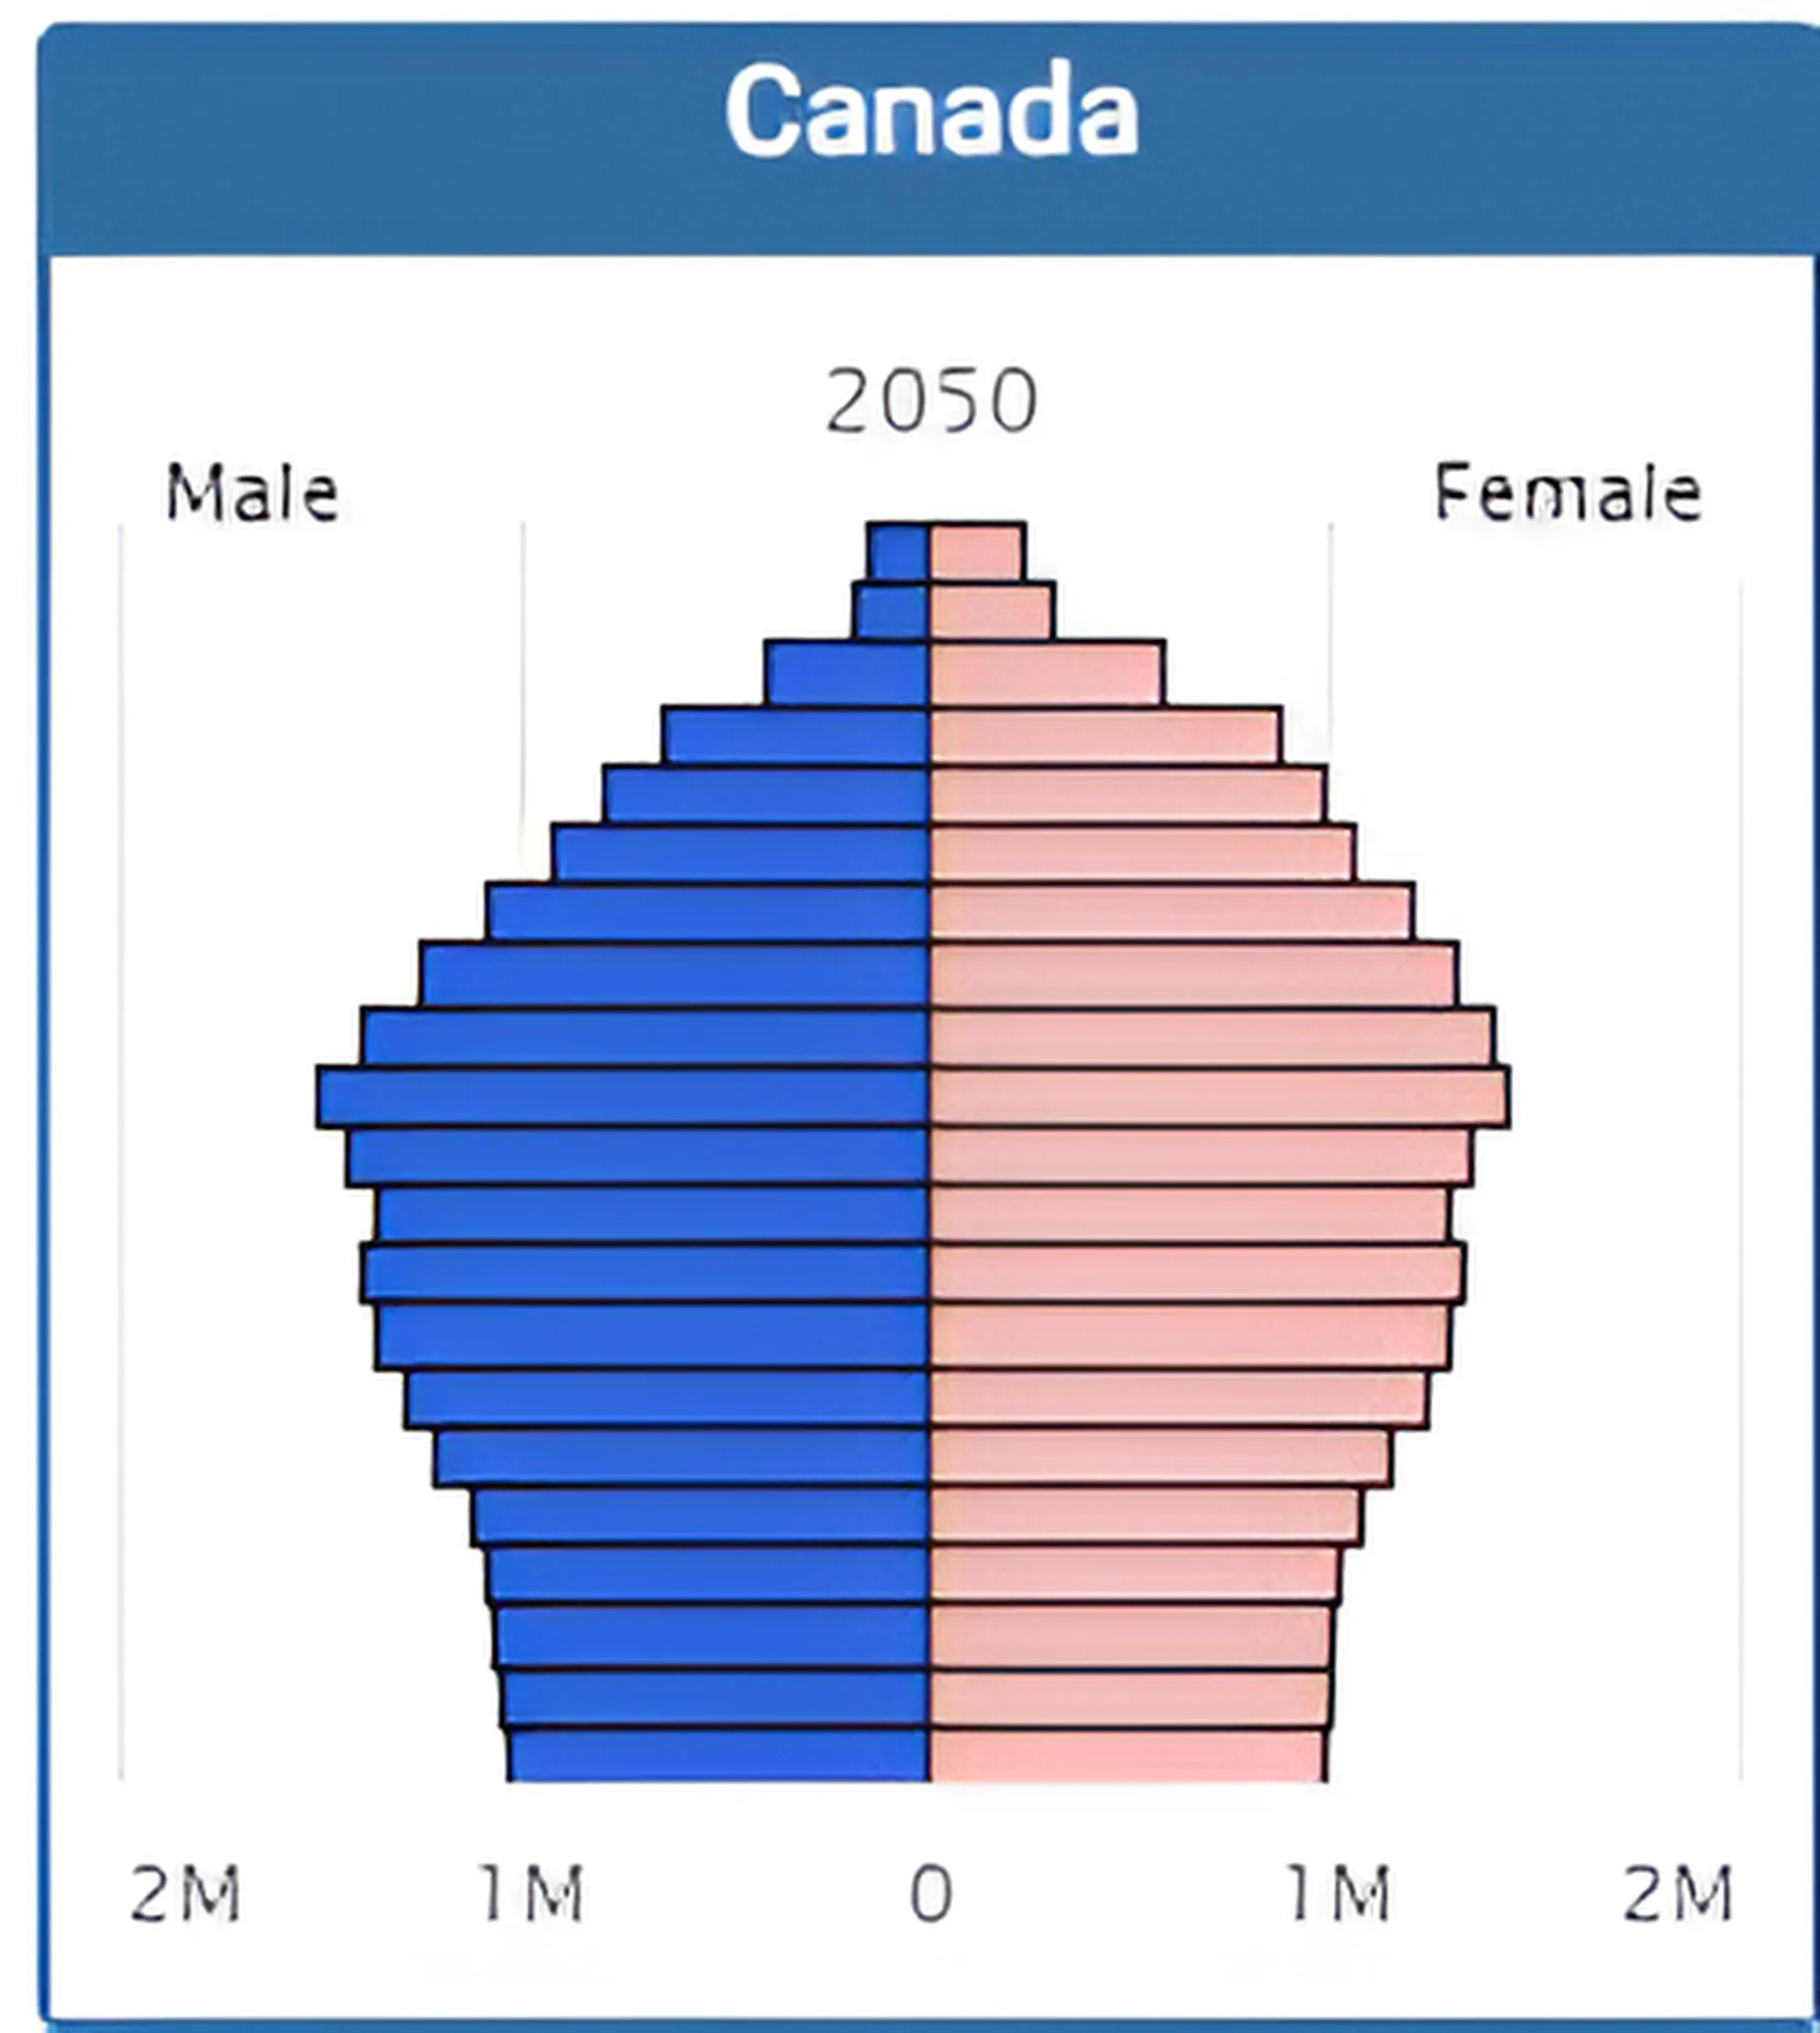
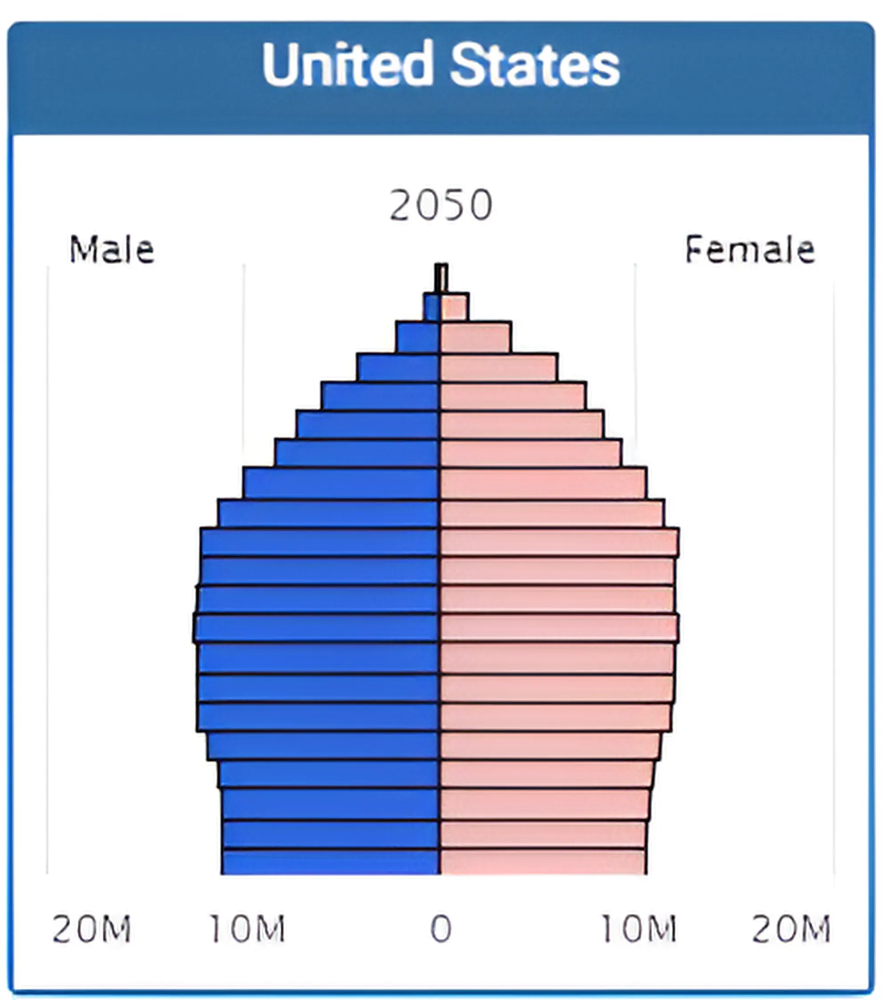
An Unprecedented Global Demographic Transition
Old
Median Age: 54.9 in 2050
Dependency Ratio: 73.7
Median Age:51.1in 2050
Dependency Ratio: 49.5
Median Age:47.3 in 2050
Dependency Ratio: 46.6
Low Birth Rates
Young
Population Pyramid
Median Age: 43 in 2050
65+ Dependency Ratio: 36
Notes:
The U.S. is not alone; it's a global trend. These population pyramids illustrate how age distributions will invert by 2050, with more elderly and fewer young. Japan leads this shift, with projections showing 74 retirees for every 100 working-age individuals by 2050 (Dependency Ratio). China, due to its one-child policy, faces a similar challenge, while Canada shares a demographic trajectory comparable to ours and relies on immigration as a partial solution.

Slide 4
US Census: Population Growth by Immigration Scenario to 2050
Population Peak: 2025
Population Peak: 2080 (Assuming background immigration rate)
Population Peak: Past 2100
Notes:
Immigration often sparks debate with good and bad aspects. Projections by the U.S. Census show that even with steady immigration, the labor force will grow modestly, with the population peaking around 2080. If immigration, legal and not-so-much were to end tomorrow, that peak moves up to 2025. Some advocate for policies that promote higher birth rates instead, but this would require a significant, near-doubling of the current fertility rate.

Slide 5
BEBR: Southeast Florida (All 7 Counties) Population 2025-2050
Notes:
Now we are going to shift focus to the forecasts produced by the University of Florida’s Bureau of Economic and Business Research for change between 2025 and 2050 by age group. As with the United States, our over 65 group is the fastest growing segment, gaining about 50% in our 7 county megaregion, 55% statewide. The over 85 set will more than double in our region, and almost triple statewide.

Slide 6
BEBR: South Florida 2025-2050 (Broward, Miami-Dade, Monroe)
Notes:
Breaking down a bit more, in most counties the over 65 cohort will nearly double, and in Monroe county over 85s will triple, with Broward’s 85+ rate just behind that of Monroe.

Slide 7
Treasure Coast 2025-2050 (Indian River, Martin, Palm Beach, St. Lucie)
Notes:
Treasure Coast will see a doubling of the 85+ cohorts, while its labor force will grow faster than South Florida’s. Now labor force growth is the most important factor in sustaining the demographic basis of our economy.

Slide 8
US Labor Force Participation Continues to Drop
Productivity Losses and Labor Shortages most acute in:
Healthcare
Education
Technical and Construction
Knowledge Economy
Recession
US labor force participation rates have declined steadily since 2000, and faster after 2011. Employment still grows because of underlying population growth. Drivers are
Baby Boomers (55-60% of decline)
Declining Prime Male Participation Rate (25-54YO)
57% cited disability
Not only labor scarcity, but also a growing skill gap
Automation, each additional robot per thousand workers reduced the employment-to-population ratio by up to 0.34%
Ask me to show you more charts to explain these trends!
Notes:
Now we come to the first major change that we face. Think of the population as a pie. Labor force participation has been on a steady decline since 2000, exacerbated by early retirements, particularly among Baby Boomers.
Although population growth has so far offset some impacts, declining participation rates among prime-age men and a widening skills gap and automation present additional challenges.

Slide 9
Seniors Spend Less Compared to Prime Age Consumers
Notes:
Aging also has consequences for spending. Older Americans typically spend less across most categories compared to prime-age consumers, except in areas like healthcare and reading. This shift will influence demand for land use and business services as the population ages, dropping taxable sales may have fiscal implications for the state.

Slide 10
Macroeconomic Impacts
US Gross Domestic
Product (GDP) May Shrink
Every 10% increase in the fraction of the population aged 60+ could result in a 5.5% reduction in GDP per capita due to slower employment growth and dropping labor productivity
Silver Lining automation can stem some decline
Consumer Spending = Jobs
More healthcare workers, legal and financial services
Fewer retail sector jobs, food service, some manufacturing jobs
Possible shift in investments from equities to more conservative, income-generating assets such as bonds.
Notes:
An aging population dampens economic growth due to reduced labor productivity and slower employment gains. As older adults' spending habits shift, markets could pivot toward safer, income-generating investments like bonds, while sectors such as healthcare and financial services may see growth.

Slide 11
Costs of Aging
Over 2023-32 average National Health Expenditure growth is projected to outpace average GDP growth, health spending share of GDP growing from 17.3% in 2022 to 19.7% in 2032. Medicare costs of dialysis alone account for 0.8% of the Federal Budget.
The median income for U.S. adults 65 and older is $50,290 while average annual expenses are $57,818. The average monthly (2024) Social Security benefit for retired workers is $1,907.
Assisted Living costs in Florida average $4,750/mo. In Miami, around $5,250/Mo. Hourly Home Care is $23.50.
Adult Day Care statewide average of $15,600/year. Larger elderly population areas pay more per person.
Notes:
Aging comes with a financial price. For instance, dialysis services alone now account for nearly 1% of the federal budget. By 2032, healthcare spending is expected to outpace GDP growth, consuming a larger share of national resources.

Slide 12
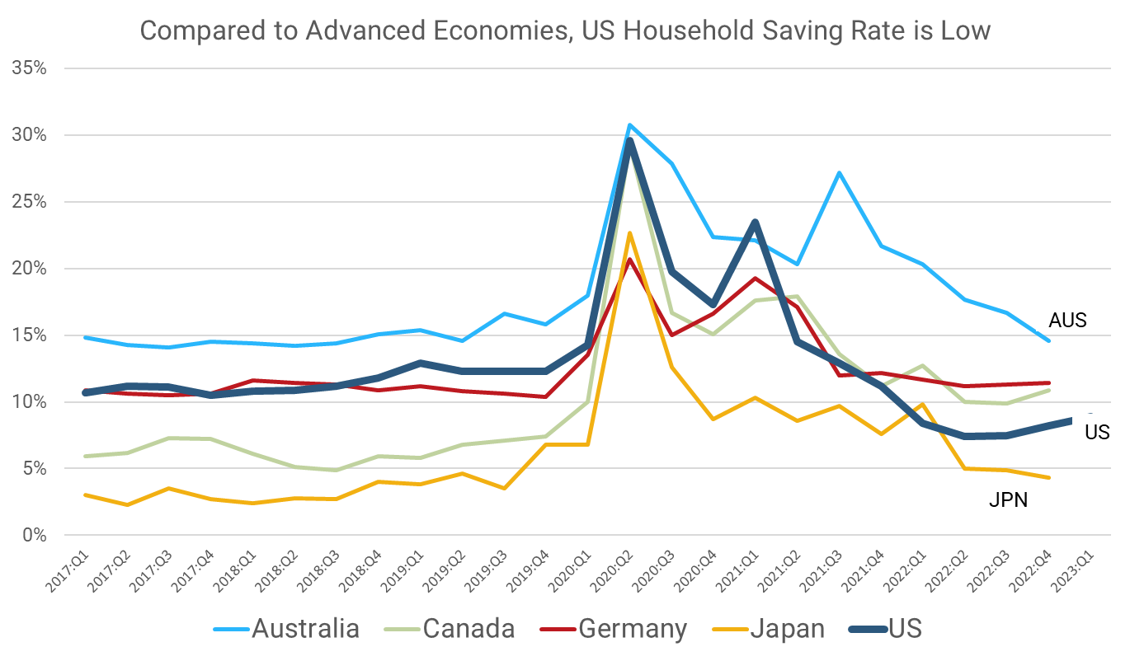
Can We Afford to Retire? Savings Rate Comparison
US savings rate is one of the lowest in the industrialized world (OECD countries). Why?
Later Retirement Ages and Spending Patterns: Americans generally retire later than Europeans, which contributes to a lower saving rate
Consumption Culture: The US has a strong consumption-oriented culture, which promotes immediate consumption over saving.
The "Wealth Effect" from Asset Appreciation: As housing and stock prices rise, households often feel wealthier and reduce their savings.
Tax Incentives and Credit Accessibility: Tax policies and readily available credit in the US allow for higher consumption relative to disposable income.
Notes:
Despite higher retirement ages and evolving work patterns, Americans save less than their peers in most developed nations. While the US is near the bottom, I want to focus attention on Japan—Japan used to have one of the highest savings rates in the world, now it’s among the lowest—they have passed over the Demographic point-of-no-return

Slide 13
Retirement Income Versus Wages
Savings and Investments: Preference for low-risk investments, bonds over equities
Wage Income: Healthier seniors may (need to) stay in the workforce
Pensions: Many funds rely on stock market returns; widening pension funding gaps.
Not all private sector workers have Defined Benefit Plans
Notes:
Let’s talk money. Generally, we are talking about trade-offs between wage income, savings and investment, and pensions. Many seniors will continue to work to save up. If pension funds do not achieve sustainable returns, pay-as-you-go funds will pay less and less over time, especially when fewer workers enter the labor force.

Slide 14
Social Security and SSI
Share of US Personal Income from Social Security will rise from 9% to 11% by 2035
Old-Age and Survivors Insurance (OASI) will restrict payments to 79% in 2035. Hospital Insurance (HI) is fully funded until 2036
Social Security: Looming Trust Fund Insolvency?
Insolvency depends on future workers: retirees ratio, Fed action
Could occur 2033-2035
In Southeast Florida
SS Transfers are ~9-10% of Personal Income (+Earnings, Property Income) in Southeast Florida.
A cut in SS and SSI benefits would cost:
$11 Billion in Sales and $10 Billion in Personal Income (-1.3% income, -1.0% of sales) per Year.
-$1,000/Person
Southeast Florida Job losses in construction, retail trade, health care, real estate, personal services
(-50,000 jobs, under baseline per year in Southeast Florida)
To prevent insolvency, benefits would be cut 21-23% and Full Retirement Age be deferred to 70/71.
.
Notes:
Of course, that also applies to Social Security—we have seen a lot of news about trust fund insolvency for Social Security, as solvency relies upon that future workers: retirees ratio. We are less than a decade away from potential cuts. May not happen, don’t think we will get there, but one study said that we could expect benefit cuts of 23%.
That would be a big blow to a region where about 18% of all personal income comes from those transfers. For our 7 county region, that’s a loss of about $23 billion in sales a year, trickling down to everyone at a loss of almost $2,000 dollars a year per person per year. More broadly speaking, that’s 100K jobs fewer in construction, retail, health care, and so on. There are very local effects of federal decisions.

Slide 15
State and Local Fiscal Cascades
Potential for Reduced Social Security Payments, Coupled with Low Savings Rate, means Less Local Spending on Goods and Services (-~10%)
=
Local Employment Shock
State pension funds already struggle to meet obligations, pension reform may lower payouts
Exacerbating the local employment shock.
FS196.075 Additional homestead exemption for persons 65+. Shifts tax burden to younger homeowners paying for more senior services. Reduces starter home inventory.
Medicaid and Other Factors Squeezes State and Local Government, Produce Shift in Size and Scope of Public Services
Need for (Regional?) Pension Solutions?
Tough Local Choices ahead:
Climate Resilient Investment; Accommodations for Older Users of Public Services, Potential for School Consolidation
Notes:
So let’s line up our dominoes here, if we do nothing to strengthen our labor force, to raise the savings rate, to reform pensions and social security, we will encounter a local employment shock and a wage-price spiral that will make many goods and services more expensive. Coupled with older people aging-in-place with additional property tax caps means that more of the tax burden shifts to younger families, just as the scope and size of public services changes to meet new demands for an aging population. States and some localities will need to spend more on Medicaid, and without local solutions, there will be bigger local problems. How do we face the need for different public services, when there is already unmet needs on meeting climate challenges.

Slide 16
Proportional Projection of Current Elder Care Needs to 2050
Notes:
Because we are going to need it. The blue bars in these graphics, for Assisted Living Facilities, Adult Care, etc. are how many beds and patient days we currently have in each county. If the Over 65 population grows as fast as forecasted for Medicaid, and the elderly population in need of the other things is proportionate to the gain in elderly Southeast Florida residents, we are going to need between 2.5 to 2.8 times as many beds, as much Medicaid patient days, as we currently have.
Thinking in land use terms, that represents a substantial jump in elder care needs that we may or may not be prepared to meet.

Slide 17
Emergencies, Lifeline Services, Evacuations (2023)
Emergency and Lifeline Capacity
Aging national electric grid needs significant investment
County | Electricity Dependent Residents | Special Needs Shelters | Special Needs Shelter Max Capacity
Broward | 11,274 | 5 | 2,068
Miami-Dade | 18,927 | 8 | 2,842
Palm Beach | 9,708 | 2 | 858
St. Lucie | 2,975 | 3 | 825
Indian River | 1,624 | 1 | 47
Martin | 1,509 | 5 | 2,233
Monroe | 396 | 1 | 91
Total | 46,413 | 25 | 8,964
Notes:
But the troubles don’t stop there, especially here where the hurricanes rumble. I did not produce a forecast for these numbers, but you can see we have a lot of elderly care exposure to lifeline services. At a time when our national electric infrastructure is in desperate need of new investment, our electricity driven lifelines leave a lot of residents in need of additional support. Imagine the number of electricity dependent residents rising to 100,000, or needing to expand special needs capacity to 27K.

Slide 18
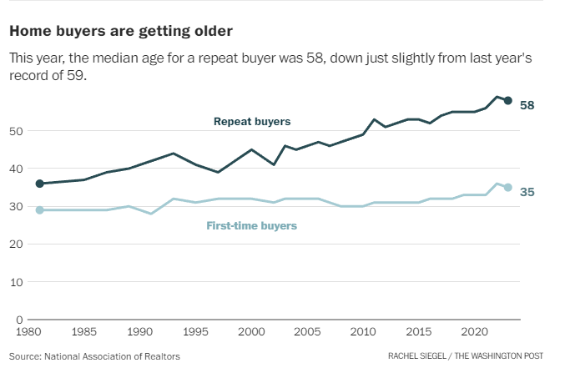
Challenges = Opportunity Beware of Wishful Thinking
Baby Boomer Retirement Decisions Point to Gradual, Not Sudden Change
Large-scale housing downsizing not occurring. 65% want to age in place (49% want to upsize).
Opportunities to Rethink Policy
Retreat from the Childcare Fiscal Cliff
Child Care Stabilization Grants ended September 2023.
Tradeoffs between automation and immigration
Increased demand for workers in healthcare, manufacturing, and the knowledge economy
"You’ll see a supply-demand dynamic shift [toward retirement downsizing]“ -- Meredith Whitney, founder and CEO of Whitney Advisory Group, Yahoo Finance's Invest Conference, Nov. 2023.
Whitney cited data from the AARP stating that 51 percent of people over 50 — a group that owns more than 70 percent of U.S. homes — are set to downsize to smaller homes.
Notes:
However, we do have time. Some of the early predictors of major demographically driven behavior change has not happened, or not at an exceptionally fast pace. There has not been a massive wave of downsizeing in housing, nor does there seem to be evidence of a major sell-off equities—as this monthly active listing count for the US shows, we have seen active listings decline, not increase in recent years. If anything this points to more people choosing to age in place.

Slide 19
Facts and Figures Round-Up
73% of Baby Boomers are already older than 65, 20% older than 75, Half will be older than 75 in 2030
Percent of 65+ in the US will rise from 16% now to 22% by 2050
85+ population in Southeast Florida will more than double in 25 years: increased elder care
If you were born in 1925, you have an average of 6-12 grandchildren; born in 1975, you would expect 2-4: decreased family support
70% of US Homes are owned by 50+ population: +slow housing production will constrain starter home stock
65% of 65+ want to age in place and Median age of home buyer is 58
Only 15% of private sector workers have a defined benefit pension plan
Assisted Living costs in Florida average $4,750/mo. In Miami, around $5,250/Mo. Hourly Home Care is $23.50. Adult Day Care statewide average of $15,600/year.

Slide 20
Sources
Title Slide: US Census, Births Per Woman, 1910-2022. Opinion | AI, Aging and Shifts Globalization Will Shock the American Economy - The New York Times (nytimes.com)
Unprecedented Global Transition: Source: US Census, International Database (IDB)
Immigration Scenarios to 2050: 2023 National Population Projections Tables: Alternative Scenarios (census.gov)
Florida Projections (Slides 4-6) by Age Cohort, UF BEBR, 2022.
Labor Force Trends: St Louis Federal Reserve Bank, US Bureau of Labor Statistics. Aaronson, D., Davis, J., & Hu, L. (2012). Explaining the decline in the U.S. labor force participation rate. Chicago Fed Letter, 1. Cline, W., & Nolan, J. (2014). Demographic versus Cyclical Influences on US Labor Force Participation. ERN: Business Fluctuations; Cycles (Topic).
How Does Older American Spending & Macroeconomic Impacts: Bureau of Labor Statistics Calendar year aggregate expenditure shares, Maestas, N., Mullen, K., & Powell, D. (2016). The Effect of Population Aging on Economic Growth, the Labor Force and Productivity. Ewing Marion Kauffman Foundation Research Paper Series. Average Retirement Income in 2024 | The Motley Fool
Costs of Aging: Projected | CMS; Patients vs. Profits: Who Wins in the Traditional U.S. Dialysis System? - Strive Health; Florida Elder Care Costs for 2023 | Senior Care Options Compared (assistinghands.com). Average Retirement Income in 2024 | The Motley Fool, ACS and Bureau of Labor Statistics.
Can We Afford to Retire: de Soyres, Francois, Dylan Moore, and Julio L. Ortiz (2023). "Accumulated Savings During the Pandemic: An International Comparison with Historical Perspective," FEDS Notes. Washington: Board of Governors of the Federal Reserve System, June 23, 2023, https://doi.org/10.17016/2380-7172.3326.
Social Security and SSI: Actuarial Status of the Social Security Trust Funds, SSA, May 2024. Reports from the Board of Trustees (ssa.gov). States’ Unfunded Pension Liabilities Persist as Major Long-Term Challenge | The Pew Charitable Trusts (pewtrusts.org); REMI PI+ Forecast, SFRPC 2032-2060, 2023 Fixed Local Dollars. Arnold, R. (2015). Politics at the Precipice: Fixing Social Security in 2033. The Forum, 13, 18 - 3.
Aging and the Built Environment: AARP Public Policy Institute. (2018) Complete Streets for All: The (Many) Benefits of Designing Streets for Inclusive Mobility; Aging Road Users Strategic Safety Plan, 2017, Miami-Dade TPO; Deloitte. (2019) The Future of Retail: Meeting the Demands of an Aging Population; zerofatalitiesnv.com/app/uploads/2020/11/2014-10-20-OffSet-Left-White-Paper.pdf; census.gov/content/dam/Census/library/publications/2020/demo/p23-217.pdf
Projection of Elder Care Needs: Florida Department of Elder Affairs, 2023 Profile of Older Floridians. SFRPC staff proportionate projection to 2050, 2024.
Emergencies, Lifeline Services, and Evacuations: Florida Department of Elder Affairs, 2023 Profile of Older Floridians. SFRPC staff analysis, 2024.
Challenges and Opportunity: Realtor.com via St. Louis Federal Reserve Bank, 2024. Baby boomers are edging out younger buyers in hot housing market - The Washington Post. agewave.com/wp-content/uploads/2016/07/2015-ML-AW-Home-in-Retirement_More-Freedom-New-Choices.pdf
Thank You!
Questions?
Randy Deshazo
SFRPC
rdeshazo@sfrpc.com
“Barreling toward us are three epochal changes poised to reshape the U.S. economy in coming years: an aging population, the rise of artificial intelligence and the rewiring of the global economy” –
Daron Acemoglu, Harvard; (“America is Sleepwalking into an Economic Storm” NYT, Oct 17, 2024)

Slide 21
Working Age Population, Labor Force, Jobs (Example)

Slide 22
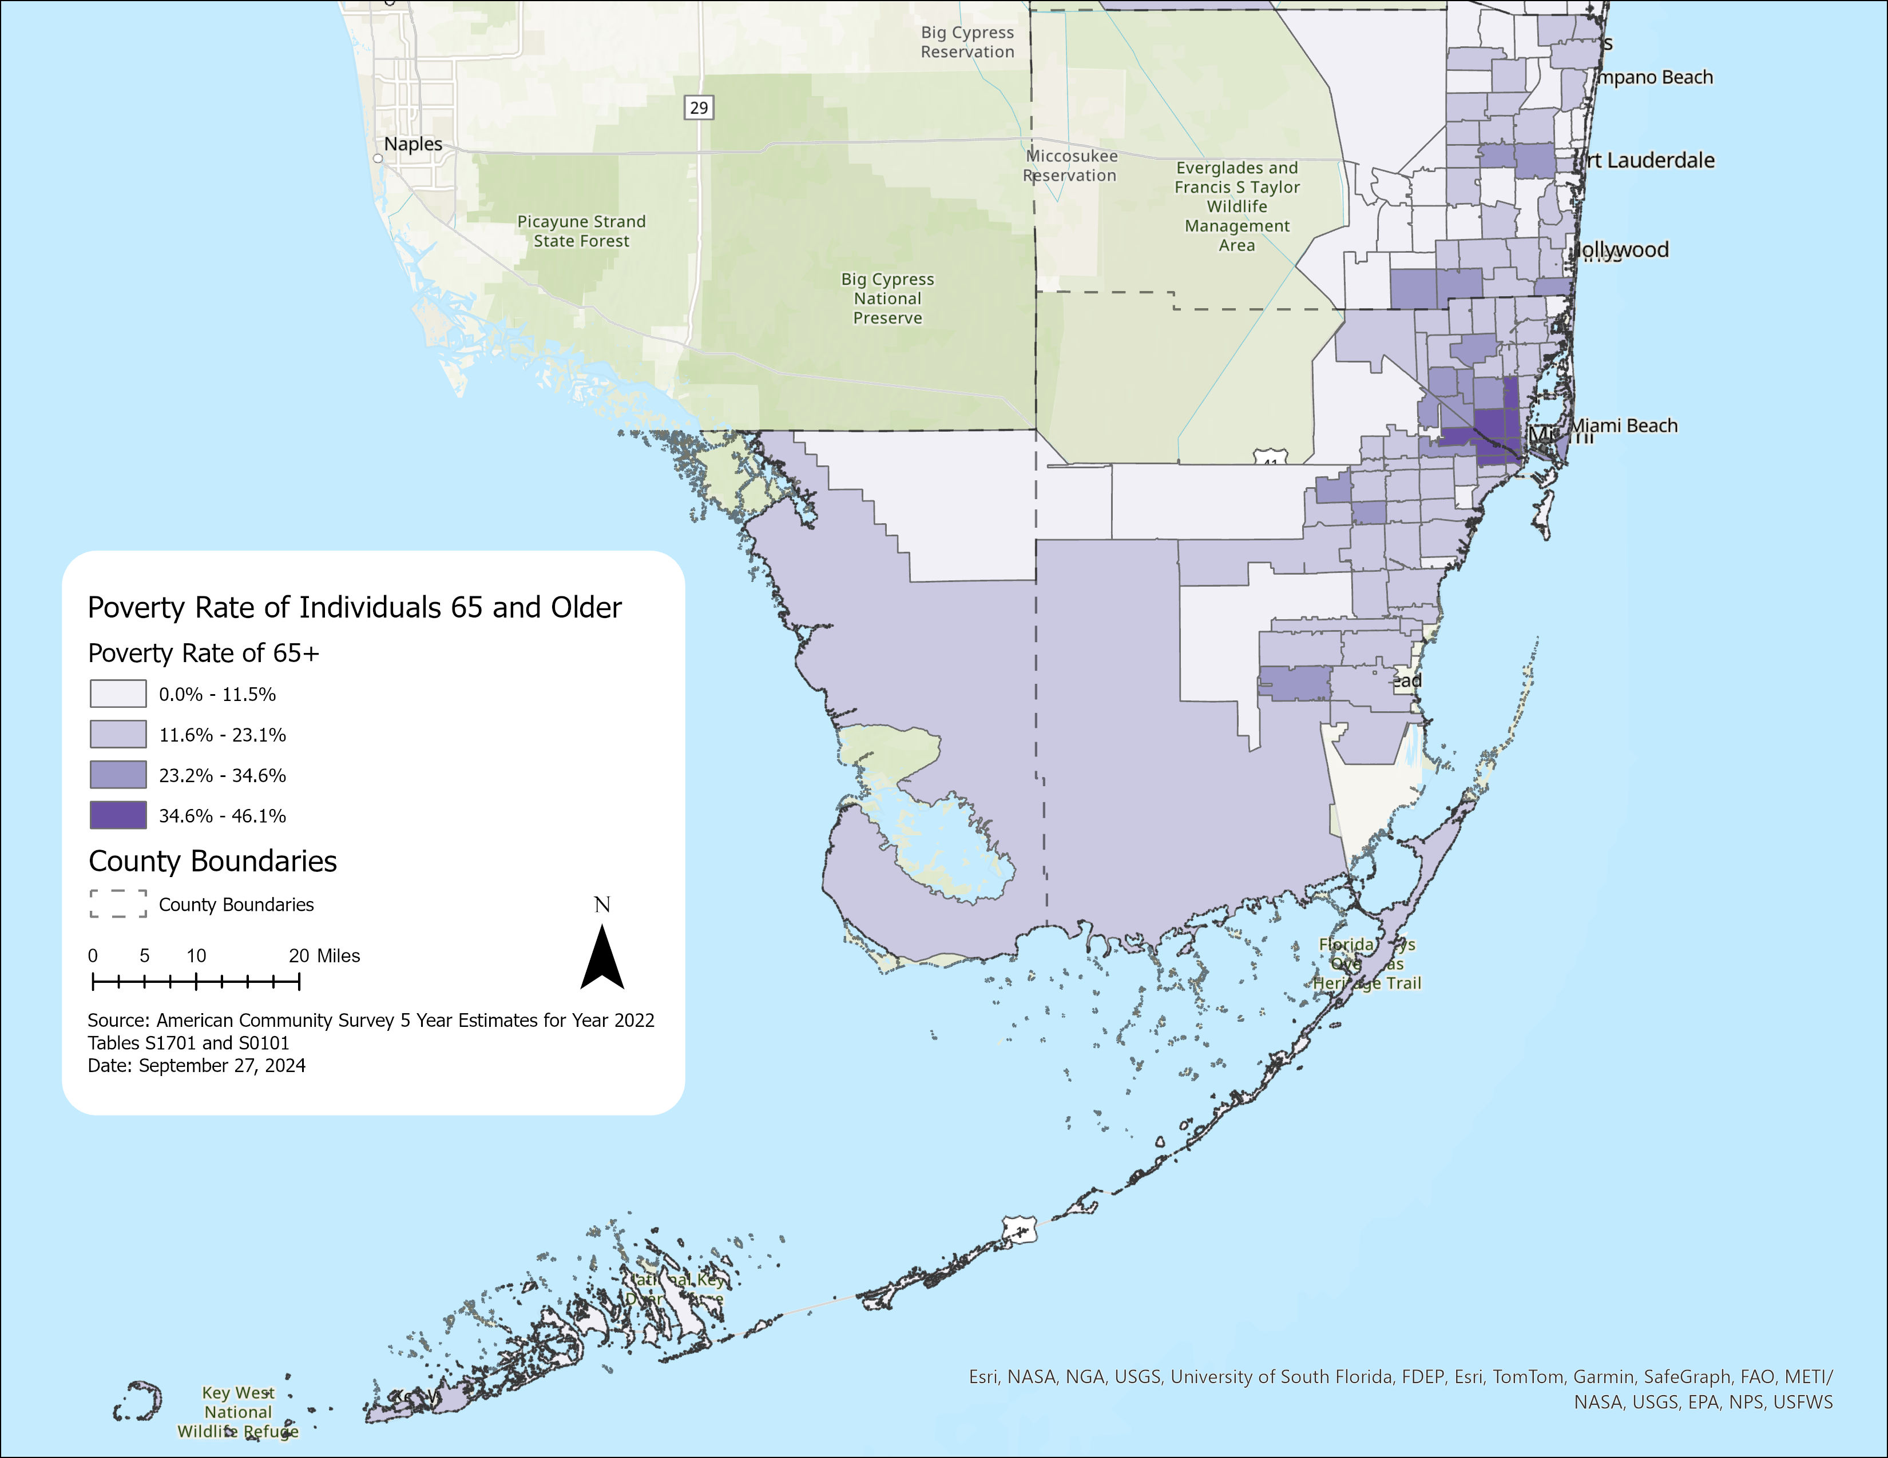
65+ in Poverty | SFRPC

Slide 23
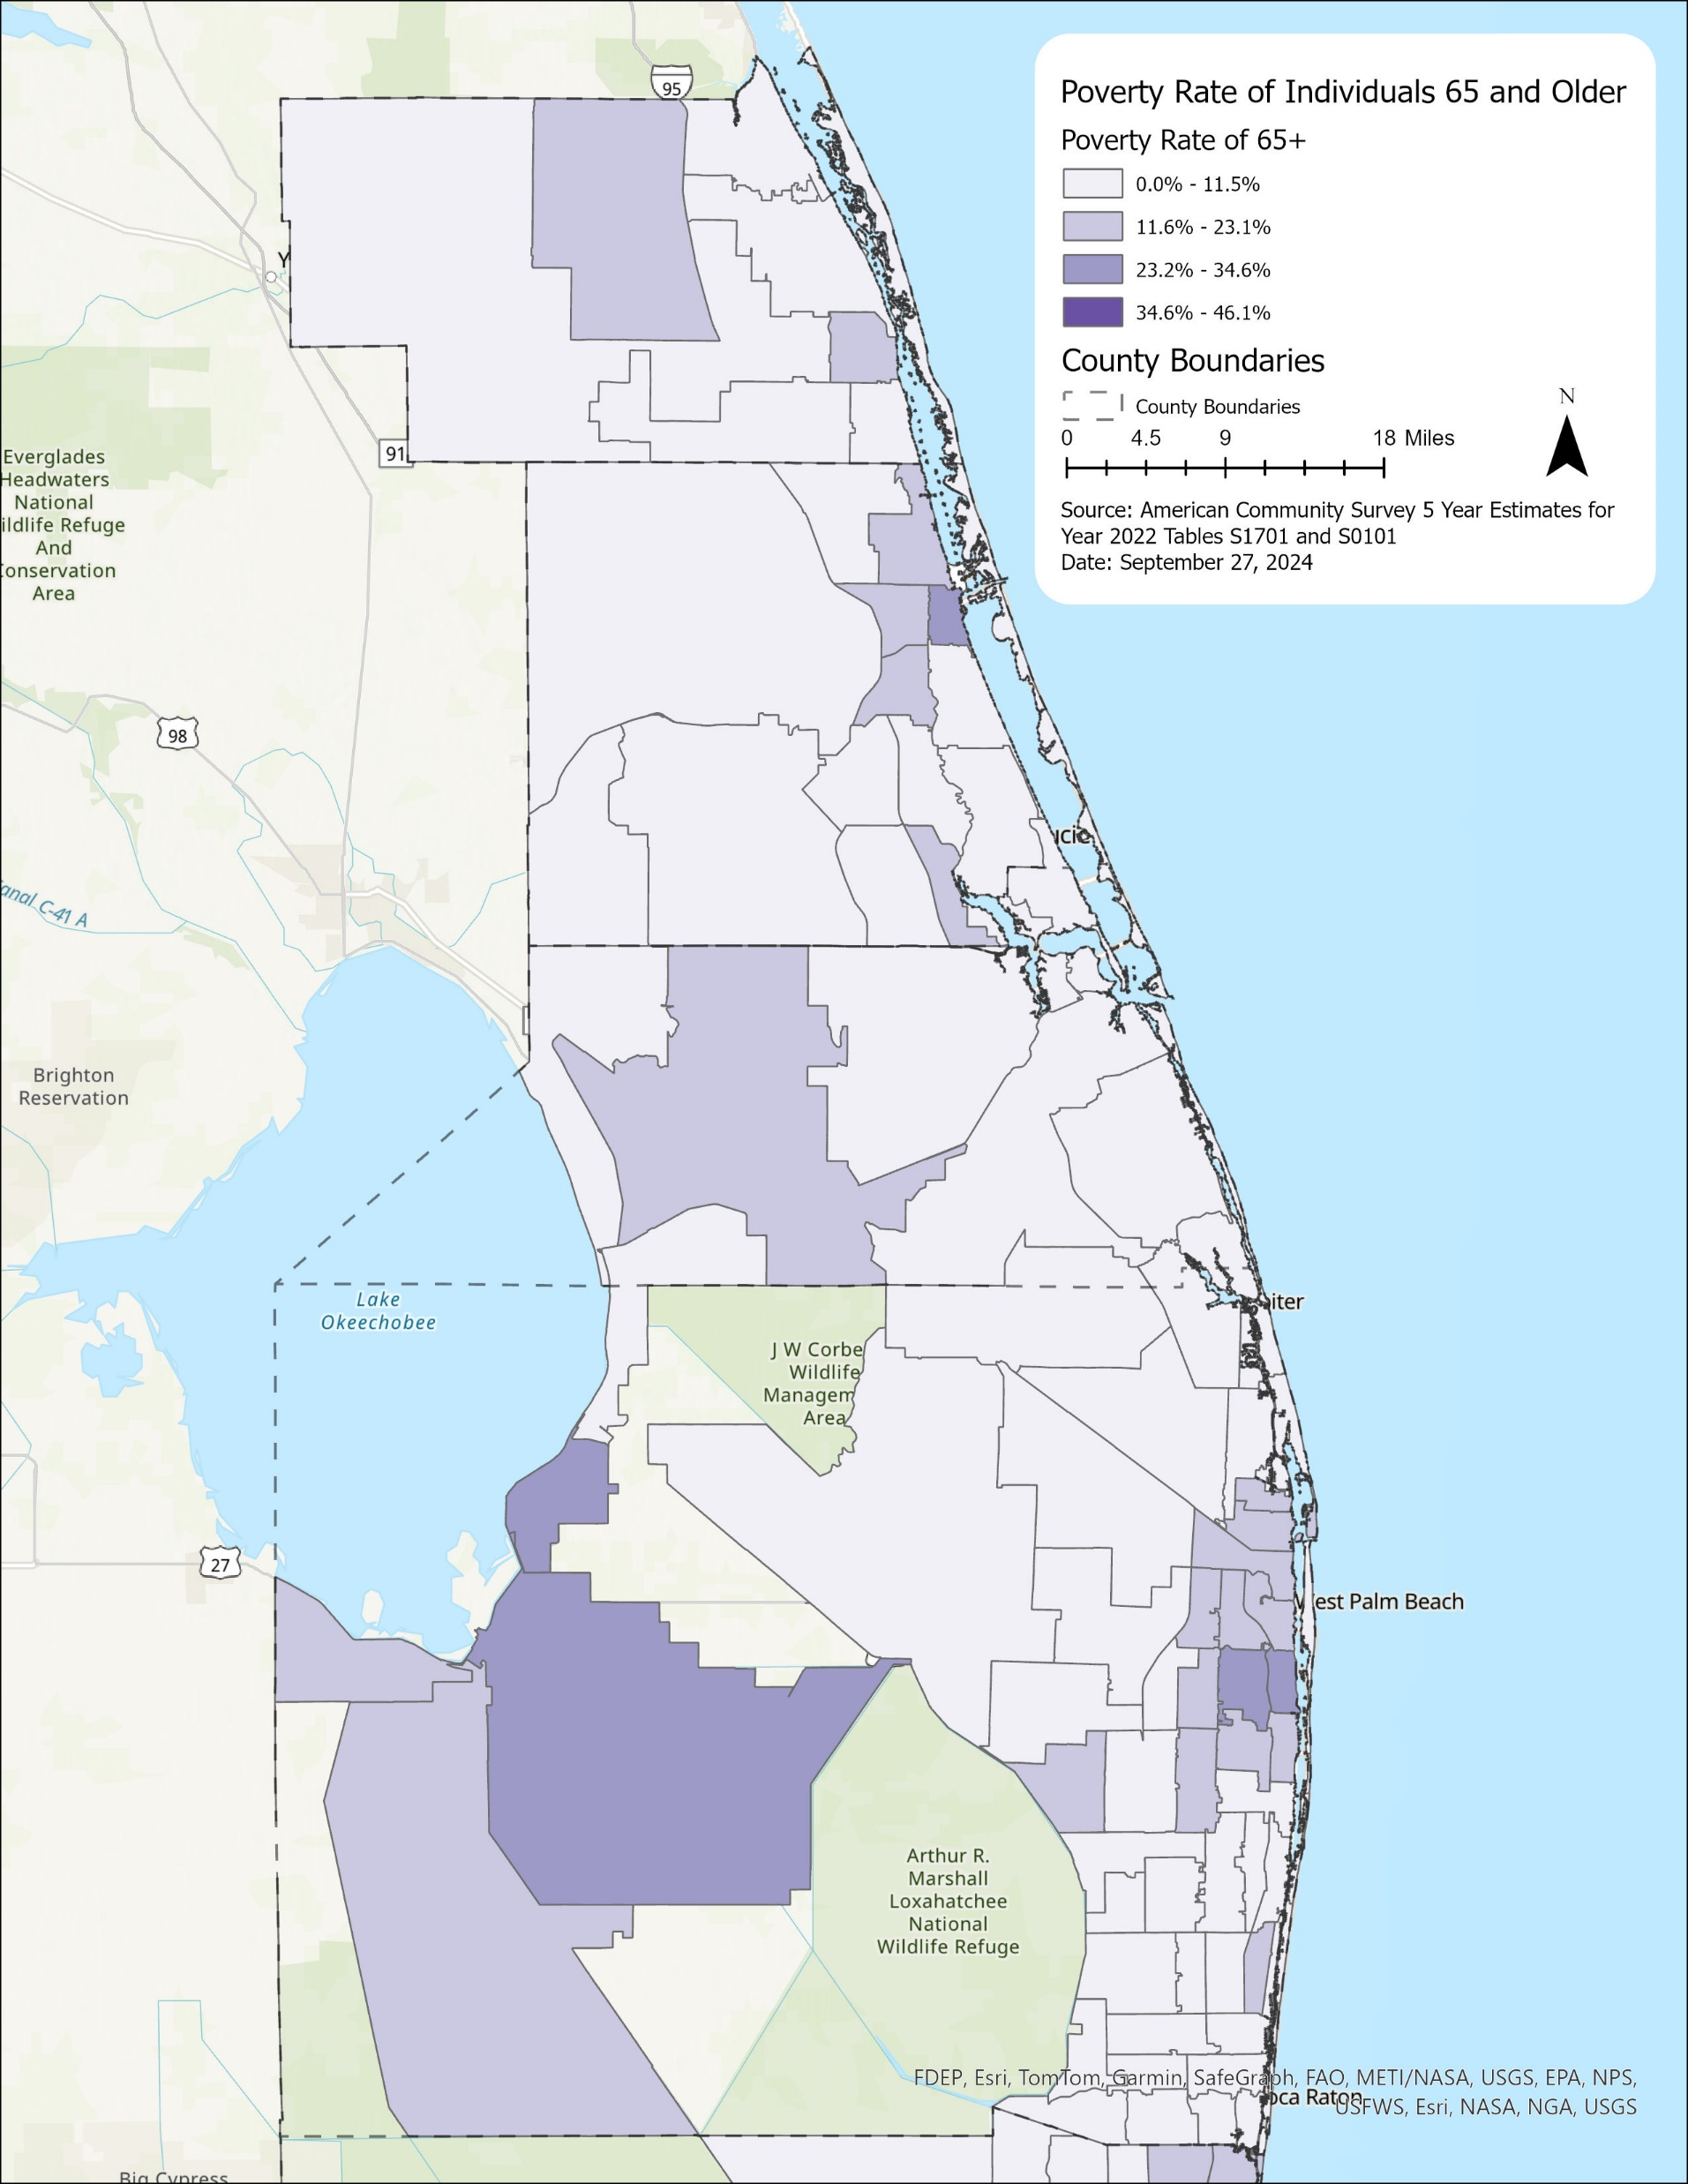
65+ in Poverty | TCPRC

