Slide 1
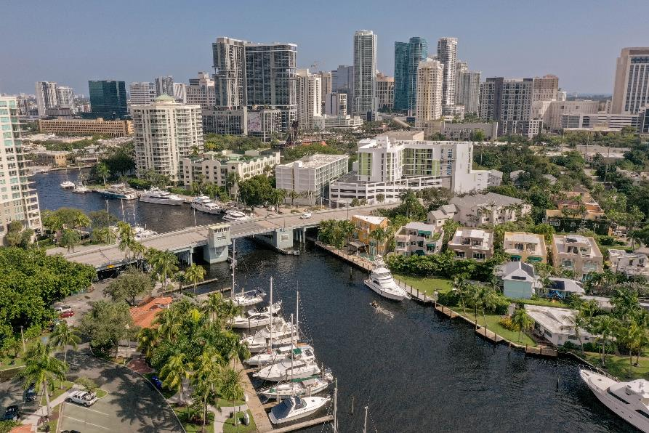
Update on the Central & Southern Florida Flood Risk Study – Status and Timing
South Florida Regional Council Meeting
September 30, 2024

Slide 2
Last Time We Met
Section 216 Study Scope under substantial pressures
Level 3 engineering requirement was driving descoping
Appropriations not meeting budgetary needs
Timeline for study completion increasing uncertain
SFWMD, Broward, and Miami-Dade counties were evaluating alternative paths forward
Cost share funding needed to complete primary
Alternative authorizations and programs

Slide 3
Subsequently
Broward County Commissioners began voicing C&SF as a budget priority
Staff dialog with SFWMD regarding potential financial partnership to accelerate study
C&SF study cost share advanced as commission budget priority, included in recommended budget
Final FY ‘25 budget includes $5 M for cost share in C&SF Resilience Study, with goal of WRDA 2026 authorization

Slide 4
Simultaneously, Path for C&SF Flood Risk Resilience Study Evolves
July 17, 2024 - SFWMD submitted to USACE letter of intent to undertake Section 203 Study for Reach A of 216 Study (Broward and Hillsboro Basins)
August 22, 2024 – ASA Connor authorizes USACE to enter into MOA w/ SFWMD for technical assistance and federal activities in support of Section 203

Slide 5
SFWMD Announces New Strategy
SFWMD assumes lead for planning study for reach A (accelerating timeline)
Reach B (Little River basins) primarily addressed through FEMA projects
Reach C (Miami River basins) and D (Sought Miami basins) remain within Section 216 process

Slide 6
Status and Next Steps
Interlocal Agreement between Broward and SFWMD being advanced
MOA and scopes of work between SFWMD and USACE underway
Timeline for approvals is sensitive and requires vigilance
Target completion for Section 203 Study – May 2026
Requires approval via Chief’s Report – Summer/Fall 2026
Target WRDA 2026 for project authorization and appropriations
Strong advocacy required
Comprehensive Study still required for recommendations beyond Section 203 Study

Slide 7
Questions ?
DR. JENNIFER JURADO
Chief Resilience Officer, Deputy Director
Resilient Environment Department
jjurado@broward.org
954-519-1464

