Slide 1
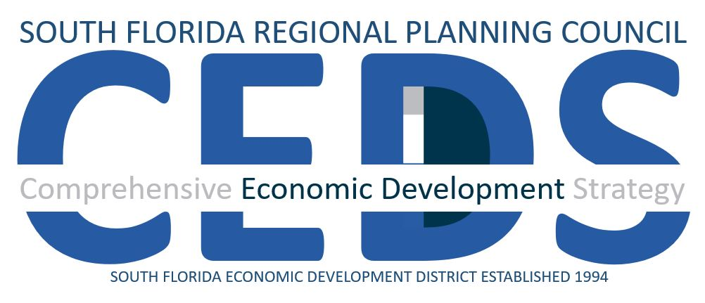
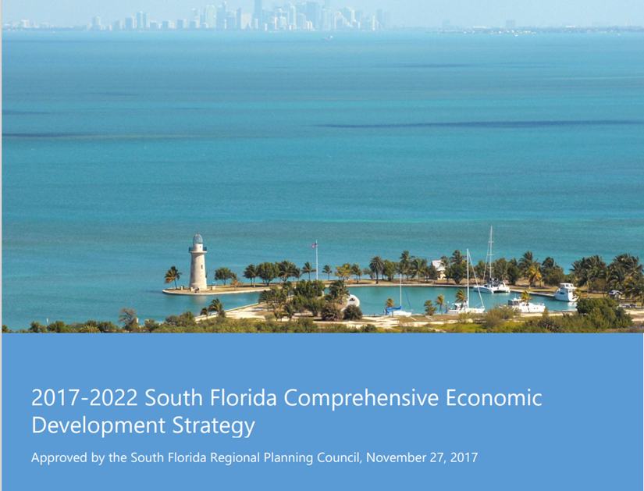
Comprehensive Economic Development Strategy Council Meeting Action Requested: Release for 30 Day Review Period
Randy deshazo
Deputy director/chief of staff/director of economic development
October 21, 2024
Notes:
Good morning everyone, and thank you very much for your time for joining us for our Second CEDS Strategy Committee meeting. I am Mark Cassidy, the Economic Development and Research Manager at the Council, and I really appreciate your participation and feedback thus far. I’ll turn it over our fearless leader and CEDS Committee Chair, Senator Geller for an introduction and some housekeeping.

Slide 2
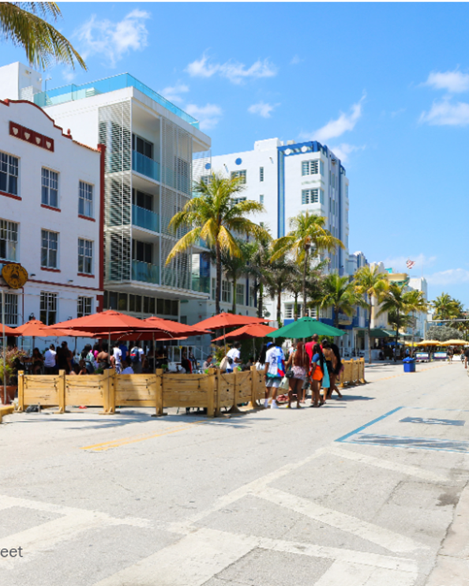
Summary
Employment Growth: South Florida has outperformed both state and national averages in job creation, with major gains in Leisure and Hospitality (adding over 40,000 jobs) and Professional and Business Services (17,000 jobs). Unemployment rates have decreased significantly across the region, with Miami-Dade showing the strongest recovery, dropping by 2.5 percentage points to 5.6%.
Sector-Specific Trends: The Information, Professional Services, and Manufacturing sectors have seen robust growth, reflecting post-pandemic recovery and labor demand. Meanwhile, the Education and Health Services sectors continue to lag behind, with under 1% growth across the region in 2022.
Workforce Challenges: A tightening labor market has increased pressure on employers to offer better wages and benefits, but labor force participation rates remain below pre-pandemic levels. The region is also facing a skills gap, particularly in high-demand industries such as information technology and healthcare, which presents an ongoing challenge.
Notes:
EDA instructed us to provide an Annual report with these items: [read from slide]. As a quick overview of the contents, first are the highlights of key changes to the economy. [read from slide] … population change in Monroe and Miami dade

Slide 3
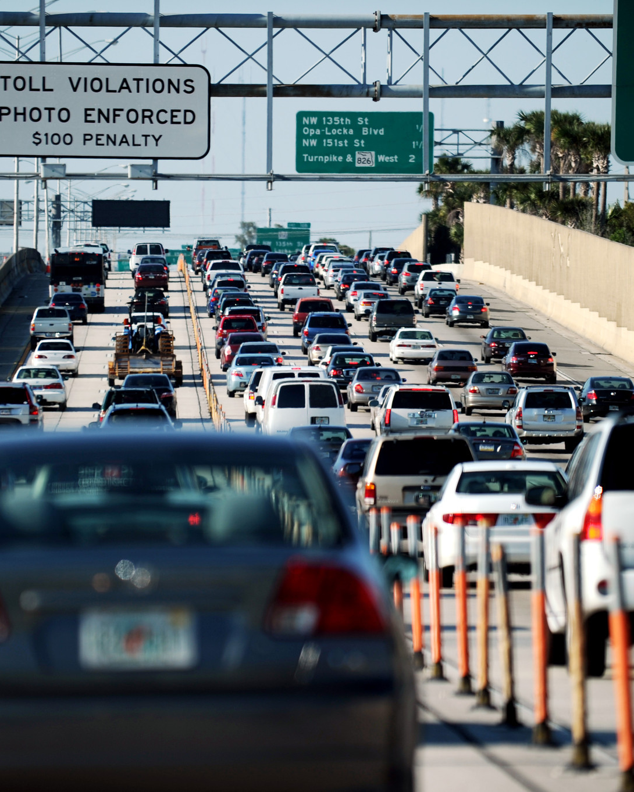
Summary Continued
Housing and Infrastructure: Housing affordability is a critical issue, with Monroe County seeing median home prices exceeding $1.3 million, and similar upward trends in Palm Beach, Miami-Dade, and Broward counties. Additionally, transportation inefficiencies—exemplified by the Miami metropolitan area's high traffic congestion—are costing the region approximately $3.1 billion annually. These challenges underscore the need for strategic investment in both housing and transit infrastructure.
Population Dynamics: South Florida's population growth has shown signs of recovery following pandemic-related declines. However, Miami-Dade's reliance on international migration has slowed its population rebound compared to Broward and Palm Beach counties, which have benefited from domestic in-migration. Monroe County's population growth has been stronger, driven by its tourism-dependent economy. (INRIX 2023, Global Traffic Scorecard. January 2024.)
Notes:
EDA instructed us to provide an Annual report with these items: [read from slide]. As a quick overview of the contents, first are the highlights of key changes to the economy. [read from slide] … population change in Monroe and Miami dade

Slide 4
Pandemic Related Dislocations Have Moderated

Slide 5
Regional Domestic Product Growing

Slide 6
Slow Decline in Labor Force Continues

Slide 7
Household Income

Slide 8
Cooling off in listing prices

Slide 9
Wages are Up, But Still Under Q4 ‘21 Levels

Slide 10
Slow Uptick in Unemployment

Slide 11
Outlook
Over the next two years, South Florida is likely to experience continued economic growth, but the pace may slow due to several structural challenges:
Labor Market: South Florida will likely continue to face workforce shortages, especially in high-skill sectors. Efforts to address the skills gap through training and education will be critical for sustaining job growth.
01
Housing Market: Housing affordability will remain a significant issue, particularly in Monroe County and Miami-Dade. Without substantial interventions, rising home prices will contribute to ongoing displacement and exacerbate inequality.
02
Infrastructure Development: While employment and business activity will continue to grow, transportation inefficiencies and congestion could act as a brake on economic growth. Investment in transit infrastructure will be essential to support the region’s expansion.
03
Sectoral Outlook: The Leisure and Hospitality sector is expected to remain a pillar of job growth, but other sectors like Information, Professional Services, and Manufacturing will likely see stronger gains as the economy diversifies. However, lingering supply chain disruptions and workforce constraints may temper the speed of recovery in industries such as construction and retail.

