Slide 1
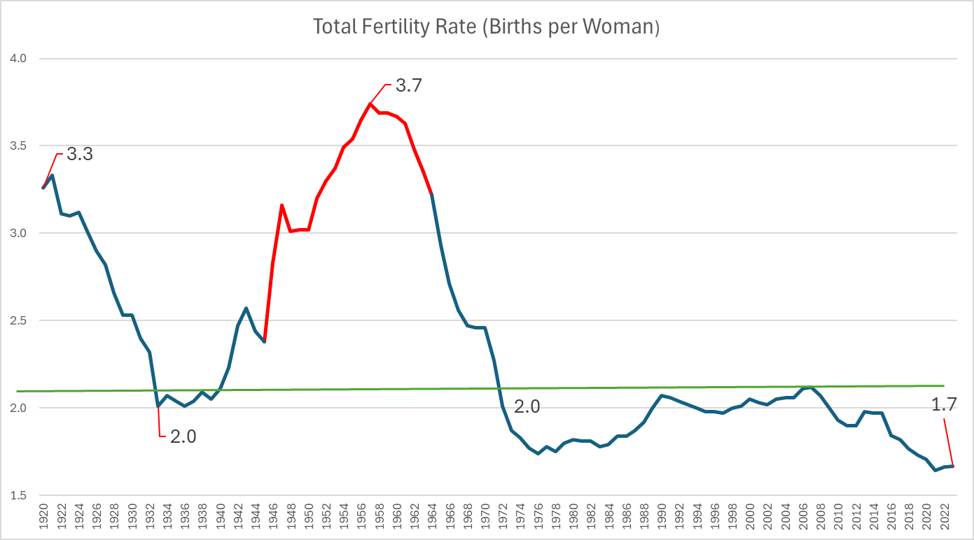
Regional Outlook on Aging in Southeast Florida SFRPC Council Meeting, October 21, 2024
Randy Deshazo
Deputy Director and Director of Economic Development and Research
South Florida Regional Planning Council
(SFRPC)
Sources on Last Slide
Notes:
We are here today because we know the United States is going through an epic demographic transition, where 75% of baby boomers have already reached and passed the age of 65. It’s a good time to look at what predictions we had for what would happen when the first wave of Baby Boomers retired, and what still may happen—in other words, is this demographic transition is tsunami or is it a case of gently rising sea level?
Let’s look at this graph, this is a century of births per woman, which dropped steadily since the early 19th century as the US became more urbanized, and the rate dropped suddenly with the Great Depression and didn’t recover until 1946, when it soared to a rate of 3.8 children. At a time when mortality rates had been plunging since the end of te war, the US entered a growth period called the Demographic Dividend—lots of young working people, relatively few older people to support at a time when the US was the only standing industrial power in the world. In 1964, there were more children born in the US than any year before or since. It’s been downhill ever since. So we have a two part question here, how will the aging of the Baby Boomers affect the overall economy, and how will the aging of that generation impact the generations that follow?

Slide 2
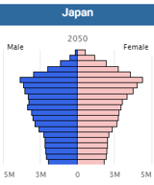
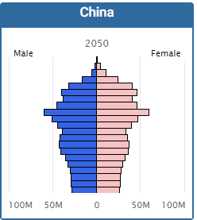
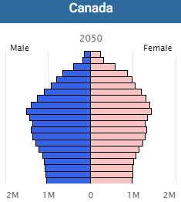
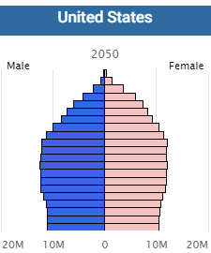
An Unprecedented Global Demographic Transition
Old
Low Birth Rates
Median Age: 54.9 in 2050
Dependency Ratio: 73.7
Median Age:51.1in 2050
Dependency Ratio: 49.5
Median Age:47.3 in 2050
Dependency Ratio: 46.6
Young
Population Pyramid
Median Age: 43 in 2050
65+ Dependency Ratio: 36
Notes:
First, let’s have some context. Not only is the United States not alone among industrialized countries that entering an aging phase, we don’t have it as bad as most other of our competitors. These beehive structures here are what we call population pyramids. They’re pyramids because each band or level represents an age group, with the oldest and therefore fewest at top, supported by more and younger people. When you have a pyramid shape, you have the ingredients of growth, when that pyramid is inverted, you have lots of older people to support with relatively few young people.
Based on Census projections for 2050, Japan is the worst case here, where the ratio of older Japanese will be 74 people to 100 younger people. How do you sustain an economy with that kind of ratio? In China, the ratio is about 50 retired people to 100, and the Chinese are worried. Relative to those countries, the US is looking to be in fairly good shape in comparison. There is a reason—even though we are no longer having enough children, we are still dominant in the world economy.
The ratio of individuals over age 85 to those in peak caregiving years of 45–64 is projected to increase from 1-to-7 today to 1-to-3 by 2050. The lack of family-based care means more institutional care.

Slide 3
US Census: Population Growth by Immigration Scenario to 2050
Population Peak: 2025
Population Peak: 2080 (Assuming background immigration rate)
Population Peak: Past 2100
Notes:
Our population is growing because of immigration, full stop. We can talk about the cultural, economic, and many different other factors of immigration, but the simple fact is that without immigration our population starts to sink. If we cut off all immigration tmw, our population will shrink from today by 2025, and instead of a labor force that grows by 4% it will shrink by 9%. Our older population will grow even faster.
The data from the US Census Bureau, and includes legal and estimates of illegal immigration. The Bureau does not distinguish between those, and while we can discuss the ups and downs on the latter category,

Slide 4
BEBR: Southeast Florida (All 7 Counties) 2025-2050
Notes:
Now we are going to shift focus to the forecasts produced by the University of Florida’s Bureau of Economic and Business Research for change between 2025 and 2050 by age group. As with the United States, our over 65 group is the fastest growing segment, gaining about 50% in our 7 county megaregion, 55% statewide. The over 85 set will more than double in our region, and almost triple statewide.

Slide 5
BEBR: South Florida 2025-2050 (Broward, Miami-Dade, Monroe)
Notes:
Breaking down a bit more, in most counties the over 65 cohort will nearly double, and in Monroe county over 85s will triple, with Broward’s 85+ rate just behind that of Monroe.

Slide 6
South Florida in 2050
Treasure Coast 2025-2050 (Indian River, Martin, Palm Beach, St. Lucie)
Notes:
Treasure Coast will see a doubling of the 85+ cohorts, while its labor force will grow faster than South Florida’s. Now labor force growth is the most important factor in sustaining the demographic basis of our economy.

Slide 7
US Labor Force Participation Rate Trends
US labor force participation rates have declined steadily since 2000, and faster after 2011. Employment still grows bc of underlying population growth
Drivers are
Baby Boomers (55-60% of decline)
Declining 25-54 Prime Male Participation Rate
57% cited disability
Status and education
Not only labor scarcity, but a growing skill gap
May be offset by more educated young workers
Recession
Productivity Losses and Labor Shortages most acute in:
Healthcare
Education
Technical and Construction
Knowledge Economy
Notes:
And the trend in the United States is that fewer people are participating in the labor force, and that is a process that has been underway since the start of the century. Now, while Baby Boomer retirements may be the single most important driver of people leaving the labor force, there are other important reasons—after each major recession, more people withdraw from the labor market. Younger workers go back to school, prime age men, especially those in physical labor, withdraw for health reasons.
There are other issues that are hidden by the graph, especially a growing skill gap between older workers and younger ones. Labor productivity in the US has been stagnant and labor shortages are more prevalent in key industries such as health care and knowledge economy jobs.

Slide 8
How Does Older American Spending Compare to 45-54 YO Baseline?

Slide 9
Macroeconomic Impacts
US GDP May Shrink
Every 10% increase in the fraction of the population aged 60+ could result in a 5.5% reduction in GDP per capita due to slower employment growth and dropping labor productivity.
Silver Lining automation likely to stem some decline
Consumer Spending = Jobs
More healthcare workers, legal and financial services
Fewer retail sector jobs, food service, some manufacturing jobs
Shift in investments from equities to more conservative, income-generating assets such as bonds.
Notes:
So what of the future? All of the trends that we see, is that as our population ages there is an economic hit as the labor force will shrink and retirees realign their spending. Estimates vary, but one analysis forecast that every 10% increase in the 60+ age group will result in 5.5% decrease in GDP per capita.
Not only will seniors spend less overall, they will change what they spend their money on—from education, clothes, food away from home to reading, cash contributions, health, home improvements,. They are also likely to shift their investments into less risky vehicles, like bonds. That could be good news for Muni market as money floods into those offering more steady returns.

Slide 10
Costs of Aging
Over 2023-32 average National Health Expenditure growth is projected to outpace average GDP growth, health spending share of GDP growing from 17.3% in 2022 to 19.7% in 2032. Medicare costs of dialysis alone account for 0.8% of the Federal Budget.
The median income for U.S. adults 65 and older is $50,290 while average annual expenses are $57,818. The average monthly (2024) Social Security benefit for retired workers is $1,907.
Assisted Living costs in Florida average $4,750/mo. In Miami, around $5,250/Mo. Hourly Home Care is $23.50.
Adult Day Care statewide average of $15,600/mo. Larger elderly population areas pay more per person.
Notes:
But getting older is more expensive, as our health care needs expand. The Centers for Medicaid and Medicare Services project that the health care spending share of GDP will inch up a couple of points to nearly 20% of GDP in the next 6 years.
Thinking about the impact to your wallet, average costs today for Assisted Living, for Adult Care and Hourly Home Care are already out of reach for many families. Even in areas where there are many elderly, and you would think scale economies would provide more options at less cost, it is generally more expensive than other areas of the state. Labor shortages in those areas are driving a wage-price spiral.

Slide 11
Can We Afford to Retire? Savings Rate Comparison
US savings rate is the one of the lowest in the industrialized world (OECD countries). Why?
Later Retirement Ages and Spending Patterns: Americans generally retire later than Europeans, which contributes to a lower saving rate
Consumption Culture: The US has a strong consumption-oriented culture, which promotes immediate consumption over saving.
The "Wealth Effect" from Asset Appreciation: As housing and stock prices rise, households often feel wealthier and reduce their savings.
Tax Incentives and Credit Accessibility: Tax policies and readily available credit in the US allow for higher consumption relative to disposable income.
Notes:
Even as we face higher costs, we cannot generally fall back on our savings. Americans have a notoriously low rate of savings compared to other countries. Driven by the perception of wealth from asset appreciation and easy credit, Americans are not generally prepared to pay out of pocket for future expenses.

Slide 12
Retirement Income Versus Wages
Savings and Investments: Preference for low-risk investments, bonds over equities
Wage Income: Healthier seniors may (need to) stay in the workforce
Pensions: Many funds rely on stock market returns, low interest rates will widen pension funding gaps.
Notes:
Let’s talk money. Generally, we are talking about trade-offs between wage income, savings and investment, and pensions. Many seniors will continue to work to save up. If pension funds do not achieve sustainable returns, pay-as-you-go funds will pay less and less over time, especially when fewer workers enter the labor force.

Slide 13
Social Security and SSI Share of GDP from Social Security will rise from 9% to 11% by 2035 Old-Age and Survivors Insurance (OASI) will restrict payments to 79% in 2035 Hospital Insurance (HI) is fully funded until 2036
Social Security: Looming Trust Fund Insolvency?
Insolvency depends on future workers:retirees ratio, Fed action
Could occur 2033-2035
In Southeast Florida
SS Transfers are ~9-10% of Personal Income (+Earnings, Property Income) in Southeast Florida.
A cut in SS and SSI benefits would cost:
$11 Billion in Sales and $10 Billion in Personal Income (-1.3% income, -1.0% of sales) per Year.
-$1,000/Person
Southeast Florida Job losses in construction, retail trade, health care, real estate, personal services
(-50,000 jobs, under baseline per year in Southeast Florida)
Researchers suggest that to prevent insolvency, benefits would be cut 21-23% and Full Retirement Age be deferred to 70/71.
.
Notes:
Of course, that also applies to Social Security—we have seen a lot of news about trust fund insolvency for Social Security, as solvency relies upon that future workers: retirees ratio. We are less than a decade away from potential cuts. May not happen, don’t think we will get there, but one study said that we could expect benefit cuts of 23%.
That would be a big blow to a region where about 18% of all personal income comes from those transfers. For our 7 county region, that’s a loss of about $23 billion in sales a year, trickling down to everyone at a loss of almost $2,000 dollars a year per person per year. More broadly speaking, that’s 100K jobs fewer in construction, retail, health care, and so on. There are very local effects of federal decisions.

Slide 14
State and Local Fiscal Cascades
Potential for Reduced Social Security Payments, Coupled with Low Savings Rate, means Less Local Spending on Goods and Services (-~9%)
=
Local Employment Shock
State pension funds already struggle to meet obligations, pension reform may lower payouts
Exacerbating the local employment shock.
FS196.075 Additional homestead exemption for persons 65+. Shifts tax burden to younger homeowners paying for more senior services. Reduces starter home inventory.
Medicaid and Other Factors Squeezes State and Local Government, Produce Shift in Size and Scope of Public Services
Need for (Regional?) Pension Solutions?
Tough Choices ahead:
Climate Resilient Investment; Accommodations for Older Users of Public Services, Potential for School Consolidation
Notes:
So let’s line up our dominoes here, if we do nothing to strengthen our labor force, to raise the savings rate, to reform pensions and social security, we will encounter a local employment shock and a wage-price spiral that will make many goods and services more expensive. Coupled with older people aging-in-place with additional property tax caps means that more of the tax burden shifts to younger families, just as the scope and size of public services changes to meet new demands for an aging population. States and some localities will need to spend more on Medicaid, and without local solutions, there will be bigger local problems. How do we face the need for different public services, when there is already unmet needs on meeting climate challenges.

Slide 15
Proportional Projection of Current Elder Care Needs to 2050
Notes:
Because we are going to need it. The blue bars in these graphics, for Assisted Living Facilities, Adult Care, etc. are how many beds and patient days we currently have in each county. If the Over 65 population grows as fast as forecasted for Medicaid, and the elderly population in need of the other things is proportionate to the gain in elderly Southeast Florida residents, we are going to need between 2.5 to 2.8 times as many beds, as much Medicaid patient days, as we currently have.
Thinking in land use terms, that represents a substantial jump in elder care needs that we may or may not be prepared to meet.

Slide 16
Emergencies, Lifeline Services, Evacuations (2023)
Aging national electric grid needs significant investment
County | Electricity Dependent Residents | Special Needs Shelters | Special Needs Shelter Max Capacity
Broward | 11,274 | 5 | 2,068
Miami-Dade | 18,927 | 8 | 2,842
Palm Beach | 9,708 | 2 | 858
St. Lucie | 2,975 | 3 | 825
Indian River | 1,624 | 1 | 47
Martin | 1,509 | 5 | 2,233
Monroe | 396 | 1 | 91
Total | 46,413 | 25 | 8,964
Notes:
But the troubles don’t stop there, especially here where the hurricanes rumble. I did not produce a forecast for these numbers, but you can see we have a lot of elderly care exposure to lifeline services. At a time when our national electric infrastructure is in desperate need of new investment, our electricity driven lifelines leave a lot of residents in need of additional support. Imagine the number of electricity dependent residents rising to 100,000, or needing to expand special needs capacity to 27K.

Slide 17
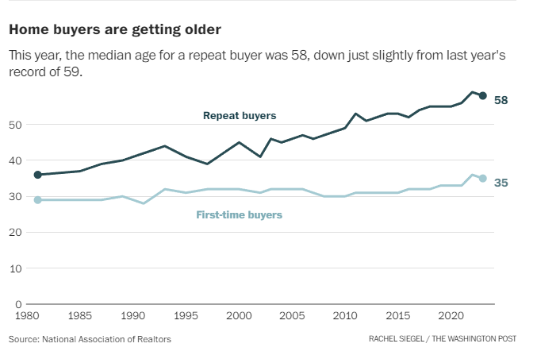
Challenges = Opportunity Beware of Wishful Thinking
Baby Boomer Retirement Decisions Point to Gradual, Not Sudden Change
Large-scale housing downsizing not occurring. 65% want to age in place (49% want to upsize).
No dramatic sell-off of equities starting in 2011, low interest rates have sustained interest in maintaining equity positions.
Opportunities to Rethink Policy
Retreat from the Childcare Fiscal Cliff
Child Care Stabilization Grants ended September 2023.
Tradeoffs between automation and immigration
Increased demand for workers in healthcare, manufacturing, and the knowledge economy
"You’ll see a supply-demand dynamic shift [toward retirement downsizing]“ -- Meredith Whitney, founder and CEO of Whitney Advisory Group, Yahoo Finance's Invest Conference, Nov. 2023.
Whitney cited data from the AARP stating that 51 percent of people over 50 — a group that owns more than 70 percent of U.S. homes — are set to downsize to smaller homes. This could bring 30 million units of housing onto the market.
Notes:
However, we do have time. Some of the early predictors of major demographically driven behavior change has not happened, or not at an exceptionally fast pace. There has not been a massive wave of downsizeing in housing, nor does there seem to be evidence of a major sell-off equities—as this monthly active listing count for the US shows, we have seen active listings decline, not increase in recent years. If anything this points to more people choosing to age in place.

Slide 18
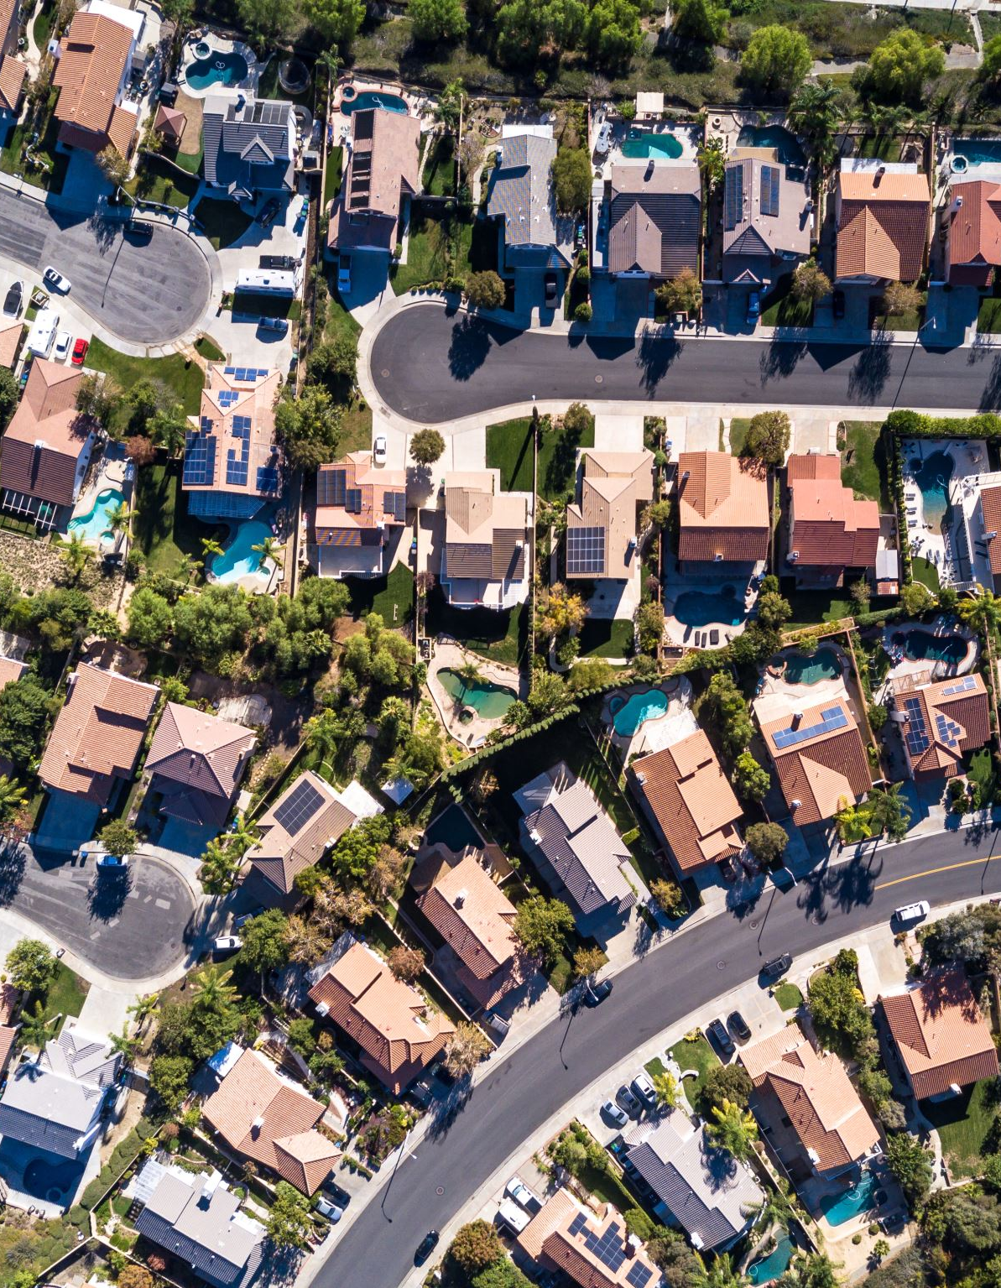
Facts and Figures Round-Up
73% of Baby Boomers are already older than 65, 20% older than 75, Half will be older than 75 in 2030
% of 65+ in the US will rise from 16% now to 22% by 2050
85+ population in Southeast Florida will more than double in 25 years
70% of US Homes are owned by 50+ population
65% of 65+ want to age in place
Median age of home buyer is 58
Assisted Living costs in Florida average $4,750/mo. In Miami, around $5,250/Mo. Hourly Home Care is $23.50. Adult Day Care statewide average of $15,600/mo.

Slide 19
Sources
Title Slide: US Census, Births Per Woman, 1910-2022. Opinion | AI, Aging and Shifts Globalization Will Shock the American Economy - The New York Times (nytimes.com)
Unprecedented Global Transition: Source: US Census, International Database (IDB)
Immigration Scenarios to 2050: 2023 National Population Projections Tables: Alternative Scenarios (census.gov)
Florida Projections (Slides 4-6) by Age Cohort, UF BEBR, 2022.
Labor Force Trends: St Louis Federal Reserve Bank, US Bureau of Labor Statistics. Aaronson, D., Davis, J., & Hu, L. (2012). Explaining the decline in the U.S. labor force participation rate. Chicago Fed Letter, 1. Cline, W., & Nolan, J. (2014). Demographic versus Cyclical Influences on US Labor Force Participation. ERN: Business Fluctuations; Cycles (Topic).
How Does Older American Spending & Macroeconomic Impacts: Bureau of Labor Statistics Calendar year aggregate expenditure shares, Maestas, N., Mullen, K., & Powell, D. (2016). The Effect of Population Aging on Economic Growth, the Labor Force and Productivity. Ewing Marion Kauffman Foundation Research Paper Series. Average Retirement Income in 2024 | The Motley Fool
Costs of Aging: Projected | CMS; Patients vs. Profits: Who Wins in the Traditional U.S. Dialysis System? - Strive Health; Florida Elder Care Costs for 2023 | Senior Care Options Compared (assistinghands.com). Average Retirement Income in 2024 | The Motley Fool, ACS and Bureau of Labor Statistics.
Can We Retire: World Bank, National Bureau of Economic Research International Comparisons of Household Saving | NBER. Johnson, S., Mensah, L., & Steuerle, C. (2006). Savings in America: Building Opportunities for All. Monetary Economics.
Social Security and SSI: Actuarial Status of the Social Security Trust Funds, SSA, May 2024. Reports from the Board of Trustees (ssa.gov). States’ Unfunded Pension Liabilities Persist as Major Long-Term Challenge | The Pew Charitable Trusts (pewtrusts.org); REMI PI+ Forecast, SFRPC 2032-2060, 2023 Fixed Local Dollars. Arnold, R. (2015). Politics at the Precipice: Fixing Social Security in 2033. The Forum, 13, 18 - 3.
Aging and the Built Environment: AARP Public Policy Institute. (2018) Complete Streets for All: The (Many) Benefits of Designing Streets for Inclusive Mobility; Aging Road Users Strategic Safety Plan, 2017, Miami-Dade TPO; Deloitte. (2019) The Future of Retail: Meeting the Demands of an Aging Population; zerofatalitiesnv.com/app/uploads/2020/11/2014-10-20-OffSet-Left-White-Paper.pdf; census.gov/content/dam/Census/library/publications/2020/demo/p23-217.pdf
Projection of Elder Care Needs: Florida Department of Elder Affairs, 2023 Profile of Older Floridians. SFRPC staff proportionate projection to 2050, 2024.
Emergencies, Lifeline Services, and Evacuations: Florida Department of Elder Affairs, 2023 Profile of Older Floridians. SFRPC staff analysis, 2024.
Challenges and Opportunity: Realtor.com via St. Louis Federal Reserve Bank, 2024. Baby boomers are edging out younger buyers in hot housing market - The Washington Post. agewave.com/wp-content/uploads/2016/07/2015-ML-AW-Home-in-Retirement_More-Freedom-New-Choices.pdf
Thank You!
Questions?
Randy Deshazo
SFRPC
rdeshazo@sfrpc.com
“Barreling toward us are three epochal changes poised to reshape the U.S. economy in coming years: an aging population, the rise of artificial intelligence and the rewiring of the global economy” –
Daron Acemoglu, Harvard; (“America is Sleepwalking into an Economic Storm” NYT, Oct 17, 2024)

Slide 20
Policy Levers
Federal/National
Monetary Policy & Immigration Policy Vs. Technology Tradeoff
State
Increased Oversight of Elderly Care
Regional & Local
Land Use: Adult Care, Safer Streets, Changing LU Demand, Shelter and Evacuations, Cooling Centers
SS, SSI, Medicare, and Medicaid Reform
Pension reform
National Electric Grid
Medicaid
Regional Pension Supplement?
Notes:
So, leaving off with an assumption that we still have time to rethink policy, we have a lot of tools at our disposal. Some of them involve trade offs—if we decide we want less immigration, we will need more automation. That choice isn’t entirely up to us, as the world isn’t waiting on automation. It’s coming no matter what—that still leaves the need for people to pay into Social Security and pensions.
That still leaves decisions and opportunities at the state and local level, will we rise to the challenge?

Slide 21
Southeast Florida’s Biggest Concerns
Money: Income, Savings, Social Security, Pensions
Impacts on the Labor Force and Wages | Local Jobs
Health: Healthcare Costs and Active Retirement
Home: Housing and Transportation
Built Environment and Housing Stock
Community Fiscal Impacts
Emergencies, Lifeline Services, and Evacuations
Notes:
So we are going to take these factors and look at how they relate to our concerns today. Some of these I’ve already touched on, but we will drill down into what they mean for our commnuities.

Slide 22
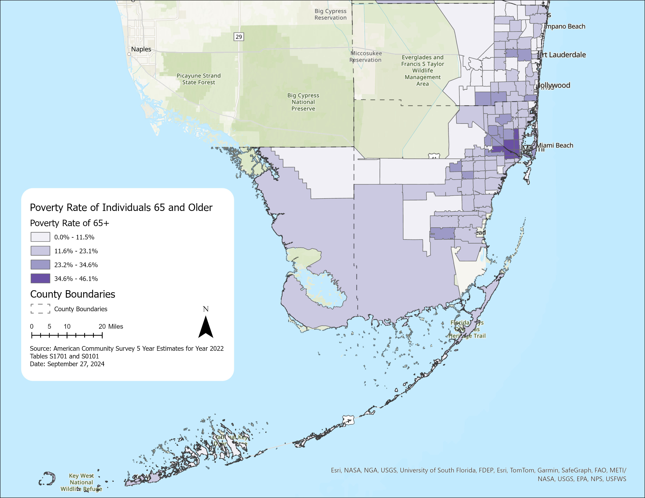
65+ in Poverty | SFRPC

Slide 23
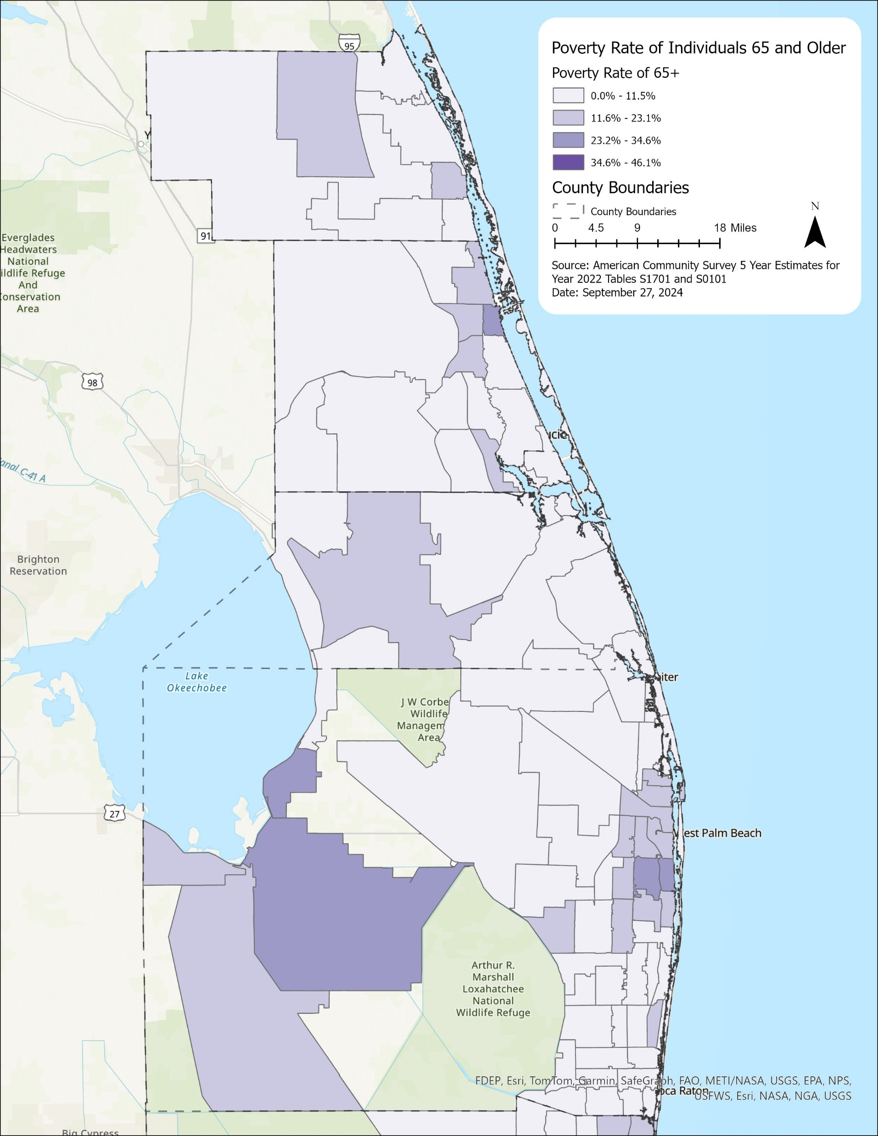
65+ in Poverty | TCPRC

Slide 24
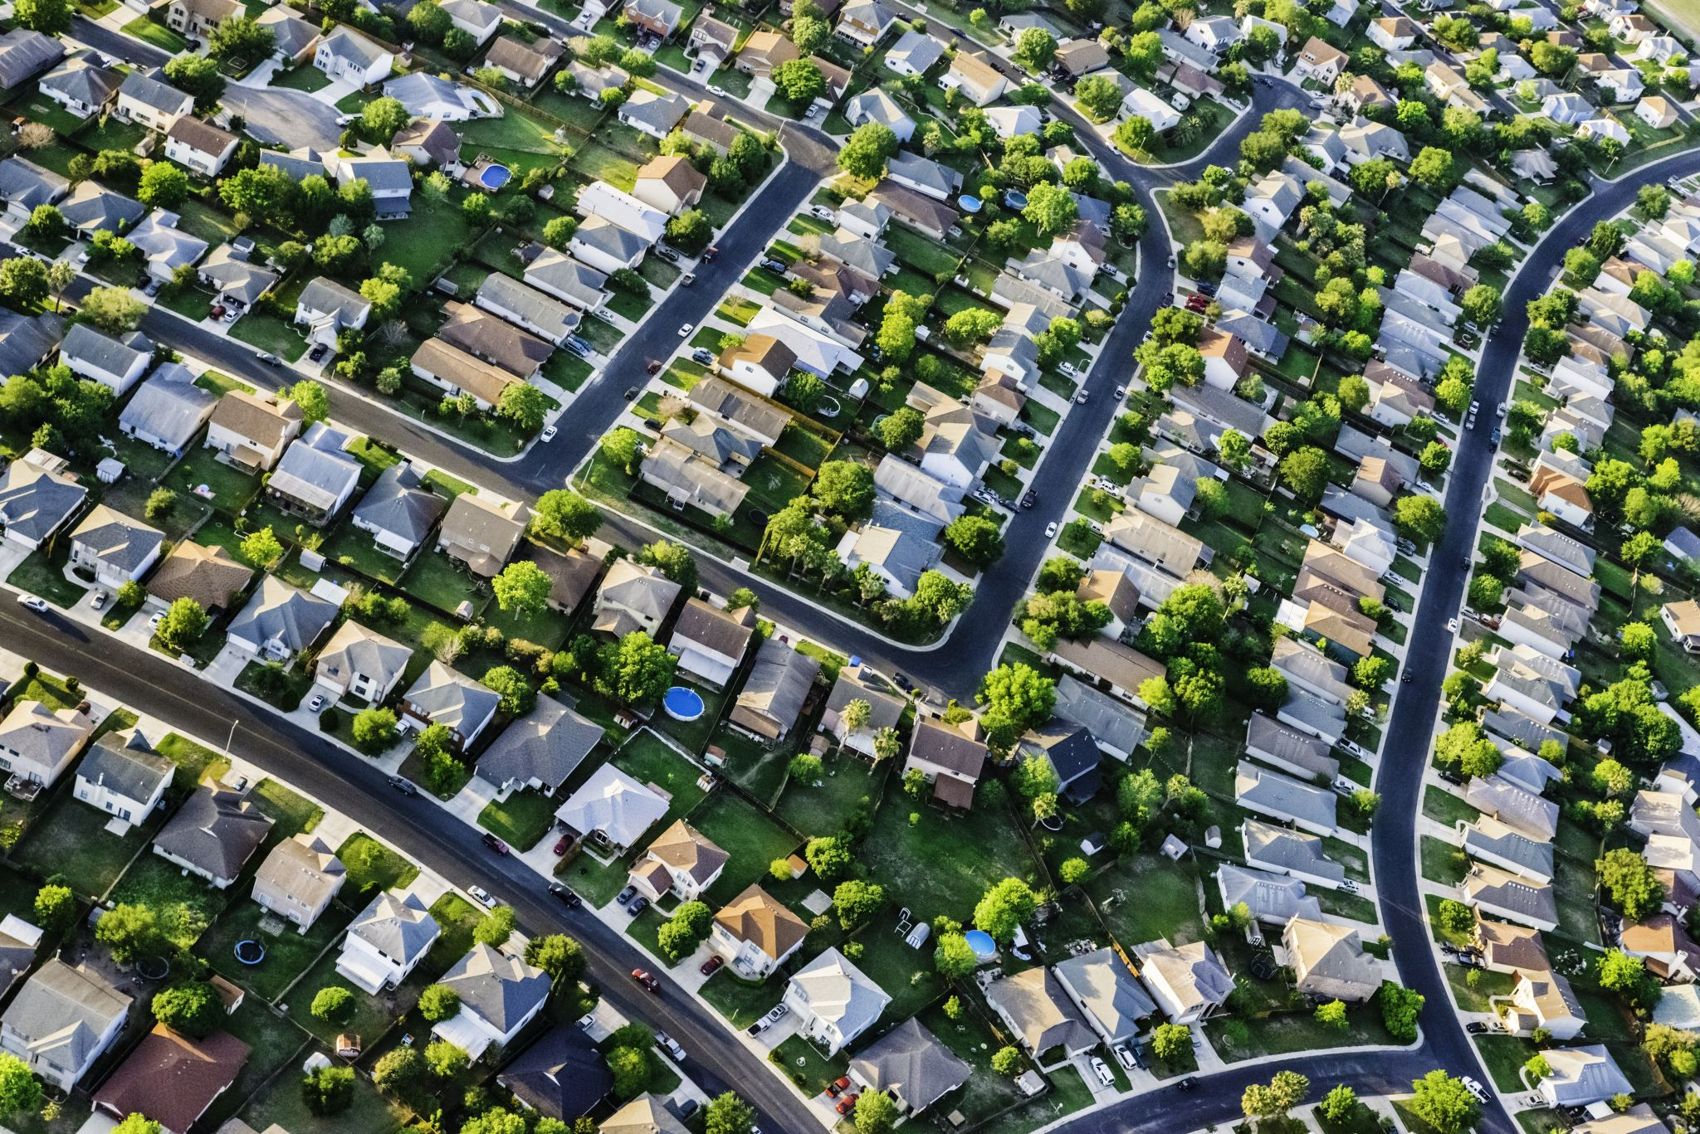
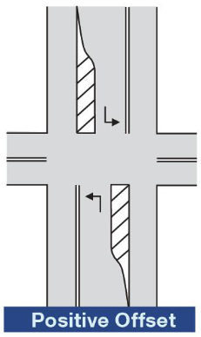
Designing the Built Environment for Aging
Connecting the Lonely Crowd
(More open and communal spaces, benches, rest areas, planning for heat (cooling centers, shade, water features)
Age-Friendly Housing: Design housing with universal design features such as step-free entrances, single-floor living, lever handles, and non-slip flooring (37% South Atlantic Homes “Age Ready”)
Wayfinding and Universal Accessibility: More walkability investment, pedestrianized streets and crossing islands, larger signal heads, countdown signals
Left turn Lanes: signalized intersection with an arrow and a left-turn will reduce the number of dangerous “right angle” collisions. “Offset” left turn lanes also improve visibility because the vehicle going in the opposite direction doesn’t block the path, but impede pedestrian movement
Proximity to healthcare facilities, pharmacies, grocery stores, and community centers to reduce travel distances. Greater total demand for groceries with less per capita spending may drive compact grocery store formats.
Consumer spending profiles will change retail and services commercial space demand
Higher demand for elderly care facilities, retirement communities, and medical specialists (more than doubling?)
24
Notes:
Let’s talk about those new challenges. Demographers say that not only will we have a larger elderly population but we will probably be the loneliest in US history, as marriage rates have plummeted. As planners we also need to think about building in opportunities for sociability into the urban landscape. Builders already are experienced with housing retrofits and building retirement communities, but at a broader urban scale we need to focus on pedestrian support, wayfinding, traffic management improvements, and the overall pattern of land uses. Not only will some retail and services decline as consumption changes, but we will need to complement complete streets with complete communities.
More than ever, we need to think about physical access to healthcare.

