Slide 1

EPA Climate Pollution Reduction Grant Overview
May 20, 2024
Kimberly Brown, AICP, Director
Resilience Planning and Implementation
Office of Resilience in the Office of the Mayor
Miami-Dade, Broward, Palm Beach, and Monroe Counties

Slide 2
CPRG Overview
The Climate Pollution Reduction Grant is a two-staged program funded through the IRA and administered by EPA.
  Planning Grant (Formula) includes $250 million for noncompetitive planning grants. The Southeast Florida Region (Monroe, MDC, Broward, and Palm Beach) received ±$1M to create a regional GHG reduction plan. The first deliverable, a “priority” plan, was submitted to EPA on March 1st. Miami-Dade is serving as Lead Organization.
  Implementation Grant (Competitive) includes $4.6 billion in competitive implementation grants. Only projects identified in the Priority Climate Action Plan were eligible to compete for funding. Broward is serving as Lead Organization on a regional application.
Notes:
Looking

Slide 3
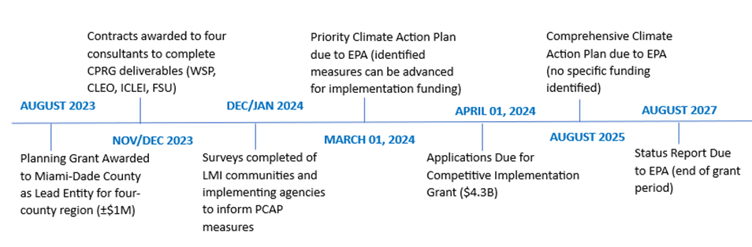
CPRG Key Milestones

Slide 4

CPRG Planning Grant (Phase I)
On March 1, 2024, the SEFL Region submitted a Priority Climate Action Plan (PCAP) on behalf of the four-county region (Miami-Dade, Broward, Palm Beach, and Monroe counties).
The PCAP serves as a regional greenhouse gas emissions (GHG) reduction plan, which will reduce air pollution that is warming our planet, clean up our air, and provide important benefits to communities in the region, such as reduced energy bills, improved public health, and more jobs.
Notes:
Looking

Slide 5
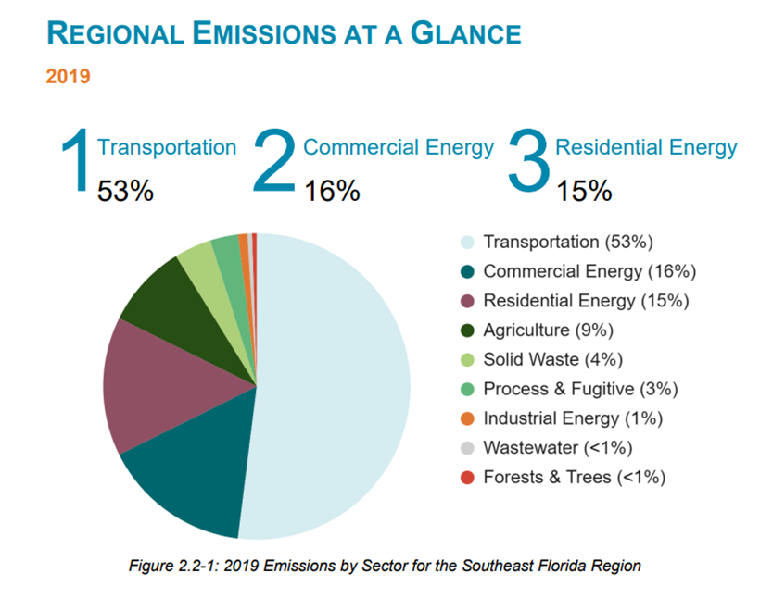
Regional Emissions Inventory
Notes:
Looking

Slide 6
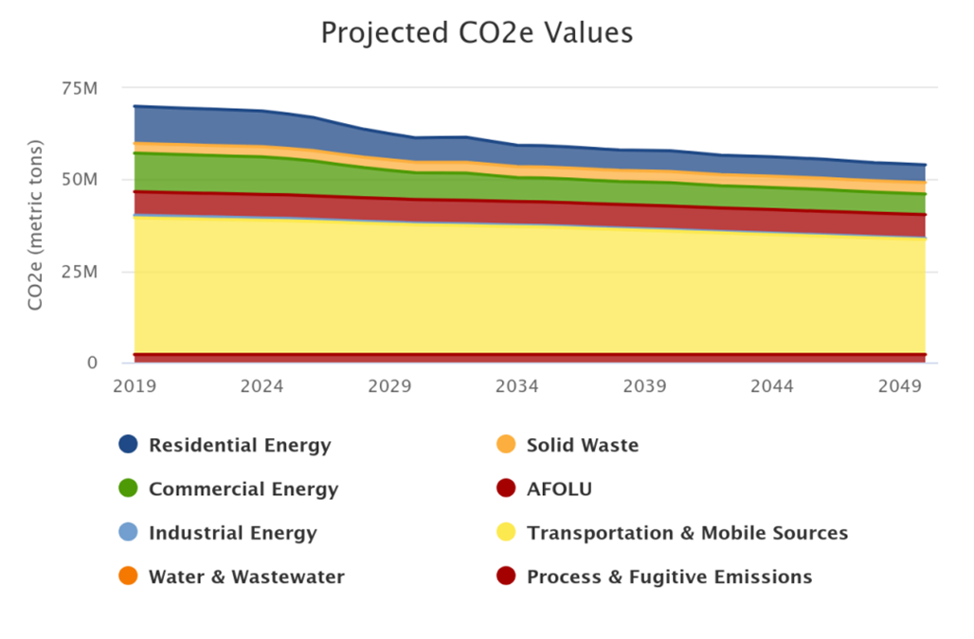
Business as Usual Projection
Notes:
Looking

Slide 7
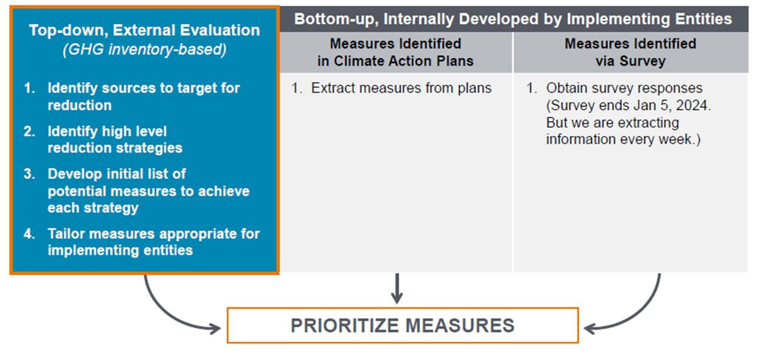
Priority Climate Action Plan
The PCAP focused on high-impact, implementation ready measures that could reduce GHG emissions through 2030
The measures were identified through surveys of all implementing agencies within the region as well as an analysis of high-impact measures.
Notes:
Looking

Slide 8
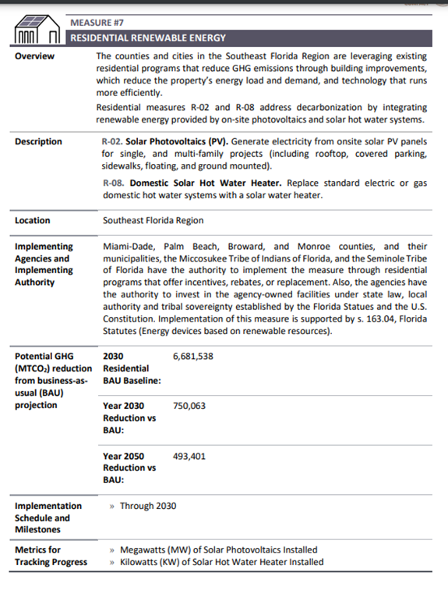
Priority Climate Action Plan
The PCAP identifies 13 broad GHG reduction measures (3 are tribe-specific)
It shows expected GHG reductions under a low, medium and high adoption scenario.
Detailed projects within each measure are outlined in the appendices.
The PCAP included projects identified by the counties, municipalities, and tribal governments.
Notes:
Looking

Slide 9
Priority Climate Action Plan
The PCAP analysis found that the four-county region should reduce absolute emissions by at least 59.3% (±41.5 million MT CO2e) by 2030 from the 2019 baseline in order to meet GHG reduction targets established in the Paris Agreement.
Under a business-as-usual scenario, emissions are expected to drop 12.3% (±8.6 million MTCO2e) by 2030 and 22.8% (±16 million MT CO2e) by 2050.
If all measures presented in the PCAP were to be implemented, it would result in the reduction of an additional ±4.35 million MT CO2e across the region by 2030 from the BAU scenario (moderate adoption scenario).
CCAP will look at a more comprehensive list of reduction measures through 2050.
Notes:
Looking

Slide 10
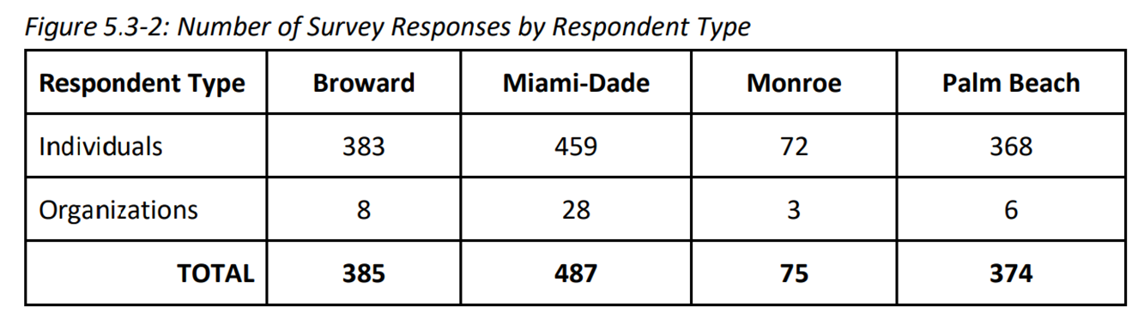
Low Income Disadvantaged Communities
Partnered with CLEO Institute to engage Low Income Disadvantaged Communities
Survey - 1,327 responses; 82% from target zip codes
Workshop - A follow up workshop with a select group of survey respondents allowed for more focused feedback
Results identify top priorities by County under the topics of transportation, housing and other services.
Financial incentives to improve housing conditions was the top housing priority in all four counties.
Notes:
Looking

Slide 11
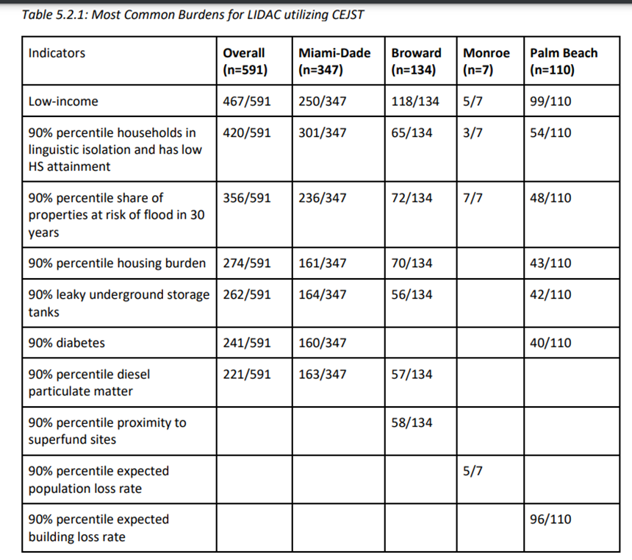
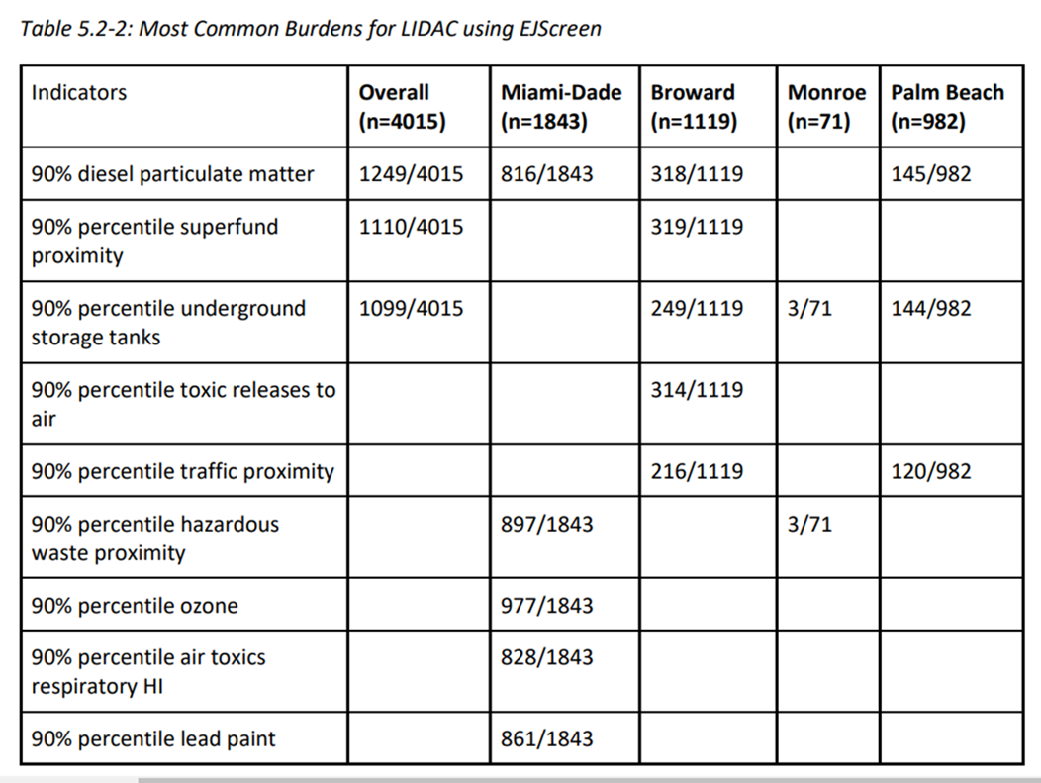
Low Income Disadvantaged Communities
Notes:
Looking

Slide 12
Low Income Disadvantaged Communities
LIDAC Benefits Analysis
Qualitative Benefits Analysis – assesses the effectiveness of the proposed reduction measures against 14 qualitative benefits including improved health outcomes, job opportunities, lower energy bills, improved housing quality, etc.
Quantitative Benefits Analysis
  Reduction in energy consumption
  Reduction in co-pollutants
Notes:
Looking

Slide 13
Comprehensive Climate Action Plan
Next Step – Comprehensive Climate Action Plan
Quantified GHG Reduction Measures to meet short-term (2030) and long-term (2050) GHG reduction targets
Review of Authority to Implement
Intersection with Other Funding Availability
Comprehensive Benefits Analysis for the full geographic scope
Low Income and Disadvantaged Communities Benefits Analysis
Workforce Planning Analysis
Notes:
Looking

Slide 14
CPRG Implementation (Competitive)
The PCAP positioned all local and tribal governments in the four-county region to apply for discretionary awards ($4.6 billion in funding) through EPA to implement mitigation measures that are identified in the Priority Climate Acton Plan.
Applications for competitive implementation grants were due to EPA on April 1, 2024 (May 1, 2024 for tribal governments). The four-county region submitted an implementation grant application.
Notes:
Looking

Slide 15
CPRG Implementation (Competitive)
Regional CPRG Implementation Application
  Residential Energy Efficiency Program – $200.5M
    home energy retrofits including basic enclosure upgrades, new energy-efficient air-conditioners, heat pump water heaters, LED replacements, and appliance upgrades (15% of funds can be used for prerequisite home repairs, such as roof and window replacements, wiring replacements, and electric service upgrades. Estimated to serve 8,365 households across the region, generating nearly $11.7M in cumulative bill savings and offsetting a cumulative 16,665 metric tons of CO2 equivalent from 2025 to 2030.
  Solar Rebate Program – $51.85M
    provides rebates for solar array installation in LIDAC. Estimated to serve 7,782 households, generating more than $45.1M in cumulative bill savings and offsetting 58,332 metric tons of CO2 equivalent from 2025 to 2030.
  Electric Vehicle Rebate Program - $18.3M
    provides rebates for electric vehicle charging equipment (L2 or DCFC) to be installed in LIDAC for public/private entities and local and tribal governments, with a particular focus on multifamily properties and large employers. Estimated to result in 802 new ports in LIDAC.
Notes:
Looking

Slide 16
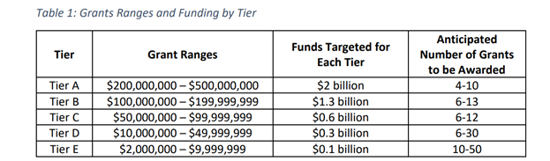
CPRG Implementation (Phase II)
EPA expects to award 30 to 115 grants ranging between $2 million and $500 million. There is no cost share requirement. All IRA funding has been allocated in Round 1.
It will be extremely competitive. All eligible entities (state agencies, counties, municipalities) throughout the country can apply, except those that declined planning grant funding.
Notes:
Looking

Slide 17
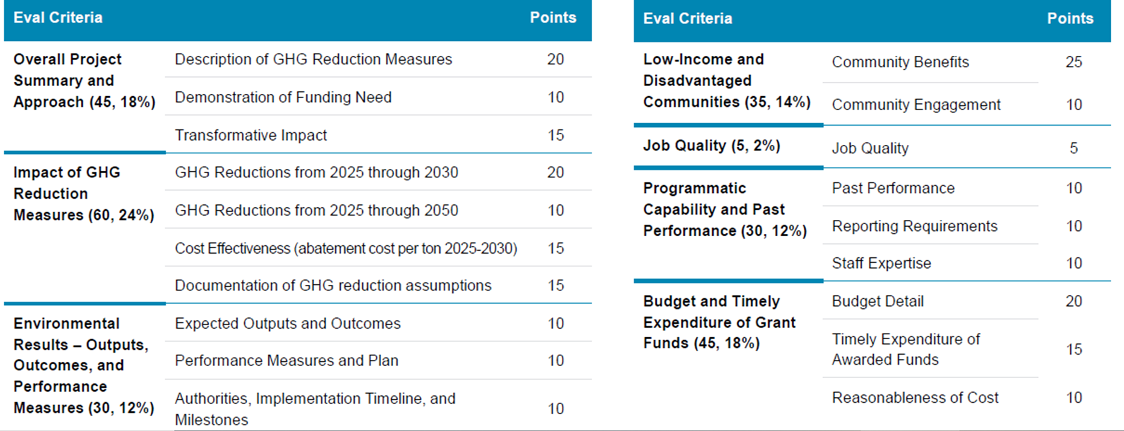
CPRG Implementation (Phase II)
Notes:
Looking

Slide 18
CPRG Implementation (Phase II)
Please help spread the word about why this funding is needed for our Region.
For More Information, Contact:
Dr. Jennifer Jurado, Broward County and Marty Cassini, Broward County
Dr. Patricia Gómez, Miami-Dade County
Rhonda Haag, Monroe County
Megan Houston, Palm Beach County
Notes:
Looking

Slide 19
Thank you!
Kimberly Brown, AICP
Director, Resilience Planning and Implementation
Kimberly.Brown@miamidade.gov
Notes:
7:00-7:10
Welcome back!
Thank you for some amazing discussion.

