Slide 1

Evaluation of Agricultural Land Use Trends and Outlook in Miami-Dade County, Florida
Final Report Highlights
March 18, 2024

Slide 2

Evaluation of Agricultural Land Use Trends and Outlook in Miami-Dade County, Florida
The Board of County Commissioners adopted Resolution No. R-423-22 on May 3, 2022
Interlocal Agreement between Miami-Dade County and the University of Florida and its research and agricultural extension
  Recognized as a leading research and education institution for tropical & subtropical horticulture & natural resources
Updates the 2002 Miami-Dade County Agricultural Land Retention Study
County’s Comprehensive Development Master Plan (CDMP) policies have long supported agriculture as a viable economic use of suitable lands
  Policy LU-1R states the County shall take steps to reserve the amount of land necessary to maintain an economically viable agricultural industry

Slide 3
Evaluation of Agricultural Land Use Trends and Outlook in Miami-Dade County, Florida
Scope of the study:
Provide an overview of agriculture in Miami-Dade County
Document agriculture’s importance to the County and beyond
Document economic trends for major agriculture crops
Identify major factors affecting profitability and sustainability
Identify and evaluate emerging technological changes
Provide recommendations to improve agriculture’s economic sustainability
Project future agricultural land needs to maintain 2030, 2040, and 2050
The study used a variety of published data sources, 74 individual and group interviews with local stakeholders, and economic and physical models

Slide 4
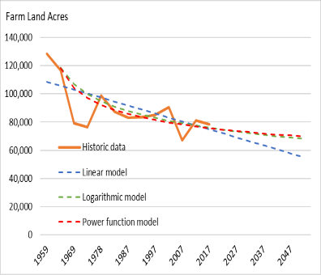
Evaluation of Agricultural Land Use Trends and Outlook in Miami-Dade County, Florida
Overview of agriculture in Miami-Dade County: Land Area
Agricultural land declined from 128,550 acres in 1959
2017: 78,543 total acres - USDA Census (baseline data)
  58,606 “Agriculture Classified” acres by Property Appraiser ~75% of total
2021: 55,946 “Agriculture Classified” acres
  50,267 outside UDB
Currently: CDMP-designated Agriculture land: 69,072 acres
  67,889 acres outside UDB
  70-75% CDMP-designated land outside UDB is “Agriculture Classified” by the Property Appraiser
2022: 68,837 total acres – USDA Census (new data)
Source: USDA-NASS, Census of Agriculture

Slide 5
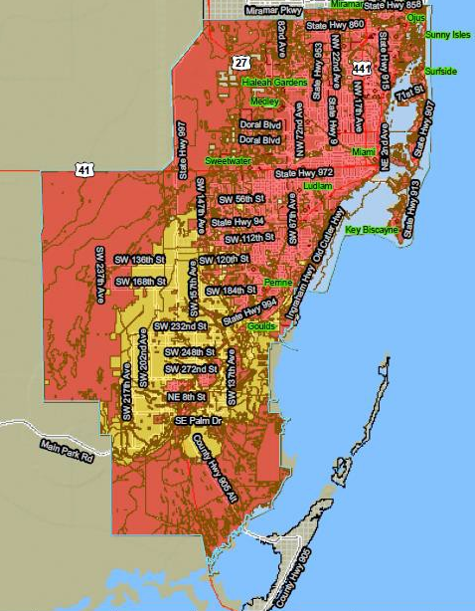
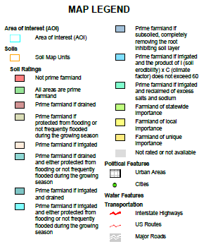
Evaluation of Agricultural Land Use Trends and Outlook in Miami-Dade County, Florida
USDA Soils Map
Land Use Plan Map
Source: USDA-NRCS, custom soil report for Miami-Dade County Area, Florida, 2012

Slide 6
Evaluation of Agricultural Land Use Trends and Outlook in Miami-Dade County, Florida
Farm size distribution in Miami-Dade County, 1997-2017 (Census, 2017)
Small farms (<10 acres) represented 73% of operations
This farm size distribution is typical of nation
Small farms increased in number and land area since 1997
Area Operated (Acres) | 1997 | 2002 | 2007 | 2012 | 2017 | Change 1997-2017 | Percent of Total, 2017
Area (acres)
Less than 10 | 4,296 | 5,341 | 6,601 | 7,371 | 6,970 | 2,674 | 8.9%
10 to 49 | 10,012 | 11,491 | 10,104 | 12,919 | 10,866 | 854 | 13.8%
50-99 | 5,357 | 6,734 | 4,671 | 5,460 | 4,890 | -467 | 6.2%
100-499 | 21,745 | 27,812 | 17,579 | 19,649 | 17,261 | -4,484 | 22.0%
500-999 | 17,798 | 16,378 | 6,203 | 18,286 | 16,684 | -1,114 | 21.2%
1,000 or more | 25,868 | 22,617 | 14,481 | 17,618 | 21,872 | -3,996 | 27.8%
Total | 85,076 | 90,373 | 59,639 | 81,303 | 78,543 |  | 100%
Number operations
Less than 10 | 1,160 | 1,423 | 1,777 | 2,045 | 2,001 | 841 | 72.7%
10 to 49 | 520 | 587 | 552 | 697 | 565 | 45 | 20.5%
50-99 | 78 | 98 | 69 | 84 | 71 | -7 | 2.6%
100-499 | 86 | 103 | 78 | 93 | 86 | 0 | 3.1%
500-999 | 26 | 22 | 8 | 25 | 21 | -5 | 0.8%
1,000 or more | 17 | 11 | 14 | 10 | 8 | -9 | 0.3%
Total | 1,887 | 2,244 | 2,498 | 2,954 | 2,752 | 865
Source: USDA-NASS, Census of Agriculture

Slide 7
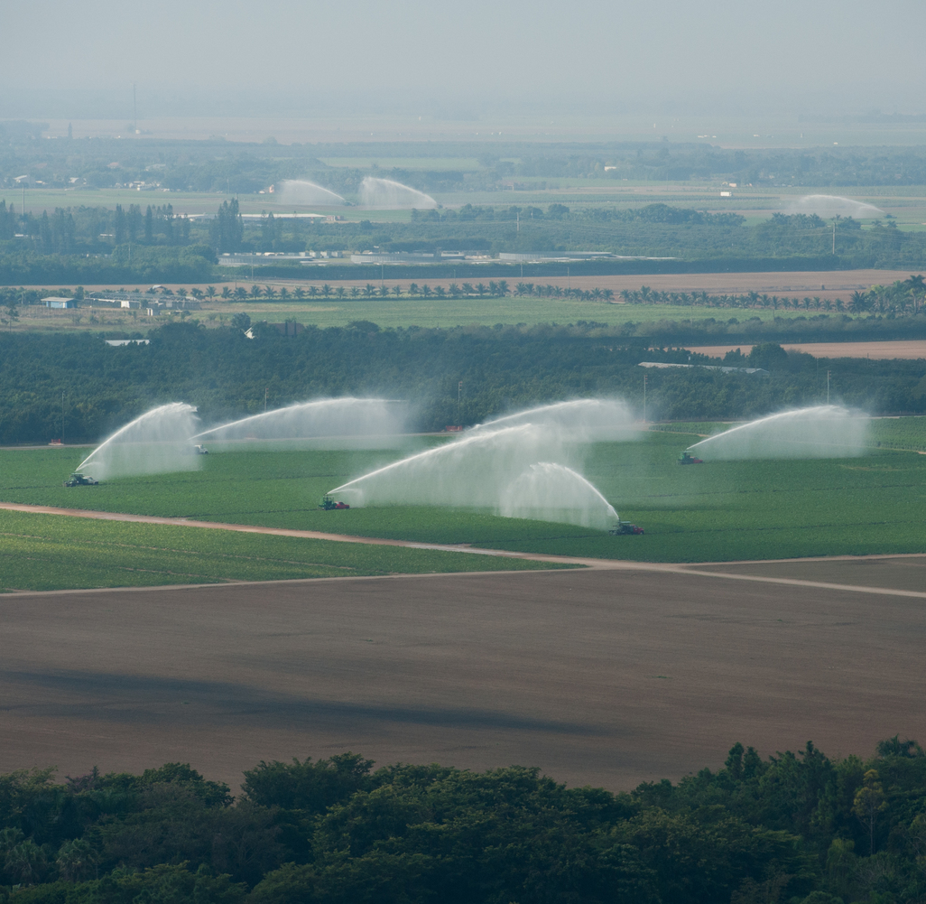
Evaluation of Agricultural Land Use Trends and Outlook in Miami-Dade County, Florida
Overview of agriculture in Miami-Dade County: Economics
Farm income was $950 million in 2021; production expenses were $905 million; and net income was $45.6 million (4.8%) - Far below historic levels due to increased operating costs and partly due to Covid-19
Farm income increased 11% from 2001-2021, but production expenses increased 42%
In 2021 there were 8,872 agricultural workers, a 6.6 percent increase from 2001, while the total County workforce increased by 13 percent
Value of fixed farm assets in land, buildings, machinery, and equipment was $3.25 billion in 2017

Slide 8
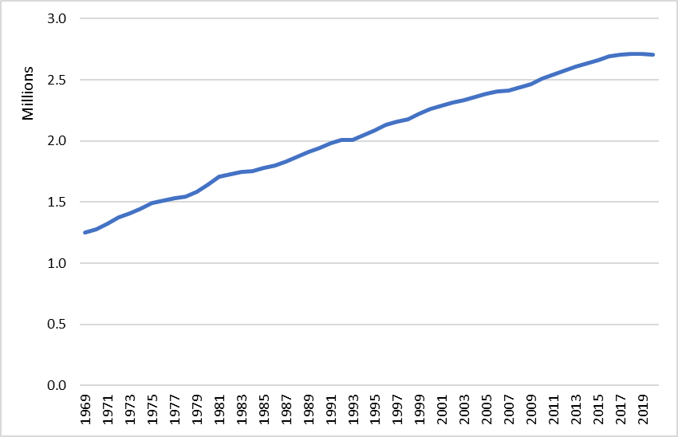
Evaluation of Agricultural Land Use Trends and Outlook in Miami-Dade County, Florida
Overview of agriculture in Miami-Dade County: Population
County population: 2.662 million (2021)
Growth by 20% or 1.0% annually since 2000
Population growth slowed after 2017 and declined slightly in 2021
2050 Projected population: 3.286 million
Population density (2020): 1,422 per square mile, overall, and over 6,000 per square mile inside the UDB
Higher cost of living (housing and homeowner costs) than state or national averages
Source: U.S. Census Bureau, reported by USDOC-Bureau of Economic Analysis

Slide 9
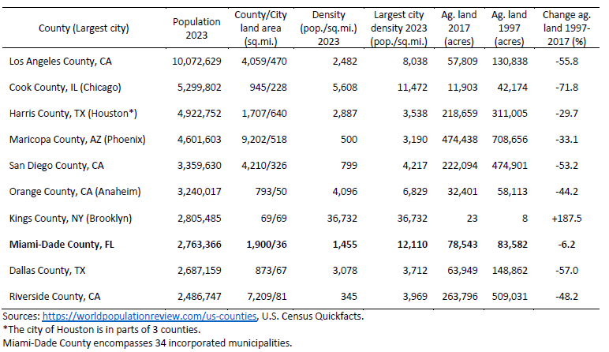
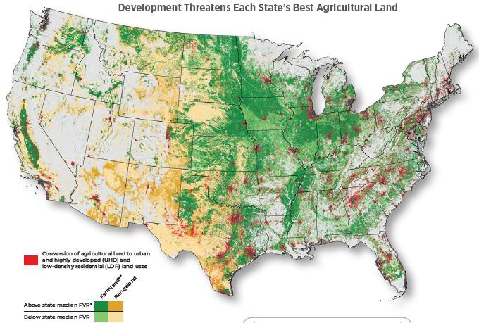
Evaluation of Agricultural Land Use Trends and Outlook in Miami-Dade County, Florida
Loss of farmland is a national and a local issue
Over 11 million acres of agricultural land was lost in the United States to development from 2001 to 2016.
The County had the lowest percentage of agricultural land loss among the nation’s 10 largest metropolitan counties (except Brooklyn)
The County’s land use policies, including the Urban Development Boundary (UDB), effectively limit the loss of agricultural land.

Slide 10
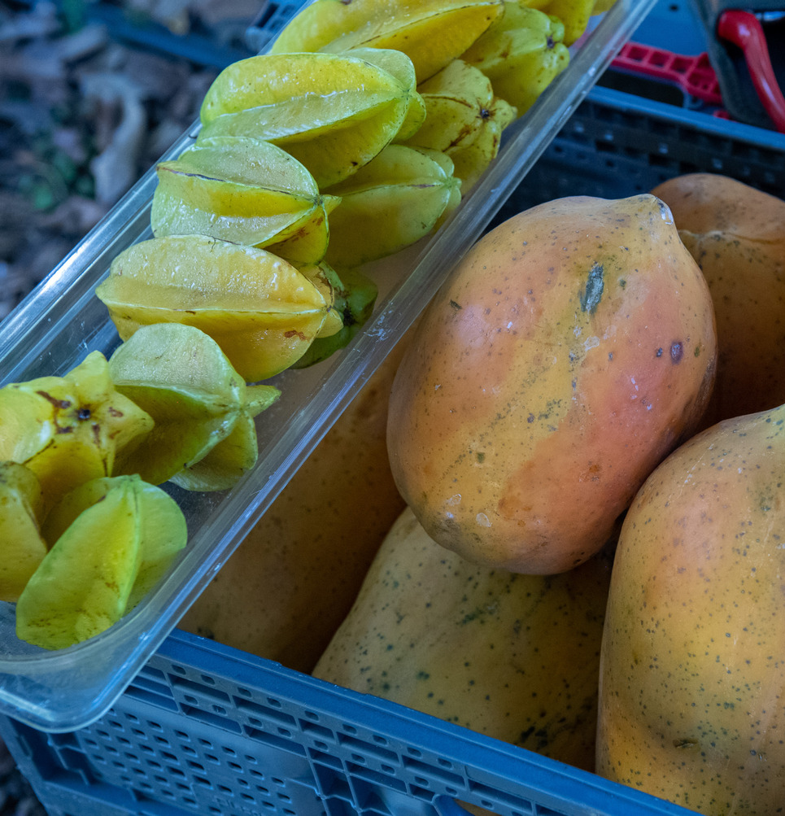
Evaluation of Agricultural Land Use Trends and Outlook in Miami-Dade County, Florida
Agriculture’s importance to the County and beyond
Total economic contributions of agriculture and related natural resource industries in 2021:
  12,836 full-time and part-time jobs
  $1.555 billion in industry output
  $902 million in value added (GDP)
  $183 million in tax revenues
GDP contributions of agriculture increased 14% during 1998-2021
One of the only areas in the United States with winter production and with certain ornamental plants and tropical crops.
About 89 percent of the County’s agricultural products are shipped out of the region
Agricultural area is designated by the USDA as having soils of unique importance.

Slide 11

Evaluation of Agricultural Land Use Trends and Outlook in Miami-Dade County, Florida
Miami-Dade County’s Industry Rankings:
First in nation in Nursery, Greenhouse, & Floriculture sales value
Second in state in total agriculture sales value
Top 1% in nation in crops sales value (number 16)
Top 2% in nation in total agriculture sales value (number 41)
Fourth in state in vegetables, melons, potatoes, & sweet potatoes sales value
Fifth in state in sheep, goats, wool, mohair, milk, and aquaculture sales value
Source: Census of Agriculture 2017

Slide 12
Evaluation of Agricultural Land Use Trends and Outlook in Miami-Dade County, Florida
Economic trends for major agriculture crops
Nursery/floriculture production has expanded rapidly over the past 20 years while tropical fruits have increased slightly, and vegetables have declined significantly
Production and investment is expected to continue increasing, but at lower-than-historical rates
Agricultural land use intensity would also continue increasing due to improved technology, management, and production practices as well as changes in crop mix: higher value per acre and lower land requirements
Profitability is highly volatile, affected by increasing production costs
Growth anticipated in aquaculture, such as with Atlantic Saphire

Slide 13

Evaluation of Agricultural Land Use Trends and Outlook in Miami-Dade County, Florida
Major factors affecting profitability and sustainability
Imports, particularly from Mexico, reduce product prices
Phytosanitary regulations prohibit import of live plants in soil media, protecting domestic nursery producers
Production costs locally increased 42% from 2001-2021
Workforce availability (H-2A needs, immigration policies, wages)
Severe weather events: Production now more intensive than during Andrew
Temperature increase 2.7 to 3.2 degrees (F) by 2050 affecting County’s tropical advantage, but may open new crop options
Rising sea levels: saltwater intrusion, elevated groundwater, and more seasonal flooding

Slide 14
Evaluation of Agricultural Land Use Trends and Outlook in Miami-Dade County, Florida
Emerging technological changes
Helpful technologies include artificial intelligence, smart sensors, robotics, mechanical harvesters, and whole farm information systems
Hydroponic and vertical growing systems are increasing in popularity
Adoption rates over the next 5 to 30 years are uncertain due to capital costs and other efficiency improvements
Small farms, a growing trend, have capital limitations for some technology adoptions
Various technology innovations can increase productivity

Slide 15
Evaluation of Agricultural Land Use Trends and Outlook in Miami-Dade County, Florida
Recommendations to improve economic sustainability
Maintain the current land use plan in the County with the Urban Development Boundary to control urban development
Lobby State and Federal elected leaders to seek more favorable international trade agreements
Work with State and Federal leaders to address labor shortages
Maintain strong County support for existing agricultural programs and partnerships
Coordinate with the U.S. Army Corps of Engineers, South Florida Water Management District, and Florida Department of Environmental Protection

Slide 16
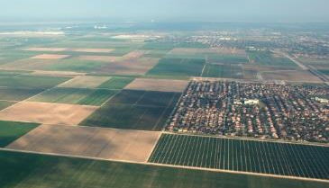
Evaluation of Agricultural Land Use Trends and Outlook in Miami-Dade County, Florida
Future agricultural land use needs for 2030, 2040, and 2050
A combination of various statistical and economic models was used to project the future agricultural land area needed
Consensus estimate:
  64,800 acres in 2030
  60,900 acres in 2040
  56,300 acres in 2050
These projections represent the minimum acreage required to meet demand for farmland without compromising the viability of the industry under current or future land use policies.
Indications for strong growth for the overall economy and the agricultural sector through 2050
Indicates that future import competition, future loss of farmland to the urban area, and future climate change/sea level rise will reduce agricultural production about 24 percent compared to the current baseline projected increases by the year 2050.

Slide 17
Evaluation of Agricultural Land Use Trends and Outlook in Miami-Dade County, Florida
The future viability of the agricultural industry in Miami-Dade County depends on:
Maintaining profitability,
Securing resources to support the capacity to produce, and
Being resilient in adapting to change.
Wise policy choices regarding land use, regulations, labor, and other issues affecting agriculture are critical to meet this need over the next three decades and beyond.

Slide 18
Thank You

