Slide 1
Miami-Dade County Flood Response Plan
March 18, 2024

Slide 2
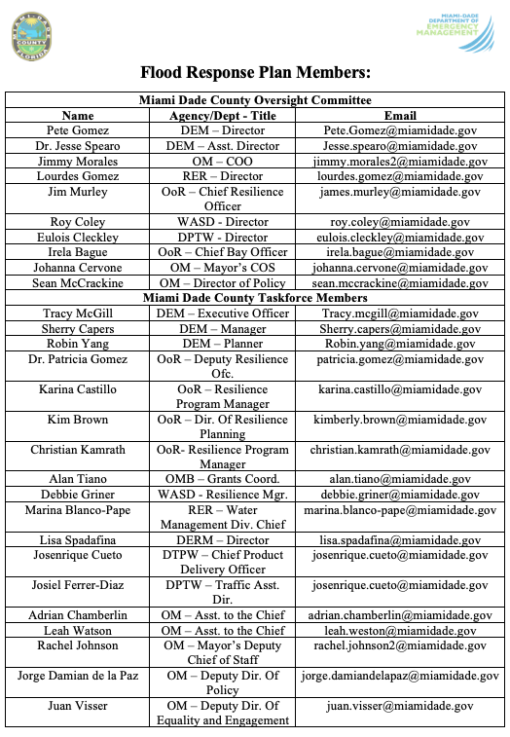
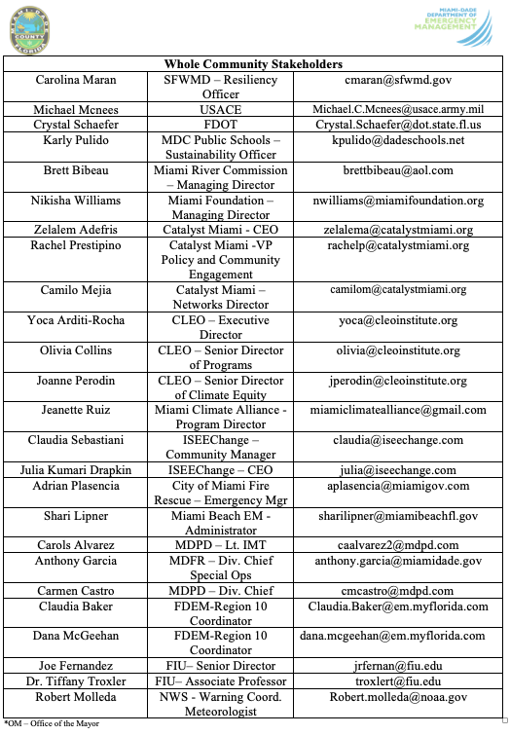
RFP is organized into two committees:
Oversight
Focus
Priorities
Objectives
Approval
Community Taskforce and Whole Community Partners
Strategies
Tactics
Technology and Science
Unmet needs
Inclusive

Slide 3
Miami-Dade County Flood Response Plan Oversight Committee
Priorities:
Better understand flooding events in MDC
Align MDC current assumptions, capabilities, GIS, and planning documents
Get input from community stakeholders
Specific Emphases:
Need for pre-season coordinating meeting, preparedness actions, trainings & exercises
Mapping repetitive flooding areas
Organizational priorities and capabilities (plans, technology, etc.)
Notifications and messaging
Operational coordination
Damage assessment
Recovery

Slide 4
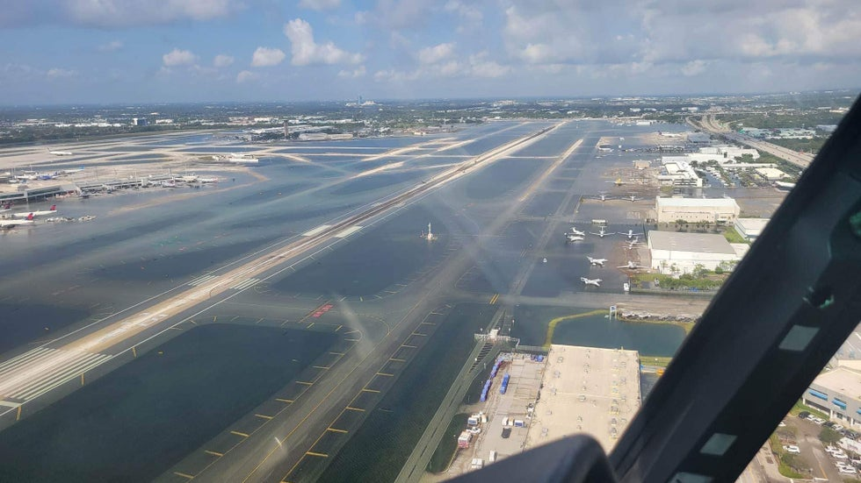

Slide 5
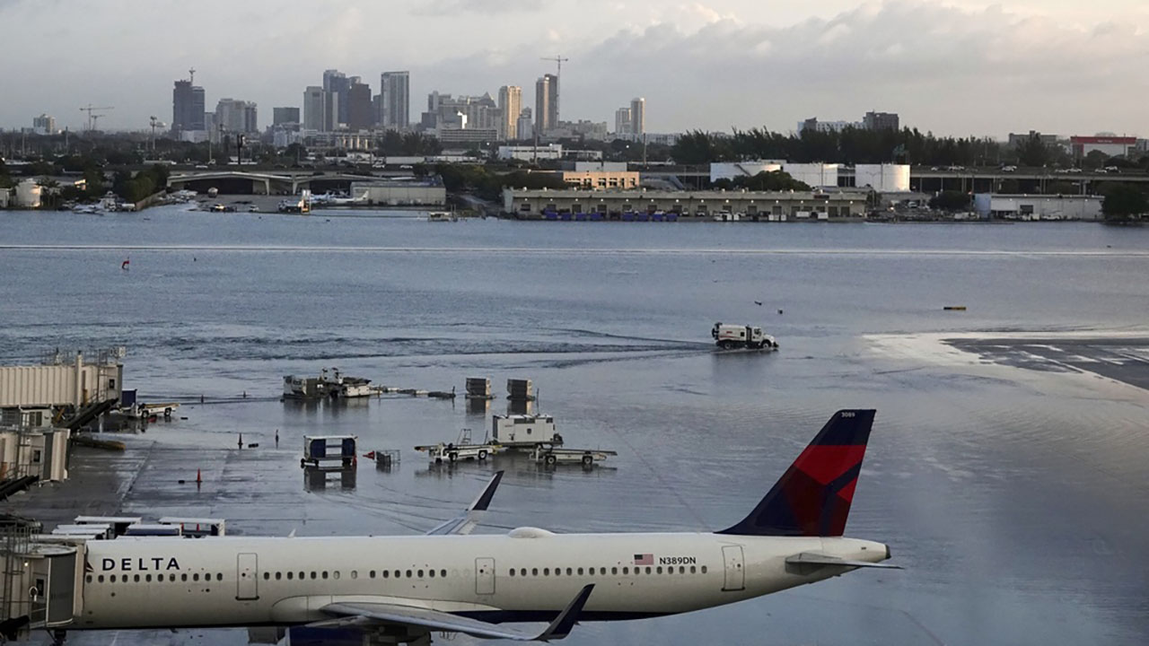

Slide 6
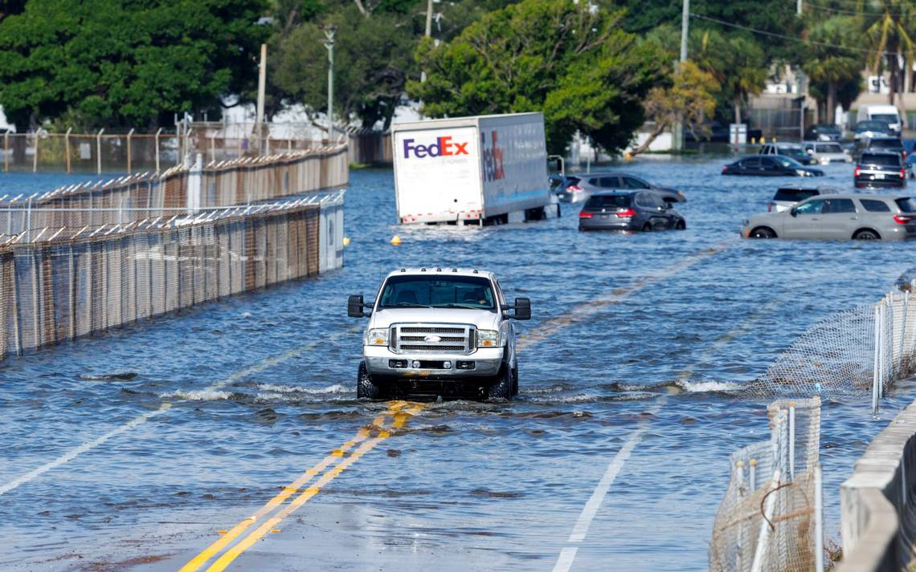
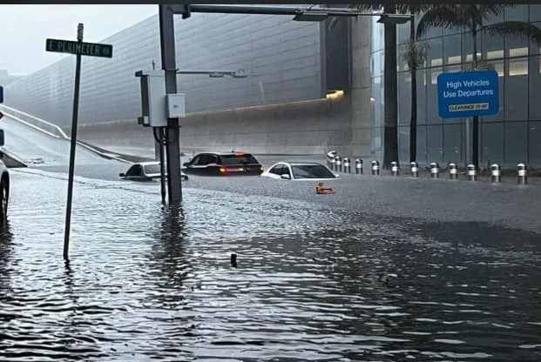
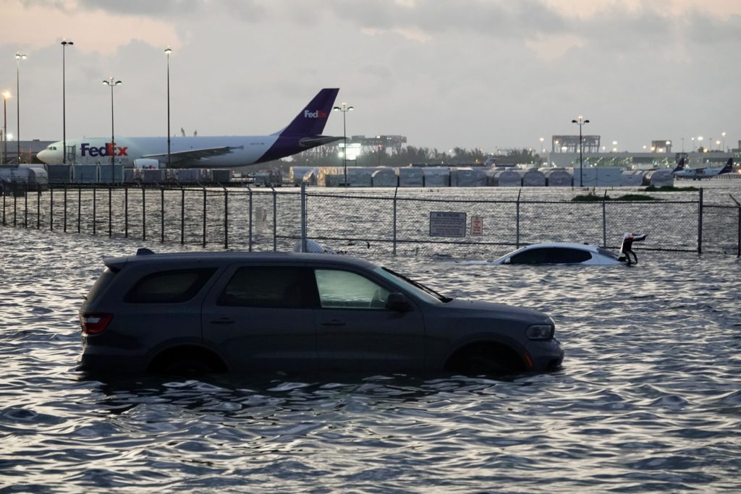
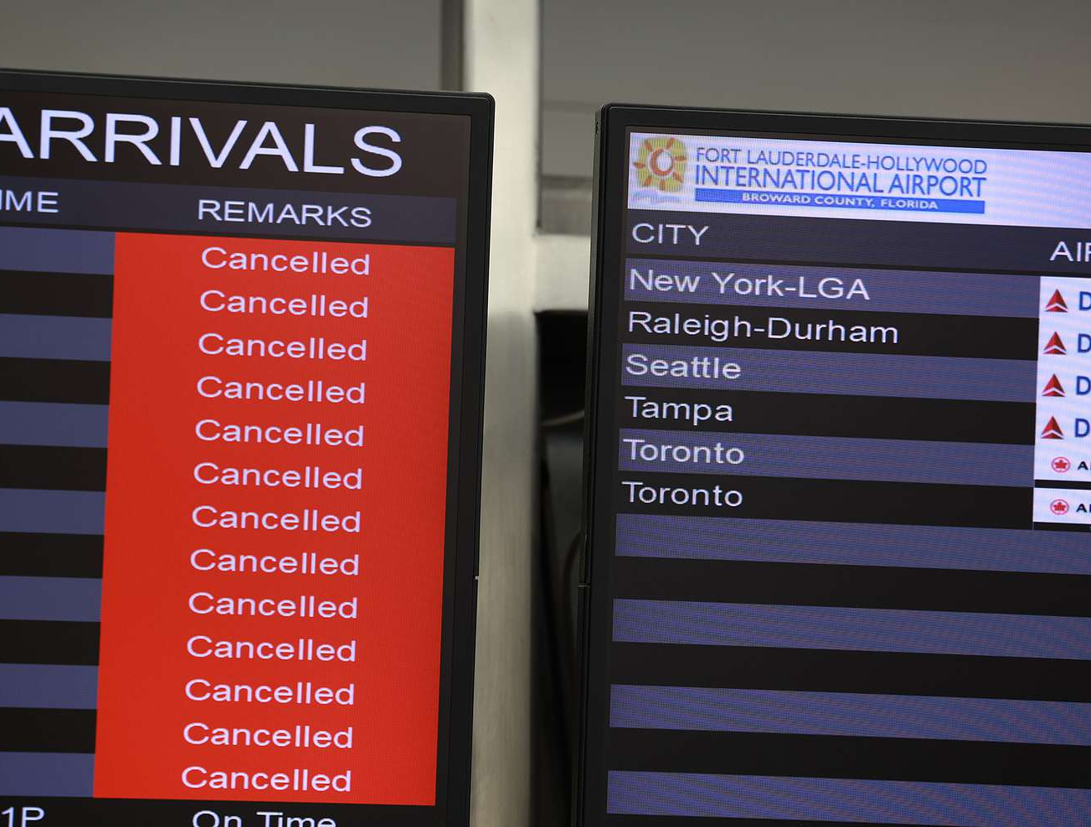
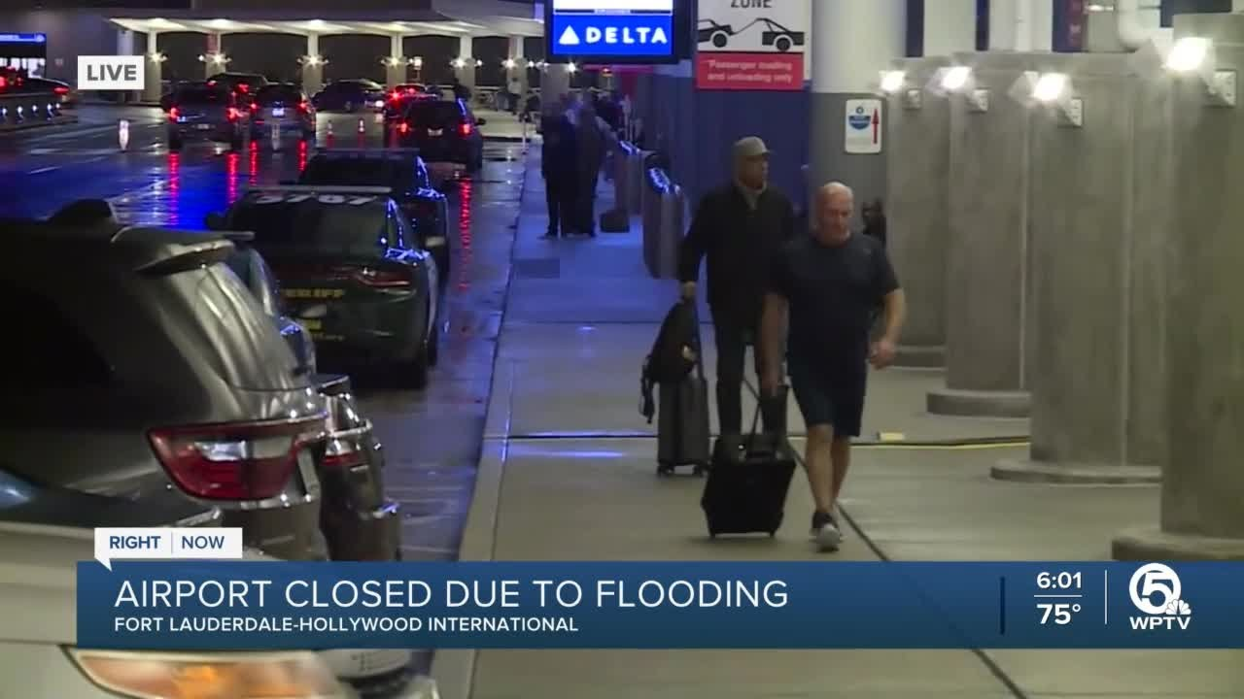

Slide 7
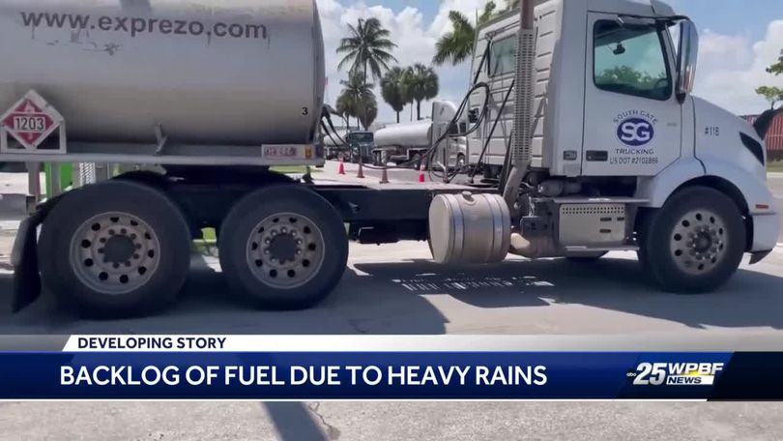
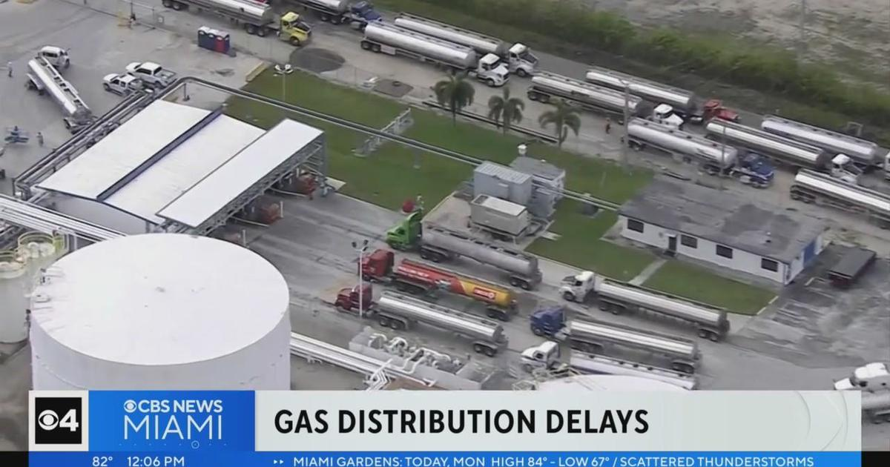
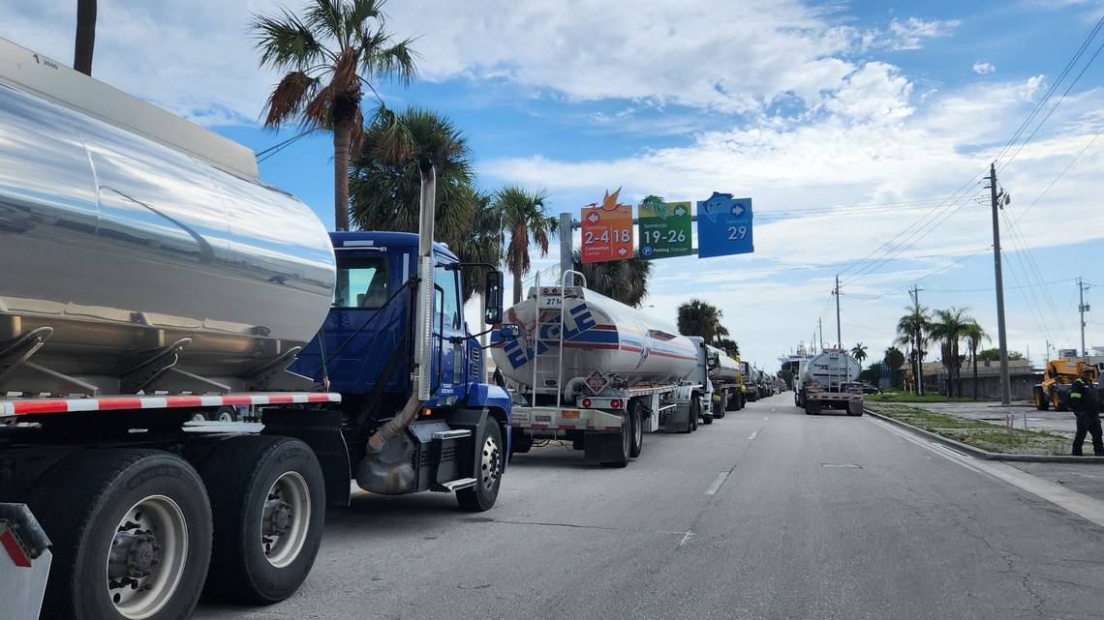
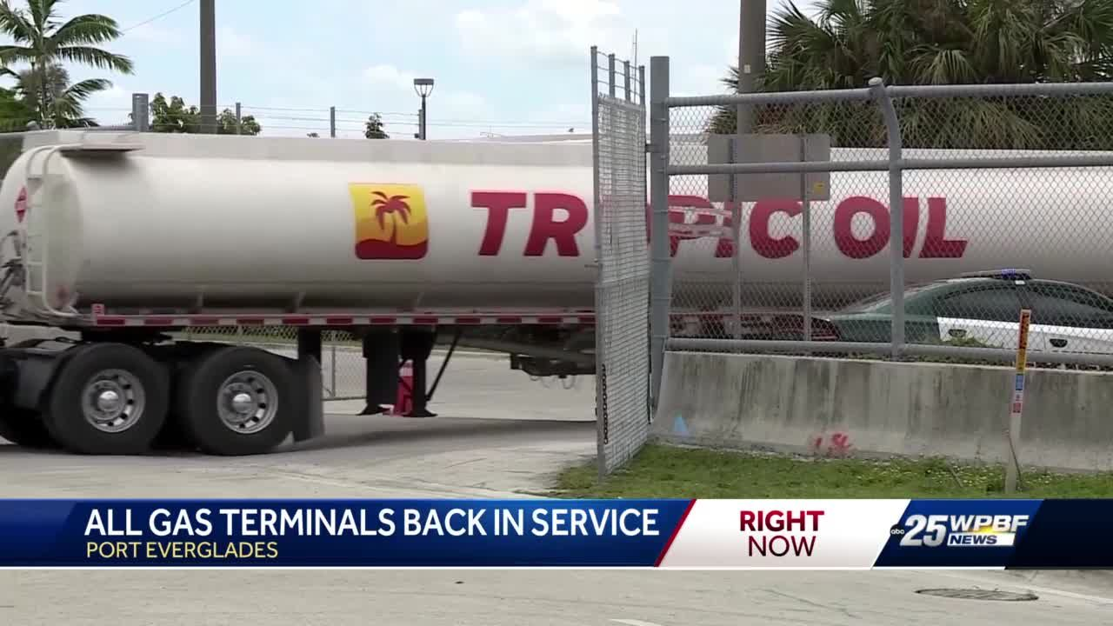

Slide 8
Questions?

