Slide 1
“One Region, One Water”
Joint Workshop
South Florida and Treasure Coast Regional Planning Councils
March 18th 2022

Slide 2
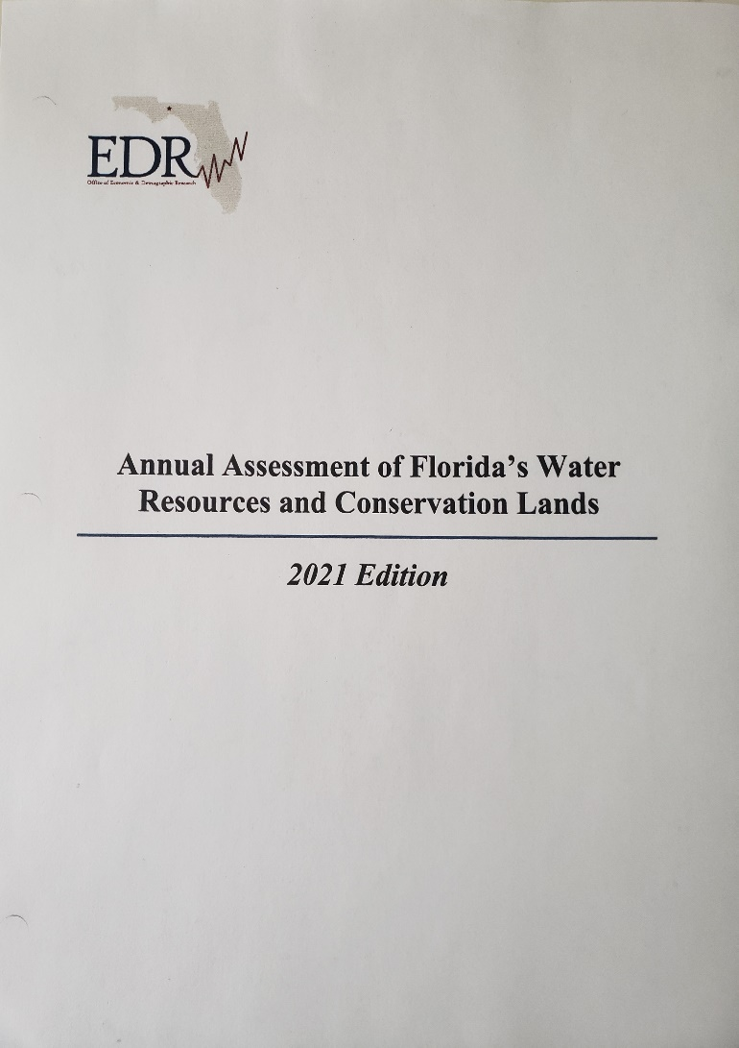
“a gap exists in every future year, growing to $840.69 million by the end of the ten-year forecast period – and this does not include any specific adjustments for new or expanding initiatives.”

Slide 3
Projected State Funding Gap

Slide 4
Water Supply
$24.1 Billion for aging water infrastructure replacement (EPA, 2016)
$570 to 1.13 Billion to meet future water demands through 2040 (15% increase in demand)
$665.1 million to meet currently established minimum flows and levels (MFLs).
Water Quality
$40.3 Billion for aging wastewater and stormwater infrastructure 20yr capital-needs estimate.
$270.5 million for development of TMDL’s.
$3.2 Billion for the implementation of BMP’s.

Slide 5
$8.4 B for the State of Florida’s share of the implementation of the Comprehensive Everglades Restoration Plan (CERP). (Source: EDR 2021 Edition – Annual Assessment of Florida’s Water Resources and Conservation Lands).
Summary
Not including adaptation for Sea Level Rise, Florida will need $66.09 Billion over the next 20 years to address its water resource protection and infrastructure needs.

Slide 6
What Comes Next?
Honest discussion of values and priorities.
Are our limitations real or a product of our choices?
How strong is our foundation?
Every stakeholder must be prepared to be uncomfortable.
No sacred cows.

Slide 7
Challenge Requires Recurring Funding Support (Billions)

Slide 8
FY 22-23 General Appropriations
Everglades Restoration - $885.9 million
Flood and Sea-Level Rise - $513.4 million
Springs Restoration - $75 million
Drinking Water
State Revolving Loan - $202.6 million
Alternative Water Supply - $50 million
Lead Service Line Replacements - $111.3 million
PFAS Test and Remediation - $29.7 million
Small & Disadvantaged Communities - $34.7 million

Slide 9
FY 22-23 General Appropriations
Wastewater
State Revolving Loan - $264.8 million
Statewide Wastewater Grants - $125 million
Small County WW Treatment Grants - $12 million
PFAS Testing & Remediation - $3.2 million
Septic Upgrade Incentives - $10 million
Water Quality Improvements
Wastewater Grants - $125 million
Indian River Lagoon WQI - $38 million

Slide 10
FY 21-22 SFWMD Budget Highlights
Total Budget $1,150,346,196
Everglades Projects Construction - $624 million 54.2%
Infrastructure Management - $234 million 20.3%
Flood Protection System Upgrade - $56 million 4.8%
Operations & Maintenance - $117 million 10.2%
Flooding Emergencies - $61 million 5.3%
Sea Level Rise & Climate Impacts - $75 million 6.5%
Water Supply Development Assist. - $7.6 million 0.007%

Slide 11
What Comes Next?
Honest discussion of values and priorities.
Are our limitations real or a product of our choices?
How strong is our foundation?
Every stakeholder must be prepared to be uncomfortable.
No sacred cows.

Slide 12
WMD Ad valorem Revenues (Millions)

Slide 13
FY 2022-2023 WMD Cooperative Funding
Total Budget %CF
NWFWMD $119.2 mil 67.7
SRWMD $ 61.0 mil 41.3
SJRWMD $151.2 mil 36.7
SWFWMD $196.6 mil 42.2
SFWMD $1,281.5 mil 1.2

Slide 14
What Comes Next?
Honest discussion of values and priorities.
Are our limitations real or a product of our choices?
How strong is our foundation?
Every stakeholder must be prepared to be uncomfortable.
No sacred cows.

Slide 15
Drinking Water
Stormwater
Resilience
Wastewater
Ecosystems

Slide 16
Drinking Water
Positive – State commitment to alternative supply dev.
Negative – Regional approach has been difficult to advance.
Solution – Increased state role in regional water supply project development.
Wastewater Management
Positive – Commitment and technology advancements.
Negative – Not yet maximizing the use of the resource.
Solution – Incentives for increased storage and use of reclaimed water.

Slide 17
Stormwater Management
Positive – State updating 20+ yr. old regulations.
Negative – Increased burden on all stakeholders.
Solution – Regional off-site options to both accelerate recovery and reduce regulatory burden.
Ecosystem Restoration
Positive – Record investment by the State.
Negative – Delays in implementation of projects.
Solution – Consideration of PPP alternatives.

Slide 18
Resilience
Positive – Recognition that this is both a coastal AND inland issue.
Negative – Scale of challenge.
Solution – Development of long-term plan for the identification and implementation (including funding) of resilience projects.

Slide 19
Where do we start?
The state should undertake a comprehensive review of water policy with the goal of developing recommendations relating to both governance and long-term funding.

Slide 20
Governance Issues
Delineation of responsibilities between state and local governments.
State Local
Water Resource Mgmt. Water Supply
Ecosystem Restoration Wastewater Mgmt.
Regional Flood Control Stormwater Mgmt.
Water Quality Protection BMAP Implementation
Process for setting and funding state priorities.
DOT Work Plan Model
Role of WMD’s.
Role of private sector.

Slide 21
Funding Issues
Development of a plan to address the growing funding gap including:
Delineation of funding responsibilities of state, water management districts and local government.
Review of current state, WMD and local revenue sources.
Review of limitations on WMD and local revenue sources and conditions under which these may be modified.
Identification of new revenue sources required to address state responsibilities.
Development of procedures for accessing state funding.

Slide 22
Discussion

