Slide 1
Florida Labor Market November 2021 Update
Mark Cassidy, AICP
Economic Development & Research Manager South Florida Regional Planning Council
Notes:
Welcome Mark. Mark welcomes everyone and starts presentation.

Slide 2
South Florida Labor Market Update
A stalling recovery at a crossroads
Notes:
Now that you’ve been introduced to the council and our services, before I turn it over to our panelists and moderator, I will set the stage by presenting the latest data that the Florida Department of Economic Opportunity releases each month, and a couple additional sources to give you an update of the labor market in the state, us, and south Florida region.
Looking at the data, I see our region as a recovering economy in urgent need of additional support to not only build the economy back to the level that it was before, but also adapting to the economy of the future to achieve long term economic resiliency.

Slide 3
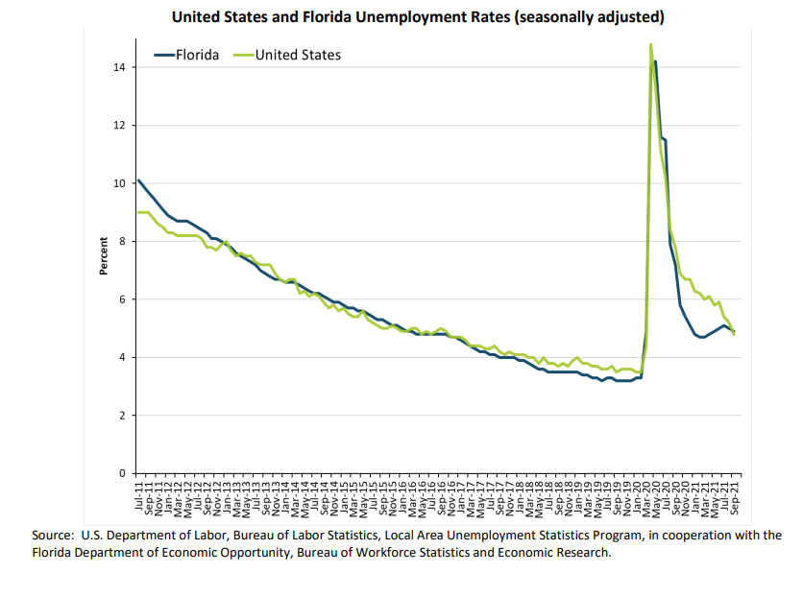
Sep-11 Sep-12 Sep-13 Sep-14 Sep-15 Sep-16 Sep-17 Sep-18 Sep-19 Sep-20 Sep-21
Source: U.S. Department of Labor, Bureau of Labor Statistics, Local Area Unemployment Statistics Program, in cooperation with the Florida Department of Economic Opportunity, Bureau of Workforce Statistic and Economic Research
Notes:
Since peaking above 14% at the height of the pandemic, Florida’s unemployment has dropped consistently and significantly through 2021, with a recent plateau. The united states, which was slower to recover for the past year, is catching up to the point of national unemployment currently being 4.8%, slightly lower than Florida’s
Florida’s unemployment rate is is down 6.6% over the year
Unemployment - 5.0% (up 0.1% from May)
Significant increase in the labor force of 83,000 over the month
We have come a long way in Florida since the height of the pandemic. For 11 consecutive months, Florida’s unemployment rate, currently at 5.1 percent, has remained below the national rate, which is currently at 5.4 percent and decreased by 6.4 percentage points over the past year. However, that recovery is stalling, with unemployment up 0.1 percentage point from May. The is still room to grow -- The change in Florida’s unemployment rate reflects the significant increase in the labor force of 83,000 over the month. More workers are entering the labor force than are taking jobs, yet more and more jobs are available. This tells me that there is a skill and wages gap. That is not the worst problem to have, but is where this needed support comes in via ARPA funds.

Slide 4
Source: U.S. BUREAU OF LABOR STATISTICS; Job openings rates, seasonally adjusted
Notes:
Taking a look at the total unemployed persons per job opening ratio, the amount of unemployed people per job is actually back to pre-pandemic levels, despite the total number of jobs still being available. This means that people are finally starting take jobs, but that has been slowing down compared to the number of job openings.
This tells me that compared to the actual unemployment level, the number of job openings is actually decreasing along with unemployment

Slide 5
Source: U.S. BUREAU OF LABOR STATISTICS; Job openings rates by industry, seasonally adjusted
Notes:
What jobs are available? Leisure and hospitality have been significantly leading the pack inrecovery.
Leisure and hospitality job openings lead the nation’s industries as they recover. Starting in 2021 job openings really starting taking off as shutdown orders expired. The data for hires shows the same patterns, strong job openings = strong hires and same patterns .

Slide 6
Source: U.S. BUREAU OF LABOR STATISTICS; Job openings rates by industry, seasonally adjusted
Notes:
Strong industries typically requiring on location performance have experienced gradual growth since start of 2020. These are industries that mostly cannot work from home, yet are higher wage

Slide 7
Source: U.S. BUREAU OF LABOR STATISTICS; Job openings rates by industry, seasonally adjusted
Notes:
Telework-conducive and construction jobs have the least openings growth and lowest growth rate, These were also the least impacted industries in the first place.

Slide 8
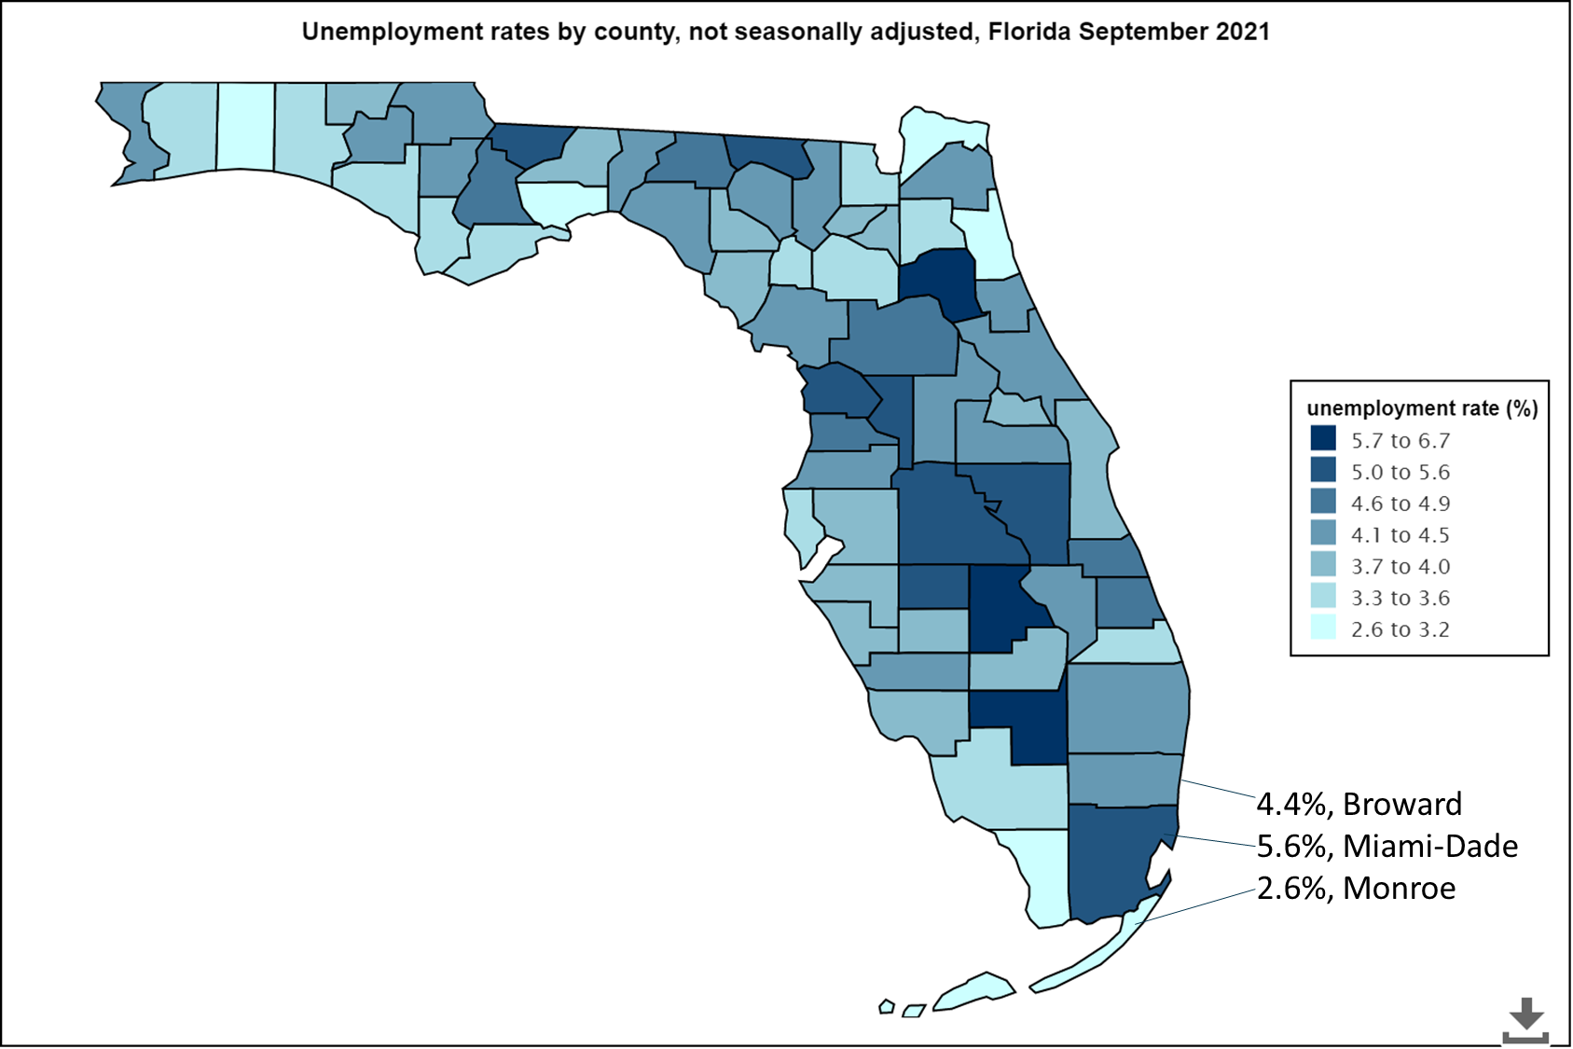
Counties mixed across state
Miami-Dade still among most impacted
Source: U.S. BUREAU OF LABOR STATISTICS Local Area Unemployment Statistics Map LAU LAU Program Links
Notes:
Across the state at the county level, there is not much of a pattern of distribution or obvious correlation to any one data point that I could see. There are some patterns relevant to cases per capita but the outbreak of the panhandle is not being captured in the labor market data yet.
Miami-Dade county remains one of the most impacted counties in the state

Slide 9
Source: Florida Department of Economic Opportunity; STATE OF FLORIDA, LOCAL AREA UNEMPLOYMENT STATISTICS BY WORKFORCE REGION
Notes:
This chart compares the difference in unemployment compared to a 2019 baseline. When looking at the impacts at the county level over the past almost 2 years, the story is that Monroe County obviously experienced the worst of it, and Miami-Dade County initially faired better than the region and state as a whole. But in mid 2020 Monroe County began to make a recovery while Miami-Dade plateaued and even increased unemployment through the end of 2020, and still has not recovered to the levels that Monroe, Broward, and the rest of the state have. Unemployment
MDC unemployment 9/19—2.6, today its 5.6,
Florida’s unemployment rate is is down 6.6% over the year
Unemployment - 5.0% (up 0.1% from May)
Significant increase in the labor force of 83,000 over the month
We have come a long way in Florida since the height of the pandemic. For 11 consecutive months, Florida’s unemployment rate, currently at 5.1 percent, has remained below the national rate, which is currently at 5.4 percent and decreased by 6.4 percentage points over the past year. However, that recovery is stalling, with unemployment up 0.1 percentage point from May. The is still room to grow -- The change in Florida’s unemployment rate reflects the significant increase in the labor force of 83,000 over the month. More workers are entering the labor force than are taking jobs, yet more and more jobs are available. This tells me that there is a skill and wages gap. That is not the worst problem to have, but is where this needed support comes in via ARPA funds.

Slide 10
Source: Florida Department of Economic Opportunity; STATE OF FLORIDA, LOCAL AREA UNEMPLOYMENT STATISTICS BY WORKFORCE REGION
Notes:
Miami-Dade’s Labor Force took the biggest hit during the pandemic, closely followed by Monroe. Miami-Dade started to see a recovery more recently, nearly reaching pre-pandemic levels. This is not the case in Monroe county, who’s labor force is still 1% below what it was in the beginning of 2020.
Uptick caused by increases in labor force
Miami’s decline is interesting
Likely caused by decrease in population
Decrease in international in-migration and continued domestic out-migration
Contributing to the low-wage labor squeeze?
Labor Force and unemployment
The large increases in labor force are contributed to the lagging unemployment numbers. The economy is still recovering, although the recovery is slowing down.
Miami’s Labor Force decline is interesting, as it contrasts with the other counties, state and us.
This is interesting because it reflects the actual population decline of Miami-Dade County, which was reflected in the 2020 Census estimates of components of population change.
The story is that South Florida’s population is growing like crazy due to domestic migration. domestic migration is on the rise. However, Miami-Dade’s population actually declined last year, because most of the people that move to Miami-Dade County are international. International migration was way down last year. So, Miami-Dade’s population actually declined, because international immigration to Miami-Dade was not able to outpace domestic out-migration from Miami-Dade county like it usually does, hence population decline. Meanwhile, Broward receives most of its population growth domestically, so population growth in that county was less affected.
In the chart you can also see the large gains that Monroe County has been able to make as its workers in its tourism-dependent economy have been able to return to work.

Slide 11
82,874
Source: U.S. Census – 2019 ACS 1-year Estimation, Decennial 2020 Count, REMI May 2021 Population Forecasted Percent Change
Notes:
A Lot of what is driving the unemployment and labor force numbers is simply population growth. international migration makes up a larger portion of population growth in our region that migrants from the us. During the pandemic, international migration was shut down. This actually caused Miami-dade’s and Broward county’s populations to decrease slightly in 2020, but not much as the increase in us migrants nearly offset it.
Monroe county is the interesting data point here. The 2020 census has much more robust counting than the estimates used to develop the 2019 population data. Monroe county is small, so my guess is that the 12% increase in population is actually just a data correction, and it was historically underestimated. Monroe county is unlikely to continue growing at a 12% per year pace. The trend of Monroe county population has been flat or slightly decreasing, and that is reflected from a population forecasting model from REMI) The 2021 and later data are all forecasted growth rates. You see Miami and Broward returning to 1% growth and Monroe county reaching a balance.
Uptick caused by increases in labor force
Miami’s decline is interesting
Likely caused by decrease in population
Decrease in international in-migration and continued domestic out-migration
Contributing to the low-wage labor squeeze?
Labor Force and unemployment
The large increases in labor force are contributed to the lagging unemployment numbers. The economy is still recovering, although the recovery is slowing down.
Miami’s Labor Force decline is interesting, as it contrasts with the other counties, state and us.
This is interesting because it reflects the actual population decline of Miami-Dade County, which was reflected in the 2020 Census estimates of components of population change.
The story is that South Florida’s population is growing like crazy due to domestic migration. domestic migration is on the rise. However, Miami-Dade’s population actually declined last year, because most of the people that move to Miami-Dade County are international. International migration was way down last year. So, Miami-Dade’s population actually declined, because international immigration to Miami-Dade was not able to outpace domestic out-migration from Miami-Dade county like it usually does, hence population decline. Meanwhile, Broward receives most of its population growth domestically, so population growth in that county was less affected.
In the chart you can also see the large gains that Monroe County has been able to make as its workers in its tourism-dependent economy have been able to return to work.

Slide 12
Source: Florida Department of Economic Opportunity; NONAGRICULTURAL EMPLOYMENT IN FLORIDA
Notes:
Looking at the changes in employment by industry in Miami-Dade and Broward from June 2020 to June 2021,
I organized the industries from top to bottom based on their total employment in the region, so Trade, Transportation, and utilities has the most employees.
You can see the strong recovery being made in the region’s strongest sectors, with Leisure and Hospitality leading the gains, but strong growth in trade and professional services as well. The only decline has been in construction, which only declined in Miami-Dade and not Broward.

Slide 13
Industry Employment Changes Over Month (March 2021)
Source: Florida Department of Economic Opportunity; NONAGRICULTURAL EMPLOYMENT IN FLORIDA
Notes:
Looking at the changes in employment by industry in Miami-Dade and Broward from June 2020 to June 2021,
I organized the industries from top to bottom based on their total employment in the region, so Trade, Transportation, and utilities has the most employees.
You can see the strong recovery being made in the region’s strongest sectors, with Leisure and Hospitality leading the gains, but strong growth in trade and professional services as well. The only decline has been in construction, which only declined in Miami-Dade and not Broward.

Slide 14
Source: U.S. Bureau of Labor Statistics- State and County Wages; Employment, Hours, and Earnings - National
Notes:
Miami-Dade and Broward lead Florida
Florida as a whole made strong increases in Q4 2020 compared to US
Monroe still behind region, state, and U.S
Miami-Dade and Broward lead Florida
Florida as a whole made strong increases in Q4 2020 compared to US, which must not be a coincidence to Florida reopening sooner than the US on average

Slide 15
Making connections
Growth of past year slowing down
More looking for work, more job openings, more working
Driven by hospitality’s resurgence
Long term impacts to hospitality, especially meetings and conferences
Remote work up over 7x in ten years
Technology replacing human work
Need innovative jobs to move to next level
Notes:
Florida should prepare for changes in labor force post-COVID (news-journalonline.com)
Notes –
State of Florida and South Florida recovery outpacing U.S
more people are looking for jobs, and many jobs are available, but there are not as many people taking the jobs are largely outweigh the difference
Growth of past year slowing down. Gains have been made as much as can be and without population replenishment, might be almost as much as we can get
The recovery is stalling. Leisure and hospitality is leading the recent growth, but that was the most impacted industry with the most room to recover. Other large industries like professional and business services and education are losing jobs recently. Unemployment is basically flat, and workers are returning to the workforce, but to lower-wage industries. This might not be sustainable considering that population growth in Miami-Dade is actually down due to reduced international immigration.
In 2011, 4.2 percent of Floridians worked remotely. In 2021, it's 30 percent.
Long term impacts to hospitality, especially meetings and conferences
Artificial intelligence is accelerating rapidly due to the pandemic and incoming minimum wage increases

Slide 16
Questions / Thoughts / Feedback

