Slide 1
Comprehensive Economic Development Strategy for South Florida, 2022-2027 Economic Diversification & Environnent & Resilient Infrastructure Work Group Meeting #3
Mark cassidy
Economic development and Research Manager
NOVEMBER 15, 2021

Slide 2
Timeline
SLIDE TIPS
These callout elements are made to be copied onto other slides.
Use them to highlight relevant info on photos, diagrams, graphics.
What do we need to do today and in the short term?
Today First Work Group Meeting
December 6, 2021 Second CEDS Strategy Committee Meeting
Work Group Established – Environment and Resilient Infrastructure & Economic Diversification
Topic – Economic Recovery and Resiliency
Recommend Best Practices and Strategies
SWOT Summary
Performance Measures
Progress on CARES Act Strategic Plan

Slide 4
Work Group Designations
SLIDE TIPS
This agenda is made with SmartArt.
Click into the text boxes or use the SmartArt window to make text changes.
Delete any unnecessary items.
To highlight the current section, change the colour of the chevron behind the item from the standard green to the dark green.
Similarly, to remove the highlight from a section, change the colour of the chevron from dark green to the standard green.
After adding your agenda items, duplicate this slide to create the section index slides.
Business Attraction / Workforce Development
Transit-Oriented Development
Economic Diversification
Environment and Resilient Infrastructure

Slide 5
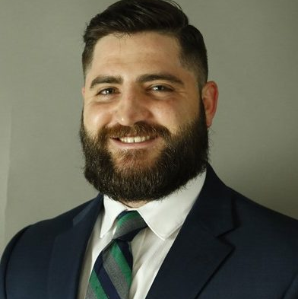
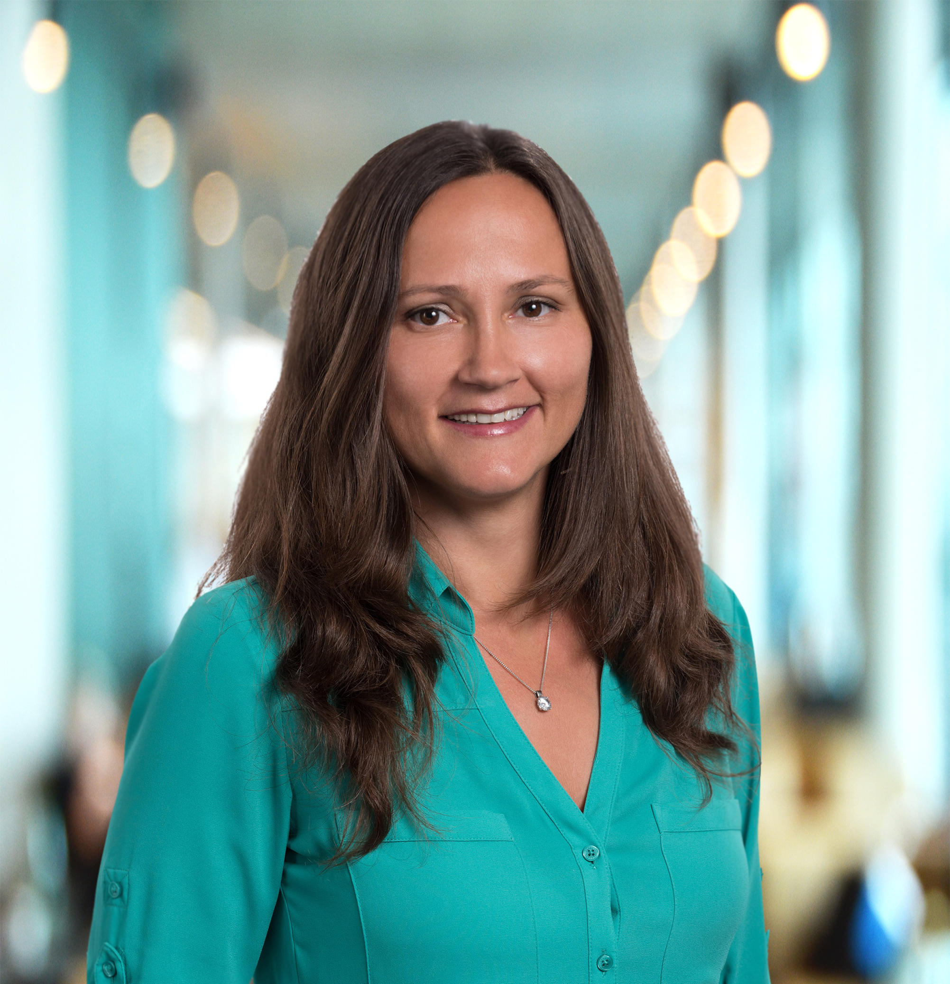
Introductions
Mark Cassidy, AICP
Economic Development & Research Manager South Florida Regional Planning Council
Eralda Agolli, MPA
CARES Act Economic Disaster Recovery Coordinator South Florida Regional Planning Council
Environment and Resilient Infrastructure & Economic Diversification
Work Groups
Notes:
My name is Eralda Agolli and I am the program manager for the CARES Act Economic Disaster Recovery program. My role at the council is to:
Serve as a liaison between local, state, and federal partners to assist the South Florida region prepare for, prevent, and respond to existing and future impacts by expanding economic development COVID-response activities.
Assist with researching federal, state and philanthropic grants and other funding opportunities
Develop an appropriate venue for communicating with the most impacted communities and stakeholders in the region.
And Implement economic recovery and resilience plans with the goal of rebuilding resilient and sustainable communities throughout South Florida.

Slide 6
CARES ACT GRANT Economic Resilience: Establishing Best Practices for Southeast Florida
Eralda agolli
Program Manager - Economic Disaster Recovery
NOVEMBER 15, 2021
Notes:
Just so you can visualize this presentation the outline will be the following:
Set the stage and Define Economic Resilience per EDA guidelines
Give an overview of the grant
Grant roadmap of what we have accomplished so far and where we are now
Go a step further and explain the EDA activities needed to meet the grant goal
Show data, and/or accomplishments if you will, of what we have achieved for each of the goals
Explain Your role in this process
And lastly your feedback/advice

Slide 7
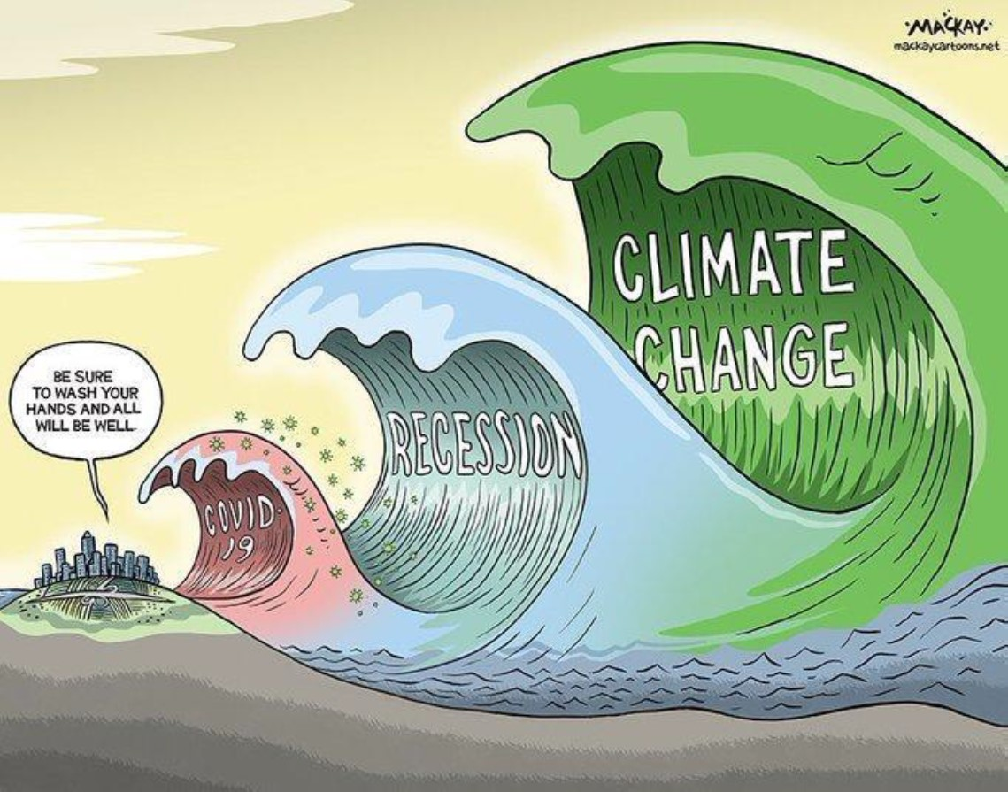
Economic resilience refers to the ability of local economies to “bounce back” to normal conditions after losing function because of an uncontrollable event. Resilient economies have the capacity to quickly respond to, withstand, and recover from adverse situations such as a public health crisis or high intensity storm.
U.S. ECONOMIC DEVELOPMENT ADMINISTRATION
Notes:
What is Economic Resiliency as defined by EDA?
From a long-term perspective, resilient economies find ways to adapt to changing conditions, such as disruptions to major supply chains, so that future losses are minimized, and continuing stresses are adequately managed.
In addition to a built capacity to withstand shocks, resilient economies take necessary measures to prevent and avoid major disruptions.
For economic resilience strategies to be successful, equity must be an integrated component of long-range plans ensuring that ALL who live and work, within a given community, have access to a good education, affordable housing and transportation and can prosper.
Economic Resiliency
Pandemic Recovery
Future Responses to pandemics and other shocks

Slide 8
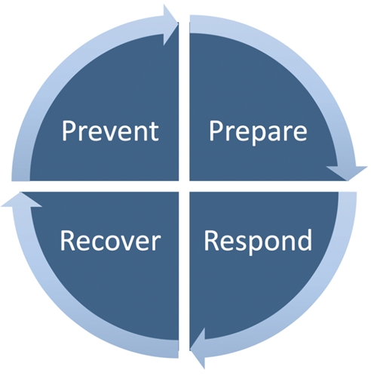
CARES ACT Scope of Work
August 2020 – June 2022
The SFRPC was recently awarded funding from the U.S. Economic Development Administration (EDA) to support economic resilience efforts across the region directly related to the coronavirus pandemic.
This funding will enable the SFRPC to augment and focus staff resources, towards priorities related to coronavirus response, recovery, and long-term planning over the next two years.
Notes:
In August of 2020 SFRPC was awarded the CARES grant to help the region to prepare for, prevent, and respond to existing and future impacts by expanding its economic development COVID-response activities including technical assistance, enhancing regional planning, collaboration, and intergovernmental coordination among local governments, economic development organizations, the business community, and other key stakeholders.

Slide 9
Grant Roadmap
Q1
Q2
Q3
Q4
JULY 20 – SEP. 20
OCT. 20-DEC. 20
JAN.21- MARCH 21
APRIL 21 – JUNE 21
Scope of Work Submittal; Hiring of EDRC September 2020.
Assessed region’s COVID-19 Impact via survey establishing top 3 issues. Developed list of available funding sources and grants at specific agencies. Initiated coordination efforts of an Economic Resilience committee to help guide future recovery efforts.
Supported Local Governments and Community Partners through outreach and personal phone calls. Hosted informational webinar on council’s work and EDA priorities.
Continued community outreach and RLF CARES Act loan promotion. Hosted educational webinars. Conducted data research/assessment of economic impact resulting from COVID-19 (SFRPC/TBRPC Report)
Notes:
This is just the grant roadmap to show you what we have done and what needs to be done until June of 2022. Amongst the activities that we have accomplished have been outreach through educational webinars, development of available list of funding sources and grants at specific agencies, survey and Covid economic impact. Further down this presentation you will see the data we have collected from the survey, economic impact report, and the outreach programs.

Slide 10
Grant Roadmap
Q5
Q6
Q7
Q8
JULY 21-SEP. 21
OCT. 21 – DEC. 21
JAN. 22 – MARCH 22
APRIL 22 – JUNE 22
Identified regional partners and established & convened Ec. Resilience committee. Utilize group to develop Long Term Economic Resilience Plan.
Work with the Committee to develop Long-Term Economic Resilience Plan that supports economic diversification, job creation, capital investment, and workforce development and opportunities. Draft due March 2022. Final report due to EDA June 2022. Continue outreach through educational webinars.
Work on draft report. Report to include actionable strategies that will assist member governments and communities in meeting short/long-term economic recovery objectives relating to the coronavirus pandemic. Provide performance measures for future similar events.
Finalize and submit report. Present recommendations to EDOs.
Notes:
Oct – Dec 2021, In the upcoming quarters staff will Work with the Strategy Committee and the workgroups to develop Long-Term Economic Resilience Plan that supports economic diversification, job creation, capital investment, and workforce development and opportunities. We are hoping that you will help us identify these strategies that will serve as a roadmap to Economic Development representatives of the region for future pandemic related events. Draft report/toolkit is due March 2022 and the final due June of 2022.

Slide 11
EDA Activities Needed to Meet Grant Goal
Align SFRPC COVID-19 related response efforts with the goals of the 2017-2022 CEDS.
Economic Diversification
Business Attraction & Workforce Development
Transit Oriented Development
Environment & Resilient Infrastructure

Slide 12
EDA Activities Needed to Meet Grant Goal Continued…
Identify areas needed for research and data analysis to support the development of the new disaster recovery and economic resiliency focus component of the CEDS.
Survey & Economic Impact Report

Slide 13
Survey
What are the top three issues?
What are the top three issues reported to you by the small businesses and the community as a result of COVID-19 pandemic?
Loss of income/revenue/business
Lack of Financial Support
Lack of Communication/Miscommunication from the local, state and federal government
Notes:
Survey was done Dec-Jan 2020 and was sent to all Ec. Dev. Reps in the region. We asked What are the top three issues reported to you by the small businesses and the community as a result of COVID-19 pandemic?
Loss of income/revenue/business.
Lack of Financial Support – be that no available governmental assistance, funding, grants, not knowing how to navigate PPP loans and/or losing out to big corporations.
Lack of Communication/Miscommunication from the local, state and federal government on how businesses should operate, open/closing hours, confusing regulations, Miscommunication or lack of communication of programs/services being offered by the government to small businesses, Lack of aggressive education from the government.

Slide 14
Notes:
This is just the graph to show all the answers and surprisingly Staffing had the same number of answers as communication – be that no staff available, staff working remotely reluctant to come in person, staff not reporting that they have covid, unable to schedule staff during peak hours because of the unpredictable flow of foot traffic.

Slide 15
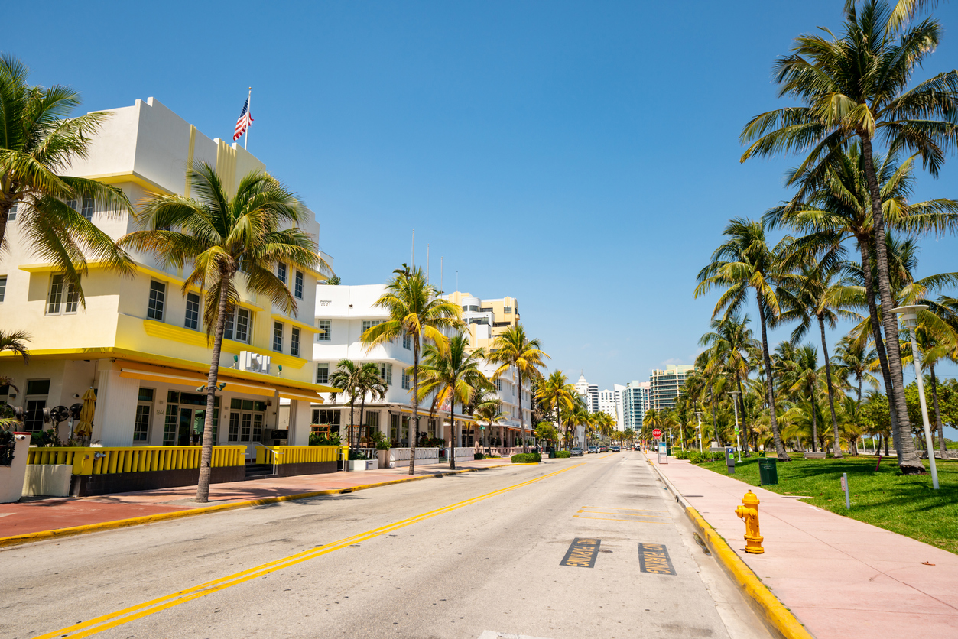
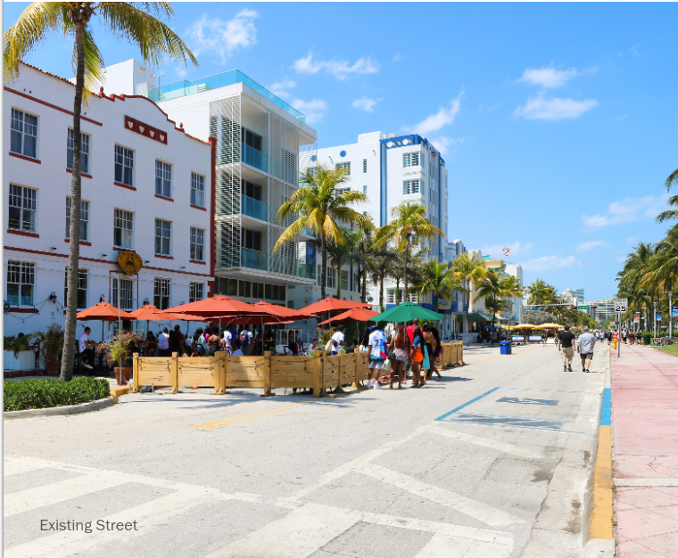
COVID 2021 Economic Impact Report
SLIDE TIPS
This agenda is made with SmartArt.
Click into the text boxes or use the SmartArt window to make text changes.
Delete any unnecessary items.
To highlight the current section, change the colour of the chevron behind the item from the standard green to the dark green.
Similarly, to remove the highlight from a section, change the colour of the chevron from dark green to the standard green.
After adding your agenda items, duplicate this slide to create the section index slides.

Slide 16
COVID 2021 Economic Impact Report
SLIDE TIPS
This agenda is made with SmartArt.
Click into the text boxes or use the SmartArt window to make text changes.
Delete any unnecessary items.
To highlight the current section, change the colour of the chevron behind the item from the standard green to the dark green.
Similarly, to remove the highlight from a section, change the colour of the chevron from dark green to the standard green.
After adding your agenda items, duplicate this slide to create the section index slides.
Job Loss by Industry
Percentage Job Loss in Largest Industries September 2019-2020
Industry | Broward | Miami-Dade
Leisure and Hospitality | -28.7% | -20.9%
Retail Trade | -2.7% | -4.5%
Education and Health Services | -6.6% | -5.7%
Professional and Business Services | -5.5% | -3.8%
Transportation, trade, and utilities | -3.8% | -4.4%
Source: Bureau of Labor Statistics
Notes:
This table shows the updated forecast for the expected economic impact in 2021. It shows overall increases in employment and labor force, particularly in Miami dade, but still not at full recovery.

Slide 17
SFRPC COVID 2021 Economic Impact Report
SLIDE TIPS
This agenda is made with SmartArt.
Click into the text boxes or use the SmartArt window to make text changes.
Delete any unnecessary items.
To highlight the current section, change the colour of the chevron behind the item from the standard green to the dark green.
Similarly, to remove the highlight from a section, change the colour of the chevron from dark green to the standard green.
After adding your agenda items, duplicate this slide to create the section index slides.
Mobility Change
Category | Year | Nation | State |  | Counties
 |  | United States | Florida | Broward | Miami-Dade | Monroe
Retail & Recreation | 2020 | -41% | -45% | -48% | -51% | -69%
 | 2021 | -8% | -10% | -17% | -16% | -13%
Grocery & Pharmacy | 2020 | -14% | -22% | -24% | -28% | -44%
 | 2021 | -2% | -4% | -11% | -8% | -8%
Parks | 2020 | -13% | -50% | -58% | -71% | -73%
 | 2021 | 22% | -10% | -20% | -35% | -18%
Transit Stations | 2020 | -50% | -58% | -68% | -65% | -70%
 | 2021 | -25% | -22% | -33% | -33% | -8%
Workplaces | 2020 | -47% | -46% | -49% | -49% | -49%
 | 2021 | -26% | -24% | -28% | -26% | -17%
Residential | 2020 | 18% | 18% | 8% | 24% | 18%
 | 2021 | 6% | 5% | 23% | 7% | 2%
Source: Google Mobility, 2020-2021. https://www.google.com/covid19/mobility/
Notes:
The situation was evolving so quickly that monitoring actual data was worthless by the time it was released, because conditions had changed. SFRPC used Economic Impact Modeling software and data from May 2020 to forecast the impacts to the economy in by the end of 2020. We found that there would likely be losses across the board in all major economic indicators throughout the region with worse impacts to florida than the nation, south florida worse than the rest of state, and the largest impacts to Monroe county.

Slide 18
COVID 2021 Economic Impact Report
SLIDE TIPS
This agenda is made with SmartArt.
Click into the text boxes or use the SmartArt window to make text changes.
Delete any unnecessary items.
To highlight the current section, change the colour of the chevron behind the item from the standard green to the dark green.
Similarly, to remove the highlight from a section, change the colour of the chevron from dark green to the standard green.
After adding your agenda items, duplicate this slide to create the section index slides.
Summary of Employment Loss in 2020 (REMI)
Notes:
Council staff updated this effort when new forecast model data was released. SFRPC worked with a statewide economic analyst to conduct a similar analysis using May 2021 data.
This chart shows that the previous forecast was relatively close, accurately forecasting the employment and GDP losses in Broward and Miami-dade, but underestimating the negative impact in Monroe county.

Slide 19
COVID 2021 Economic Impact Report
SLIDE TIPS
This agenda is made with SmartArt.
Click into the text boxes or use the SmartArt window to make text changes.
Delete any unnecessary items.
To highlight the current section, change the colour of the chevron behind the item from the standard green to the dark green.
Similarly, to remove the highlight from a section, change the colour of the chevron from dark green to the standard green.
After adding your agenda items, duplicate this slide to create the section index slides.
Summary of Employment Loss in 2021 (REMI)
Notes:
This table shows the updated forecast for the expected economic impact in 2021. It shows overall increases in employment and labor force, particularly in Miami dade, but still not at full recovery.
Not so much of a drop in retail sales despite less travel to the stores, much more shopping from home in addition to working from home’

Slide 20
Community Outreach
Outreach Events, One on One Meetings with Municipalities
Feb 2021 - Informational Session
Intro to SFRPC, how we can assist, tech services avail etc.
May 2021 - EDA Informational Session
EDA funding opportunities
Role of SFRPC when applying for grants
August 2021 - American Rescue Plan Fund Allocation, Covid Planning, Response, & Recovery for SF.
ARPA Fund allocation numbers
Miami – Dade $527.7 mil focused in 3 buckets
1. Economic recovery
2. Infrastructure
3. Basic needs and businesses
Broward $189 mil
Confusion, uncertainty
No coordination between county-city for allocation of funds and infrastructure projects
Notes:
Next, we move to Community Outreach which is a big part of this program and the outcomes we achieved from them.

Slide 21
Community Outreach
Outreach Events, One on One Meetings with Municipalities
October 2021, “Leadership in Times of Crisis: A Toolkit for Economic Recovery and Resiliency”. Outcomes:
Communication and Outreach
Neighborhood Revitalization Process
Approaches to Economic Resilience and Diversification

Slide 22
Community Outreach
Upcoming Outreach Events
November 9, 2021, “The Future of South Florida’s Workforce Post Covid – Observations, Needs, and Strategies”. Expected Outcomes:
Emerging focus for companies and industries in the South Florida region.
Available workforce training programs and their challenges.
Spotlight specific initiatives that have worked and how they can be improved, which jobs, professions, and skill sets are most in demand.
How our region is preparing for this transformation and what private- and public-sector leaders can do to support workforce transitions.

Slide 23
EDA Activities Needed to Meet Grant Goal Continued…
Identify and address opportunities to drive investment into Opportunity Zones and employ and train OZ residents.
Develop, in conjunction with stakeholders, plans and activities that support economic diversification, job creation, capital investment, and workforce development and opportunities.
Identify and provide performance measures for future similar events.

Slide 24
CARES Committee Role
SLIDE TIPS
This agenda is made with SmartArt.
Click into the text boxes or use the SmartArt window to make text changes.
Delete any unnecessary items.
To highlight the current section, change the colour of the chevron behind the item from the standard green to the dark green.
Similarly, to remove the highlight from a section, change the colour of the chevron from dark green to the standard green.
After adding your agenda items, duplicate this slide to create the section index slides.
What we need help with?
Assess
Recommend
Identify
Develop
Notes:
You heard what we have accomplished in detail up until now. What are we asking you to help us with?
Comprehensively assess the conditions that local communities in South Florida are dealing with. Staff will share COVID-19 report, survey results, and other available data. Do we need any other data?
Recommend strategies that will assist member governments and communities in meeting short-term economic recovery objectives relating to the coronavirus or other pandemics. In developing these recommendations, committee members will review existing economic damage surveys, data, and reports; and will make inventory of available strategies that can increase the region’s resilience to disruptions moving forward.
Through support from SFRPC staff, the committee will identify performance measures and long-term objectives and strategies that will protect South Florida from a broad range of future shocks and stresses.
Lastly, the committee will develop a “Regional Economic Resilience Plan,” for South Florida, that is holistic, action-oriented, equitable, and capable of being executed.

Slide 25
Questions, Comments, Feedback on Defining the Plan
What we hope to get from our meeting today?
How do we tie Opportunity Zones activity with Equity, the new EDA Investment Priority?
What goals and objectives should be included as it relates to transit-oriented development?
What types of performance measures should be considered for future events?
Notes:
You now have an understanding of the program. Are there any questions about the program?
Do you have any general comments/feedback on business attraction and workforce development as it relates to this program?
Next step – Discuss OZs. EDA changed their OZ investment priority to Equity. What strategy should region take to achieve equity? Developers are still pursuing OZs since the program ends in 2022. Do you know of any successful projects in the region?
Multiple racial and ethnic groups have been disproportionately impacted by unemployment in 2020.

Slide 26
Business Attraction/Workforce Dev. Workgroup Recommendations
Pressing issues for our region to include in Ec. Resiliency Plan
Affordable Housing
Transportation
Workforce Development
Strategies for New Business Attraction and/or retain existing businesses

Slide 27
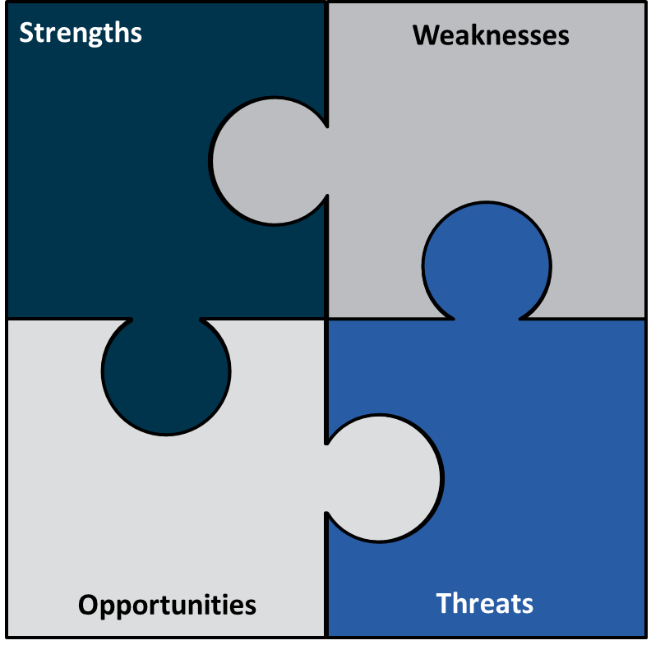
Comprehensive Economic Development Strategy for South Florida, 2022-2027 Economic Diversification & Environment & Resilient Infrastructure Work Group SWOT Analysis

Slide 28
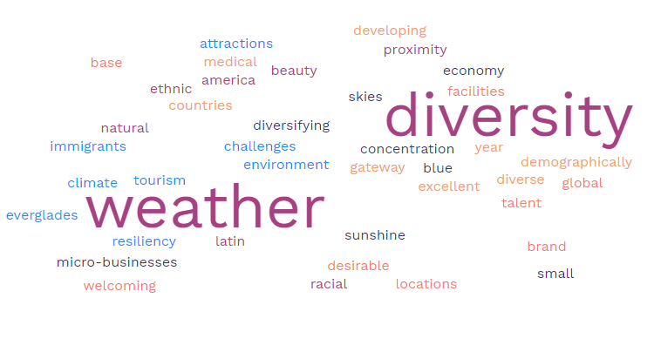
Strengths
Strengths
Environmental
Costs/Wages gap
Public Transportation
Racism
Notes:
Economic Resiliency
Pandemic Recovery
Future Responses to pandemics and other shocks

Slide 29
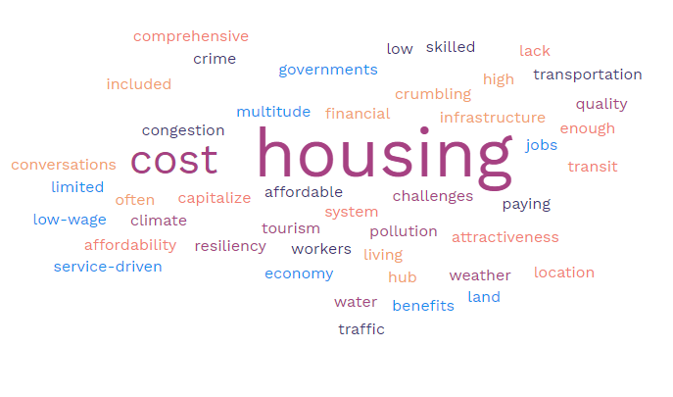
Weaknesses
Weaknesses
Environmental
Costs/Wages gap
Public Transportation
Racism
Notes:
Economic Resiliency
Pandemic Recovery
Future Responses to pandemics and other shocks

Slide 30
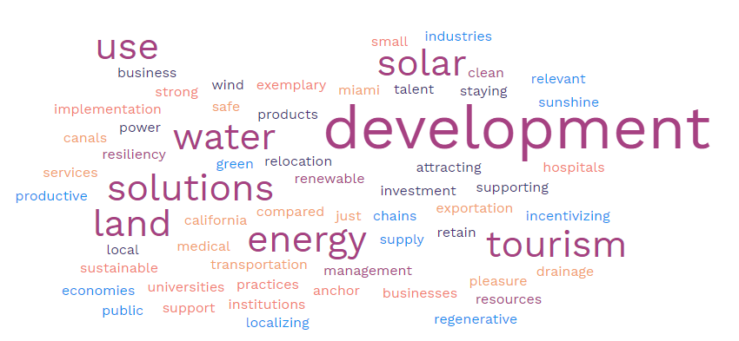
Opportunities
Opportunities
Notes:
Economic Resiliency
Pandemic Recovery
Future Responses to pandemics and other shocks

Slide 31
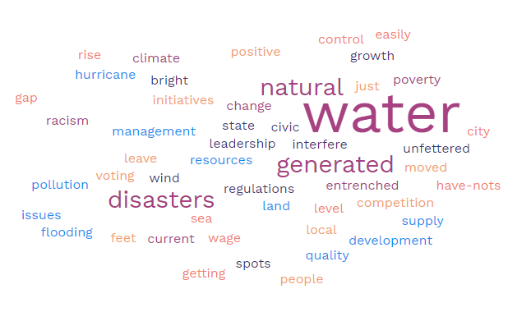
Threats
Threats
Environmental
Costs/Wages gap
Public Transportation
Racism
Notes:
Economic Resiliency
Pandemic Recovery
Future Responses to pandemics and other shocks

Slide 32
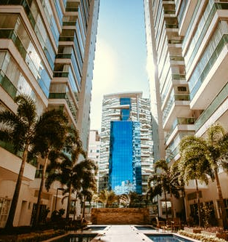
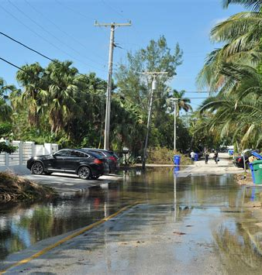
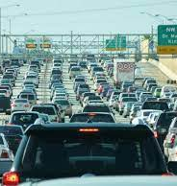
Commonly repeated themes – Mobility and Access Workgroup
Lack of affordable housing
Climate
Transportation options
Notes:
Remind Mark Lack of Communication from survey with Leadership as a threat.

Slide 33
Business Attraction/ Workforce Development
Leadership
Econ / Educ
Transportation
Environmental
Notes:
Remind Mark Lack of Communication from survey with Leadership as a threat.

Slide 34
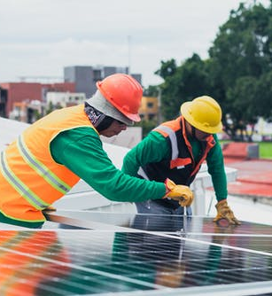
Bringing it all together
Secure primary asset – environment
Leverage universities to promote high skilled workers while simultaneously improving transit so we are more competitive in attracting high-wage companies instead of falling victim to brain drain
Prioritize training a workforce to support green / environmental solutions industries
Improve coordination between state and local governments to efforts align instead of clash

Slide 35
Next Steps
2nd CEDS Strategy Committee Meeting Monday December 6, 2021, at 10:00am
Finalize SWOT Analysis and Performance Measures
Working topic – CARES Act Strategic Plan Goals and Objectives

Slide 36
Next Steps
2nd Work Group Meeting – February 2022
Identify specific projects to recover economy and become more resilient to future shocks
Identify CEDS Goals and Objectives, discuss evaluation plan and framework
Develop economic resiliency project evaluation framework
3rd CEDS Strategy Committee Meeting
March 2022
Draft CARES Act Strategy
Finalize Action Plan and Evaluation Framework, formal vision statement, goals, and objectives

Slide 37
MARK CASSIDY, AICP

