Slide 1
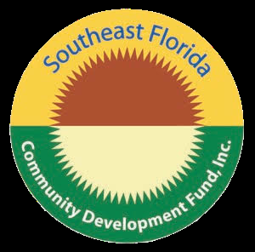
2019 Board of Directors
Patricia Asseff, Councilmember South Florida Regional Planning Council
Hollywood, FL
Lisa Mooney, VP, Sr. Branch Sales Leader Bank United Weston, FL
Gabino Cuevas, Executive VP Cherokee Enterprises Miami, FL
James Murley, Chief Resilience Officer Miami-Dade County Miami, FL
Isabel Cosio-Carballo, Executive Director South Florida Regional Planning Council Hollywood, FL
Tequisha Myles, Esq. Fair Housing & Elder Law Projects West Palm Beach, FL
Southeast Florida Community Development Fund, Inc.
One Oakwood Boulevard, Suite 250
Hollywood, FL 33020
Contact us:
Jeff Tart, Senior Loan Officer
jtart@sfrpc.com
Joyce Hall, Financial Specialist
jhall@sfrpc.com
Southeast Florida Community Development Fund, Inc.
One Oakwood Boulevard, Suite 250
Hollywood Florida 33020
954-924-3653

Slide 2
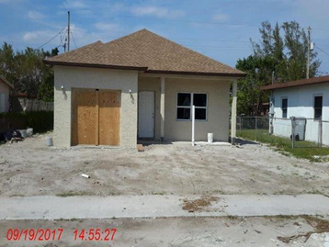
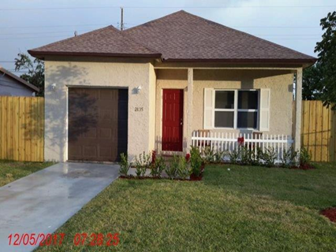
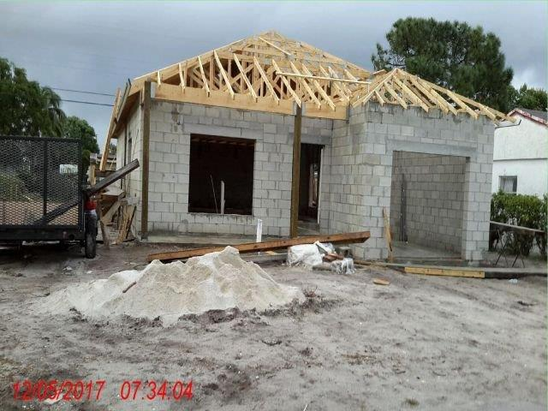
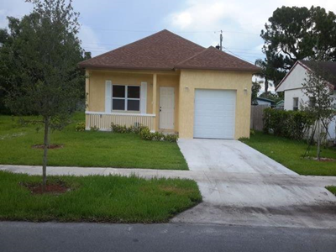
Successful Clients
The SFCDFI program partners with those approved developers and contractors to provide the construction financing to complete the single-family homes. On average, the typical single-family home costs approximately $217K to build inclusive of all hard and soft costs. Due to limited construction funds in the program, the majority of which are being utilized to build current homes, the SFCDFI has a need to obtain additional program funds. The SFCDFI currently has four applications for funding to build affordable housing. Additional program funds will be used to fund the current backlog of four homes to be built and then address the additional affordable housing needs of South Florida CRAs in Broward, Miami-Dade and Monroe counties.
Affordable Housing Focus
The Southeast Florida Community Development Fund, Inc. (SFCDFI) program is designed to facilitate the provision of clean, decent, affordable and sustainable housing for low-to-moderate income families through rehabilitation of existing housing, affordable first-time homebuyer programs, counseling and partnering with community stakeholders. To date, the CDFI program has financed six new single-family homes in the Broward Municipal Services District In-Fill Lot Development Program. The BMSD In-Fill Lot Development program is a part of the County’s overall strategy designed to enhance and preserve neighborhoods by awarding lots and buyer down payment/purchase assistance funds to eligible developers or contractors to construct in-fill housing or develop single family housing for resale within unincorporated Broward County.

