Slide 1
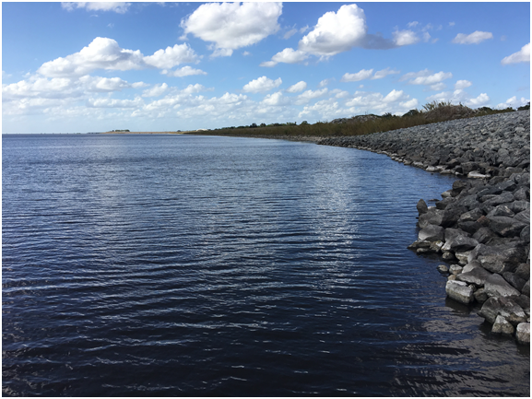
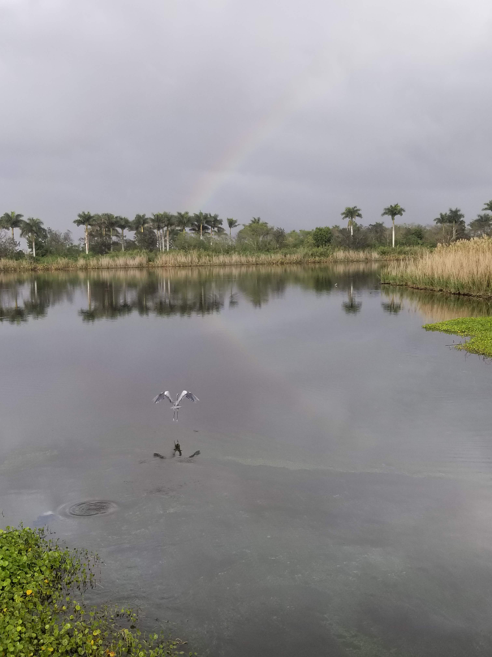
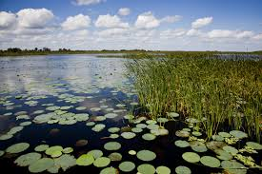
South Florida
Regional
PLANNING
COUNCIL
Lt. Col. Jennifer Reynolds
Deputy Commander, South Florida
Jacksonville District
U.S. Army Corps of Engineers
15-APR-2019

Slide 2
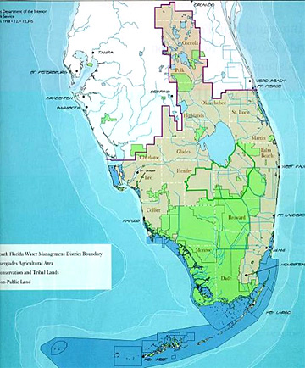
The south Florida Ecosystem
Area – 18,000 square miles
Twice the size of New Jersey
Population - ~8 million

Slide 3
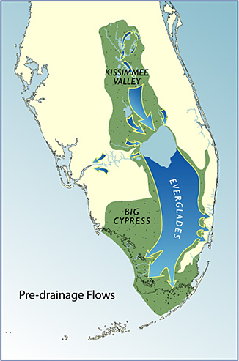
The Historic Everglades Ecosystem
“River of Grass”
Natural system composed of over 9 million acres of lakes, rivers and wetlands
Water flowed from central Florida through Lake Okeechobee and south into Florida Bay
Unique and diverse mosaic of habitat
Over 60 inches of rain annually
Very flat - slopes one inch per mile

Slide 4
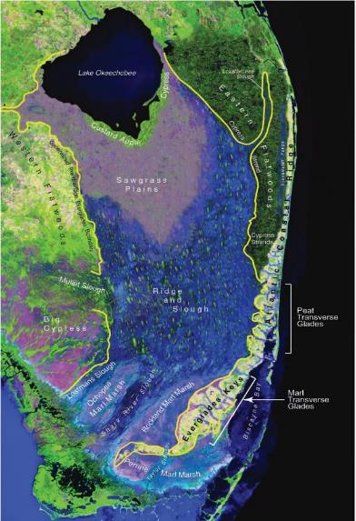
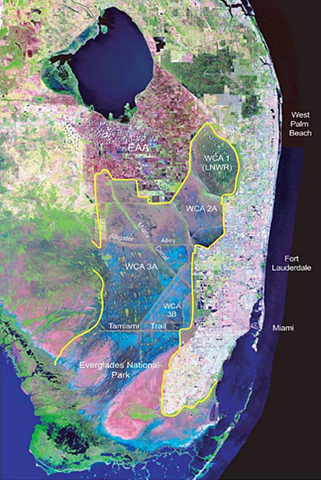
Challenge 1: changed habitat/loss of wetlands
Then…
Now…

Slide 5
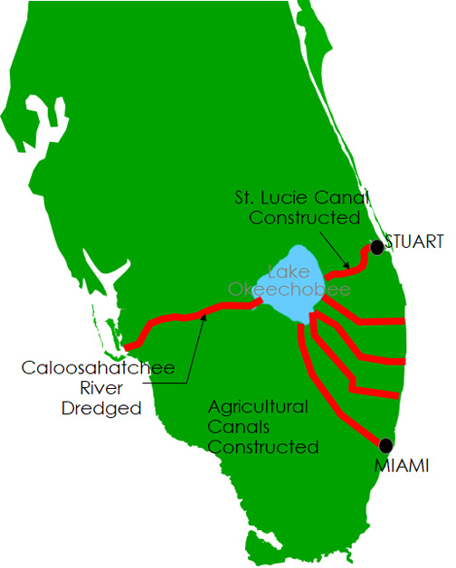
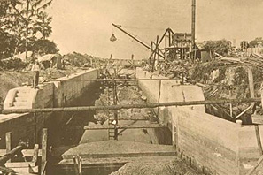
Challenge 2: system design
Everglades Drainage District Works
1905-1928

Slide 6
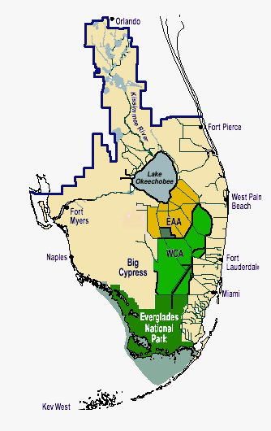
Challenge 2: system design Cont‘D
C & SF Project
River Channelization
Herbert Hoover Dike
Water Conservation Areas
Protective Levees
  Everglades Agricultural Area
  Lower East Coast
Drainage Network
  Salinity Structures

Slide 7
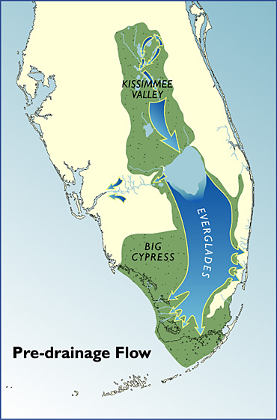
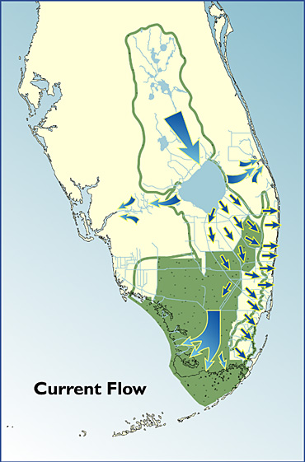
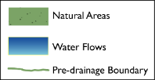
Challenge 3: inflows vs. outflows

Slide 8
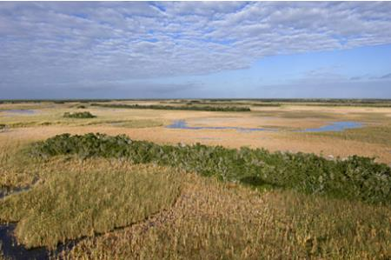
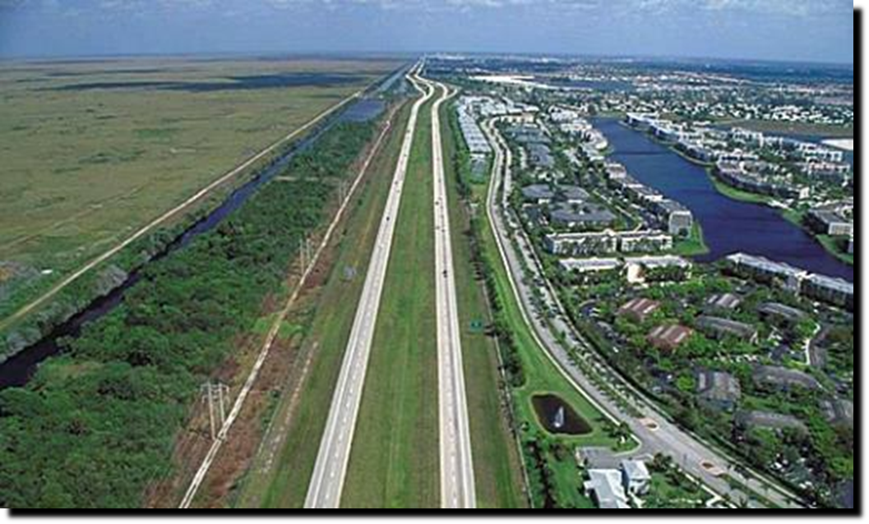
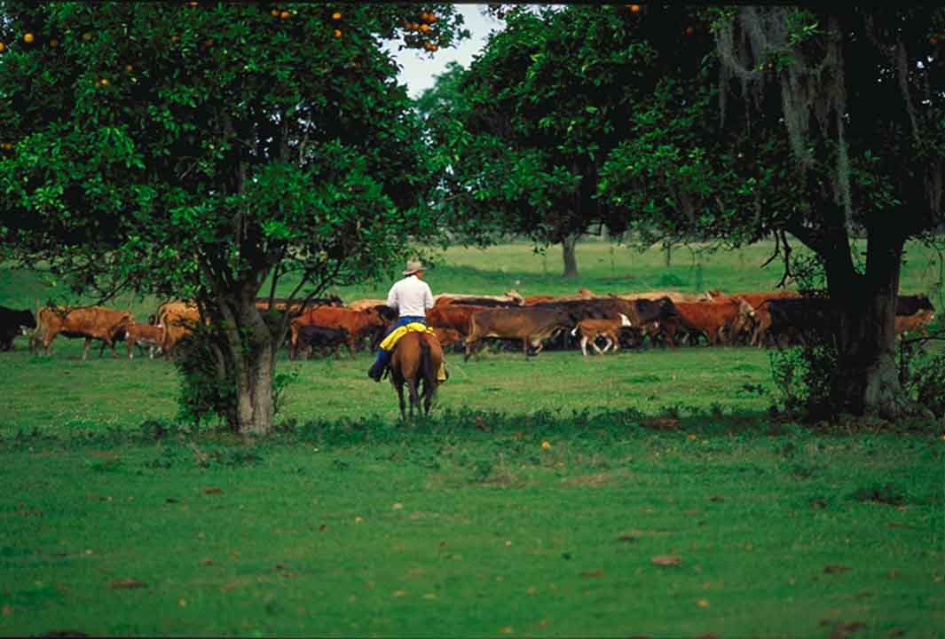
Challenge 4: working together
Myths of Competition
Oysters vs Bass
Snail Kite vs Sparrow
Coasts vs Lake
Agriculture vs Environment
Flood Protection vs Water Supply
Development vs Tourism

Slide 9
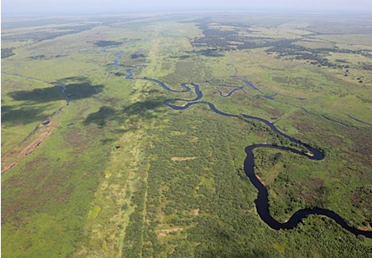
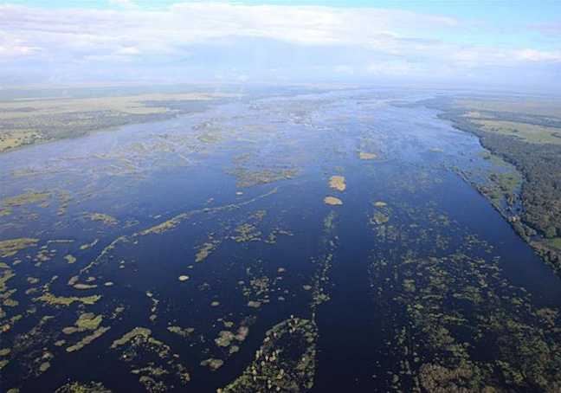
Opportunities instead of challenges….
Dry Season
Up to 17 inches of rain fell in Kissimmee Basin after Hurricane Irma

Slide 10
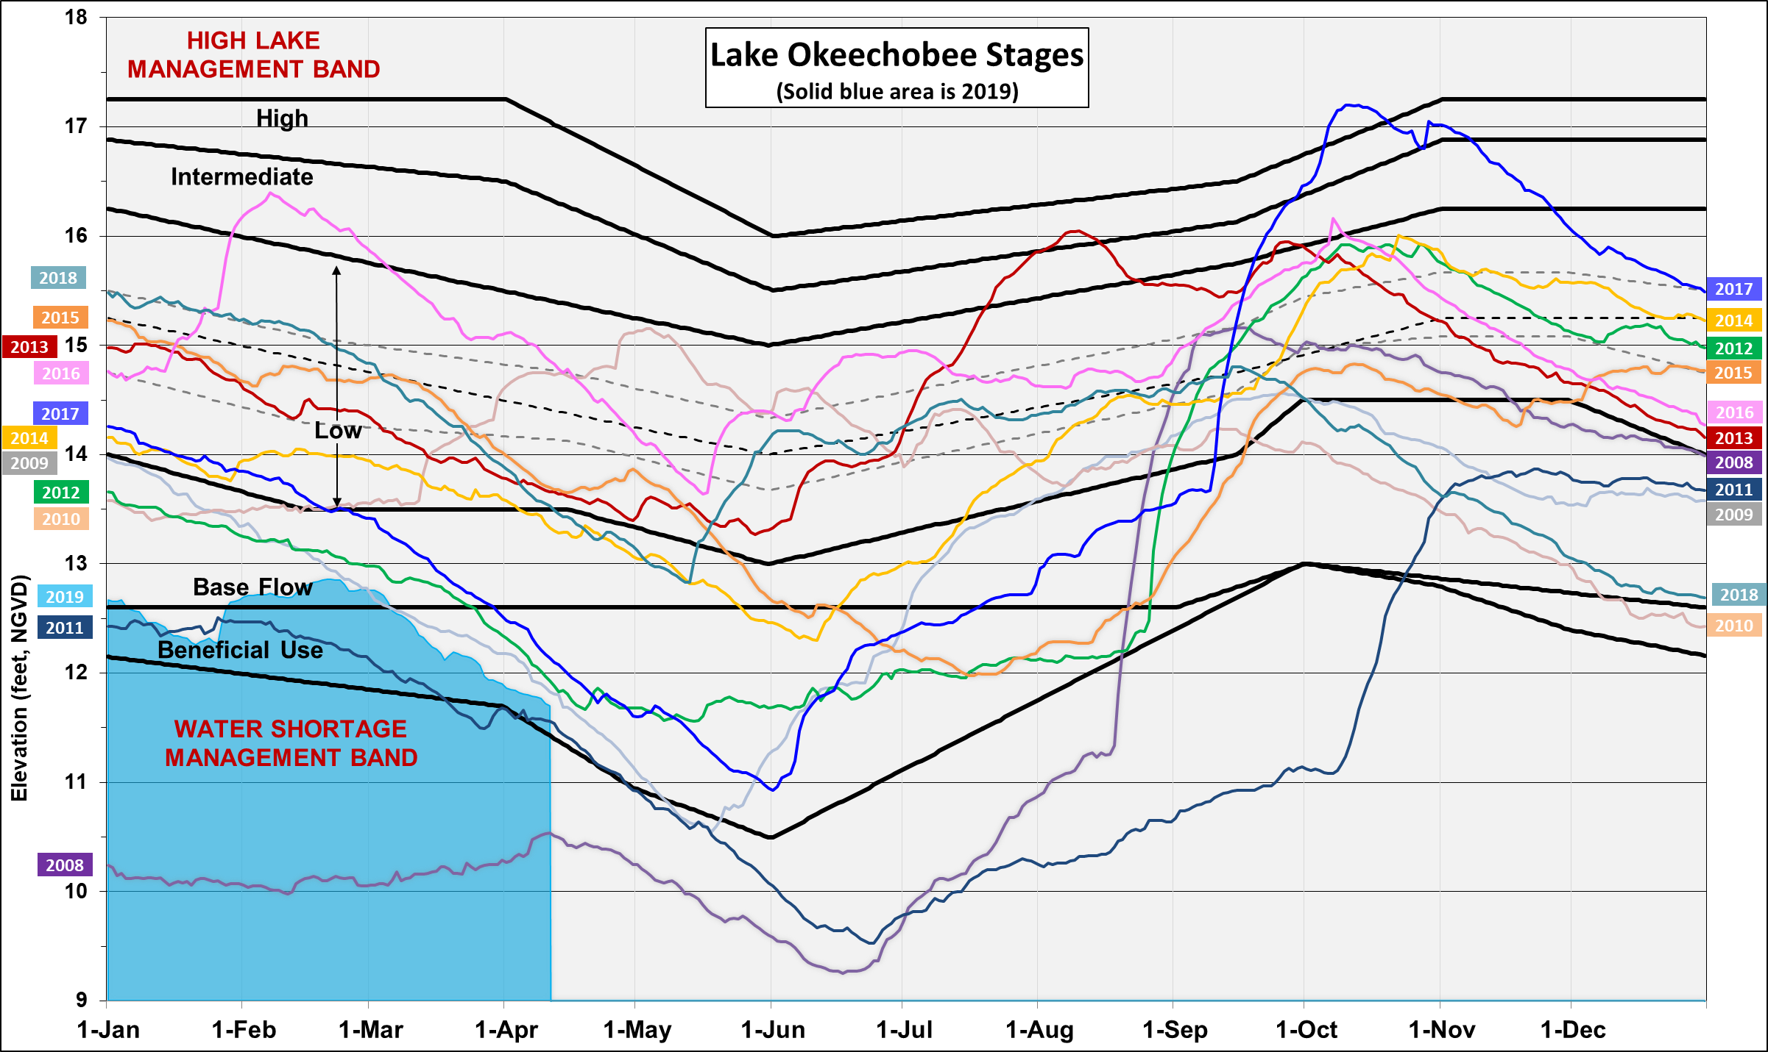

Slide 11
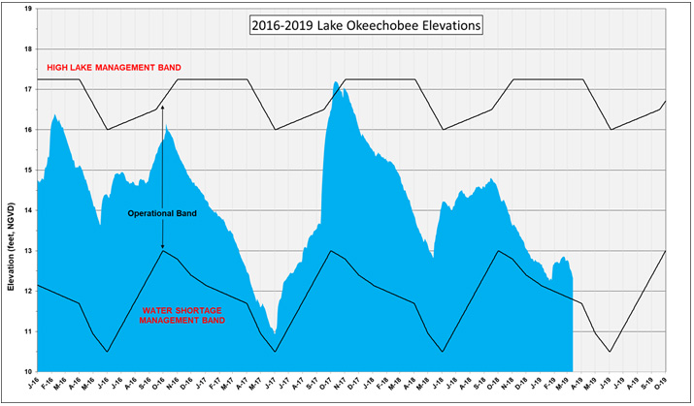

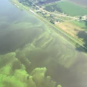



Three years of extremes on lake Okeechobee
17.2 ft
Irma
El Niño
Algae
El Niño
La Niña
Algae
12.11 ft
33,000 ac
20,000 ac
10.9 ft
5,000 ac

Slide 12
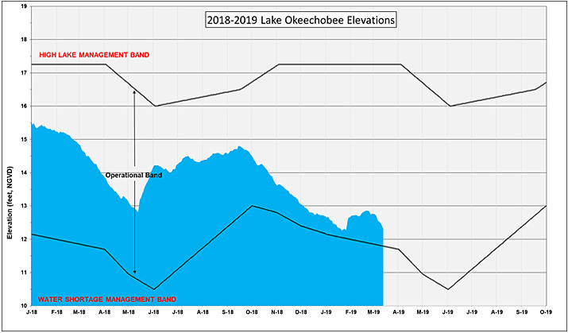



Dry Season 2019 plan

Slide 13
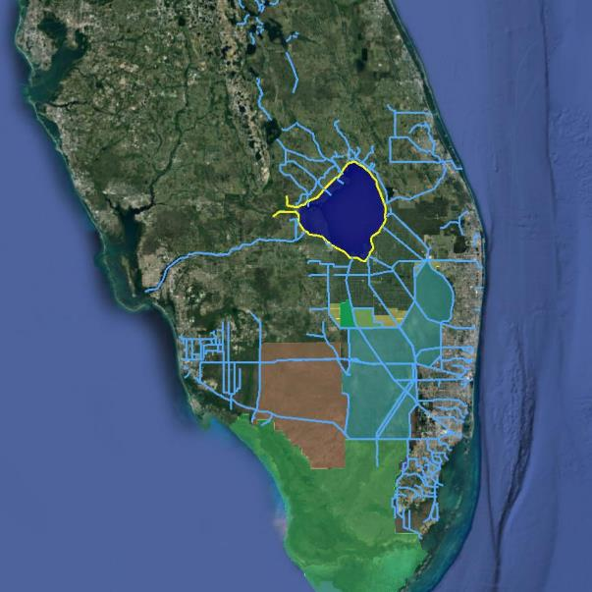
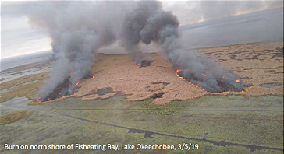
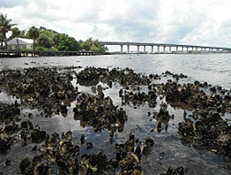
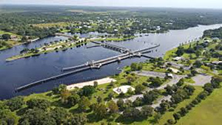
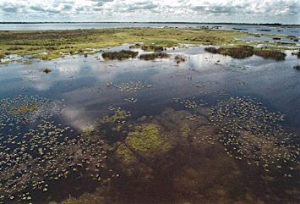
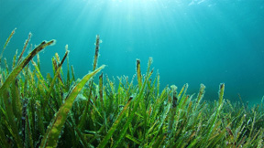
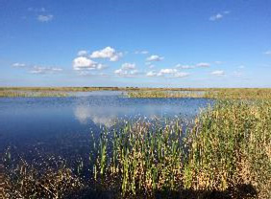
What are we monitoring?
0 cfs
11.70 ft
1,000 cfs
1,787 cfs

Slide 14
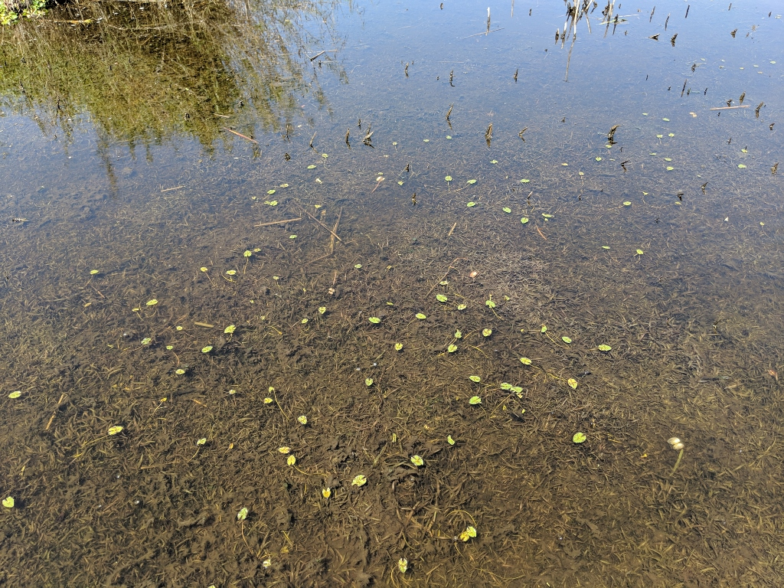
How ARE WE DOING?

Slide 15
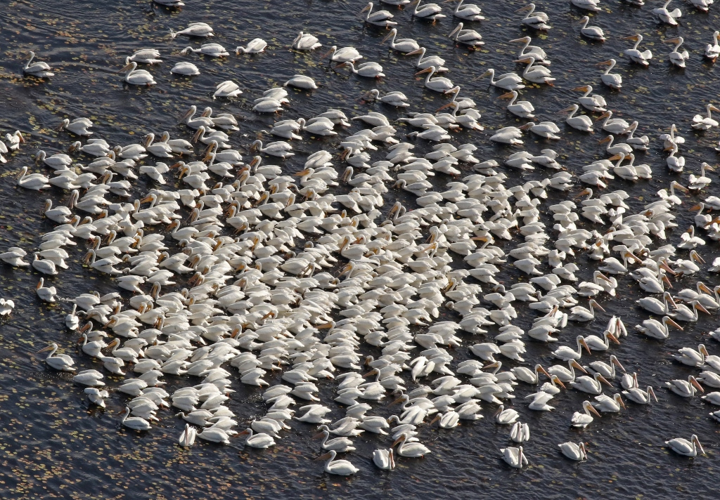
How ARE WE DOING?

Slide 16
How ARE WE DOING?

Slide 17
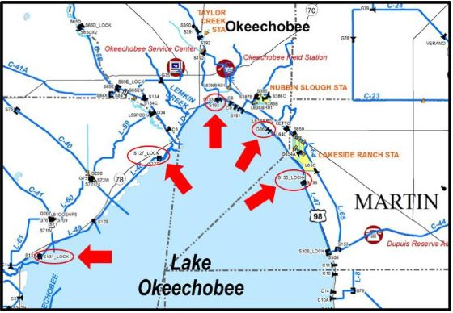
How ARE WE DOING?

Slide 18
Lake Okeechobee System Operating Manual
OCT 2018
WE ARE HERE
DEC 2022
DECISION &
PUBLIC COMMENT
PMP
PUBLIC INPUT &
PLANNING
ALTERNATIVE EVALUATION & PUBLIC FEEDBACK
1
2
3
4
5
Public Engagement Opportunities | Date
1 - Scoping Meetings | February 2019
2 - Planning Workshops | May & August 2019
3 - Alternative Evaluation Workshops | Multiple in 2019 -2021
4 - Draft Report - Public Comment Period | April-May 2022
5 - Final Report – Public Comment Period | September 2022
LOSOM comments due April 22 LakeOComments@usace.army.mil

Slide 19
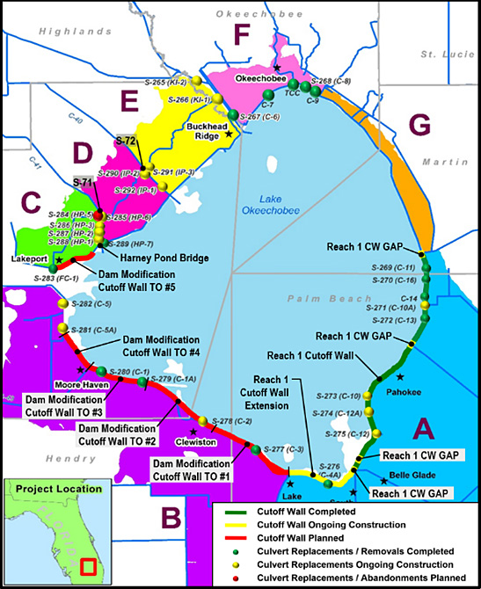
Herbert hoover dike implementation progress
Completed Work
21.4 miles of cutoff wall in Reach 1
11 culvert replacements
4 culvert removal / abandonments
Ongoing Work
16 culvert replacements
Reach 1 Cutoff Wall Gap Closures
6.6 mile Reach 1 Cutoff Wall Extension
Planned Work
28.6 mile Dam Modification Cutoff Wall MATOC Task Orders
1 culvert replacement
Harney Pond Bridge Armoring
S-71 and S-72 Embankment Raising
All Zones completed by 2022

Slide 20
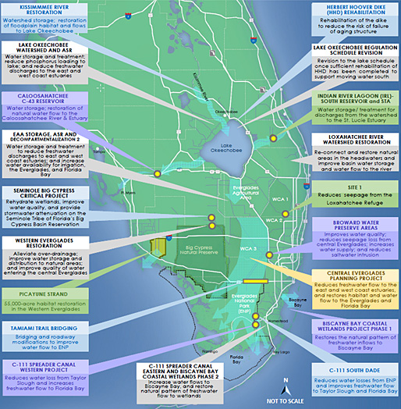
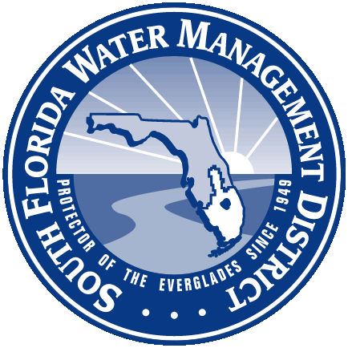
South FLORIDA PROGRAM
A 50-50 Partnership between the federal government and the State of Florida
68 Components combined into 56 projects
Dependent on foundation projects
Expensive ( ~ $ 16.5+ B)
Essential to restoring a functioning ecosystem
Essential to sustaining the economy of Florida

Slide 21
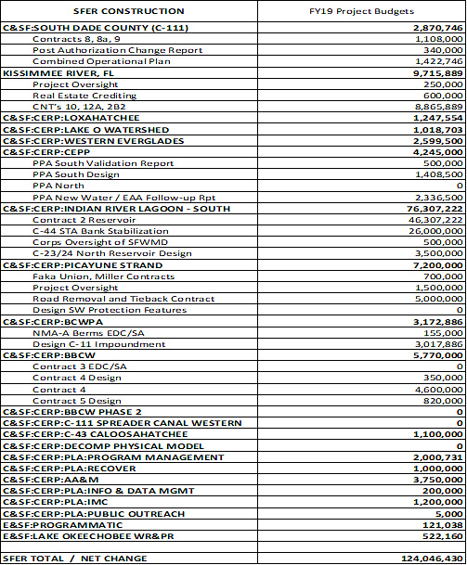


SOUTH FLORIDA ECOSYSTEM RESTORATION PROGRAM
FY19 Construction Budget Review
FY19 SFER Construction Budget
Carry-In $ 18,485,627
Conference Report $ 67,500,000
Additional Work Plan $ 37,065,160
Supplemental $ 995,643
TOTAL $124,046,430
FY20 SFER Construction Budget
President’s Budget $ 63,255,000

Slide 22
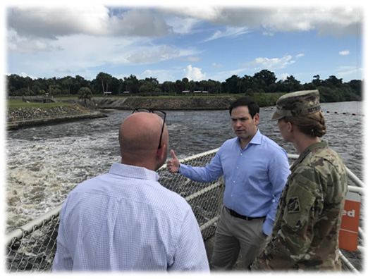
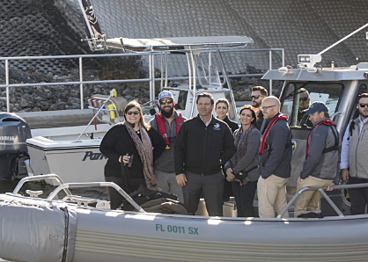
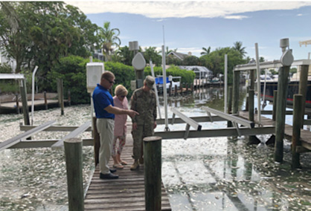
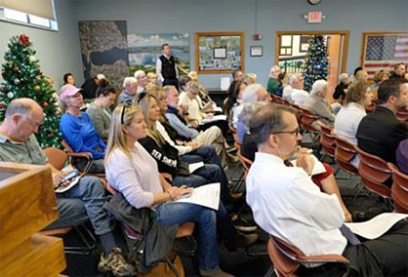
Everyone has to be part of the solution….
Agencies, Elected Officials, and the Public
working together

