Slide 1
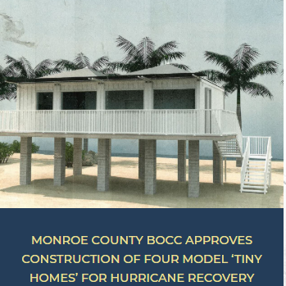
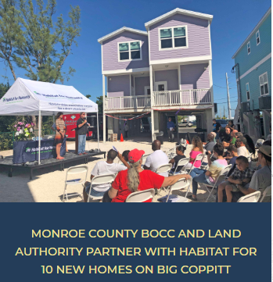
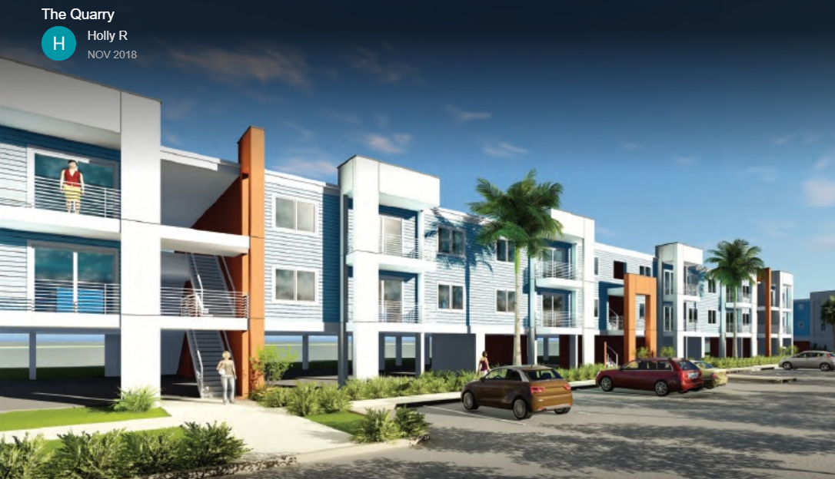
Monroe County Housing Recovery is Underway…

Slide 2
INITIATIVE #1-CDBG-DR FUNDING $90m
$50 Million Rebuild Florida Program
Underway with just over 1100 people registered and approx. 417 are in the application process.
Program will repair and/or rebuild elevated structures to wind/flood code.
Acts as the final piece of the unmet need for storm survivors after FEMA, SBA, and Insurance. Max assistance is $150,000 with exceptions case by case.
We customized a permit review process to prevent bottlenecks in the state’s process.

Slide 3
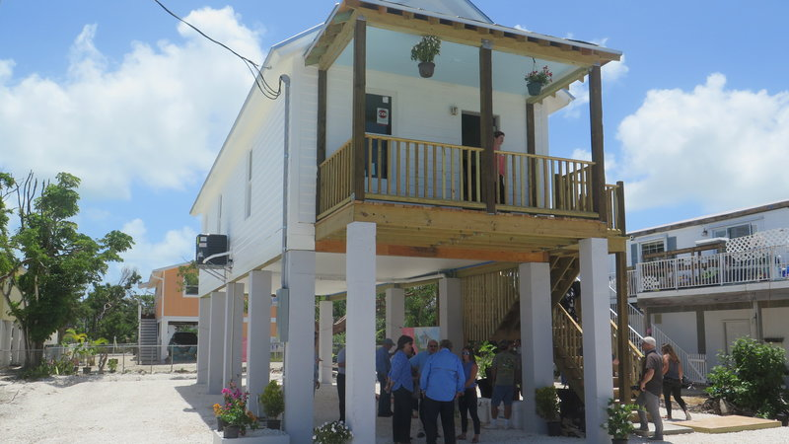
INITIATIVE #1-CDBG-DR FUNDING $90m
$30 Million Rental Workforce New Construction & Land Acquisition Program
Florida Housing Finance Corporation recently released a new draft RFA for the funding.
Geared to public entities/partnerships who will preserve the new development in perpetuity through land ownership.
Monroe County developing plans now. Expecting a minimum of 15 units with up to 25 units possible.
$10 Million Voluntary Acquisition for conservation lands. Waiting for DEO’s release of this program.

Slide 4
INITIATIVE #2-HAZARD MITIGATION GRANT PROGRAM FUNDING $90m
$3.6 Million requested in grant funds last August to provide reconstruction for flood elevation and wind resistance.
$16.9 Million requested for land acquisition to mitigate environmental concerns.
Awaiting response from Florida Division of Emergency Management on the grant round.
We expect to submit again in any new rounds that are released.

Slide 5
INITIATIVE #3-PRE-DISASTER & FLOOD MITIGATION ASSISTANCE
$953,000 request submitted last August for land acquisition to restore habitat.
$848,000 and $349,000 requests submitted last December for mitigation and reconstruction.
FDEM has notified FEMA of awards.
Awaiting FEMA to provide final notice of award to applicants.

Slide 6
INITIATIVE #4-VOLUNTEER FLORIDA
Affordable Housing Development Proposal was presented to the Volunteer Florida board in January 2019.
We proposed 3 alternative funding options from $2.4 million to $8.15 million creating from 11 units up to 26 units of affordable housing that will be affordable in perpetuity.
We are awaiting an official RFP to be released for such a project.

Slide 7
How can you help?…
Remind your colleagues that Storm Season 2019 is on its way…
We need all of this money moving to create the preparedness that matters!
TO FEMA/FDEM: – Release the award notices and the funding!
DEO: – Release the program for Voluntary Acquisitions and Economic Development!
VOLUNTEER FLORIDA: - Decide to fund the project! Or at least Release the RFP!!

Slide 8
Monroe County Housing Recovery is Underway…
Thank You!
For more information please contact:
Emily Schemper, AICP, CFM
Sr. Director of Planning & Environmental Resources Department
305-289-2500
Juanita Jones, PMP
Housing Recovery Administrator
305-289-2560
Jones-Juanita@monroecounty-fl.gov

