Slide 1
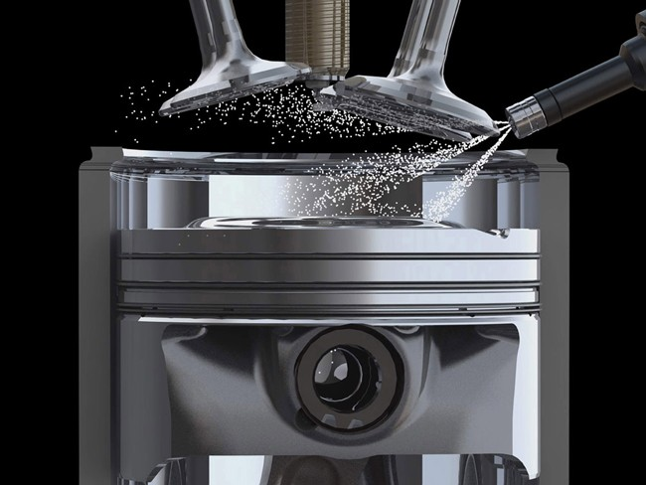
The Revolution of Alternative Fuel Vehicle Systems
Latin America
&
Caribbean

Slide 2
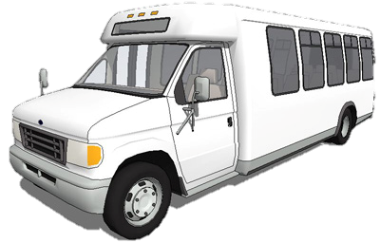
At Icom North America
We Have One Of The Best and Most Positive Missions:
First:
HELPING FLEETS TO ACHIEVE AS SEAMLESSLY AS POSSIBLE
CLEANER AIR
PROPANE POWERED

Slide 3
DOMESTIC FUEL SOURCE
X
NO WAR!!
O
I
L

Slide 4
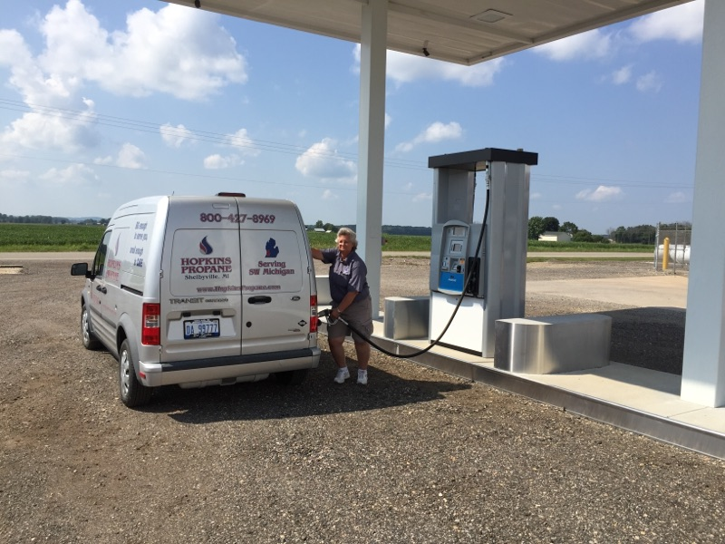
FUEL COST SAVINGS TO FLEETS
WITH $$$ SAVED FLEETS CAN HIRE MORE EMPLOYEES!!
Inexpensive and easy to use fueling infrastructure:
GOING GREEN !!!
Rolling it all together for the fleets
( fuel-station-vehicle-service point )

Slide 5
Hundreds of Success Stories Including
PUBLIC SECTOR:
PRIVATE SECTOR:
USNPS
WSDOT
NC para-Transit Agencies
City Of Boston
Springfield Illinois Police Dept.
Columbus OH Airport Auth. Shuttles
Wyandotte County KS
Town of Greenwich CT
City of Livonia
City of Wellington FL
City of Ypsilanti
UPS
DHL
FEDEX Contractors
Metro Cars
AAA
Old Town Trolleys
Flight Line
Groomes Transportation
Super Shuttle
GO Airport Shuttle
Yellow Cabs

Slide 6
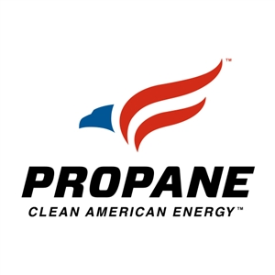
Benefits of Utilizing Propane Autogas
Substantial fuel cost savings as compared to gasoline or diesel
Reduce emissions of toxins by up to 30-90% compared to gasoline
Domestic – Propane is produced in North America, with large reserves in the U.S. and Canada
Lower maintenance cost
Greenhouse gas emissions are reduced approximately 20%
Maintains the torque, horsepower, and drivability you would feel in a gasoline vehicle
$$$
$$$
Courtesy of PERC

Slide 7
For some more information on propane please visit the U.S. Department of Energy, Energy Efficiency and Renewable Energy website or contact your local American Lung Association office.
What is Propane?
Propane is liquefied petroleum gas that consists of propane, propylene, butane, and butylenes in various mixtures. In the United States, propane is the primary ingredient. Propane is a by-product of natural gas processing and petroleum refining and it is stored under moderate pressure to maintain its liquid state.
Why is Propane a Clean Air Choice?
Propane vehicles produce less tailpipe emissions of virtually all pollutants associated with automobile vehicles that use gasoline or diesel. According to the U.S. Environmental Protection Agency, a typical four-horsepower gasoline lawnmower engines generates almost six times as much volatile organic compound (VOCs) per hour of use as a typical car. Converting small utility engines such as lawnmowers to burn propane can reduce emissions of ozone precursors by one third and increase fuel economy by 14 percent.
What are the other benefits of Propane?
Energy Security: the majority of propane used in the U.S. today is domestically produced.
Cost: Propane costs less than gasoline and diesel fuel per gallon
Availability: with numerous propane vehicles available and a national infrastructure of pipelines, processing facilities, and storage already exists for the efficient distribution of propane, the propane option is accessible to the masses.
American Lung Association of The Upper Midwest
490 Concordia Avenue
St. Paul, MN 55103-2441
Phone: 651-227-8014
Fax: 651-227-5459
Email: cleanairchoice@lungum.org

Slide 8
Propane Autogas is Safe.
Courtesy of:
Meets all federal motor vehicle safety standards.
Fuel tanks are 20 times more puncture-resistant than gasoline and diesel tanks.
Stored at relatively low pressure, about 250 psi.

Slide 9
Propane Autogas is Safe
Courtesy of:
Propane Autogas is a contained
fuel source:
No spillage
No shrinkage
No pilferage
No contamination
Non-toxic
Notes:
Propane is a contained fuel, stored in a closed system. It is non toxic, so in the rare instance of a leak, it will not contaminate air, soil or water resources.
With fuel prices where they are today, theft can be a HUGE cost center for all fleets. Losses due to theft and contamination are eliminated.
Best reasons to switch to propane autogas –
it saves the owner money!
Its affordable and safe
It makes common sense

Slide 10
This is Propane Autogas!!
Courtesy of:
Clean
Cost Effective
Conserves Resources
Common Sense
Commitment friendly
Domestic
Abundant
Affordable
Available
Propane Autogas is the viable alternative fuel
Notes:
After reviewing the data and requirements, the final analysis reveals that propane autogas meets or exceeds all alternative fuel criteria. Check the green box for propane autogas. Go Green – Save Green
Switch to Propane Autogas and check the clean and green boxes!

Slide 11
Icom’s Global Presence
GERMANY
CANADA
ENGLAND
POLAND
Korea
BELGIUM
BULGARIA
UNITED STATES
FRANCE
GREECE
ITALY
AUSTRALIA
Manufacturing Plants
Distribution Centers

Slide 12
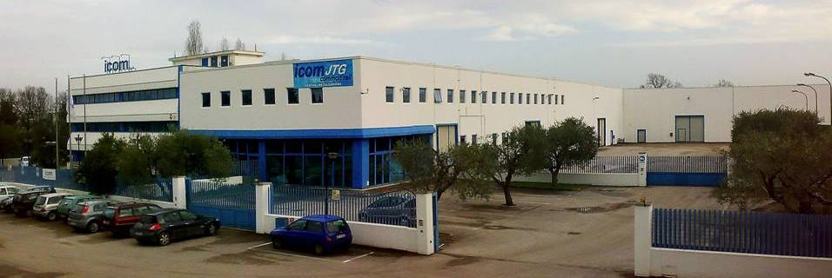
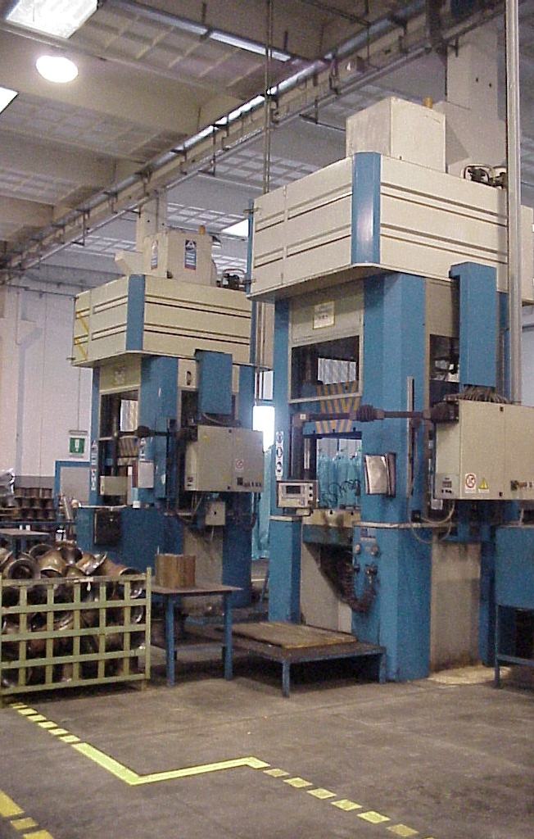
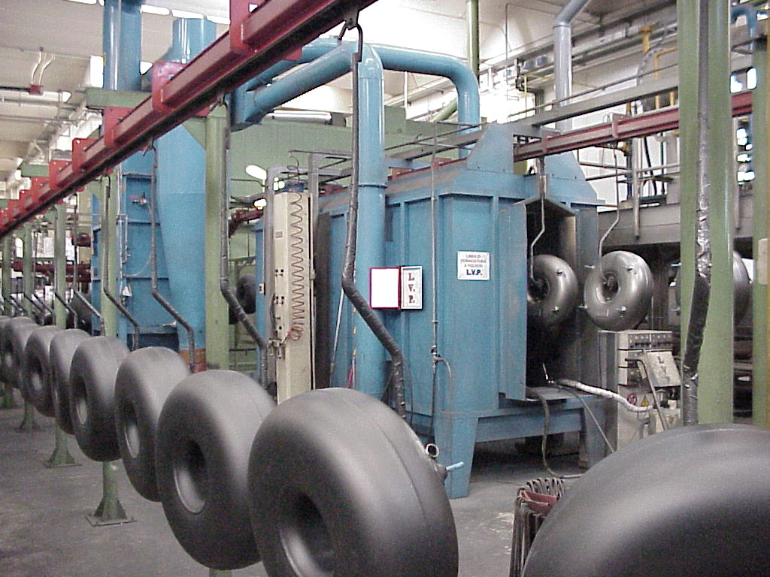
ICOM Manufacturing Italy
Founded in 1984
Invented and patented the toroidal LPG tank
Holds numerous patents on alternative fuel systems
Sold over 4 million LPG automotive tanks
Sold over 250,000 JTG propane liquid injection systems
ISO 9001 and ISO 14001 Certified
Holds numerous EN67 certifications
ASME certified
Has distribution in 15 countries on 5 continents
Tier I OEM supplier
JTG® System approved to rigid Canadian -40° testing
Successfully Crash Tested numerous vehicles

Slide 13
ICOM North America
Established North American operations in 2004
Headquarters and Assembly Plant in New Hudson, Michigan
Icom systems utilize a substantial percentage of domestic components
Icom systems are Safety tested & safe: NFPA 58 & DOT FMVSS303 compliant, Canadian IGAC Certified to -40 degrees, E67/01 Certified, & Crash Tested
Icom has the industry leading list of OVER 1,000 EPA CERTIFIED vehicle platforms
Bifuel & Monofuel Systems

Slide 14
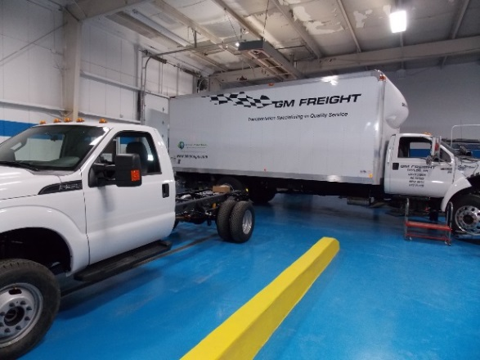
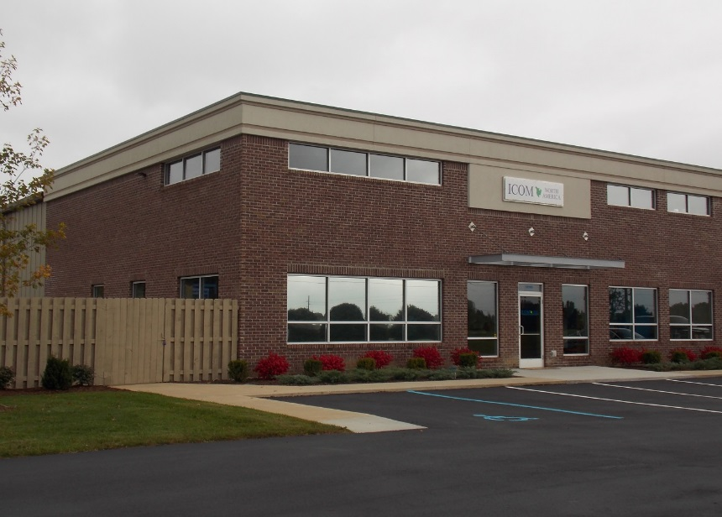
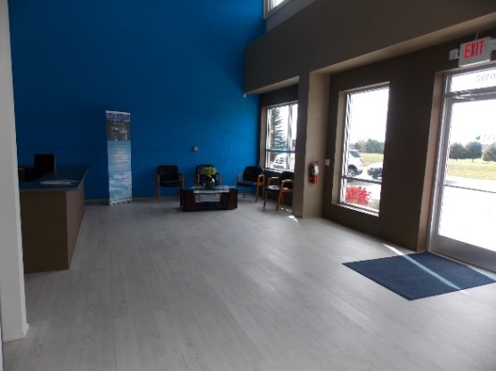
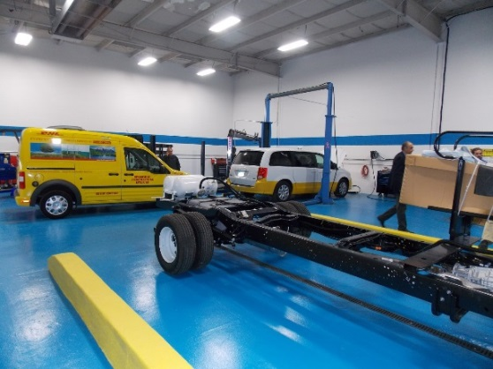
ICOM Technology & Training Center

Slide 15
Understanding & Utilizing UPAS Group an Icom company
UPAS Group Main Focus:
The Growth of Propane Autogas as an industry
Promote and assist fleets & propane marketers with the following:
Autogas conversions, infrastructure, installations, fleet management, safety, regulations and changes as Propane Autogas expands
Utilize & expand its opportunities:
Connect fleets with a one stop shop to utilizing autogas as a fuel source
Give the tools a propane marketer needs to assist in promoting autogas
Connect certified installation & service points with propane marketers & fleets
As more members join UPAS we create & expand new autogas opportunities

Slide 16
Icom Installation & Service Points - USA
Icom North America Plant
New Hudson, MI
Icom Technology & Training Center
New Hudson, MI
Additional Service & Installation Points

Slide 17
Icom Systems and Technology in North America
Approximately:
Over 25,000 Propane Systems in use in North America utilizing Icom Technology
Fleets enjoyed a huge fuel cost savings of over $600,000,000 to date
Estimated emissions reduction over 30% and Particulate reduced to almost 0
400,000,000 gallons of Propane Autogas utilized
360,000,000 gallons of gasoline and diesel displaced
Over Two Billion miles driven safely
Icom is working hard with our partners and Dealers to place over 100,000 Icom systems on the road in the next 5 years

Slide 18
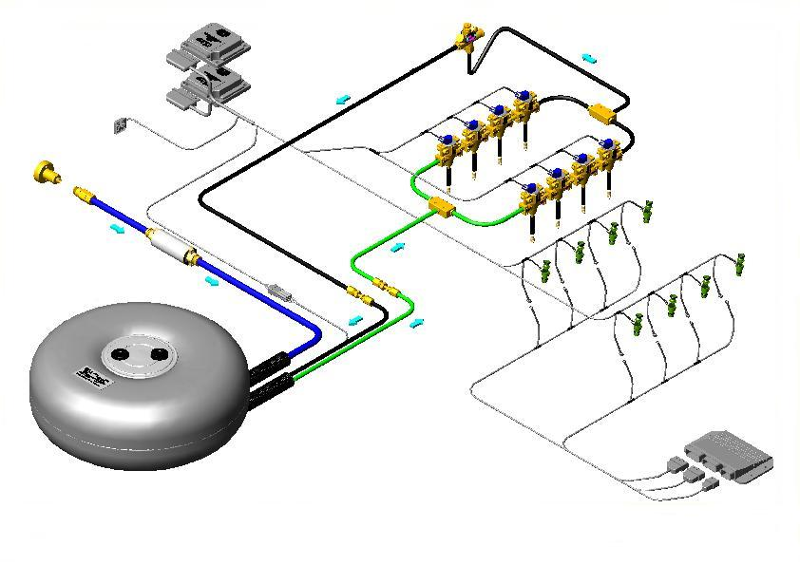
®
JTG® System Advantages:
The JTG® system is ‘plug and play’ – the fuel tank, fuel rails and hoses are preassembled.
No need to alter OEM ECU in any way.
Propane injectors calibrated to match gasoline injectors in amount of energy delivered with fuel.
Complete standard OBDII factory diagnostics.
Propane injection system not affected by temperature changes.
No cutting, splicing nor soldering required – only three electrical connections needed to operate the JTG® system
Icom invented and patented the revolutionary JTG® Propane Liquid injection system and electronically-controlled LPG multivalve
Propane Liquid Injection System

Slide 19
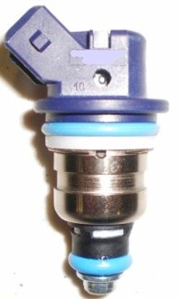
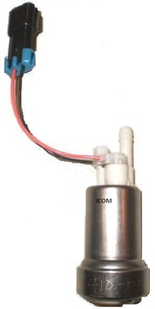
ICOM JTG® Liquid Injection
vs.
Vapor Propane Systems
Power
Noticeable increase compared to gasoline vs. decrease for vapor.
Torque
Increase due to cooling effect as propane evaporates, increasing air-propane mixture density. More mixture can be introduced into engine cylinders increasing peak torque (and power). No such advantage for vapor systems.
Drivability
Better throttle response and no acceleration lag
OEM quality fuel injector and fuel pump designed specifically for propane
Cold Start
Reliable in cold climates. Vapor systems are affected by ice blockages.
Valve Recession
Liquid Injection does not lead to excessive valve recession or engine failure as many vapor systems could.
Smell of Propane
Vapor systems often emit a strong propane odor due to leaky regulators that are utilized in vapor systems.

Slide 20
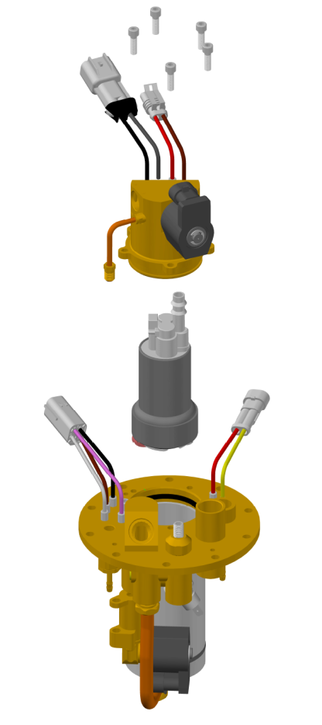
JTG® MultiValve
The Advanced JTG
Multivalve with Integrated Fuel Pump
Developed and Patented by Icom for improved serviceability!!
Pump Cover
Propane Prepped Fuel Pump
Multivalve w/Integrated Fuel
Pump Housing
No need to depressurize fuel tank to access fuel pump!
Increased flow rate for fast filling

Slide 21
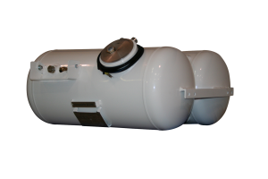
ICOM JTG Liquid Injection System vehicles
vs.
CNG vehicles
Cost
Propane system installed is less expensive so the ROI is more beneficial & savings are increased
Performance
Increased throttle response with superior power, torque, & drivability
No backfires & no acceleration lag with propane vehicles
Environment – Fueling Infrastructure
Unlike CNG propane is not a greenhouse gas
Propane can be found more available in rural areas
Propane fuel costs & maintenance costs are less
Propane is more prevalent throughout the USA, Canada, & globally
Tanks
LPG tanks are approximately 4x smaller than CNG tanks of the same useable gallonage
Propane utilizes more useable gallonage per tank
LPG tanks are usually lighter
Pressure
Propane pressure is at 312psi maximum
CNG pressure is at 3600psi maximum
Facility
Propane Vehicle system installation and service normally do not require any modifications to the
existing building while CNG often requires substantial modifications at large costs
(please check NFPA 58 and NFPA 52 building requirements).

Slide 22
ICOM Priority Target Markets
These sectors are chosen as priority for various reasons including:
Concentrated vehicle populations (fleet size)
Available EPA Certifications
ROI based on fuel usage
Centrally fueled

Slide 23
Current EPA On-Road Approval Paths
For ease of understanding for sales people Icom will simply outline the available EPA Approval Paths:
Vehicle manufacturers warranty is retained when equipped with an EPA Certified/Compliant system!!
EPA Certification: Required for any vehicle greater than or equal to the current calendar year minus one.
Example: In calendar year 2012 both 2011 & 2012 require full EPA Certification. Certificate issued by EPA.
If we have an EPA Certification that goes back further it is valid too. Example: if we have a 2009 MY (model year) EPA Certification is valid.
EPA Compliance/Intermediate: MY <= current calendar year minus 2 and within useful life of vehicle (useful life is 120,000 miles or ten years old, whichever comes first, for a light duty vehicle).
Example: In calendar year 2012 light duty vehicles from 2010 back to 2003 that are not over 120,000 miles have to be either EPA Compliance or EPA Certified. No certificate is issued by EPA but Compliance testing and submission to EPA is required.

Slide 24
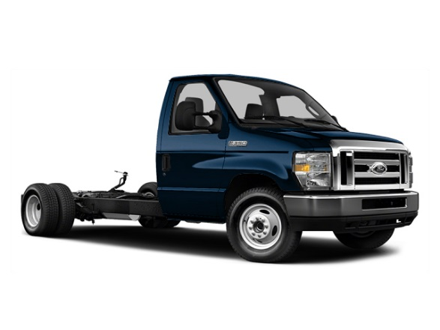
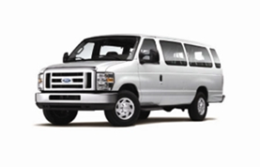
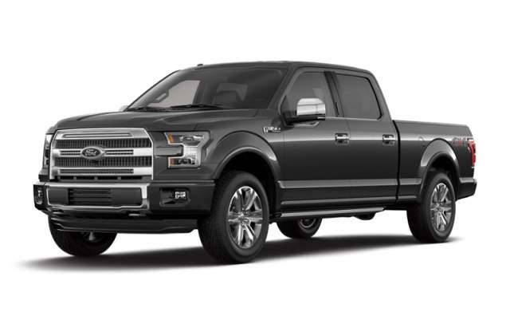
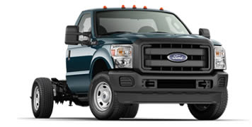
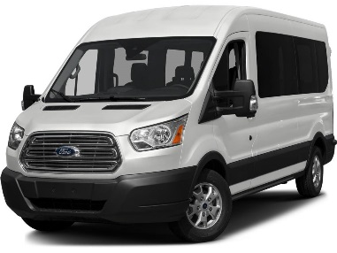
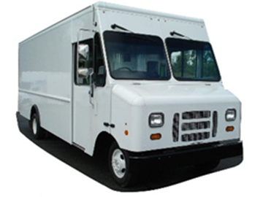
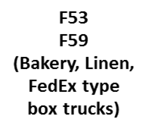
EPA Certifications
The Icom JTG II system is EPA Certified for over 1,000
2009-2016 vehicle platforms including many Ford models.
The Total Solution for any Type of Fleet!
E150
E250
E350
F150
F250
F350
F450
F550
F650
E450
Ford Taurus
Lincoln MKZ
Ford Explorer
Lincoln MKT
Lincoln Navigator
Ford Expedition
Ford Transit
Please confirm with Icom engine family

Slide 25
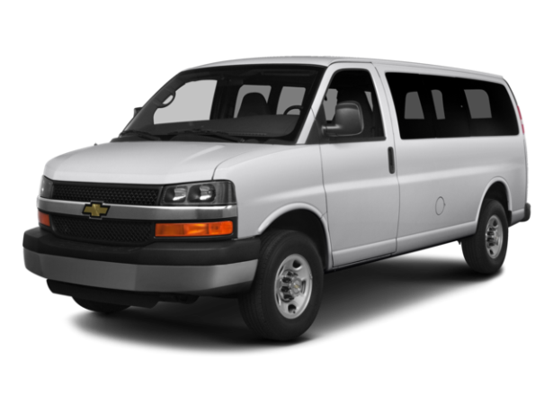
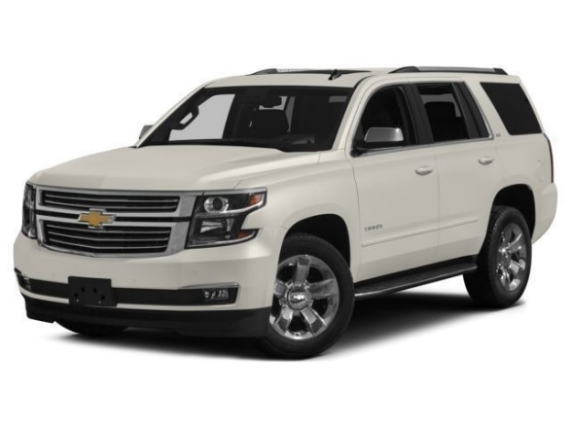
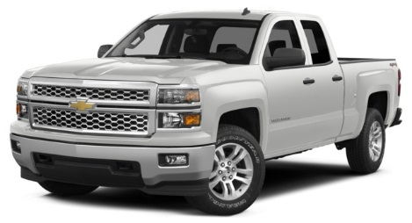
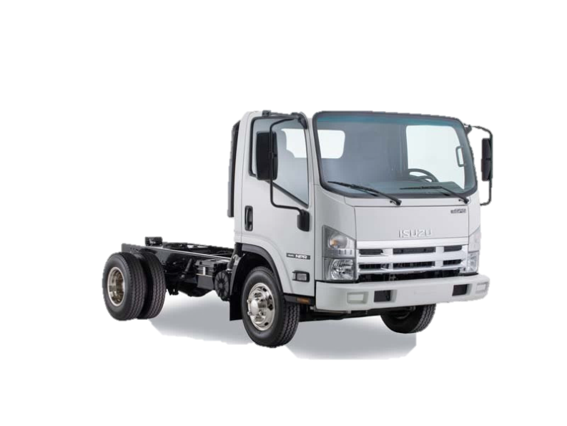
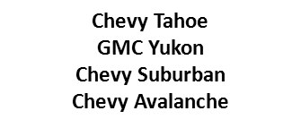
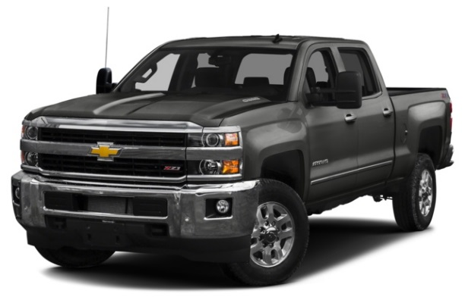
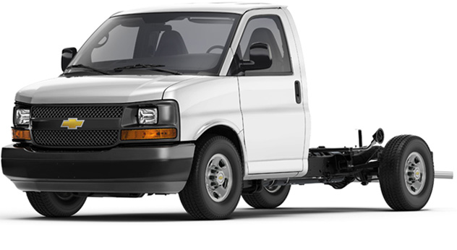
EPA Certifications
ICOM JTG Liquid Injection Bi-Fuel Propane System is EPA certified for most 2010-2017 GMC and Chevrolet Light trucks and SUV’s equipped with the 4.8L, 5.3L engine & 6.0L
Available shortly
6.0L HD
Chevy Cutaway
6.0L 2500HD, 3500HD
Please confirm with Icom engine family

Slide 26
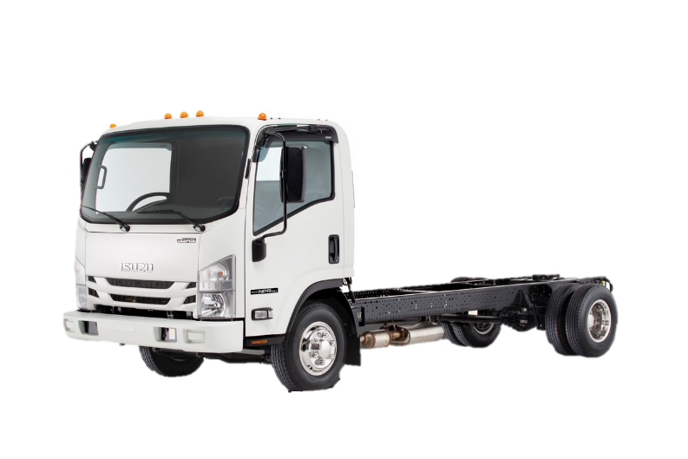
EPA Certified Vehicle Platform Projections for 2016
Chevrolet Impala 3.6 D.I.
GM 5.3L D.I. & 6.2L D.I.
GM 6.0L HD over 14,001 GVWR

Slide 27
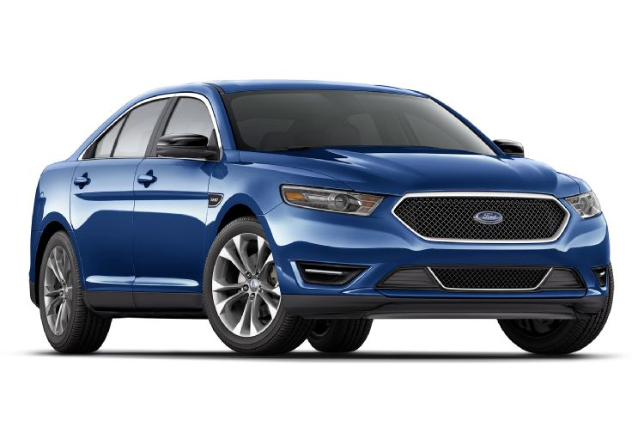
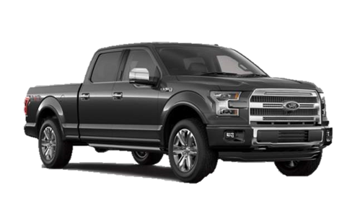
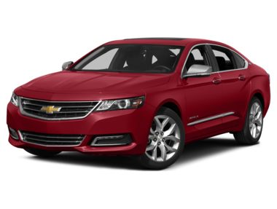
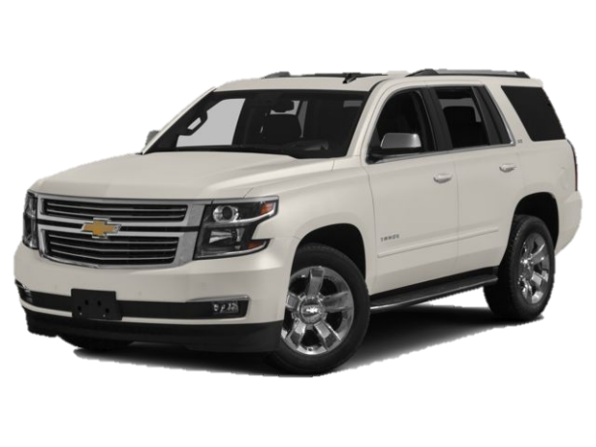
Direct Injection Applications
Ford Taurus 3.5L D.I.
Ford Explorer 3.5L D.I.
&
Ford F150 3.5L D.I.
Ford Transit 3.5 D.I.
Chevrolet Impala 3.6L D.I.
Chevrolet Tahoe 5.3L D.I.
Chevrolet Silverado 5.3L D.I. & 6.2L D.I.

Slide 28
Lake Michigan Mailers Road to Propane
Fuel Type | Vehicle Cost | Convert Cost | Fuel Cost | Range | Infrastructure | Maint. Cost
Electric
Flex Fuel (E-85)
CNG
Propane
Courtesy of Lake Michigan Mailers, Inc.

Slide 29
Lake Michigan Mailers Road to Propane Choice of System Manufacturer
Icom North America
☑ Experienced
☑ Michigan company
☑ EPA Certified
☑ Liquid vs. Vapor system
☑ “Smart” system – no driver interaction required
☑ No loss of cargo space
Courtesy of Lake Michigan Mailers, Inc.

Slide 30
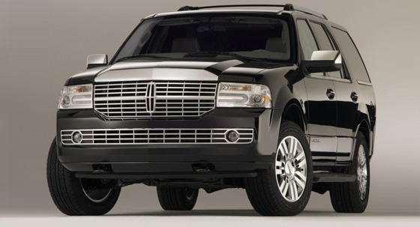
Icom Fleet Case Study Outline
METROCARS
Detroit Airport Transportation Company
Approximately
260 vehicles with Icom system
Approximately $1.5 Million of annual fuel cost savings
Continually adding Icom Systems as new vehicles are added
Lincoln Navigators, & Town Cars, Ford E450 Shuttle Buses, and Chevy Suburbans
Icom JTG II Bi-fuel Lincoln Navigator

Slide 31
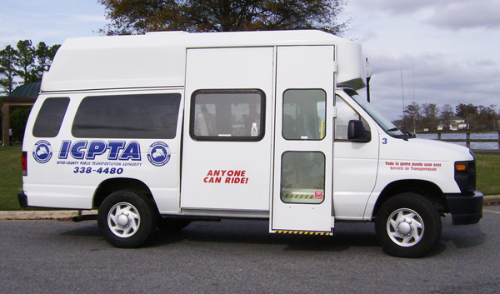
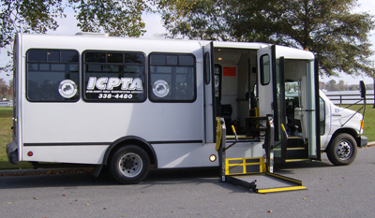
Icom Fleet Case Study Outline
Albemarle Regional Health Services d/b/a Inter-County Public Transportation Authority
16 Ford 2011 to 2015 E350 and E450 shuttle buses, some with wheelchair lifts-Icom Bi-Fuel Propane systems
Propane cost before taxes has averaged approximately .94 cents per gallon
Estimated annual fuel cost savings of $75,000
Dramatically reduced emissions
Utilization of a domestic fuel source
Reduced vehicle maintenance costs
Herb Mullen-CCTM Director of Transportation
Elizabeth City, NC

Slide 32
Icom Fleet Case Study Outline DHL Contractor AAustin Express
Approximately
200 vehicles
$5,000.00 per day saving
1.2 Million dollars savings per year for fuel
750,000 gallons of foreign oil displaced per year
Continually adding Icom Systems as new vehicles are added
7 State coverage area

Slide 33
Icom JTG systems are distributed, installed
and serviced across Canada. UPS Canada utilizes Icom Monofuel Systems through-out Canada
Applicable Icom JTG II components are Canadian IGAC Certified to -40 Degrees & for Safety and Durability
Icom Tanks are Canadian CRN Registered

Slide 34
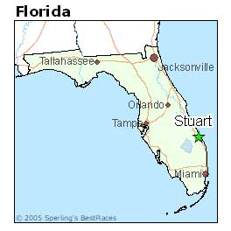
Introducing
3556 SE Dixie Hwy
STUART FL 34997
Phone: 772 600 4423
e-mail: info@imegausa.net

Slide 35
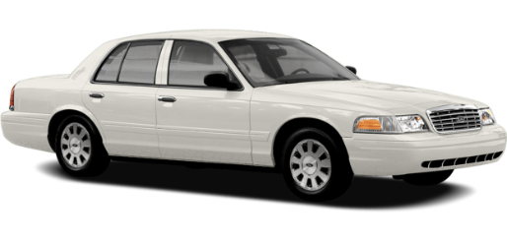
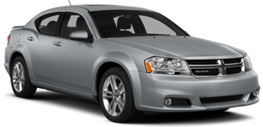
EPA Approved
Ford Crown Victoria
Lincoln Town Car
2009 / 2010 / 2011
Usable Gallons – 19.5
Dodge Charger 5.7L HEMI
2014 / 2015
Usable Gallons – 21
Projecting Certification Autumn 2015
Ford Crown Victoria
Police Interceptor
2009 / 2010 / 2011
Usable Gallons – 19.5
Dodge Grand Caravan
Chrysler Town & Country
2012 / 2013 / 2014 / 2015
Usable Gallons - 19.5
Chrysler 200
Dodge Avenger
2012 / 2013 / 2014 / 2015
Usable Gallons - TBD
Dodge Journey
2012 / 2013 / 2014 / 2015
Usable Gallons - TBD

Slide 36
Thank You for your interest!
With the proper use of alternative fuels, we can enjoy increased energy security, increased employment in an emerging sector, and decreased emissions.
www.icomnorthamerica.com
54790 Grand River Avenue
New Hudson, MI. 48165
Feel free to contact us either by phone:
(248) 573-4935
Or by email:
info@icomnorthamerica.com

